Slide 1

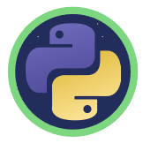
Python Loops
Notes:
Hello and welcome to this Practicum AI recording.
I’m Dan Maxwell. And I work as an AI Trainer for Research Computing, here at the university of Florida.
In this short briefing, I’m going to introduce you to Python loops.
[NEXT SLIDE]

Slide 2
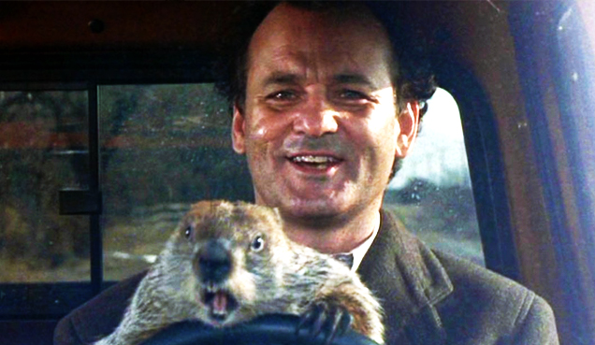

When does a loop end?
Image Credit: Ramis, H. (Director). (1993). Groundhog Day [film]. Columbia Pictures.
Notes:
In the comedy Groundhog Day, Bill Murray plays Phil Connors, an unhappy TV weatherman who’s sent to Punxsutawney, PA to cover the story of Punxsutawney Phil, the town’s famous groundhog. The legend is that Punxsutawney Phil can predict either an early spring or extended winter depending on whether he sees his shadow or not. While there, Phil Connors gets caught in a time warp, reliving the same day over and over again until he learns to value each moment and the people he works with. See the Reference section for links to the movie trailer as well as the film’s Wikipedia entry.
In Python, loops allow you to repeat a specific action over and over again. This grants you special powers as a programmer. For example, you could define a groundhog loop that repeats a specified number of times, forcing Phil Connors to relive the same day until the loop reaches a defined limit.
[NEXT SLIDE]

Slide 3
Anatomy of the Python for loop
Iterator
Reserved word
Iterable
for
i in
range(10):
: = Loop Start
print(i)
Loop Body
Notes:
Let’s begin our learning journey with a look at the anatomy and vocabulary of a for loop.
In Python, a loop construct begins with a reserved word – in this case, the word for. Remember reserved words? I talked about them in our variable presentation.
An iterator is a variable that keeps track of where you are in the loop. It’s an index. The lower-case i or idx are common names for iterators.
The iterable is a data structure that can be processed one item at a time in a specific order. Here we use the range function to generate a list of 10 numbers. The iterator then steps through that list, in order, as the loop executes.
A colon at the end of the loop statement announces the start of the loop body.
And finally, the loop’s body consists of statements that are executed during each loop cycle.
[NEXT SLIDE]

Slide 4
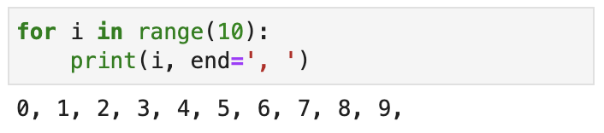
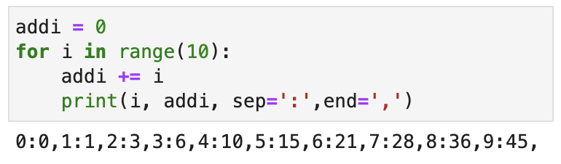
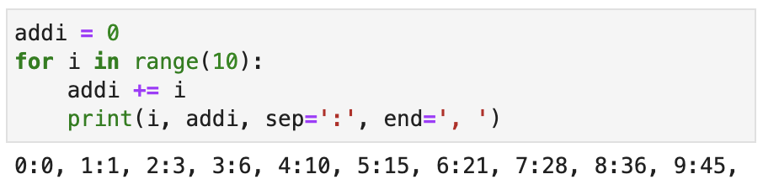
for Loop Summary
The "for" loop in Python is simple
"for" iterates through an iterable object one item at a time
A colon (:) and indention indicates where the loop starts and ends
for <var> in <iterable>:
<statement>
<statement>
. . .
<statement after loop>
"for" takes care of the iterator for you!
Source: Randy Switt – University of Florida (Pythonista)
Notes:
Let’s summarize what we learned in last slide and look at some code examples.
The for loop in Python is simple. And here’s the code (jazzed up) from our last slide, with output.
Stated technically, a for loop iterates through an iterable object. What? You learned the vocabulary in our last slide!
A colon indicates where a for loop begins, and indentation delimits the loop’s body.
What’s neat about Python is that it takes care of the iterator for you! In these code examples, the variable i is the iterator which walks through a range of numbers. And as you can see in the 2nd and 3rd examples, the variable i is automatically incremented. Now that’s the power of Python!
[NEXT SLIDE]

Slide 5

Transfer Learning for Loop
Notes:
So, loops are great. But where do we use them in AI? Well, I’m glad you asked! This snippet of code comes from our transfer learning workshop. In this example, we’re freezing each layer in the base model (making them untrainable) and using a for loop to do so.
[NEXT SLIDE]

Slide 6
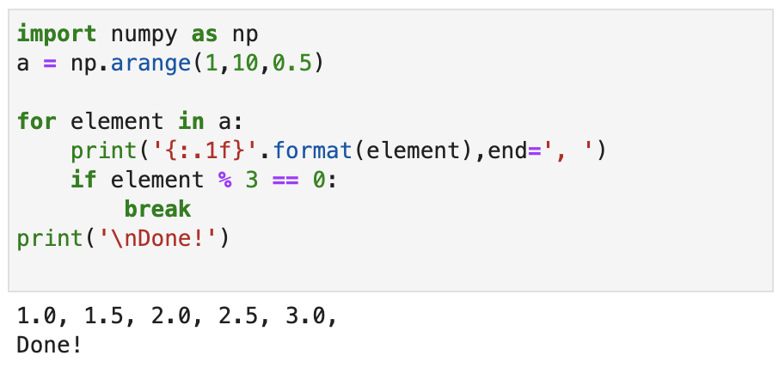
break
The break statement immediately ends a loop when executed
Source: Randy Switt – University of Florida (Pythonista)
Notes:
The break statement immediately ends a loop when executed.
[NEXT SLIDE]

Slide 7
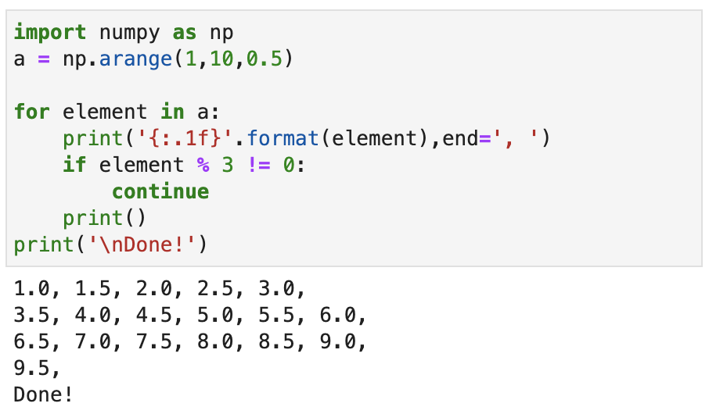
continue
The continue statement immediately goes back to the top of the loop when executed
Source: Randy Switt – University of Florida (Pythonista)
Notes:
The continue statement immediately goes back to the top of the loop when executed.
[NEXT SLIDE]

Slide 8
Anatomy of the Python while loop
i = 1
Iterator
Reserved word
Exit Condition
while
i
<= 10:
: = Loop Start
print(i)
Loop Body
i = i + 1
Notes:
In addition to the for loop, Python also has the while loop.
Just like the for loop, the while loop begins with a reserved word.
It also has an iterator.
But unlike the for loop, a while loop must specify an exit condition. When the exit condition evaluates to true, the loop is exited. In this example, that happens when i is greater than 10. Although while loops are useful, there’s one BIG gotcha. If that exit condition never evaluates to TRUE, the loop never ends. It’s infinite. Our Groundhog Day loop never ends. And Phil Connors is trapped forever.
A colon announces the start of the loop body.
And finally, the loop’s body consists of statements executed during each cycle.
Take a moment now to carefully examine this code sample. Is this an infinite loop? Pause the video and think about this for a minute or two. If you had concerns, I am going to justify them right now. Unlike a for loop where Python automatically increments the i variable for you, that does not happen in while loops. Here’s what we need to do to this code:
First, we initialize the index variable before entering the loop
Second, we increment it each time the loop executes.
And with those changes, we avoid the dreaded infinite loop.
[NEXT SLIDE]

Slide 9
Decision Controlled Loops
Decision Controlled Loops require a Decision with a <condition>
The <condition> is an expression evaluates to True or False
(just like an if statement)
If the <condition> is True the statements inside the loop are executed
Then execution returns to the top of the loop
If the <condition> is False
execution continues at the first statement after the loop end
FALSE
DECISION
TRUE
SEQUENCE
Source: Randy Switt – University of Florida (Pythonista)
Notes:
Let’s summarize what we just learned about exit conditions in while loops, also called decision-controlled loops.
[NEXT SLIDE]

Slide 10
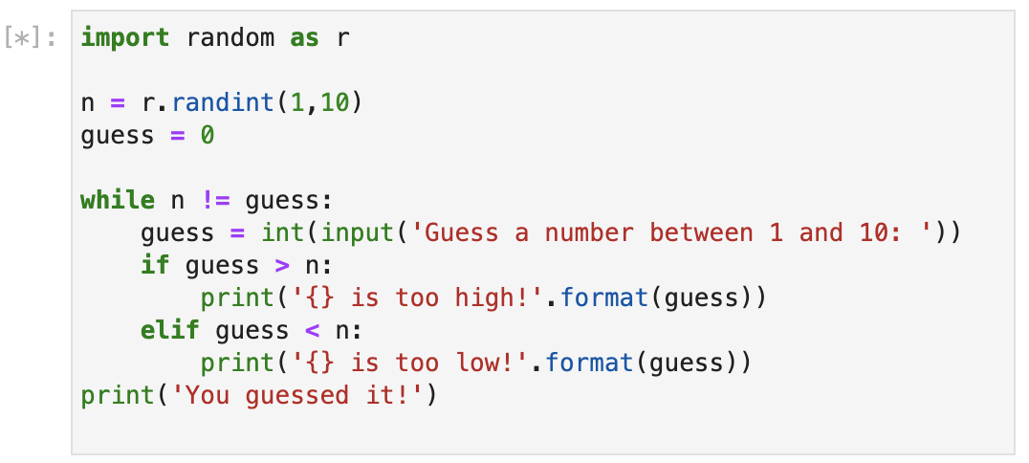
While Loop Logic
while statement syntax
while <condition>:
<statement>
<statement>
< . . . statements>
<statement after while loop>
Source: Randy Switt – University of Florida (Pythonista)
Notes:
<condition> evaluates to True or False
All indented statements are executed *if* <condition> is True
Execution returns to the top of the loop, and the <condition> is re-evaluated
If <condition> is False, execution resumes after indention ends.
Also note: If you fail to satisfy the condition upfront, the while loop will never execute!
[NEXT SLIDE]

Slide 12
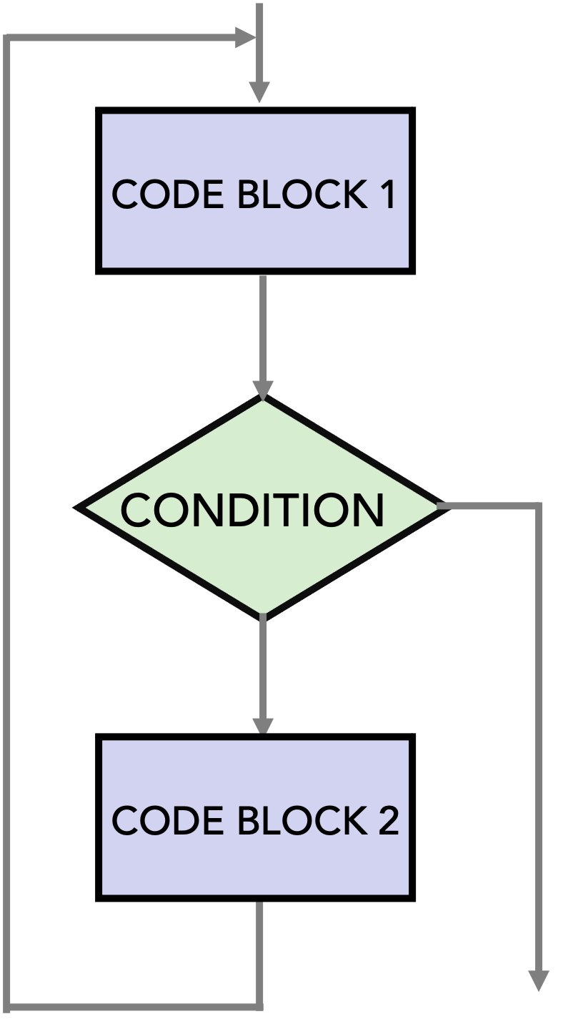
Decision Controlled Loop Structures
There are 3 different Decision Controlled Loop structures
Pre-test loop
Tests for ending condition at the beginning of the loop
Post-test loop
Tests for ending condition at the end of the loop
Mid-test loop
Tests for ending condition in the middle of the loop
CODE BLOCK
CONDITION
CONDITION
CODE BLOCK
Pre-Test Loop
Post-Test Loop
Mid-Test Loop
Source: Randy Switt – University of Florida (Pythonista)
Notes:
[NEXT SLIDE]

Slide 13
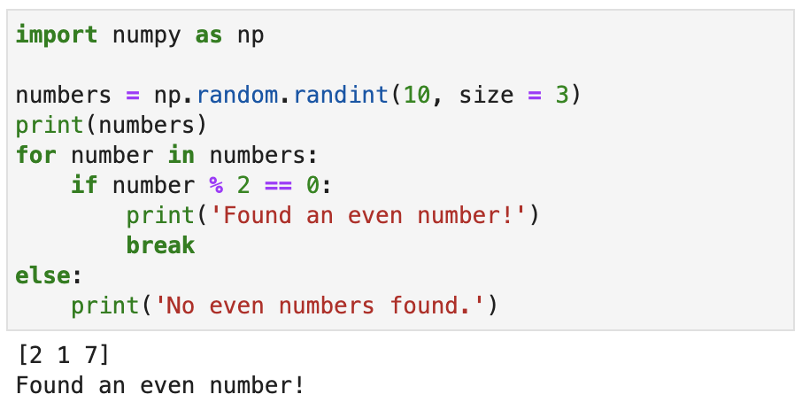
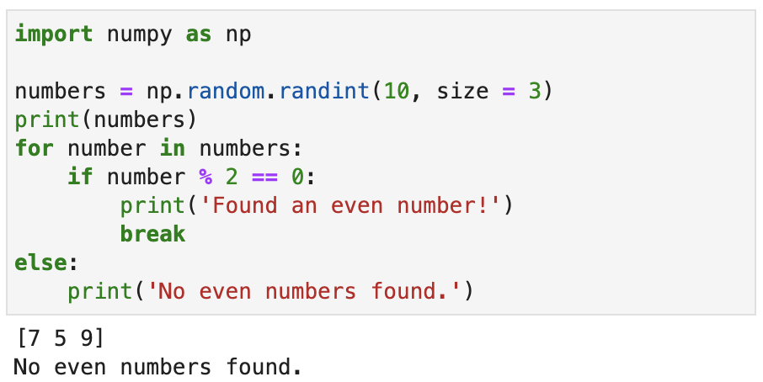
else
Most programming languages don't have an else statement with a for loop
In Python, any statements in a for else block will only execute if the for loop ended normally (i.e., not with break)
Source: Randy Switt – University of Florida (Pythonista)
Notes:
[NEXT SLIDE]

Slide 14
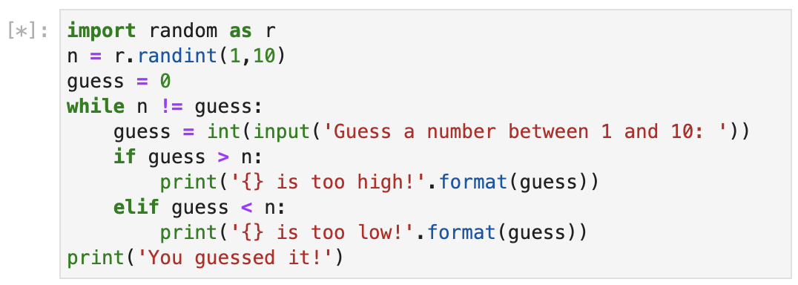
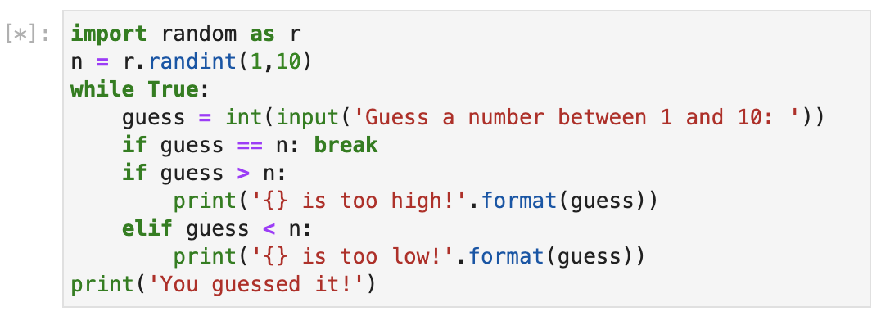
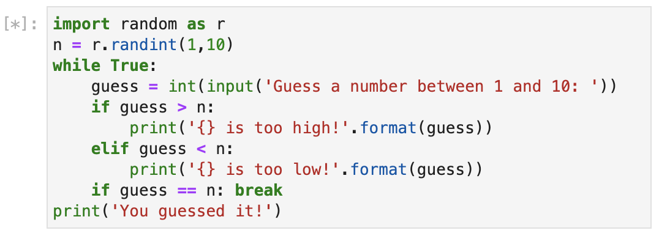
Pre-Test vs. Mid-Test vs. Post-Test Loop
break , continue and else can also be used with while loops
break can be used to create mid and post-test loops
Pre-Test Loop
Mid-Test Loop
Post-Test Loop
Source: Randy Switt – University of Florida (Pythonista)
Notes:
[NEXT SLIDE]

