Slide 1


Python Functions
Notes:
Hello and welcome to this Practicum AI recording.
I’m Dan Maxwell. And I work as an AI Trainer for Research Computing, here at the university of Florida.
In this short briefing, I’m going to introduce you to Python functions.
[NEXT SLIDE]

Slide 2

Functions quote
“You can think of a function as a small program inside a program. The basic idea of a function is that we write a sequence of statements and give that sequence a name. The instructions can then be executed at any point in the program by referring to the function name…
When a function is subsequently used in a program, we say that the definition is called or invoked.”
John Zelle
Notes:
Most of the AI code you write in Python is nothing more than calls to various functions. And what is a function? Noted computer science educator John Zelle writes, “The basic idea of a function is that we write a sequence of statements and give that sequence a name. The instructions can then be executed at any point in another program by referring to the function name.
So how do we call or execute a function? Let’s take a look…
[NEXT SLIDE]

Slide 3
A function is a self-contained block of code…
It may accept inputs (parameters)
It will output (return) one or more results
the result may be nothing! (None)
Can contain any statements found in a normal program
We've already encountered functions
i.e., set(), list(), range(), many more – these are "built-in functions"
Functions we write ourselves are "user-defined" functions
Source: Randy Switt – University of Florida (Pythonista)
Notes:
[NEXT SLIDE]

Slide 4
Why use Functions?
Main Program
Module-M1
Module-M2
Module-M3
Module-M4
Module-M5
Module-M6
Source: Randy Switt – University of Florida (Pythonista)
Notes:
A function should perform a specific task
this allows our program to be "modular"
It can be reused
avoids repetition
increases reliability
Easier debugging
a function is easier to test and debug as it performs a single task
Avoiding name collisions
variable "scope" allows us to reuse variable names
[NEXT SLIDE]

Slide 5
Don’t repeat yourself
Thou shalt not repeat thyself
Thou shalt not repeat thyself
Thou shalt not repeat thyself
Thou shalt not repeat thyself
Notes:
Don't Repeat Yourself
One of the cardinal rules of good programming is stated here: Thou shalt not Repeat Thyself. In other words, "Every piece of knowledge or logic must have a single, unambiguous representation within a system." If you want to do the same thing multiple times in your code, it should be expressed as a function, and called wherever it is needed.
[NEXT SLIDE]
Bird, Andrew, et al. The Python Workshop : Learn to Code in Python and Kickstart Your Career in Software Development or Data Science, Packt Publishing,
Limited, 2019. ProQuest Ebook Central, http://ebookcentral.proquest.com/lib/ufl/detail.action?docID=5974923.

Slide 6
Syntax for Creating a Function
def <name>():
<statements>
return <values>
def hello():
print('hello')
Source: Randy Switt – University of Florida (Pythonista)
Notes:
def – keyword indicating a function
<name> - name of the function (same rules as variables)
return – optional statement to return value(s) to program
[NEXT SLIDE]

Slide 7
Syntax for Calling a Function
<function_name>()
def hello():
print('Hello!')
hello()
Hello!
Source: Randy Switt – University of Florida (Pythonista)
Notes:
A function can only be called after it is defined
A function can be (and usually is!) called many times
[NEXT SLIDE]

Slide 8
Function Parameters and Arguments
def <function_name>(param1, param2, . . .)
Source: Randy Switt – University of Florida (Pythonista)
Notes:
Function parameters are input variables defined ("declared") in the function definition
A function can have 0 to many parameters
When calling a function, you must specify arguments for each required parameter
Arguments are passed to parameters by position NOT name!
We’ll cover a second way of calling functions in just a moment
[NEXT SLIDE]

Slide 9
Parameters vs Arguments
Parameter
def hello(name):
print('Hello {}!'.format(name))
myName = input('Name? ')
hello(myName)
Argument
Source: Randy Switt – University of Florida (Pythonista)
Notes:
The 2 terms are often used interchangeably
Even the textbook is inconsistent!
Parameter = "Placeholder"
Defined by the function
the "place" where values are assigned when the function is called
Argument = "Actual values"
specified when calling the function
specifies actual values or variables that will be used as inputs
[NEXT SLIDE]

Slide 10
Returning Values
return <value1>,<value2>, . . .
def hello(name):
print('Hello {}!'.format(name))
return True
myName = input('Name? ')
status = hello(myName)
print(status)
Name? Randy
Hello Randy!
True
Source: Randy Switt – University of Florida (Pythonista)
Notes:
Functions can (and usually do) return values
To specify the return values, use "return" followed by one or more values or variables
return <value1>,<value2>, . . .
The returned value is usually assigned to a variable
[NEXT SLIDE]

Slide 11
Call by Position or Keyword
def hello(name):
print('Hello {}!'.format(name))
myName = input('Name? ')
# Call by position
hello(myName)
# Call by keyword
hello(name = myName)
Notes:
When calling a function and passing arguments to it, you can do so in two ways – by position or by keyword. Although you can pass arguments to a function in multiple ways, my personal preference is to pass arguments to functions by KEYWORD. When you do that, you know exactly what's being passed to the function. And your code becomes self-documenting. This is important when you come back to a piece of code after a lapse of time. Write code for the future you!
[NEXT SLIDE]

Slide 12
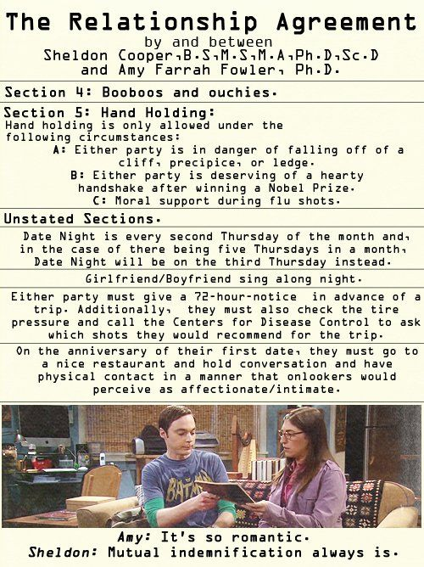
Python Functions are like Contracts
Image Credit: Lorre, C., Prady, B., & Reynolds, J. (Writers), & Cendrowski, M. (Director). (2011, November 17). The Flaming Spittoon Acquisition (Season 5, Episode 10) [TV series episode]. In (Executive Producer), The Big Bang Theory. Warner Bros. Television
Notes:
At this point, I want to briefly discuss an important yet often overlooked point.
In the Big Bang Theory TV series, the show's resident genius - Sheldon Cooper - enjoys creating legally-binding agreements that specify the particulars of any relationship he is presently in. His romance with Amy is regulated by a relationship agreement, as is his relationship with his roommate, Leonard Hofstadter.
Python Functions
The fundamental concept behind functions is the notion of a contract. Just as Sheldon's relationship and roommate agreements ensure that the parties involved will act in regular and predictable ways, so too the interface to a function is like a contract. If a call to a function passes the correct arguments in the correct order, a well written function responds in a predictable way, providing the promised output.
Counterintuitively, the first step in creating a function is to define what it will do. I say "counterintuitively" because most programmers simply dive right in and start writing code. This strategy works well for small and rather simple programs. However, you'll quickly run into trouble when the complexity begins to increase. For that reason, seasoned software developers usually begin by writing a specification (spec) - a document that spells out the terms of the contract. A well-written specification typically includes interface documentation as well as pseudocode, a clear statement in plain English of the steps to be taken to accomplish the function's task.
[NEXT SLIDE]

Slide 13
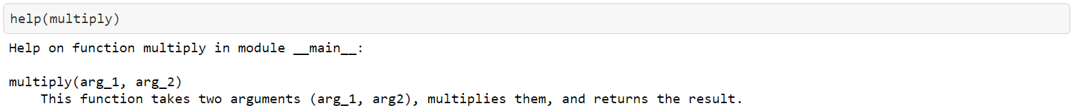
Specification
The multiply() function takes two arguments
(arg_1, arg_2), multiplies them, and returns the result.
def multiply(arg_1, arg_2):
’ ’ ’This function takes two arguments (arg_1, arg2), multiplies them, and returns the result.
’ ‘ ’
return(arg_1 * arg_2)
# end multiply()
help(multiply)
Notes:
Let's illustrate this process by writing a spec for a rather simple function called multiply. Here's the initial specification. Simple enough!
Because this function is so simple, we won't bother with the pseudocode at this point. For more complex functions, however, pseudocode is strongly recommended as it helps you understand the flow and logic of your program before you start coding. With all that said, here's a first look at the code.
This is a straightforward function, if there ever was one. Even so, a couple points need to be highlighted. Consider, for example, the documentation (doc) string immediately following the function definition. As you can see, this string is enclosed by three single quotes '''. The information in a doc string displays whenever one runs help() on a given function.
In his wonderful book, Python without Fear, Brian Overland makes the following points about doc strings (p. 322). You'll want to keep these in mind as you create doc strings for your functions.
The doc string must be the first statement after the beginning (header) of the function definition.
Normal indentation rules apply. The doc string must be indented under the heading of the definition, just as any statement.
The indentation requirement applies only to the first physical line. However, the cleanest style is to continue the indentation of the first line.
You can use any kind of quotation marks. However, the literal quote marks (''') enable you to write doc strings that span any number of physical lines.
The last thing we need to point out is the comment at the end of the function definition. The pound sign (#) indicates that anything following it is a comment. In this case, we mark the end of the function with a comment. When developing a module containing multiple functions, best practice encourages the placement of comments at the end of each function. This helps you to clearly see where one function ends and another begins.
[NEXT SLIDE]

Slide 14
Flowcharts and Pseudocode
Start
Read input from
pin 13 Arduino
Is
the input
HIGH?
No
Yes
Send HIGH output
to pin 11 Arduino
Delete the image
Capture the image
Get a confirmation
from user
Is it
True?
No
Yes
Send output to
pin 12 Arduino
End
Notes:
Flowcharts and/or Pseudocode are your friends!
A picture is worth a thousand words.
Flowcharts and pseudocode are useful software design tools.
[NEXT SLIDE]

Slide 15
Exercise
Exercise
Exercise
Functions
03.3_functions.ipynb

Slide 16
Slide intentionally left blank

Slide 17

Iterative Functions

Slide 18
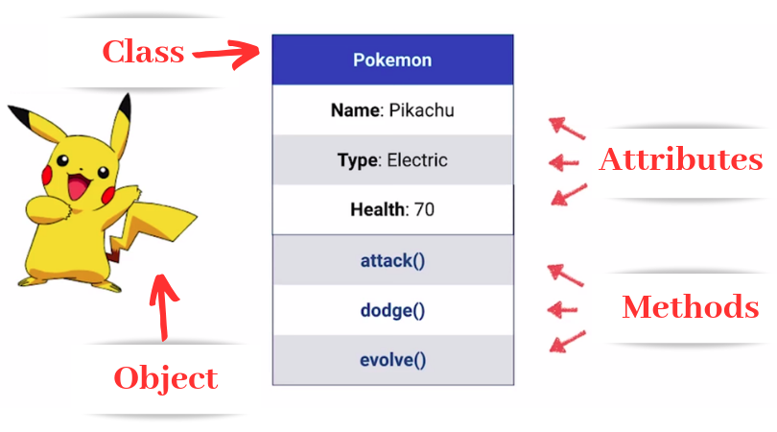
Classes
Image Credit: https://medium.com/future-vision/intro-to-oop-with-python-39ba63967e45
Notes:
Think of a class as a blueprint for how an object may operate. The object is a particular instance derived from the class. For example, an object could represent a particular person with attributes including name, age, address, etc., and methods like walking, talking, breathing, and running. Here the object is Pikachu, derived from the class Pokemon. Keep in mind: methods define what a given object can do while attributes define its features.

Slide 19
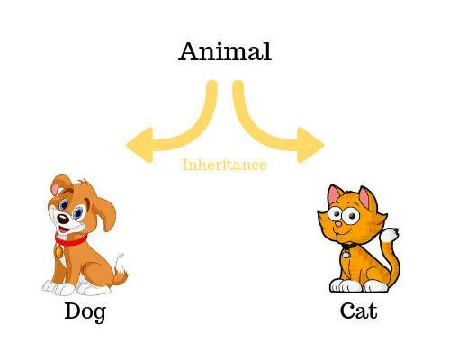
Objects
Inheritance
Image Credit: https://tutorials.supunkavinda.blog/php/oop-inheritance
Notes:
In the previous slide, I indicated that an object is a particular instance of a class. In technical terms, we say that objects are instantiated. That is, they are actual things you can manipulate in code. Interestingly, we can create hierarchies of classes. In Object-Oriented Programming, when a class derives from another class, it’s called inheritance.

