Slide 1


Python Data Management

Slide 2

Agenda
Introduction
Reading .csv Files

Slide 3

pandas

Slide 4
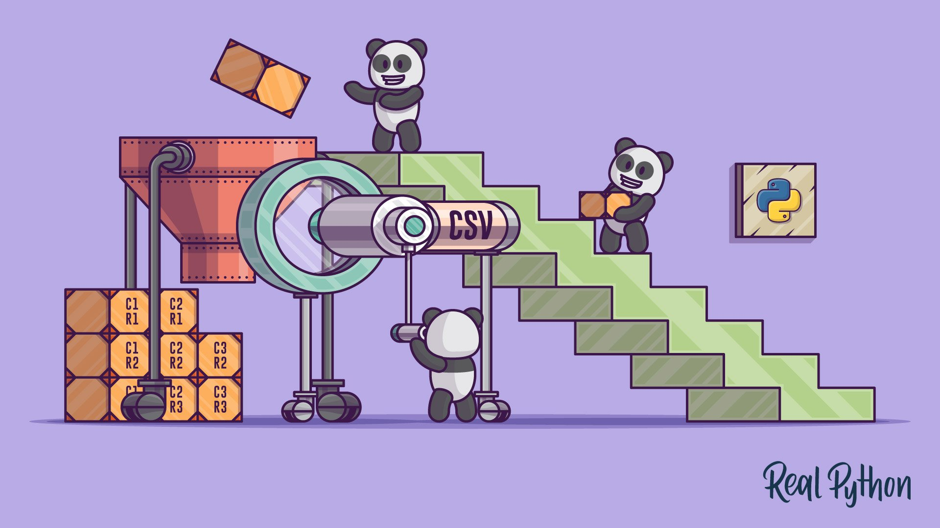
Pandas illustration
Image Credit: https://realpython.com/courses/reading-and-writing-csv-files/

