Slide 1

Recurrent Neural Networks: Getting Started
Notes:
Up to now, we’ve considered every sample presented to a neural network as a separate entity, unrelated to any other samples. This makes sense for things like photographs. If we’re classifying an image and decide that we’re looking at a cat, it doesn’t matter if the image before or after this one is a dog, a squirrel, or an airplane. The images are independent of each other. But if an image is a frame of a movie, then it can be helpful to look at it in the context of the other images around it. For example, we can track objects that might be temporarily obscured.
When we work with multiple samples whose order matters, we call that a sequence. Surprisingly, algorithms that understand and process sequences are frequently capable of generating, or creating, new sequences. Trained systems can generate stories (Deutsch 2016a) or TV scripts (Deutsch 2016b), Irish jigs (Sturm 2015b), polyphonic melodies (LISA Lab 2018), and complex songs (Johnson 2015; O’Brien and Román 2017). We can create lyrics (Krishan 2016) for pop music (Chu, Urtasun, and Fidler 2016), folk music (Sturm 2015a), rap (Barrat 2018), or country (Moocarme 2020). We can turn speech into text (Geitgey 2016; Graves, Mohamed, and Hinton 2013) and write captions for images and video (Karpathy and Li 2013; Mao et al. 2015).
In this workshop series, we look at a method for handling sequences based on remembering something about each element as it comes by. The models we build are called recurrent neural networks (RNNs). But first, let’s consider the nature of time series data.
Source: Glassner, A. (2021). Deep learning: A visual approach. San Francisco, CA: No Starch Press. (Chapter 19)

Slide 2

Image Credit: https://cktechcheck.com/

Slide 3
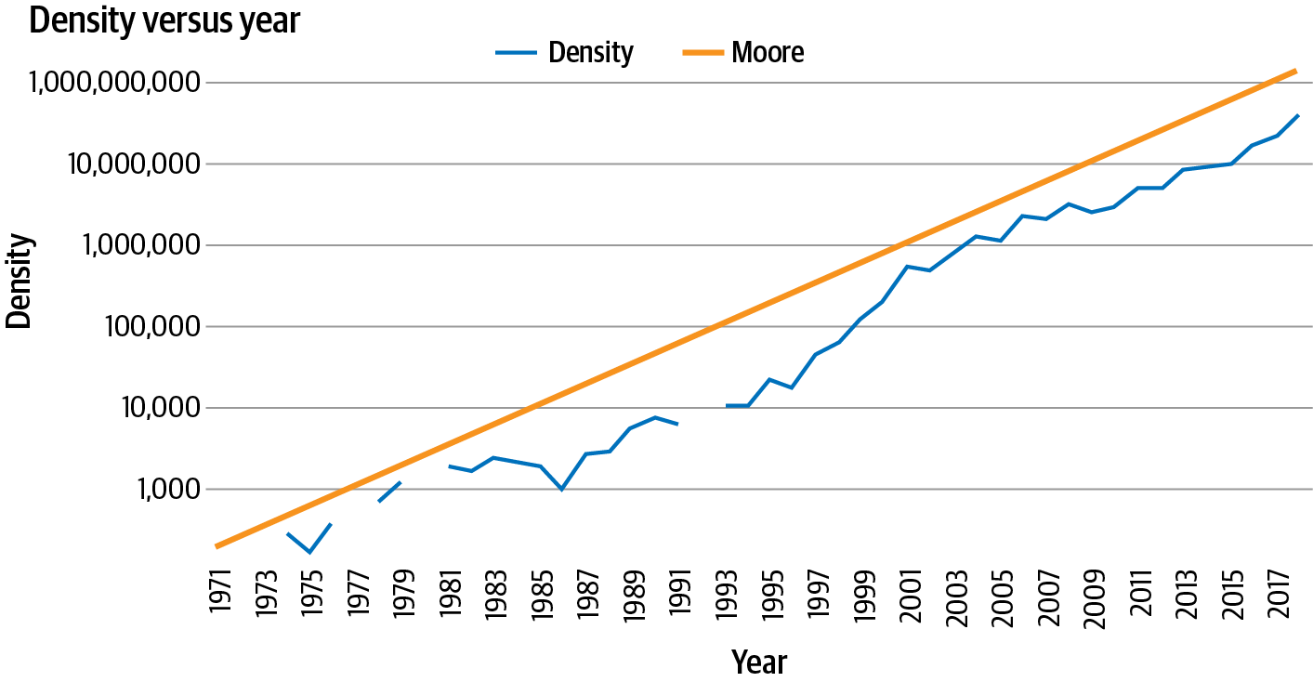
Source: Moroney, L. (2021). AI and Machine Learning for Coders: A Programmer’s Guide to Artificial Intelligence. Sebastopol, CA: O'Reilly Media, Inc. (Chapter 9)
Notes:
Time series are everywhere. You’ve probably seen them in things like weather forecasts, stock prices, and historic trends like Moore’s law pictured here. If you’re not familiar with Moore’s law, it predicts that the number of transistors on a microchip will roughly double every two years. For almost 50 years it has proven to be an accurate predictor of the future of computing power and cost.
Time series data is a set of values that are spaced over time. When plotted, the x-axis is usually temporal in nature. Often there are a number of values plotted on the time axis, such as in this example where the number of transistors is one plot and the predicted value from Moore’s law is the other. This is called a multivariate time series. If there’s just a single value—for example, volume of rainfall over time—it’s called a univariate time series.
With Moore’s law, predictions are simple because there’s a fixed and simple rule that allows us to roughly predict the future—a rule that has held for about 50 years.

Slide 4
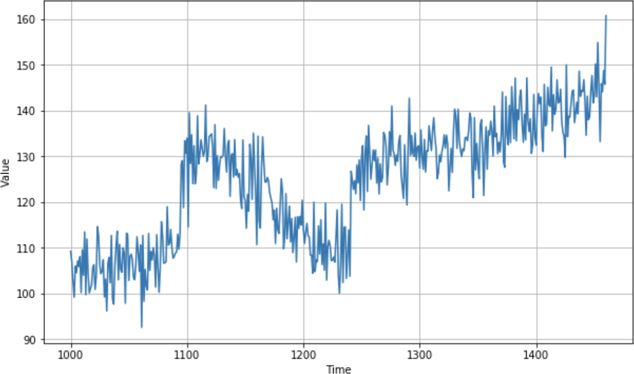
Source: Moroney, L. (2021). AI and Machine Learning for Coders: A Programmer’s Guide to Artificial Intelligence. Sebastopol, CA: O'Reilly Media, Inc.
Notes:
But what about a time series like the one pictured here?
While this time series was artificially created, it has all the attributes of a complex real-world time series like a stock chart or seasonal rainfall. Despite the seeming randomness, time series have some common attributes that are helpful in designing ML models that can predict them. Let’s consider those attributes now…

Slide 5
Trend
Seasonality
Source: Moroney, L. (2021). AI and Machine Learning for Coders: A Programmer’s Guide to Artificial Intelligence. Sebastopol, CA: O'Reilly Media, Inc.
Notes:
Time series typically move in a specific direction. In the case of Moore’s law, it’s easy to see that over time the values on the y-axis increase, and there’s an upward trend. There’s also an upward trend in the time series in the top figure. Of course, this won’t always be the case: some time series may be roughly level over time, despite seasonal changes, and others have a downward trend. For example, this is the case in the inverse version of Moore’s law that predicts the price per transistor.
Many time series have a repeating pattern over time, with the repeats happening at regular intervals called seasons. Consider, for example, temperature in weather. We typically have four seasons per year, with the temperature being highest in summer. So if you plotted weather over several years, you’d see peaks happening every four seasons, giving us the concept of seasonality. But this phenomenon isn’t limited to weather—consider, for example, the bottom figure, which is a plot of traffic to a website.
It’s plotted week by week, and you can see regular dips. Can you guess what they are? The site in this case is one that provides information for software developers, and as you would expect, it gets less traffic on weekends! Thus, the time series has a seasonality of five high days and two low days. The data is plotted over several months, with the Christmas and New Year’s holidays roughly in the middle, so you can see an additional seasonality there. If I had plotted it over some years, you’d clearly see the additional end-of-year dip.

Slide 6
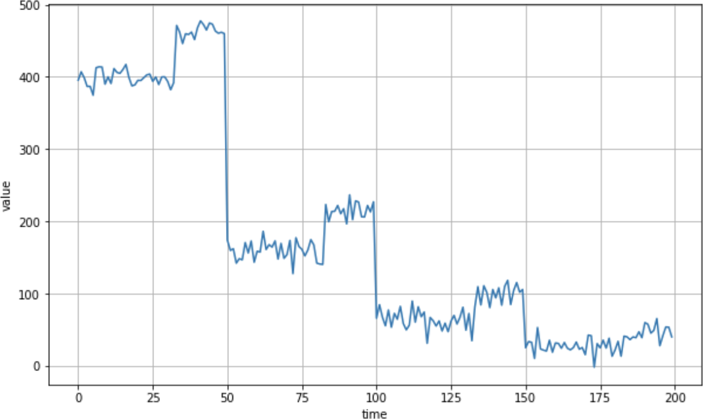
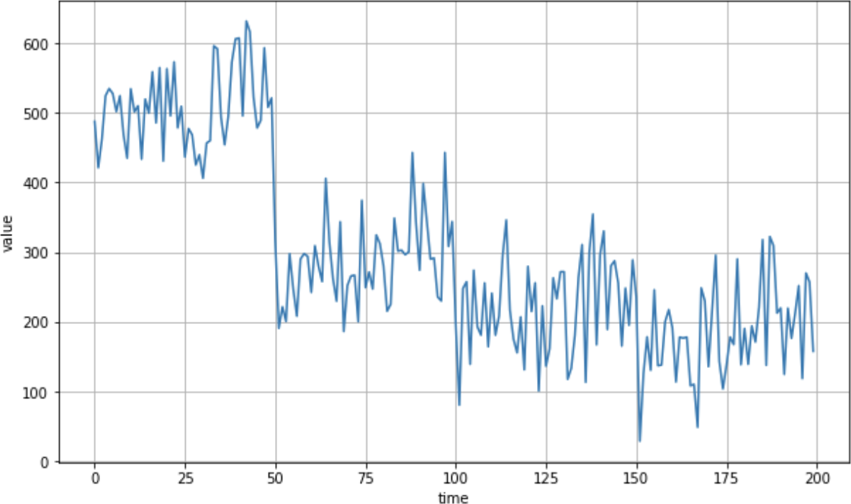
Autocorrelation
Noise
Notes:
Another feature that you may see in time series is when there’s predictable behavior after an event. You can see this in the top figure where there are clear spikes, but after each spike, there’s a deterministic decay. This is called autocorrelation. In this case, we can see a particular set of behavior, which is repeated. Autocorrelations may be hidden in a time series pattern, but they have inherent predictability, so a time series containing many of them may be predictable.
As its name suggests, noise is a set of seemingly random perturbations in a time series. These perturbations lead to a high level of unpredictability and can mask trends, seasonal behavior, and autocorrelation. For example, the noise plot adds a little noise to the auocorrelation plot. Suddenly it’s much harder to see the autocorrelation and predict values.

Slide 7
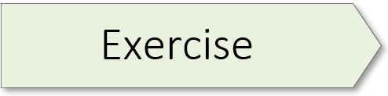
(Visualizing Time Series Data) 01.1_data_visualize.ipynb
Notes:
Exercise 5.01 starts on page 221 of the textbook.

Slide 8
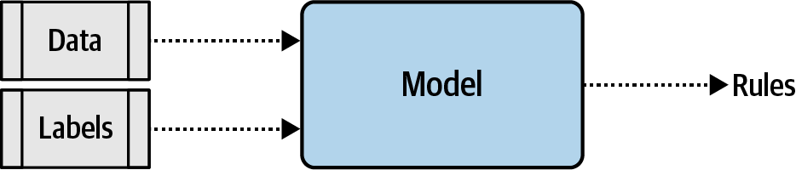
Source: Moroney, L. (2021). AI and Machine Learning for Coders: A Programmer’s Guide to Artificial Intelligence. Sebastopol, CA: O'Reilly Media, Inc. (Chapter 7)
Notes:
To understand how recurrence might work, let’s first consider the limitations of the models we’ve encountered so far. Ultimately, creating a model that looks a little bit like this figure. You provide data and labels and define a model architecture, and the model learns the rules that fit the data to the labels.
But, as you can see, the data is lumped in wholesale. There’s no granularity involved, and no effort to understand the sequence in which that data occurs. This means the words “blue” and “sky” have no different meaning in sentences such as “today I am blue, because the sky is gray” and “today I am happy, and there’s a beautiful blue sky.” To us the difference in the use of these words is obvious, but to a model, with the architecture shown here, there really is no difference.
So how do we fix this? Let’s first explore the nature of recurrence, and from there you’ll be able to see how a basic RNN can work.

Slide 9
Source: Moroney, L. (2021). AI and Machine Learning for Coders: A Programmer’s Guide to Artificial Intelligence. Sebastopol, CA: O'Reilly Media, Inc.
Notes:
Consider the famous Fibonacci sequence of numbers. In case you aren’t familiar with it, some of them are displayed here.

Slide 10
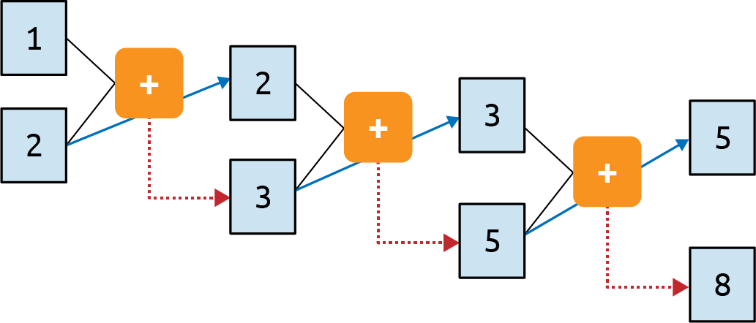
Source: Moroney, L. (2021). AI and Machine Learning for Coders: A Programmer’s Guide to Artificial Intelligence. Sebastopol, CA: O'Reilly Media, Inc.
Notes:
The idea behind this sequence is that every number is the sum of the two numbers preceding it. So, if we start with 1 and 2, the next number is 1 + 2, which is 3. The one after that is 2 + 3, which is 5, then 3 + 5, which is 8, and so on. The process is illustrated here in a computational graph.
Here you can see that we feed 1 and 2 into the function and get 3 as the output. We carry the second parameter (2) over to the next step, and feed it into the function along with the output from the previous step (3). The output of this is 5, and it gets fed into the function with the second parameter from the previous step (3) to produce an output of 8. This process continues indefinitely, with every operation depending on those before it. The 1 at the top left sort of “survives” through the process. It’s an element of the 3 that gets fed into the second operation, it’s an element of the 5 that gets fed into the third, and so on. Thus, some of the essence of the 1 is preserved throughout the sequence, though its impact on the overall value is diminished.

Slide 11
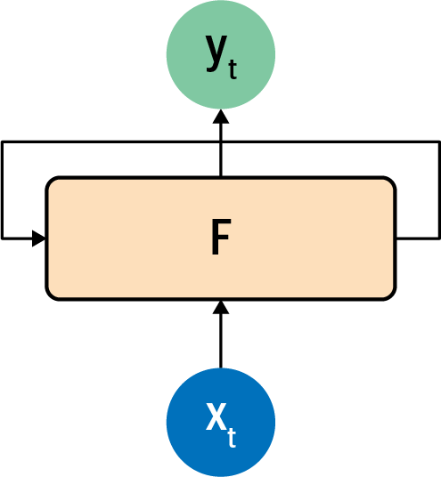
Source: Moroney, L. (2021). AI and Machine Learning for Coders: A Programmer’s Guide to Artificial Intelligence. Sebastopol, CA: O'Reilly Media, Inc.
Notes:
This process is analogous to how a recurrent neuron is architected. You can see the typical representation of a recurrent neuron here.
A value x is fed into the function F at a time step, so it’s typically labeled x_{t}. This produces an output y at that time step, which is typically labeled y_{t}. It also produces a value that is fed forward to the next step, which is indicated by the arrow from F to itself.

Slide 12
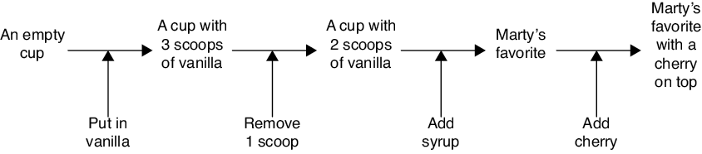
Source: Glassner, A. (2021). Deep learning: A visual approach. San Francisco, CA: No Starch Press. (Chapter 19)
Notes:
In our Fibonacci example, the system retained (or remembered) things about its previous actions. In other words, RNNs make use of an idea called state. State is just a description of a system (such as a neural network) at any given time. A state can represent the current condition of a system, plus any other information it’s convenient to remember.
Suppose that you’re working at an ice cream shop and you’re learning how to make a simple fudge sundae. In this story, you play the role of the system, and the recipe you’re building up in your head is your state. Before getting any instructions, your starting state or initial state would be “An empty cup.” So, let’s say you have an empty cup. Your starting state is shown at the far left in the image displayed here.
Your manager says that the first step is to put in some vanilla ice cream. So, you update your internal recipe, or state, to “An empty cup with three scoops of vanilla ice cream.” You put three scoops of ice cream into the cup.
Your manager says that’s too much, and you should remove one scoop. You do so, and you update your state to “An empty cup with two scoops of vanilla ice cream.”
Now your manager says to pour on enough chocolate syrup to cover the ice cream. You do this and update your state to “an empty cup with two scoops of vanilla ice cream covered in chocolate syrup.” But this reminds you of your friend Marty, because this is his favorite dessert. So, you simplify your state by throwing out what you had, now remembering only “Marty’s favorite.”
Finally, your manager says you should place a cherry on the top. So, you update your state to “Marty’s favorite with a cherry on top.” Congratulations, your sundae is complete!

Slide 13
State
State is not just a snapshot of the current situation
After reviewing new information at each step, you update your state
The order of the input matters
Source: Glassner, A. (2021). Deep learning: A visual approach. San Francisco, CA: No Starch Press. (Chapter 19)
Notes:
There are a few key things to take away from this story and the concept of state.
First, your state is not simply a snapshot of the current situation or a list of the information you were given. It captures both of those ideas, perhaps in a compressed or modified form. For example, instead of remembering to put in three scoops of ice cream and then removing one, you remembered instead to put in two scoops.
Second, after receiving new information at each step, you updated your state and produced an output. The output depends on the input you received and your internal state, but an outside observer can’t see your state, and so they might not understand how your output resulted from the input you just received. In fact, outside observers usually don’t get to see a system’s internal state. We emphasize this by sometimes referring to a system’s state as its hidden state.
Finally, the order of the input matters. This is the essential aspect of this example that makes it about a sequence, rather than just a bunch of inputs, and thus distinguishes it from a simple, fully connected layer. If you’d put the chocolate in the cup first, you’d have made quite a different dessert, and you probably wouldn’t have created a reference to your friend Marty in your state.
We call each input a time step. This makes sense when the inputs represent events in time, as they were here. Other sequences might not have a time component, like a sequence describing the depth of a river at successive points along its length from its source to its terminus. In particular, words in a sentence have a time component when they’re spoken aloud, but that idea doesn’t really apply when they’re printed. Nevertheless, the term time step is widely used to refer to each successive element of a sequence.

Slide 14
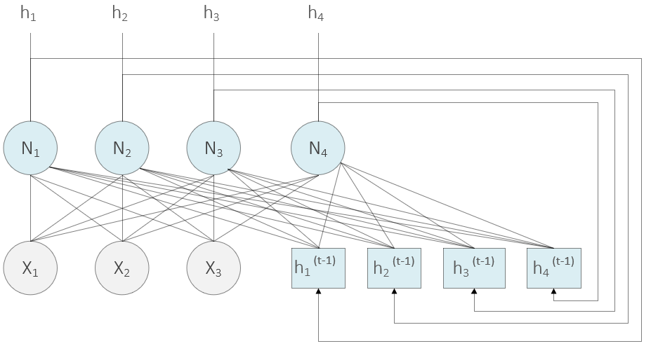
Source: Ekman, M. (2021). Learning Deep Learning. New York, NY: Addison-Wesley. (Chapter 9)
Notes:
A simple form of RNN can be created by connecting the outputs from a fully connected layer to the inputs of that same layer as shown here. The figure shows a three-value input vector connected to a fully connected layer of four neurons. The bias values are omitted from the figure. Along with the three inputs (and bias input), each neuron has four additional inputs. These inputs receive the output values from the four neurons but delayed by one timestep.
That is, at time t, they will receive the output values for time t – 1. We denote these outputs as h for hidden because recurrent layers typically serve as hidden layers inside the network. Although they are explicitly called out as hidden, these outputs are no different than outputs from a regular feedforward layer inside of a network.
Just as in a feedforward network, we can freely choose the number of hidden neurons independently of the number of elements in the input vector. However, the number of inputs (weights) to a single neuron is now a function of both the size of the input vector and the number of neurons in the layer. We can stack multiple recurrent layers after each other to create a deep RNN. We can also combine recurrent layers, regular fully connected feedforward layers, and convolutional layers in the same network.
(Page 242)

Slide 15
(Building Our First Plain RNN Model) 01.2_simple_rnn.ipynb
Notes:
Exercise 5.03 starts on page 243 of the textbook.

Slide 17
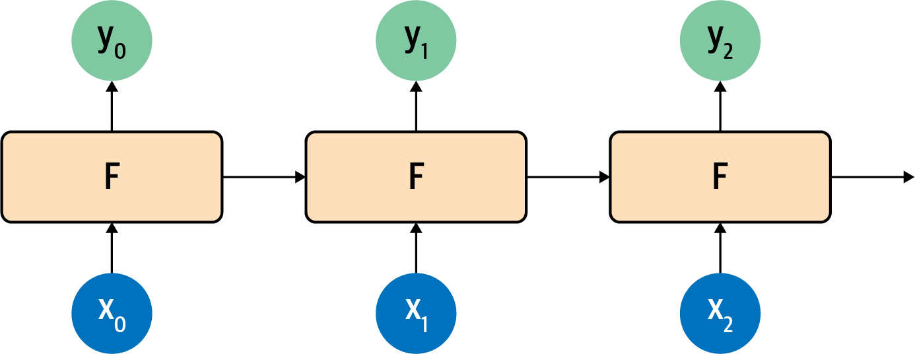
Source: Moroney, L. (2021). AI and Machine Learning for Coders: A Programmer’s Guide to Artificial Intelligence. Sebastopol, CA: O'Reilly Media, Inc.
Notes:
This is made a little clearer if you look at how recurrent neurons work beside each other across time steps, which you can see here.
Here, x₀ is operated on to get y₀ and a value that’s passed forward. The next step gets that value and x₁ and produces y₁ and a value that’s passed forward. The next one gets that value and x₂ and produces y₂ and a pass-forward value, and so on down the line. This is similar to what we saw with the Fibonacci sequence, and I always find that to be a handy mnemonic when trying to remember how an RNN works.

