Slide 1

Recurrent Neural Networks: LSTMs, GRUs & Advanced RNNs

Slide 2
I lived in Ireland, so in high school I had to learn how to speak and write <something>
Source: Moroney, L. (2021). AI and Machine Learning for Coders: A Programmer’s Guide to Artificial Intelligence. Sebastopol, CA: O'Reilly Media, Inc. (Chapter 7)
Notes:
To contextualize today’s mini-lecture, let’s first consider a sentence like: “Today has a beautiful blue <something>,” the word “blue” will have a strong impact on the next word; we can guess that it’s likely to be “sky.” But what about context that comes from further back in a sentence?
For example, consider this sentence: “I lived in Ireland, so in high school I had to learn how to speak and write <something>. That <something> is Gaelic, but the word that really gives us that context is “Ireland,” which is much further back in the sentence. Thus, for us to be able to recognize what <something> should be, a way for context to be preserved across a longer distance is needed. The short-term memory of an RNN needs to get longer, and in recognition of this an enhancement to the architecture, called long short-term memory (LSTM), was invented.
… but there was another motivating factor driving this innovation.

Slide 3
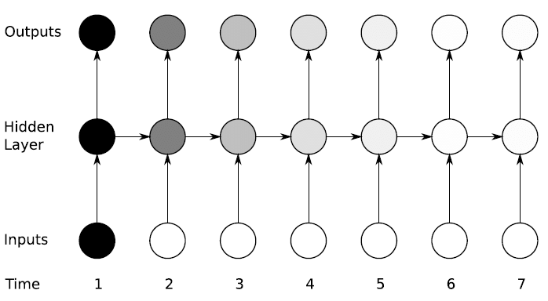
The Vanishing Gradient
Source: Glassner, A. (2021). Deep Learning: A Visual Approach. San Francisco, CA: No Starch Press. (Chapter 19)
Notes:
One of the biggest challenges while training standard feedforward deep neural networks is the vanishing gradient problem. As the model gets more and more layers, backpropagating the errors all the way back to the initial layers becomes increasingly difficult. Layers close to the output will be "learning"/updated at a good pace, but by the time the error propagates to the initial layers, its value will have diminished greatly and have little or no effect on the parameters for the initial layers.
With RNNs, this problem is further compounded, as the parameters need to be updated not only along the depth but also for the time steps. If we have one-hundred time steps in the inputs (which isn't uncommon, especially when working with text), the network needs to propagate the error (calculated at the 100th time step) all the way back to the first-time step. For plain RNNs, this task can be a bit too much to handle. This is where RNN variants like LSTMs and GRUs become useful.
Another practical issue with training deep networks is the exploding gradient problem, where the gradient values get very high – too high to be represented by the system. This issue has a rather simple workaround called "Gradient Clipping", which means capping the values of the gradient.

Slide 4
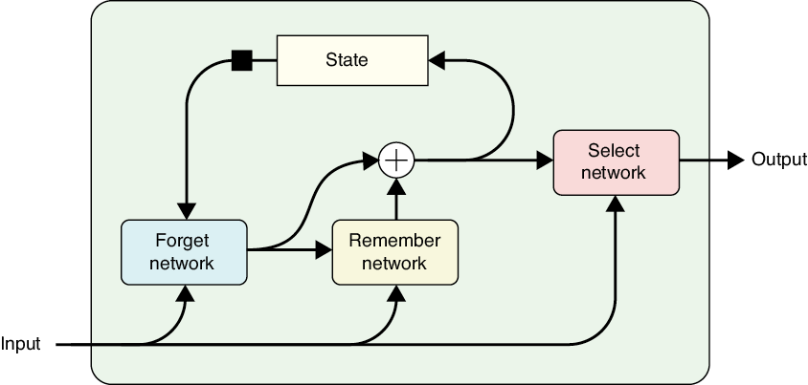
LSTM Architecture
Source: Glassner, A. (2021). Deep Learning: A Visual Approach. San Francisco, CA: No Starch Press. (Chapter 19)
Notes:
We can avoid both vanishing and exploding gradients with a fancier recurrent cell, called a long short-term memory, or LSTM. The name can be confusing, but it refers to the fact that the internal state changes frequently, so it can be considered a short-term memory. But sometimes we can choose to keep some information in the state for a long time. It might make more sense to think of this as a selectively persistent short-term memory. A block diagram of an LSTM is shown here.
The LSTM uses three internal neural networks. The first is used to remove (or forget) information from the state that is no longer needed. The second inserts new information the cell wants to remember. The third network presents a version of the internal state as the cell’s output.
The LSTM has proven to be such a good way to implement a recurrent cell that when people speak of “an RNN” they often mean a network that uses LSTM. A popular variation of the LSTM is the gated recurrent unit, or GRU. It’s not uncommon to try out both the LSTM and GRU in a network to see which performs better on a specific task.

Slide 5
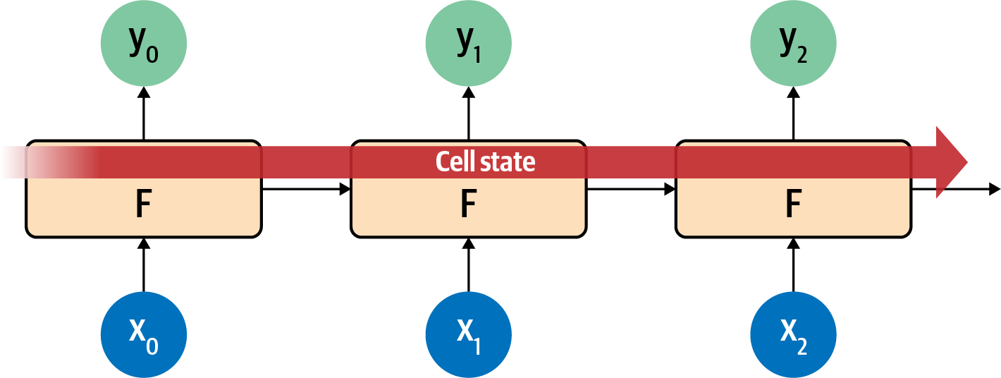
Source: Moroney, L. (2021). AI and Machine Learning for Coders: A Programmer’s Guide to Artificial Intelligence. Sebastopol, CA: O'Reilly Media, Inc. (Chapter 7)
Notes:
The LSTM architecture enhances the basic RNN by maintaining a cell state not just from step to step, but across the entire sequence of steps. Thereby ensuring that the context will be learned over time.

Slide 6
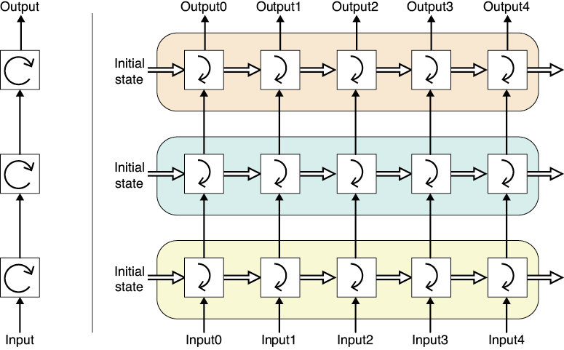
Stacked LSTM
Source: Glassner, A. (2021). Deep Learning: A Visual Approach. San Francisco, CA: No Starch Press. (Chapter 19)
Notes:
As is the case with other neural networks, we can stack recurrent cells on top of each other. We call the result a deep RNN. We just take the outputs from the cells on one layer and use them as the inputs to the cells on the next layer. The image pictured here shows one way to connect three layers, drawn in both rolled-up (on the left) and unrolled forms (on the right). As usual, the RNN units on each layer have their own internal weights and hidden state.
The appeal of this architecture is that each RNN can be specialized for a particular task. For example, the first layer might translate an input sentence into an abstract, common language, the second might rephrase it to change the mood, and then the third could translate that into a different target language. By training each LSTM individually, we gain the advantages of specialization, such as the freedom to update or improve each layer independently of the others. If we replace one LSTM layer with another, we will need to do some extra training on the whole network to make sure the layers work together smoothly.

Slide 7
Gated Recurrence Units (GRU)
Notes:
… and just a quick note about Gated Recurrence Units. More information is available in the text. GRUs are simplified forms of LSTMs and aim at reducing the number of parameters while retaining the power of the LSTM. In tasks around speech modeling and language modeling, GRUs provide the same performance as LSTMs, but with fewer parameters and faster training times.

Slide 8
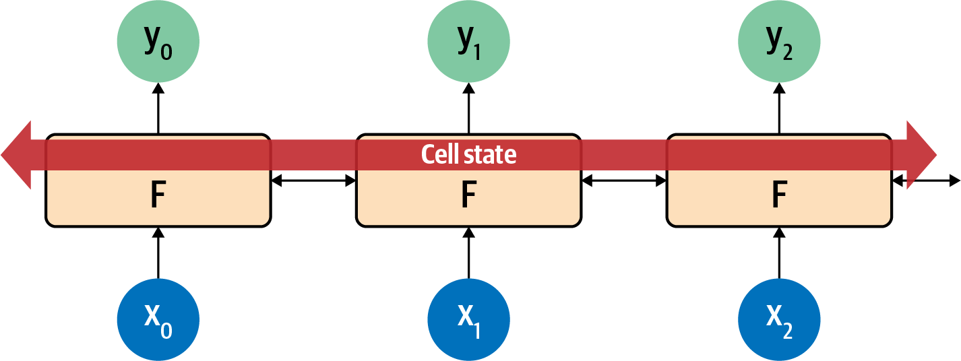
Bi-Directional LSTM
Source: Moroney, L. (2021). AI and Machine Learning for Coders: A Programmer’s Guide to Artificial Intelligence. Sebastopol, CA: O'Reilly Media, Inc (Chapter 7).
Notes:
LSTM’s can also be bidirectional—the time steps iterate both forward and backward, so that context can be learned in both directions, as pictured here.
In this way, evaluation in the direction from 0 to number_of_steps is done, as is evaluation from number_of_steps to 0. At each step, the y result is an aggregation of the “forward” pass as well as the “backward” pass.

Slide 9
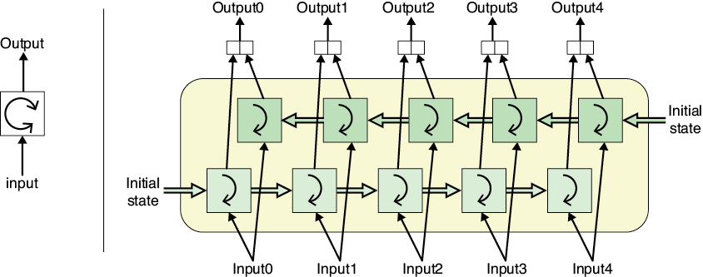
Source: Glassner, A. (2021). Deep Learning: A Visual Approach. San Francisco, CA: No Starch Press. (Chapter 19)
Notes:
With bi-directional RNN’s, we often feed input – a sentence for example – simultaneously to the lower recurrent cell in forward order and the upper recurrent cell in backward order. That is, we give input 0 to the lower cell at the same time we give input 4 to the upper cell. Then we give input 1 to the lower cell while we give input 3 to the upper cell, and so on. Once all the words have been processed, each recurrent cell will have produced an output for each word. We simply concatenate those outputs and that’s the output of the bi-RNN.

Slide 10
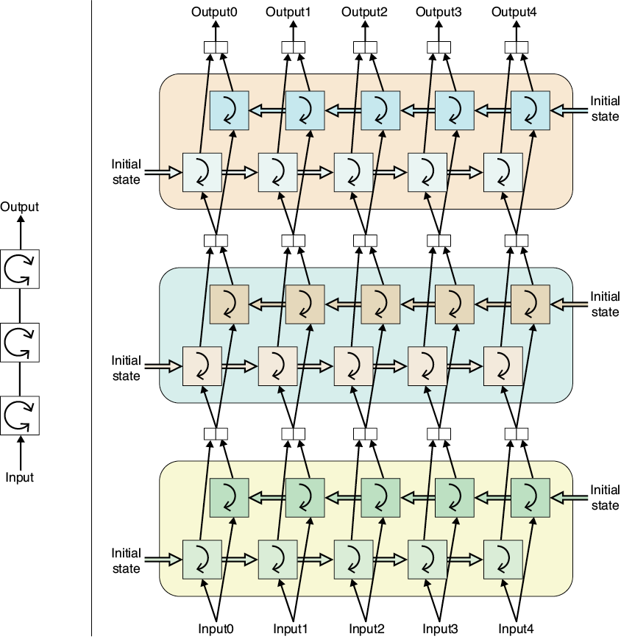
Source: Glassner, A. (2021). Deep Learning: A Visual Approach. San Francisco, CA: No Starch Press. (Chapter 19)
Notes:
We can stack up lots of bi-RNNs to create a stacked LSTM. The network with three bi-RNN layers. On the left is our schematic for this layer, and on the right, we draw each layer in its unrolled form. In this diagram, we have three layers, each containing two independent recurrent cells.
As before, part of the value here is that each bi-RNN can be independently trained for a different task, and a new bi-RNN can be swapped in if we find (or train) another one that performs better.

Slide 11
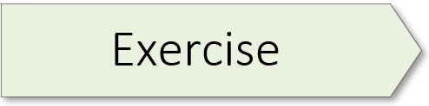
(Sentiment Classification Models) 02.1_advanced_rnn.ipynb

Slide 12
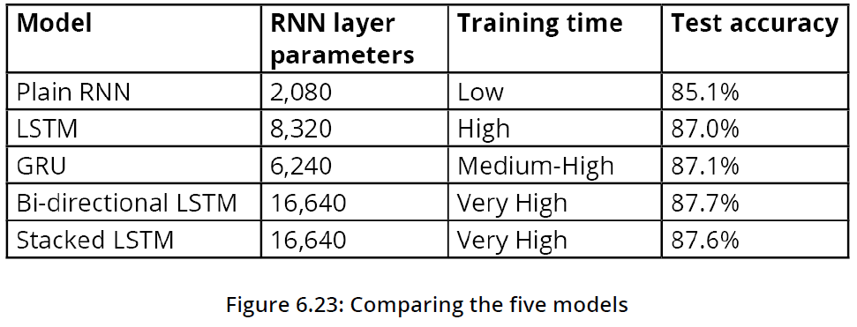
Notes:
So, let’s quickly review what we learned in our exercise. I liked this exercise as it walks you through a series of exercises where you can compare / contrast different kinds of advanced RNNs. But before we cut you loose, I’d like to highlight a few key points from the text.
Building the Plain RNN Model (p. 275)
LSTM-Based Sentiment Classification Model (p. 288).
Benefits of LSTMs:
• More powerful, as it uses more parameters and an explicit cell state
• Models long-range dependencies better
Drawbacks of LSTMs:
• Many more parameters
• Takes more time to train
• More prone to overfitting
GRU-Based Sentiment Classification Model (p. 294)
Between the LSTM and GRU, which one should you choose? The LSTM has more parameters and an explicit cell state designed to store long-term memory. But the GRU has fewer parameters, which means faster training, combined with a free-flowing cell state to allow it to model long-range dependencies.
Bidirectional LSTM-Based Sentiment Classification Model (p. 299)
Bidirectional RNNs process the sequence in both directions, allowing the network to have both backward and forward information about the sequence, providing it with a much richer context.
Stacked LSTM-Based Sentiment Classification Model (p. 302)
In all the models we've looked at in this chapter, we've used a single layer for the RNN layer (plain RNN, LSTM, or GRU). Going deeper, that is, adding more layers, has typically helped us for feedforward networks so that we can learn more complex patterns/features in the deeper layers.

Slide 14
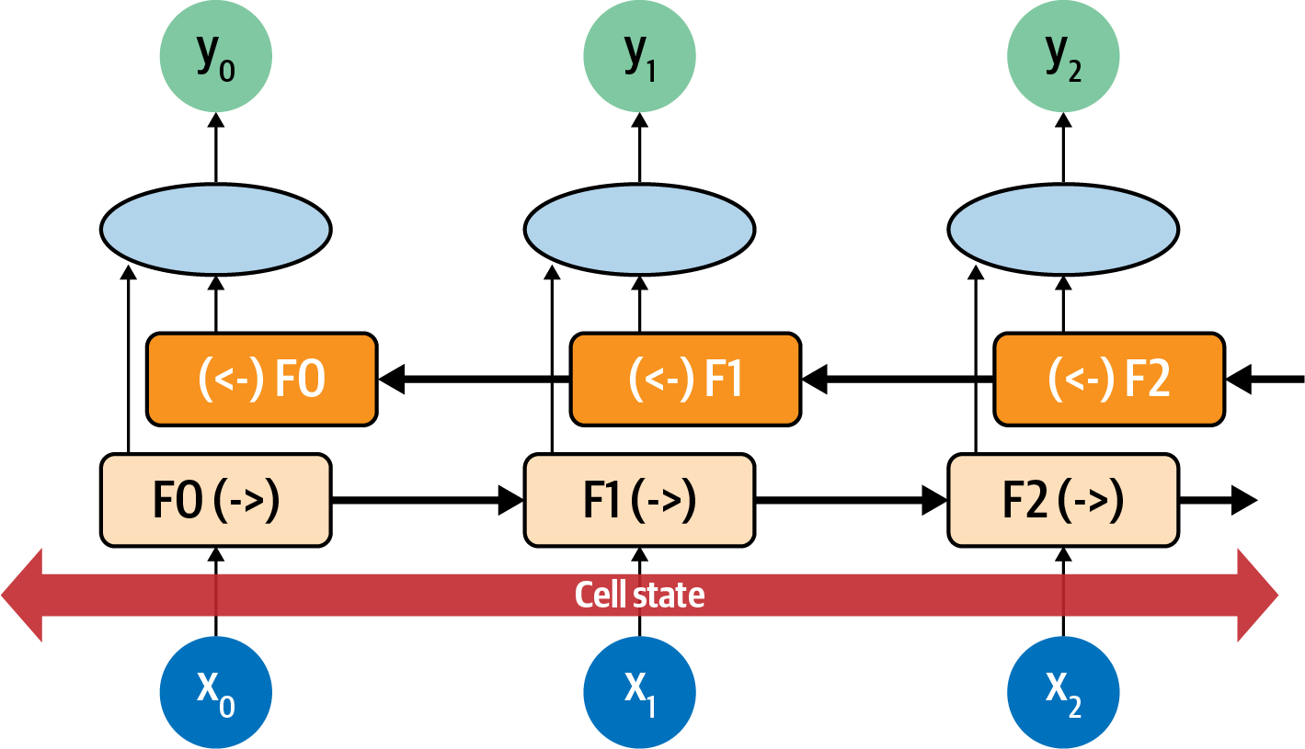
Source: Moroney, L. (2021). AI and Machine Learning for Coders: A Programmer’s Guide to Artificial Intelligence. Sebastopol, CA: O'Reilly Media, Inc (Chapter 7).
Notes:
In this way, evaluation in the direction from 0 to number_of_steps is done, as is evaluation from number_of_steps to 0. At each step, the y result is an aggregation of the “forward” pass and the “backward” pass. You can see that pictured here.
Consider each neuron at each time step to be F0, F1, F2, etc. The direction of the time step is shown, so the calculation at F1 in the forward direction is F1(->), and in the reverse direction it’s (<-)F1. The values of these are aggregated to give the y value for that time step. Additionally, the cell state is bidirectional. This can be really useful for managing context in sentences. Again, considering the sentence “I lived in Ireland, so in high school I had to learn how to speak and write <something>,” you can see how the <something> was qualified to be “Gaelic” by the context word “Ireland.” But what if it were the other way around: “I lived in <this country>, so in high school I had to learn how to speak and write Gaelic”? You can see that by going backward through the sentence we can learn about what <this country> should be. Thus, using bidirectional LSTMs can be very powerful for understanding sentiment in text

