Slide 1

Transfer Learning: Getting Started
Notes:
Let’s get started…

Slide 2

Image Credit: https://cktechcheck.com/

Slide 3

Arts
Humanities
Science
Social Sciences
Business
Other

Slide 4
Situation where what has been learned in one setting is exploited to improve generalization in another setting
Deep Learning (Ian Goodfellow, et al)
Notes:
Start with a definition from Ian Goodfellow and Yoshua Bengio’s book – Deep Learning – the definitive introductory text on deep learning.

Slide 5
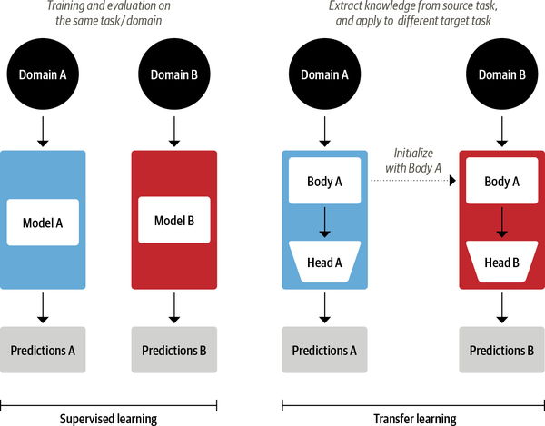
Source: Tunstall, L, et al. (2022). Natural Language Processing with Transformers. Sebastopol, CA, O’Reilly Media Publishing. (Chapter 1)
Notes:
Nowadays, it’s common practice to use transfer learning to train a neural network like ResNet on one task, and then adapt it to or fine-tune it on a new task. This allows the network to make use of the knowledge learned from the original task. Architecturally, this involves splitting the model into a body and a head, where the head is a task-specific network. During training, the weights of the body learn broad features of the source domain, and these weights are used to initialize a new model for the new task. Compared to traditional supervised learning, a transfer learning approach typically produces high-quality models that can be trained much more efficiently on a variety of downstream tasks, and with much less labeled data.
Let’s consider a computer vision example. In this domain, basic models are first trained on large-scale datasets such as ImageNet, which contain millions of images. This process is called pretraining and its main purpose is to teach the models the basic features of images, such as edges or colors. These pretrained models can then be fine-tuned on a downstream task such as classifying flower species with a relatively small number of labeled examples (usually a few hundred per class). Fine-tuned models typically achieve a higher accuracy than supervised models trained from scratch on the same amount of labeled data.

Slide 6
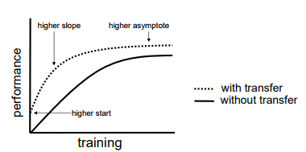
Source: Sarkar, D, et al. (2018). Hands-on transfer learning with Python. Birmingham, UK: Packt Publishing. (Chapter 4)
Notes:
Advantages of Transfer Learning:
Improved baseline performance: When we augment the knowledge of an isolated learner (also known as an ignorant learner) with knowledge from a source model, the baseline performance might improve due to this knowledge transfer.
Model-development time: Utilizing knowledge from a source model might also help in fully learning the target task, as compared to a target model that learns from scratch. This, in turn, results in improvements in the overall time taken to develop and train a model.
Improved final performance: And finally, higher final performance might be attained by leveraging transfer learning.

Slide 7
Three Key Questions
What to Transfer
When to Transfer
How to Transfer
Source: Sarkar, D, et al. (2018). Hands-on transfer learning with Python. Birmingham, UK: Packt Publishing. (Chapter 4)
Notes:
Three key questions.
What to transfer: This is the first and the most important step in the transfer learning process. Here we seek to discover the part of the knowledge that can be transferred from the source to the target in order to improve the performance of the target task. Our goal is to identify what knowledge is source-specific and what is common between the source and the target.
When to transfer: Sometimes transfer learning doesn’t make sense. In fact, at times transfer learning can make things worse. We call this – negative transfer. Obviously, the goal is to improve target performance and results, not degrade them. All this calls for wisdom about when to transfer and when to build from the ground up.
How to transfer: Once the first two question have been answered, we then identify ways of actually transferring the knowledge across domains/tasks. This often calls for changes to existing algorithms and/or the use of different techniques.

Slide 8

Image Credit: http://clipart-library.com/clipart/338971.htm
Notes:
Many types of transfer – don’t have time to cover here – please review the material in the handout
https://docs.google.com/document/d/1-NSkeWmzSzi6myow-q9avX4Oz2k9zywZpoDts63CQvQ/edit?usp=sharing

Slide 9
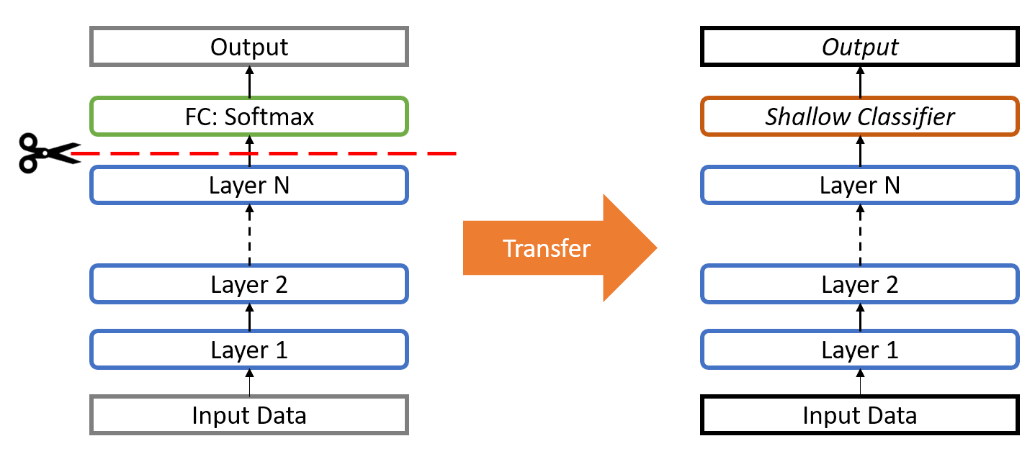
Source: Sarkar, D, et al. (2018). Hands-on transfer learning with Python. Birmingham, UK: Packt Publishing. (Chapter 4)
Notes:
Before we start our first exercise, let’s take an initial look at the transfer learning process. Deep learning systems are layered architectures that learn different features at different layers. These layers are then finally connected to a last layer (usually a fully connected layer, in the case of classification) to get the final output. This layered architecture allows us to utilize a pretrained network (such as Inception V3 or VGG) without its final layer as a fixed feature extractor for other tasks.

Slide 10

Notes:
Setup Instructions…

Slide 11
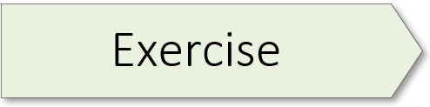
3.5 (Transfer Learning)

Slide 12
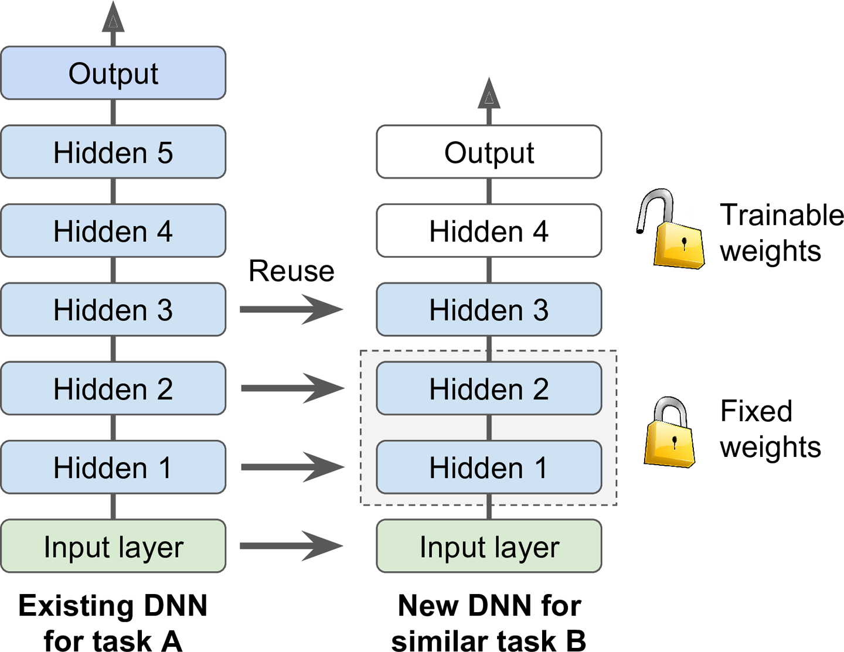
Source: Geron, A. (2019). Hands-on machine learning with Sci-Kit Learn, Keras, and Tensorflow. Sebastopol, CA: O’Reilly Media. (Chapter 11)
Notes:
Let’s dig a little deeper into the details of transfer learning. It is generally not a good idea to train a very large DNN from scratch: instead, you should always try to find an existing neural network that accomplishes a similar task to the one you are trying to tackle, then reuse the lower layers of this network. If done well, transfer learning not only speeds up training considerably, but also requires significantly less training data.
Suppose you have access to a DNN that was trained to classify pictures into 100 different categories, including animals, plants, vehicles, and everyday objects. You now want to train a DNN to classify specific types of vehicles. These tasks are very similar, even partly overlapping, so you should try to reuse parts of the first network as shown here.
The output layer of the original model will usually be replaced because it is most likely not useful at all for the new task, and it may not even have the right number of outputs for the new task.
In like manner, the upper hidden layers of the original model are less likely to be as useful as the lower layers, since the high-level features that are most useful for the new task may differ significantly from the ones that were most useful for the original task. You want to find the right number of layers to reuse.
Try freezing all the reused layers first (i.e., make their weights non-trainable so that Gradient Descent won’t modify them), then train your model and see how it performs. Then try unfreezing one or two of the top hidden layers to let backpropagation tweak them and see if performance improves. The more training data you have, the more layers you can unfreeze. It is also useful to reduce the learning rate when you unfreeze reused layers: this will avoid wrecking their fine-tuned weights.

Slide 13
Model
model.save_model(filepath = 'path_to_model/model_name')
loaded_model = tf.keras.models.load_model(filepath = 'path_to_model/model_name')
Source: Baig, M., et al (2020). The deep learning workshop. Birmingham, UK: Packt Publishing. (Chapter 3)
Notes:
To save and retrieve the entire model, use the example code displayed here as a template.

Slide 14
Weights
model.save_weights('path_to_weights/weights.h5')
new_model.load_weights('path_to_weights/weights.h5')
Source: Baig, M., et al (2020). The deep learning workshop. Birmingham, UK: Packt Publishing. (Chapter 3)
Notes:
To save and retrieve the model’s trained weights, use the example code displayed here as a template.

Slide 15
Architecture
import json
config_json = model.to_json()
with open('config.json', 'w') as outfile:
json.dump(config_json, outfile)
import json
with open('config.json') as json_file:
config_data = json.load(json_file)
loaded_model = tf.keras.models.model_from_json(config_data)
Source: Baig, M., et al (2020). The deep learning workshop. Birmingham, UK: Packt Publishing. (Chapter 3)
Notes:
To save and retrieve just the model’s architecture (the layers but not the trained weights), use the example code displayed here as a template.
JSON = Java Script Object Notation.

Slide 16

Notes:
https://huggingface.co/

Slide 17
3.6 (Fine-Tuning)

Slide 18

Activity 3.02 (Fruit Classification w/Transfer Learning)
Notes:
The learning experience for this workshop starts on page 150 of the textbook.

Slide 20
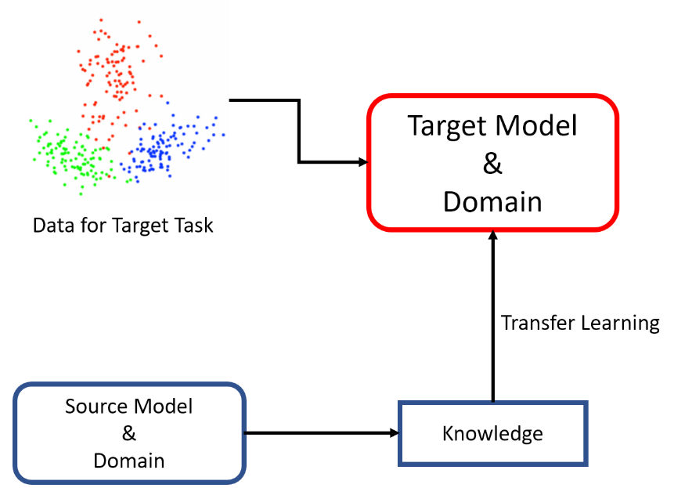
Source: Sarkar, D, et al. (2018). Hands-on transfer learning with Python. Birmingham, UK: Packt Publishing. (Chapter 4)
Notes:
Transfer learning visual.

