Slide 1


Transfer Learning Concepts
Notes:
Hello and welcome to this first presentation in the Practicum AI Convolutional Neural Networks workshop series. I’m Dan Maxwell, and I will act as your guide and mentor for this learning experience. I currently work as an AI Trainer / Consultant in the Research Computing Department at the University of Florida.
So, let’s get started…

Slide 2
Class Schedule
Event | Time
Login/Introduction | 1:00
Module 1 | 1:15
Exercise 1 | 1:45
Break | 2:45
Module 2 | 2:50
Exercise 2 | 3:20
Module 3 | 4:20
Wrap Up | 4:50

Slide 3
Transfer Learning Concepts - Objectives
Define transfer learning and its benefits.
Identify common deep learning tasks using transfer learning.
List the steps in a typical transfer learning workflow.
Differentiate between key techniques (feature extraction, fine-tuning, LoRA).
Explain how knowledge is leveraged from pre-trained models.

Slide 4
What *is* Transfer Learning?
higher slope
higher asymptote
performance
Leveraging knowledge from a pre-trained model to solve a new but related problem.
with transfer
without transfer
higher start
training
Source: Sarkar, D, et al. (2018). Hands-on transfer learning with Python. Birmingham, UK: Packt Publishing. (Chapter 4)
Notes:
Uses features learned on a large dataset for a different domain/task.
Reduces need for large labeled datasets and computational resources.
Example: Adapting a general object recognition model (dogs, cars) for medical X-ray analysis.
This tendency motivates the idea of freezing some layers and leaving other layers unfrozen. For very similar tasks and/or domains, you may only want to unfreeze one to a few layers of a model before fine-tuning. For more divergent tasks and/or domains, you might want to unfreeze most or all the layers.

Slide 5
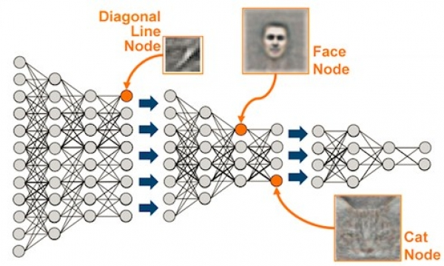
Deep Learning Refresher
Source - https://sdat.ir/en/sdat-blog/item/1-deep-learning
Notes:
As seen in Figure 1’s representation shown here, computer vision models tend to capture features like horizontal or vertical lines in the earliest layers, while later layers tend to capture more complex combinations of features. The same is true for language models, with earlier layers primarily focusing on encoding low-level features of the input text, like individual words and their basic grammatical structure. They are essentially capturing the "building blocks" of the language, like how early layers in a vision network might detect edges in an image. Later layers in a deep network combine information from the earlier layers to learn more complex semantic relationships, context, and sentiment within a text.
This tendency motivates the idea of freezing some layers and leaving other layers unfrozen. For very similar tasks and/or domains, you may only want to unfreeze one to a few layers of a model before fine-tuning. For more divergent tasks and/or domains, you might want to unfreeze most or all the layers.

Slide 6
Deep Learning Refresher - Hyperparameters
Learning Rate
Batch Size
Regularization
Optimizer
Epochs
And a new one: Frozen Layers
Notes:
Learning Rate – The amount numerical amount that parameter weights are adjusted during backpropagation.
Batch Size – How many samples are viewed at once while training.
Regularization – Methods used to prevent overfitting and improve generalization of a model.
Optimizer – The algorithm that is used in conjunction with the loss function to find optimal parameters.
Epochs – The number of full training passes a model undergoes.
Frozen Layers – Layers of a pre-trained model that are locked, or frozen, during the retraining process to preserve the patterns they’ve learned.

Slide 7
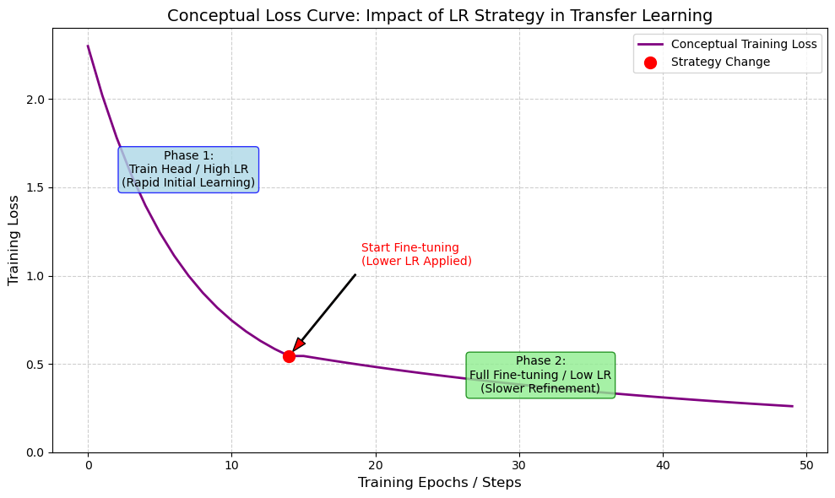
Learning Rate
Pre-trained layers typically require lower learning rates (10⁻⁵ to 10⁻⁴).
Newly added layers, however, often benefit from a higher learning rate (10⁻³).
Notes:
Choosing an appropriate learning rate is crucial for transfer learning. Pre-trained layers typically require lower learning rates (e.g., 1e-5 to 1e-4) to avoid overwriting their learned features. Newly added layers, however, often benefit from a higher learning rate (e.g., 1e-3).
Learning Rate – The amount numerical amount that parameter weights are adjusted during backpropagation.
Batch Size – How many samples are viewed at once while training.
Regularization – Methods used to prevent overfitting and improve generalization of a model.
Optimizer – The algorithm that is used in conjunction with the loss function to find optimal parameters.
Epochs – The number of full training passes a model undergoes.
Frozen Layers – Layers of a pre-trained model that are locked, or frozen, during the retraining process to preserve the patterns they’ve learned.

Slide 8


Freezing Layers
Output
Hidden 5
Output
“Freezing” layers is a coding technique of specifying pre-trained layers of a model to *not* update their parameter weights during training.
Trainable weights
Hidden 4
Hidden 4
Reuse
Hidden 3
Hidden 3
Hidden 2
Hidden 2
Fixed weights
Hidden 1
Hidden 1
Input layer
Input layer
Existing DNN for task A
New DNN for similar task B
Source – Batman Forever
Notes:
“Freezing” layers is a coding technique of specifying pre-trained layers of a model to *not* update their parameter weights during training. Freezing the earlier layers and fine-tuning the later layers is a common strategy when the source and target domains are similar. In dissimilar domains, unfreezing more layers allows the model to adapt to new features.
This tendency motivates the idea of freezing some layers and leaving other layers unfrozen. For very similar tasks and/or domains, you may only want to unfreeze one to a few layers of a model before fine-tuning. For more divergent tasks and/or domains, you might want to unfreeze most or all the layers.

Slide 9
Quick Quiz!
Question 1: What is the primary benefit of using a lower learning rate for pre-trained layers during transfer learning?
A) To speed up training significantly.
B) To help the model learn new features faster.
C) To avoid drastically changing weights that already capture useful information.
D) To initialize the new layers correctly.
Answer: C

Slide 10
Quick Quiz!
Question 2: True or False: Transfer learning typically requires more data and computational resources than training a model from scratch.
Answer: False

Slide 11
Key Terminology
Extract knowledge from source task, and apply to different target task
Task
Domain
Source
Target
Domain A
Domain B
Initialize
with Body A
Body A
Body A
Head A
Head B
Predictions A
Predictions B
Source: Tunstall, L, et al. (2022). Natural Language Processing with Transformers. Sebastopol, CA, O’Reilly Media Publishing. (Chapter 1)
Notes:
Task: The specific problem (e.g., image classification, sentiment analysis). Example: Classifying animal photos.
Domain: The type of data (e.g., animal images, medical X-rays). Example: Dataset of animal images.
Source: The pre-trained model/task/domain providing knowledge. Example: Model trained on ImageNet.
Target: The new model/task/domain where knowledge is applied. Example: Fine-tuning for dog breed classification.

Slide 12
Domain Transfer vs Adaptation
Domain Transfer
Domain Adaptation
Notes:
Domain Transfer: Applying knowledge across significantly different domains/contexts. Requires adapting foundational knowledge. May need more layers unfrozen.
Example: Imagine a model initially trained to classify land types (forest, water, city) using satellite images from space. Domain Transfer allows adapting this knowledge to analyze low-altitude drone footage for farming. While both involve images of the ground, the type of imagery (satellite vs. drone), perspective, and specific goal (general land type vs. detailed crop health) are significantly different. The model transfers its basic image understanding to the new context.
Domain Adaptation: Adjusting model for variations within the same general domain/task. Focus on aligning data distributions. Smaller gap than Domain Transfer.
Example: Consider a self-driving car model trained extensively on U.S. roads. Domain Adaptation is used to make it work effectively on Indian roads. The general domain (driving on roads) and core task (identifying cars, pedestrians, signs) remain the same. However, the model needs to adapt to specific variations like different lighting conditions, road markings, sign designs, and traffic patterns unique to India. It's learning to apply its existing driving knowledge under slightly different conditions.

Slide 13
Task Transfer vs Adaptation
Task Transfer
Task Adaptation
Notes:
Task Transfer: Applying a model trained for one type of problem to a different type of problem. Learned features used in new context.
Example: A model trained for image classification being adapted for object detection to localize objects in an image. For example, a ResNet model pre-trained on ImageNet can be adapted into a Faster R-CNN architecture by adding bounding box regression layers, allowing it to identify specific objects like animals in wildlife conservation studies.
Task Adaptation: Modifying transferred knowledge for specific requirements of the new task. Often involves changing final layers.
Example: Adapting a facial recognition model to perform emotion detection by replacing the final classification layers with ones that predict different emotions instead of identities. By modifying the last dense layers of a VGGFace model and training it on datasets like the popular face-image dataset FER-2013 , the model can accurately classify emotions such as happiness, sadness, anger, and surprise, making it useful for human-computer interaction applications.

Slide 14
Benefits of Transfer Learning
Efficiency
Performance
Adaptability
Notes:
Efficiency: Reduces training time and computational cost.
Performance: Often improves results, especially with limited target data.
Adaptability: Allows using state-of-the-art models for niche domains.
Revolutionized fields like CV and NLP.

Slide 15

Typical Workflow - Phase 1: Setup & Prep
Define
Define Problem & Gather Data
Select
Select Pre-Trained Model
Notes:
Typical Workflow - Phase 1: Setup & Prep
Step 1: Define Problem & Gather Data: Clarify target task; collect, clean, split data. Consider source/target similarity.
Step 2: Select Pre-Trained Model: Choose based on target task/domain compatibility (e.g., ResNet/ViT for vision, BERT/GPT for NLP).

Slide 16
Typical Workflow - Phase 2: Adaptation
Adapt
Modify model architecture for target task
Freeze
Freeze/Unfreeze layers based on task/domain similarity and dataset size
Source – Batman Forever
Notes:
Typical Workflow - Phase 2: Adaptation
Step 3: Adapt Model Architecture: Modify model for target task (e.g., replace final layer). Ensure input compatibility (e.g., RGB vs. grayscale).
Step 4: Freeze/Unfreeze Layers: Decide based on task similarity and dataset size. Freeze more for similar tasks/small data; unfreeze more for different tasks/large data.

Slide 17
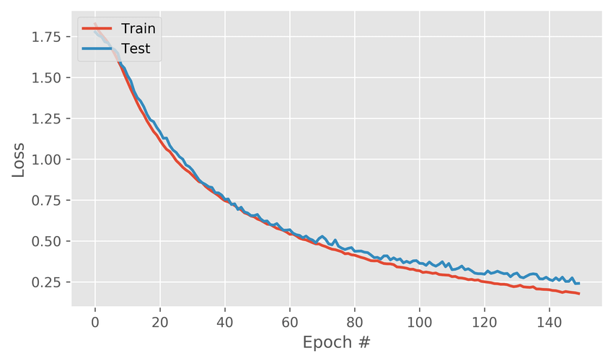
Typical Workflow - Phase 3: Training & Evaluation
Train
Optimize on target data
Evaluate
Measure performance on unseen data using appropriate metrics (accuracy, F1, etc.).
Source – Ferro, Rodolfo & Mitre-Hernandez, Hugo. (2020). 10.48550/arXiv.2005.07649.
Notes:
Transfer Learning Workflow (Phase 3) : Training & Evaluation
Step 5: Train the Model: Optimize on target data. Use techniques like data augmentation. Use smaller learning rates for fine-tuning.
Step 6: Evaluate the Model: Measure performance on unseen data using appropriate metrics (accuracy, F1, etc.). Visualize errors (confusion matrix, bounding boxes). Compare to baseline.

Slide 18
Typical Workflow - Phase 4: Deployment & Iteration
Deploy
Deploy to real-world setting
Iterate
Continuous improvement is key.
Source – Ferro, Rodolfo & Mitre-Hernandez, Hugo. (2020). 10.48550/arXiv.2005.07649.
Notes:
Transfer Learning Workflow (Phase 4: Deployment & Iteration
Step 7: Deploy and Monitor: Deploy to real-world setting. Monitor performance; retrain if data shifts. Fine-tune with new data/feedback.
Step 8: Iterate and Optimize: Experiment with different models, hyperparameters (learning rate schedules, regularization), data augmentation. Continuous improvement is key.

Slide 19
Quick Quiz!
Question 1: Which transfer learning technique typically involves freezing all layers of the base pre-trained model?
Fine-tuning
LoRA
Feature Extraction
Domain Adaptation
Answer: C
Notes:
Fine-tuning
LoRA
Feature Extraction
Domain Adaptation

Slide 20
Quick Quiz!
Question 2: If your target task domain is very different from the source model's domain, what layer freezing strategy is generally recommended?
Freeze all layers.
Freeze only the last layer.
Unfreeze only the first few layers.
Unfreeze most or all layers.
Answer: D
Notes:
Freeze all layers.
Freeze only the last layer.
Unfreeze only the first few layers.
Unfreeze most or all layers.

Slide 21
Potential Pitfalls (Brief Mention)
Catastrophic Forgetting
Negative Transfer
Domain Shift
Notes:
Catastrophic Forgetting: The model loses previously learned knowledge when fine-tuned on a new task.
Negative Transfer: Knowledge from the source task harms performance on the target task due to domain or task mismatch.
Domain Shift: Differences in data distributions between source and target domains cause poor generalization.

Slide 22
Fine-Tuning Exercise!!!
Notes:
Freeze all layers.
Freeze only the last layer.
Unfreeze only the first few layers.
Unfreeze most or all layers.

Slide 23
Neural Network Neurons

Slide 24
Module 2 Objectives
Describe the basis of a neural network (neuron).
Identify and describe an artificial neuron (perceptron).
Discuss bias and weights.
Describe and identify activation functions.
Describe and simulate image processing in a small neural network.
Implement and train a perceptron using TensorFlow.

