Slide 1

Transformers: Getting Started
Notes:
Transformers are increasingly important -- Add agenda slide…

Slide 2
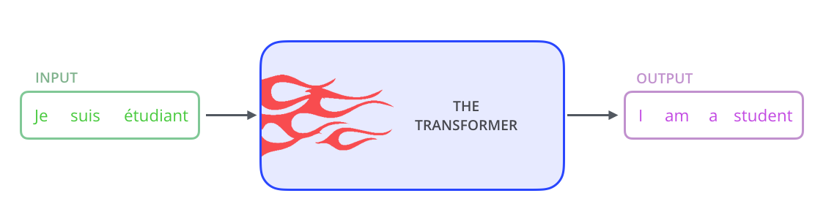
Transformer Architecture
Image Credit: https://towardsdatascience.com/transformers-141e32e69591
Notes:
We begin with a simple image… first off, the Transformer architecture excels at handling sequential text data. It takes a text sequence as input and produces another text sequence as output. Here we see a French sentence translated into English.
As opposed to directional models, which read the text input sequentially (left-to-right or right-to-left), the Transformer encoder reads the entire sequence of words at once. Therefore, it is considered bidirectional, though it would be more accurate to say that it’s non-directional. This characteristic allows the model to learn the context of a word based on all of its surroundings (left and right of the word).

Slide 3
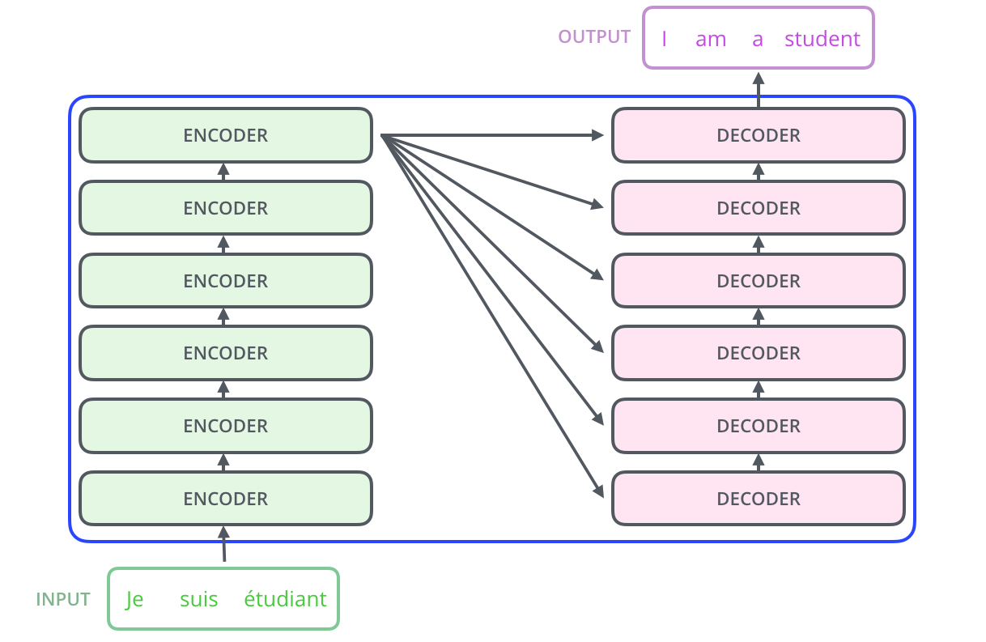
Add – Embedding Layer
Add – Embedding Layer
Image Credit: https://towardsdatascience.com/transformers-141e32e69591
Notes:
At its core, a transformer contains a stack of Encoder and Decoder layers. To avoid confusion, we refer to the individual layer as an Encoder or a Decoder and will use Encoder stack or Decoder stack for a group of Encoder layers.
The Encoder stack and the Decoder stack each have their corresponding Embedding layers for their respective inputs. And finally, there is an Output layer to generate the final output.

Slide 4
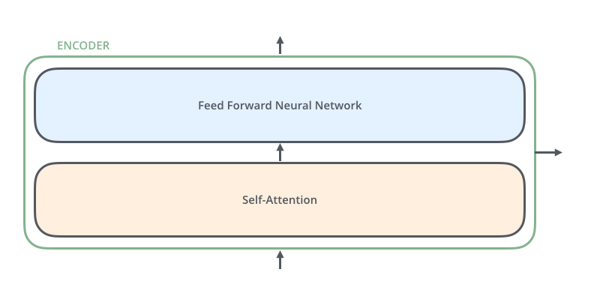
Image Credit: https://towardsdatascience.com/transformers-141e32e69591
Notes:
All encoders have the same architecture. Each encoder consists of two layers: Self-attention and a feed Forward Neural Network. The encoder’s inputs first flow through a self-attention layer which helps it look at other words in the input sentence as it encodes a specific word.

Slide 5
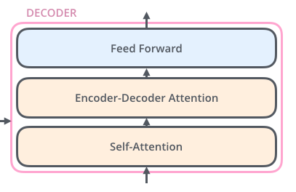
Image Credit: https://towardsdatascience.com/transformers-141e32e69591
Notes:
All decoders have the same architecture. And like the encoder, the decoder contains both self-attention and feed forward layers, with an attention layer sandwiched in-between. This layer helps the decoder focus on relevant parts of the input sentence.

Slide 6
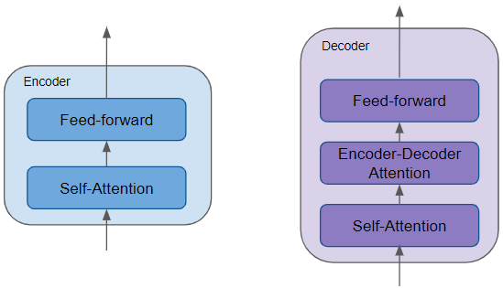
Source: Doshi, K. (2020). https://towardsdatascience.com/transformers-explained-visually-part-1-overview-of-functionality-95a6dd460452
Notes:
All the Encoders are identical to one another. Similarly, all the Decoders are identical.
The Encoder contains the all-important Self-attention layer that computes the relationship between different words in the sequence.
The Decoder also contains the Self-attention layer and the Feed-forward layer, as well as a second Encoder-Decoder attention layer.
Each Encoder and Decoder has its own set of weights.

Slide 7
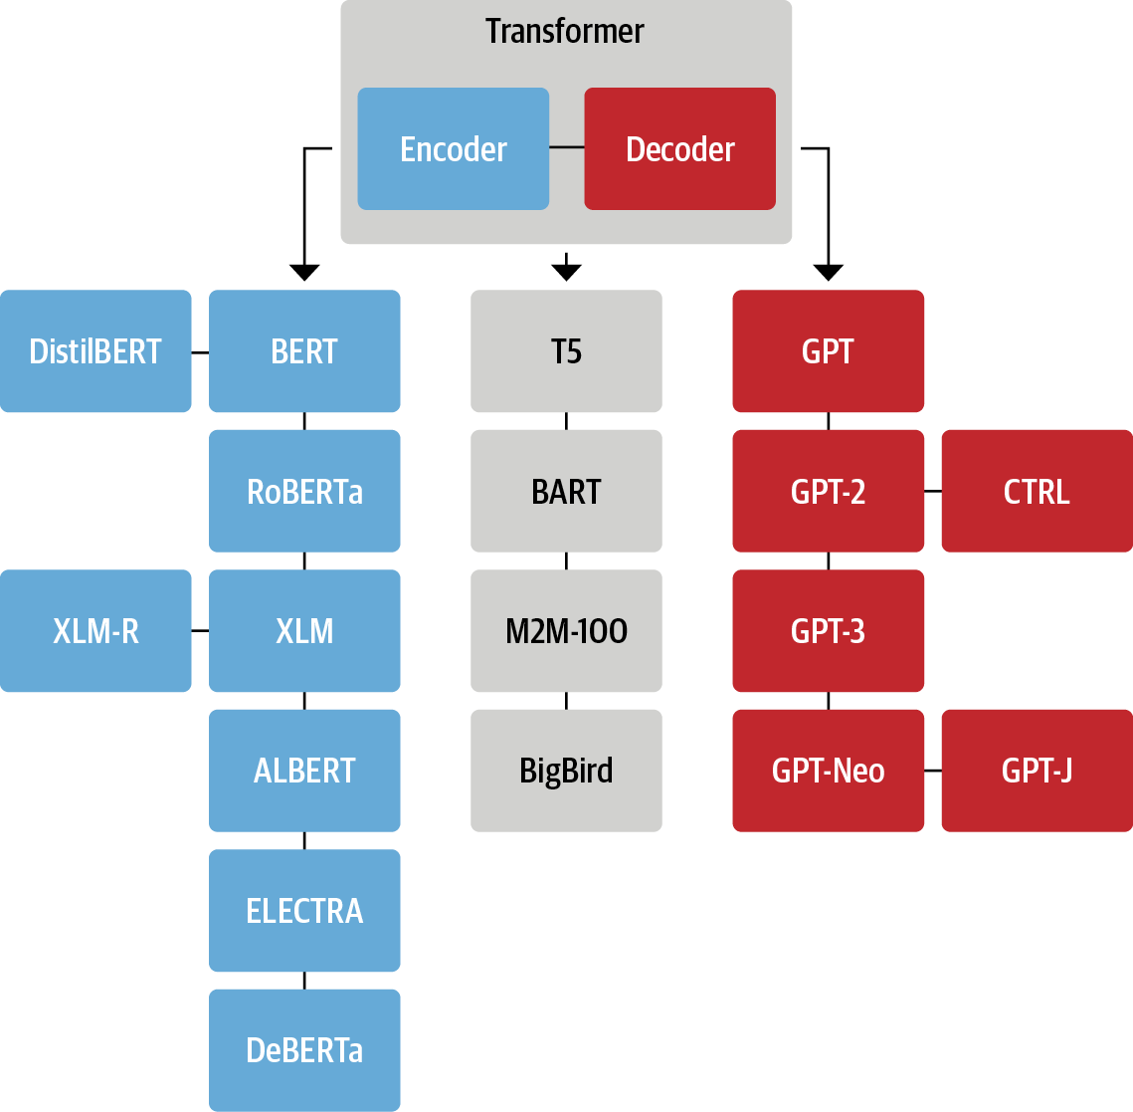

Slide 8
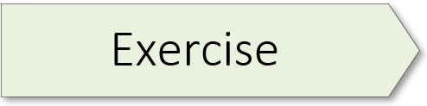
Transformers Introduction 01.2_transformer_intro.ipynb

Slide 9
Transformer Building Blocks
Source: Glassner, A. (2021). Deep learning: A visual approach. San Francisco, CA: No Starch Press. (Chapter 20)
Notes:
Now that you’ve completed a hands-on exercise, let’s consider some of the building blocks that make transformers unique. Note: I will not discuss word embeddings as that topic was covered in the last workshop of our NLP sequence. In this mini-lecture, we will cover three building blocks: 1) layer norm, 2) positional encoding, and 3) skip connections. Because attention is such an important topic, it is covered in our next workshop.

Slide 10

Source: Glassner, A. (2021). Deep learning: A visual approach. San Francisco, CA: No Starch Press. (Chapter 20)
Notes:
Layer norm is our first building block. In transformers, we usually apply a regularization step called layer normalization, or layer norm, to the outputs of a layer, as shown here on the left. Layer norm belongs to the class of regularization techniques, such as dropout and batchnorm, which help control overfitting by keeping the values flowing through the network from getting too big or too small. (Vanishing / exploding gradients) The layer norm step learns to adjust the values coming out of a layer so that they approximate the shape of a Gaussian bump with a mean of 0 and standard deviation of 1.

Slide 11
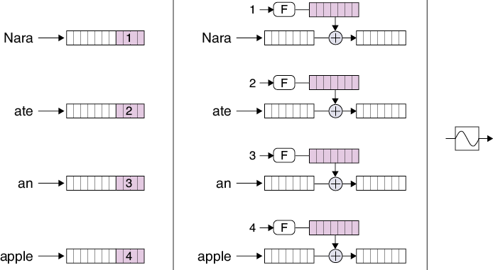
Source: Glassner, A. (2021). Deep learning: A visual approach. San Francisco, CA: No Starch Press. (Chapter 20)
Notes:
Positional encoding – was designed to solve a problem that comes up as soon as we take RNNs out of our system: we lose track of where each word is in the input sentence. This important information is inherent in the RNN structure, because the words come in one at a time, allowing the hidden state inside a recurrent cell to remember the order in which the words arrived.
But as we’ve seen, attention mixes together the representations of multiple words. How can later stages know where each word belongs in the sentence?
The answer is to insert each word’s position, or index, into the representation for the word itself. That way, as the word’s representations get processed, the position information naturally comes along for the ride. The generic name for this process is positional encoding. I will not cover the technical details of positional encoding in this mini-lecture.
Alright, that wraps up this mini-lecture of transformer building blocks.

Slide 12

Source: Glassner, A. (2021). Deep learning: A visual approach. San Francisco, CA: No Starch Press. (Chapter 20)
Notes:
And finally, our third transformer building block is the skip connection, also known as a residual connection. The inspiration for this innovation lies in our desire to reduce the amount of work that’s required of a deep network layer.
Let’s start with an analogy. Suppose you’re painting a real, physical portrait using acrylic paints on canvas. After weeks of sittings, the portrait is done, and you send it to your subject for their approval. They say that they like it, but they regret having worn a particular ring on one finger, and wish they’d worn a different one that they like more. Can you change that?
One way to proceed would be to invite your subject back to the studio and paint a whole new portrait from scratch on a blank canvas, only this time with the new ring on their finger. That would require a lot of time and effort. A faster way would be to take the portrait you have, and just paint the new ring over the old one.
Now consider a layer in a deep network. A tensor comes in, and the layer does some processing to change that tensor. If the layer only needs to change the input by small amounts, or only in some places, then it would be wasteful to expend resources processing the parts of the tensor that don’t need to change. Just as with the painting, it would be much more efficient for the layer to compute only the changes it wants to make. Then it can combine those changes with the original input to produce its output.
The red line in the drawing which carries the input directly to the addition node is called a skip connection, or a residual connection. We can also place a skip connection around multiple layers in sequence, if we like, as shown here on the right.

Slide 13
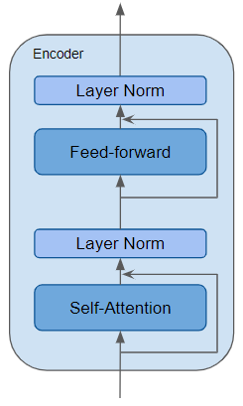
Skip Connection
Source: Doshi, K. (2020). https://towardsdatascience.com/transformers-explained-visually-part-1-overview-of-functionality-95a6dd460452
Notes:
An encoder may feature multiple transformer building blocks. Here we see an encoder comprised of a self-attention layer as well as a couple of layer norm layers. Additionally, residual skip connections allow this encoder to bypass the self-attention and feed forward layers as needed. We will discuss these unique transformer building blocks in just a moment…

Slide 14
Jay Alamaar (Illustrated Transformer) 01.1_alamaar.ipynb

Slide 16
Emotion Detector 01.2_emotion_detector.ipynb

Slide 17
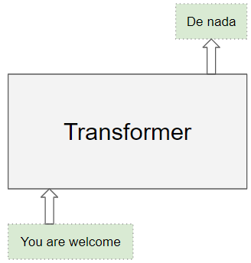
Source: Doshi, K. (2020). https://towardsdatascience.com/transformers-explained-visually-part-1-overview-of-functionality-95a6dd460452
Notes:
We begin with a simple image… first off, the Transformer architecture excels at handling text data which is inherently sequential. It takes a text sequence as input and produces another text sequence as output; for example, to translate an input English sentence to Spanish.
As opposed to directional models, which read the text input sequentially (left-to-right or right-to-left), the Transformer encoder reads the entire sequence of words at once. Therefore, it is considered bidirectional, though it would be more accurate to say that it’s non-directional. This characteristic allows the model to learn the context of a word based on all of its surroundings (left and right of the word).

Slide 18
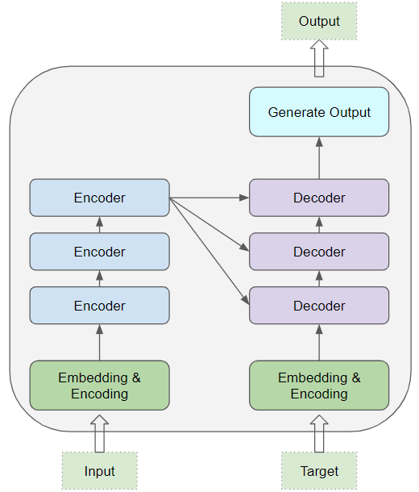
Source: Doshi, K. (2020). https://towardsdatascience.com/transformers-explained-visually-part-1-overview-of-functionality-95a6dd460452
Notes:
At its core, a transformer contains a stack of Encoder and Decoder layers. To avoid confusion, we will refer to the individual layer as an Encoder or a Decoder and will use Encoder stack or Decoder stack for a group of Encoder layers.
The Encoder stack and the Decoder stack each have their corresponding Embedding layers for their respective inputs. And finally, there is an Output layer to generate the final output.

