Slide 1

Transformers: Getting Started
Notes:
Transformers are the new “kid” on the block.
And since 2017 – when the paper (All You Need is Attention) was published – they’ve taken the deep learning world by storm.

Slide 2
Lesson Overview
Learning Objective 1
Learning Objective 1
Learning Objective 1
Learning Objective 1

Slide 3

Limits of Recurrent Neural Networks
Image Credit: https://www.shutterstock.com/search/limit
Notes:
Though powerful, RNN architecture suffers from two significant limitations:
Because all the information about an input is represented in a single piece of state memory, or context vector, the networks inside each recurrent cell must compress everything that’s needed into the available space. And no matter how large we make the state memory, we can always get an input that exceeds available memory. Inevitably, vital information is lost.
A second problem is that a RNN must be trained and used one word at a time. This can be a slow way to work, especially with large datasets.

Slide 4
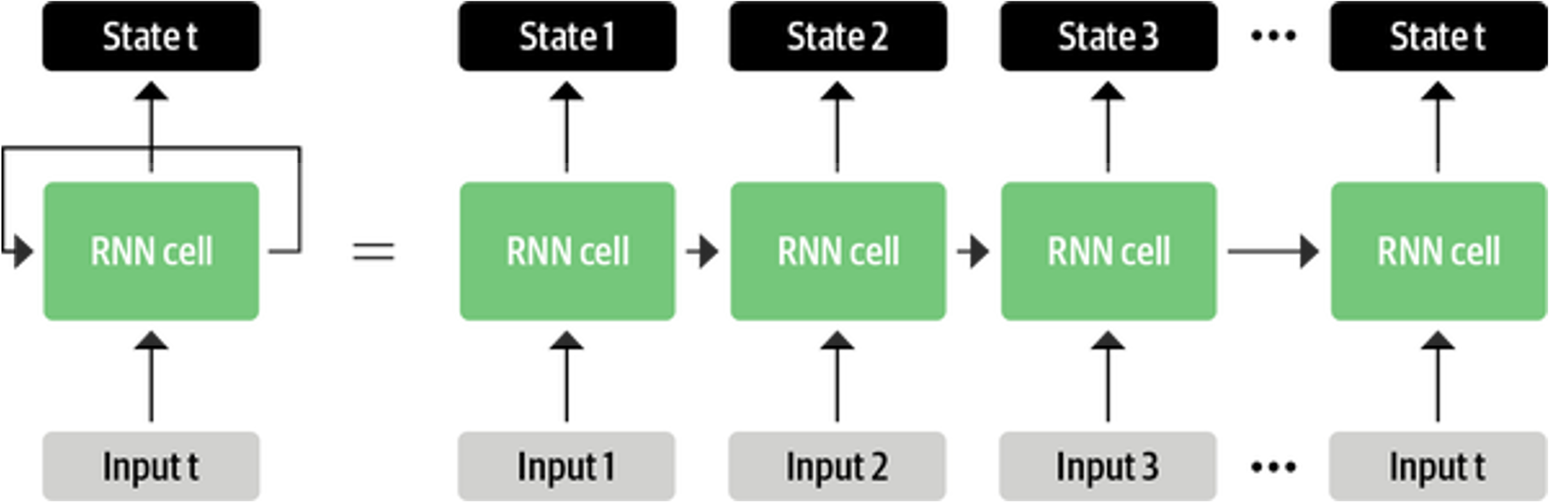
Source: Tunstall, L., et al (2022). Natural Language Processing with Transformers. Sebastopol, CA: O’Reilly Publishing. (Chapter 1)
Notes:
Hopefully, the paint analogy from today’s first mini-lecture has helped you gain an intuitive understanding of attention. We will now consider transformers from a technical architecture point-of-view. We start with a quick review of RNN architecture and its shortcomings.
RNN models contain a feedback loop which allows information to move from one step to another. As such, they’re ideal for modeling sequential data like text. As pictured here, an RNN receives some input (a word or character), feeds it through the network, and outputs a vector called the hidden state. At the same time, the model feeds some information back to itself via the feedback loop, which it can then use in the next step.
To the right of the equal sign, the RNN process is unrolled. During each iteration, the RNN cell passes information about its state to the next operation in the sequence. This allows the cell to retain information from previous steps and use it for its output predictions.

Slide 5
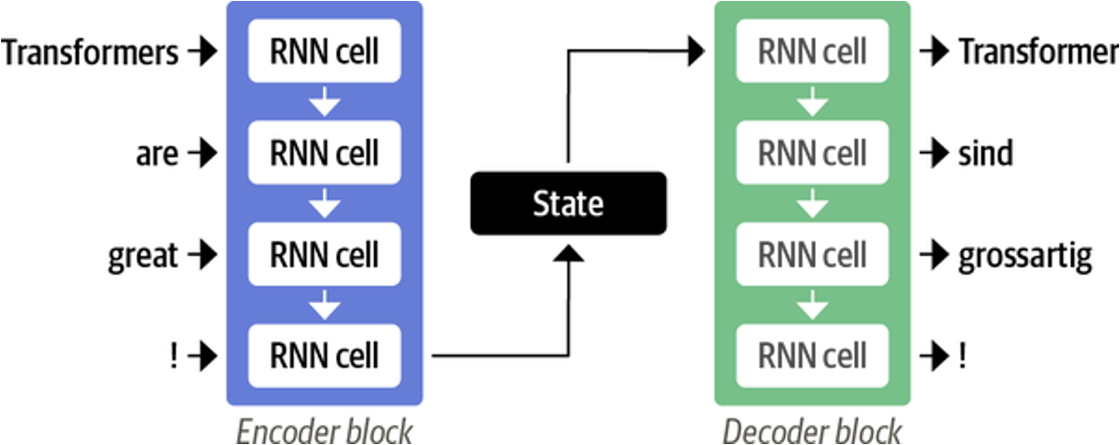
Source: Tunstall, L., et al (2022). Natural Language Processing with Transformers. Sebastopol, CA: O’Reilly Publishing. (Chapter 1)
Notes:
The RNN architecture enabled early machine translation systems. The way in which RNNs translate text is usually done by linking an Encoder to a Decoder. This architecture works well when both the input and output sequences are of fixed length. Here a short English sentence of 3 words plus exclamation point is translated into German. The encoder ingests each sentence element sequentially while maintaining its state along the way. The encoder’s last hidden state – a numerical representation of the entire sentence – is then passed to the decoder. The decoder, in turn, generates the German equivalents from top to bottom.
This architecture is simple and elegant, but it has one big weakness. The encoder’s final hidden state is an information bottleneck. That is, it must represent the meaning of the entire input sequence in a compressed form. With long sequences, this creates a challenge. The information at the start of the sequence might be lost in the process of compressing everything into a single (fixed) representation.
When that happens, the decoder is unable to do its job well.

Slide 6
Image Credit: https://towardsdatascience.com/transformers-141e32e69591
Notes:
Let’s simulate the bottleneck problem. This animation shows how a RNN sequence-to-sequence model works. Each word is processed separately, with a single hidden state passed between words before being handed off to the decoder which generates the output…
=====
Fortunately, we can avoid this bottleneck altogether. What if the decoder could access all the encoder’s hidden states, not just the final one? If that was the case, it could then pay attention to different combinations of hidden states as it translates each element in a sequence.

Slide 7

Attention is All You Need (2017)
Notes:
The RNN bottleneck limited the usefulness of this architecture.
But an answer to the problem appeared in 2017, in a paper entitled, “Attention is all You Need.” The transformer was born. And since then, it has proven to be a powerful and capable architecture, used in a variety of ways.

Slide 8
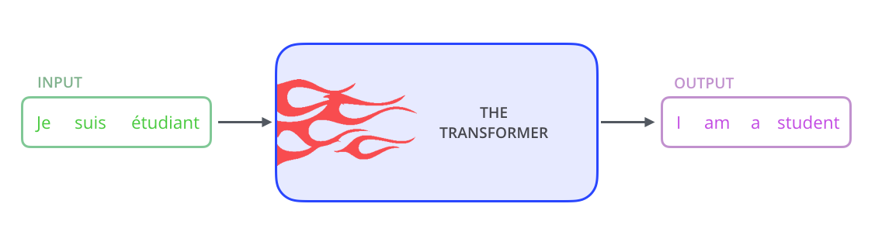
Transformer Architecture
Image Credit: https://towardsdatascience.com/transformers-141e32e69591
Notes:
We begin our transformer learning journey with a quick (high-level) overview of the architecture. Like RNNs, transformer architecture excels at handling sequential data. Translation is a special kind of sequential task which takes a text sequence in one language and outputs it in another.
Unlike directional models which read the text input sequentially (left-to-right or right-to-left), a Transformer encoder reads the entire sequence of words at once. It is therefore considered bidirectional. Or more precisely, we say that it’s non-directional. This property allows the model to learn the context of a word based on all its surroundings (left and right of the word).

Slide 9
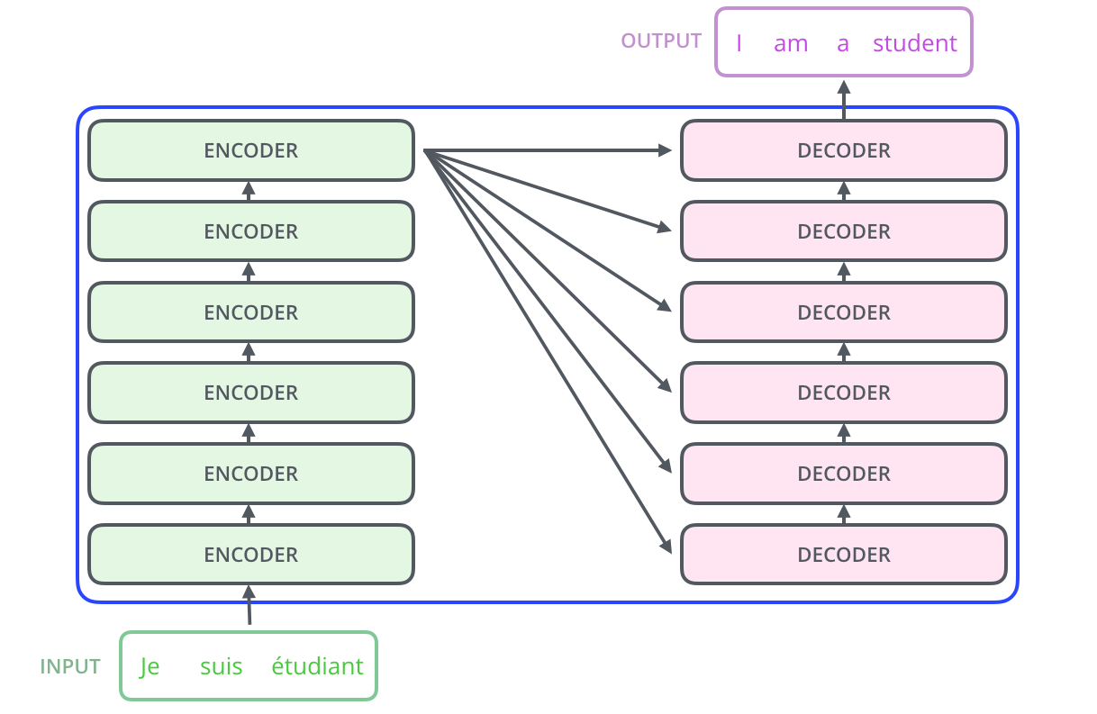
Add – Embedding Layer
Add – Embedding Layer
Image Credit: https://towardsdatascience.com/transformers-141e32e69591
Notes:
At its core, a transformer contains a stack of Encoder and Decoder layers. To avoid confusion, we refer to the individual layer as an Encoder or a Decoder and use Encoder stack or Decoder stack for a group of layers. The Encoder and Decoder stacks each have their corresponding Embedding layers for their respective inputs. And finally, there is an Output layer to generate the final output.

Slide 10
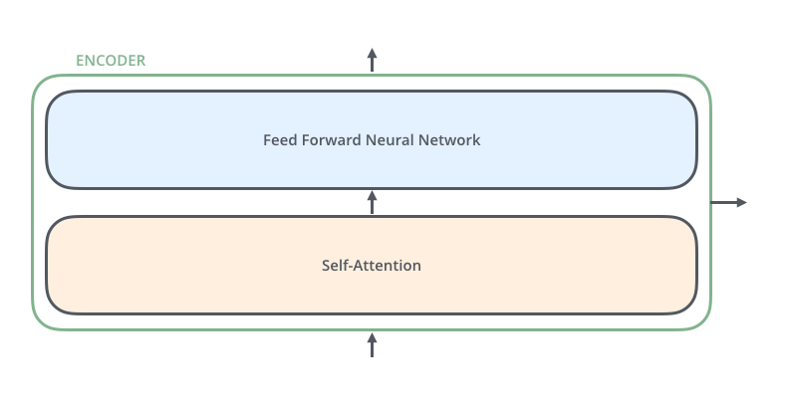
Image Credit: https://towardsdatascience.com/transformers-141e32e69591
Notes:
All encoders have the same architecture. Each encoder consists of two layers: Self-attention and a feed Forward Neural Network. The encoder’s inputs first flow through a self-attention layer which helps it look at other words in the input sentence as it encodes a specific word.

Slide 11
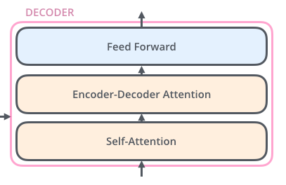
Image Credit: https://towardsdatascience.com/transformers-141e32e69591
Notes:
All decoders have the same architecture. And like the encoder, the decoder contains both self-attention and feed forward layers, with an attention layer sandwiched in-between. This layer helps the decoder focus on relevant parts of the input sentence.

Slide 12
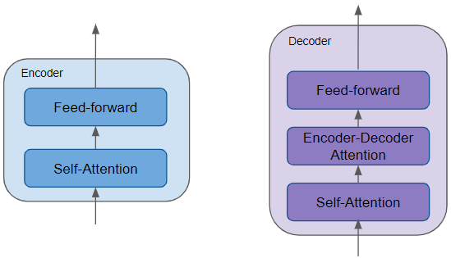
Source: Doshi, K. (2020). https://towardsdatascience.com/transformers-explained-visually-part-1-overview-of-functionality-95a6dd460452
Notes:
In summary, all the Encoders are identical to each other, and all the Decoders are identical to each other. A quick recap and review:
The Encoder contains the all-important Self-attention layer that computes the relationship between different words in the sequence.
The Decoder also contains the Self-attention layer and the Feed-forward layer, as well as a second Encoder-Decoder attention layer.
Each Encoder and Decoder has its own set of weights.

Slide 13
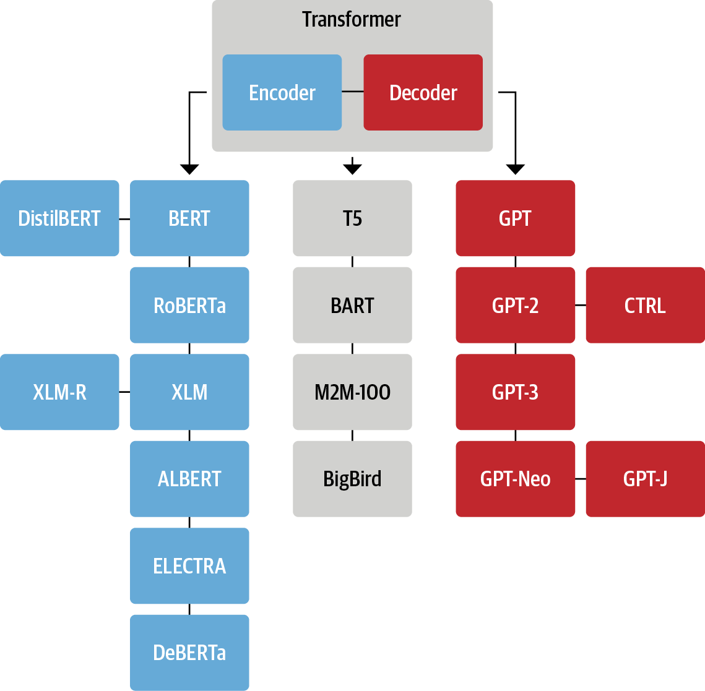
Source: Tunstall, L., et al (2022). Natural Language Processing with Transformers. Sebastopol, CA: O’Reilly Publishing. (Chapter 1)
Notes:
Pictured here is the family tree of the most prominent transformer models. With more than 50 models available, this is not a complete list. Please see the transformer_family_tree.pdf for additional information about the models shown here.
In our next session, we will examine the inner-workings of BERT.

Slide 14
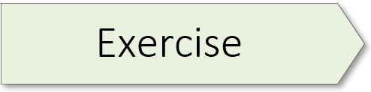
Jay Alamaar (Illustrated Transformer) 01.1_alamaar.ipynb

Slide 15
Transformers Introduction 01.2_transformer_intro.ipynb

Slide 16
Transformer Building Blocks
Source: Glassner, A. (2021). Deep learning: A visual approach. San Francisco, CA: No Starch Press. (Chapter 20)
Notes:
Now that you’ve completed a hands-on exercise, let’s consider some of the building blocks that make transformers unique. Note: I will not discuss word embeddings as that topic was covered in the last workshop of our NLP sequence. In this mini-lecture, we cover three building blocks: 1) layer norm, 2) positional encoding, and 3) skip connections. Because attention is such an important topic, it is covered in our next session.

Slide 17

Skip Connection
Source: Glassner, A. (2021). Deep learning: A visual approach. San Francisco, CA: No Starch Press. (Chapter 20)
Notes:
Skip connection is our first building block, also known as a residual connection. The inspiration for this innovation lies in our desire to reduce the amount of work that’s required of a deep network layer.
Let’s start with an analogy. Suppose you’re painting an oil portrait. And after weeks of sittings, the painting is done, and you send it to your subject for approval. They say they like it, but they regret they wore a particular ring on one finger, and wish they’d worn a different one instead. Can you change that?
Well, you have two options. You could invite your subject back to the studio and paint a whole new portrait from scratch on a blank canvas, only this time with the new ring on their finger. That would require a lot of time and effort. Or you could take the portrait you have, and just paint the new ring over the old one.
Now consider a layer in a deep network. A tensor comes in, and the layer does some processing to change that tensor. If the layer only needs to change the input by small amounts, or only in some places, then why do anything with the parts of the tensor that don’t need to change? As was the case with the painting, it’s more efficient for a layer to compute only the changes it wants to make. It can then combine those changes with the original input to produce its output.
As pictured on the left, the red line that carries the input directly to the addition node is called a skip connection. Another option is to place a skip connection around multiple layers as shown on the right.

Slide 18

Layer Norm
Norm-Add
Addition Node
Source: Glassner, A. (2021). Deep learning: A visual approach. San Francisco, CA: No Starch Press. (Chapter 20)
Notes:
Layer norm is our second building block. Layer norm is a regularization technique like dropout and batchnorm. Regularization controls overfitting, a topic we cover in our CNN workshop series. Layer norm keeps the values flowing through the network from becoming too big or too small. A layer norm step adjusts the values coming out of a layer such that they approximate the shape of a Gaussian bump with a mean of 0 and standard deviation of 1.
Layer norm operations help optimize transformer performance. A technical architect has some flexibility as to where this step is located. One popular option is to place a layer norm operation just before the addition step of a skip connection. Pictured on the left. And because these two operations always come in pairs, they’re often combined into a single operation called “Norm-Add”. Pictured on the right.
=====
In transformers, we usually apply a regularization step called layer normalization, or layer norm, to the outputs of a layer, as shown here on the left. Layer norm belongs to the class of regularization techniques, such as dropout and batchnorm, which help control overfitting by keeping the values flowing through the network from getting too big or too small. (Vanishing / exploding gradients) The layer norm step learns to adjust the values coming out of a layer so that they approximate the shape of a Gaussian bump with a mean of 0 and standard deviation of 1.

Slide 19
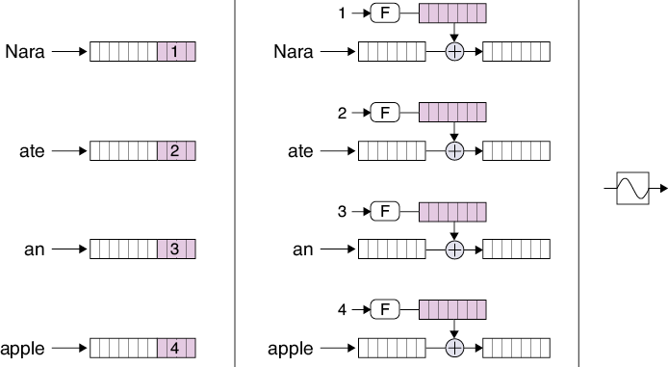
Source: Glassner, A. (2021). Deep learning: A visual approach. San Francisco, CA: No Starch Press. (Chapter 20)
Notes:
Our third and final building block is positional encoding. Positional encoding solves a problem that arises whenever RNNs are removed from the picture: we lose track of the location of each word in the input sentence. A RNN does not have this problem because the words in a sequence present one at a time, thereby allowing the hidden state inside a recurrent cell to remember the order in which they arrived.
But attention mixes together the representations of multiple words. So, how can later stages know where each word belongs in the sentence?
The answer is to insert each word’s position, or index, into the representation of the word itself. That way, as the word’s representations get processed, the position information comes along for the ride. The generic name for this process is positional encoding. There are multiple ways to do this. We can append an index number to the end of each word’s representation. Left. Or we can use a function (F) to turn each index into a vector that’s added to the word’s representation. Middle. And finally, the icon for positional encoding is shown. Right.

Slide 20
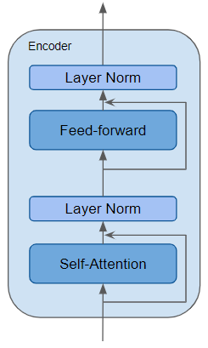
Skip Connection
Source: Doshi, K. (2020). https://towardsdatascience.com/transformers-explained-visually-part-1-overview-of-functionality-95a6dd460452
Notes:
An encoder may feature multiple transformer building blocks. The encoder pictured here, for example, contains both a self-attention and feed-forward layer. After each, a layer norm operation is executed. And two skip connections complete this design.
The important topic of attention is discussed in our next session…

Slide 21
Emotion Detector 02.1_emotion_detector.ipynb Part I
Notes:
We are now going to take the training wheels off. This exercise will step you through the process of executing an NLP project, using transformers. As this is a two-part exercise, work on the first half of the notebook today. And then, in our next session, you’ll have a chance to complete it.

Slide 23
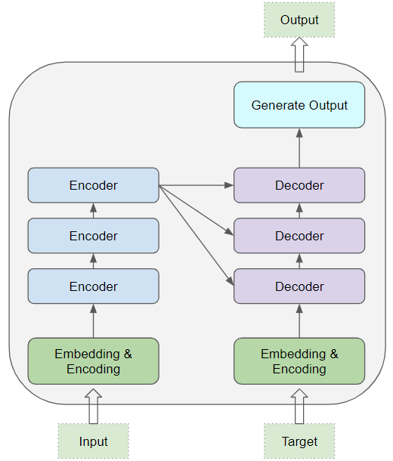
Source: Doshi, K. (2020). https://towardsdatascience.com/transformers-explained-visually-part-1-overview-of-functionality-95a6dd460452
Notes:
At its core, a transformer contains a stack of Encoder and Decoder layers. To avoid confusion, we will refer to the individual layer as an Encoder or a Decoder and will use Encoder stack or Decoder stack for a group of Encoder layers.
The Encoder stack and the Decoder stack each have their corresponding Embedding layers for their respective inputs. And finally, there is an Output layer to generate the final output.

