Slide 1

Transformers: Getting Started
Notes:
Hello and welcome to this transformers presentation. I’m Dan Maxwell, and I will act as your guide and mentor for this learning experience. I currently work as an AI Trainer / Consultant in the Research Computing Department at the University of Florida.
Let’s get started…

Slide 2

Limits of Recurrent Neural Networks
Image Credit: https://www.shutterstock.com/search/limit
Notes:
Though powerful, RNNs have a few drawbacks. Because all of the information about an input is represented in a single piece of state memory, or context vector, the networks inside each recurrent cell need to work hard to compress everything that’s needed into the available space. And no matter how large we make the state memory, we can always get an input that exceeds what the memory can hold, so something necessarily gets lost.
Another problem is that an RNN must be trained and used one word at a time. This can be a slow way to work, particularly with large databases.
An attention network is an alternative approach. Attention networks do not have a state memory and can be trained and used in parallel. They can also be combined into larger structures called transformers; large language models capable of performing complex tasks like translation. In fact, the building blocks of transformers can be used in other architectures that provide even more powerful language models, including generators.
So, what is a transformer?

Slide 3
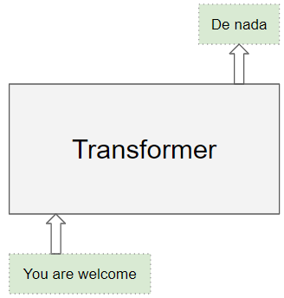
Source: Doshi, K. (2020). https://towardsdatascience.com/transformers-explained-visually-part-1-overview-of-functionality-95a6dd460452
Notes:
We begin with a simple image… first off, the Transformer architecture excels at handling text data which is inherently sequential. It takes a text sequence as input and produces another text sequence as output; for example, to translate an input English sentence to Spanish.
As opposed to directional models, which read the text input sequentially (left-to-right or right-to-left), the Transformer encoder reads the entire sequence of words at once. Therefore, it is considered bidirectional, though it would be more accurate to say that it’s non-directional. This characteristic allows the model to learn the context of a word based on all of its surroundings (left and right of the word).

Slide 4
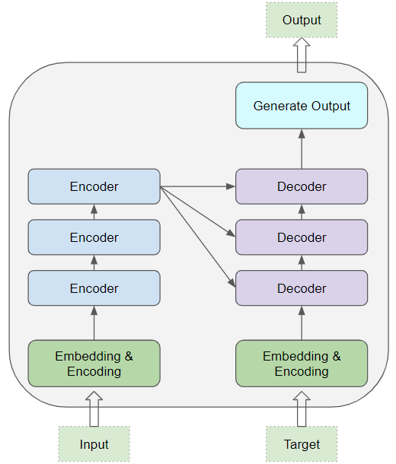
Source: Doshi, K. (2020). https://towardsdatascience.com/transformers-explained-visually-part-1-overview-of-functionality-95a6dd460452
Notes:
At its core, a transformer contains a stack of Encoder and Decoder layers. To avoid confusion, we will refer to the individual layer as an Encoder or a Decoder and will use Encoder stack or Decoder stack for a group of Encoder layers.
The Encoder stack and the Decoder stack each have their corresponding Embedding layers for their respective inputs. And finally, there is an Output layer to generate the final output.

Slide 5
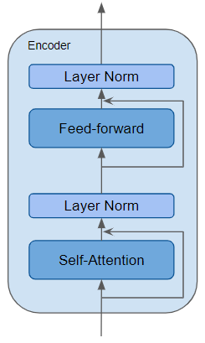
Skip Connection
Source: Doshi, K. (2020). https://towardsdatascience.com/transformers-explained-visually-part-1-overview-of-functionality-95a6dd460452
Notes:
The Encoder is a reusable module that is the defining component of all Transformer architectures. Here we see an encoder comprised of a self-attention layer as well as a couple of layer norm layers. Additionally, residual skip connections allow this encoder to bypass the self-attention and feed forward layers as needed. We will discuss these unique transformer building blocks in just a moment…

Slide 6
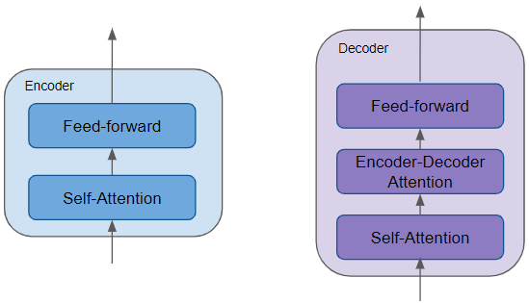
Source: Doshi, K. (2020). https://towardsdatascience.com/transformers-explained-visually-part-1-overview-of-functionality-95a6dd460452
Notes:
All the Encoders are identical to one another. Similarly, all the Decoders are identical.
The Encoder contains the all-important Self-attention layer that computes the relationship between different words in the sequence.
The Decoder also contains the Self-attention layer and the Feed-forward layer, as well as a second Encoder-Decoder attention layer.
Each Encoder and Decoder has its own set of weights.

Slide 7
Transformer Building Blocks
Source: Glassner, A. (2021). Deep learning: A visual approach. San Francisco, CA: No Starch Press. (Chapter 20)
Notes:
Let’s now consider some of the unique transformer building blocks presented in the last two slides. However, I will not discuss word embeddings as that topic has already been covered in the last workshop of our NLP sequence. Attention, skip connections, and the layer norm operation have all appeared in previous slides, except for positional encoding. Now it’s time to dive into the details…

Slide 8
I saw a big dog eat his dinner
Source: Glassner, A. (2021). Deep learning: A visual approach. San Francisco, CA: No Starch Press. (Chapter 20)
Notes:
So, let’s start with our first transformer building block – attention. More concretely, what is attention?
Suppose we want to translate the sentence “I saw a big dog eat his dinner.” When we’re translating dog, we probably don’t care about the word saw, but to translate the pronoun his correctly may require us to connect that to the two words big dog.
If we can work out, for each word in the input, which other words can influence our translation, then we can focus just on those words and ignore the others. This would be a big savings in both memory and computation time. And if we can work this out in a way that doesn’t depend on processing the words serially, we can even do it in parallel.
The algorithm that does this job is called attention, or self-attention. Attention lets us focus our resources on only the parts of the input that matter. Let’s start with an analogy…

Slide 9
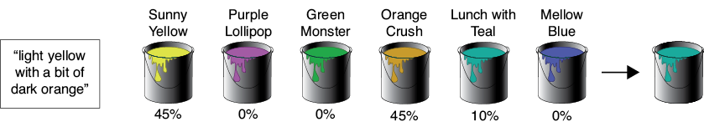
Source: Glassner, A. (2021). Deep learning: A visual approach. San Francisco, CA: No Starch Press. (Chapter 20)
Notes:
Suppose that you need to buy some paint, but all you’ve been told is that the color should be “light yellow with a bit of dark orange.”
At the only paint store in town, the clerk on duty is new to the paint department and isn’t personally familiar with the colors. You both presume you’ll need to mix a few of their standard paints to get the color you want, but you don’t know which paints to choose or how much of each to use.
The clerk suggests that you compare your desired color description with the color names on each can of paint they carry. Some names will probably match better than others. The clerk puts a funnel on top of an empty can and suggests that you pour in some of each can of paint on the shelves, guided by how well that can’s name matches your description. That is, you’ll compare your desired description “light yellow with a bit of dark orange” with what’s printed on the label of each can, and the better the match, the more of that paint you’ll pour into the funnel.
The figure here shows the idea visually for six cans of paint. It shows their names and the quality of each name’s match with your desired color’s description. We got good matches on “Sunny Yellow” and “Orange Crush,” though a little bit of “Lunch with Teal” snuck in thanks to the match with the word “with.”
There are three things to focus on in this story. First, there’s your request: “light yellow with a bit of dark orange.” Second, there’s the description on each can of paint, like “Sunny Yellow” or “Mellow Blue.” Third, there’s the content of the paint that’s actually inside each can. In the story, you compared your request with each can’s description to find out how well they match. The better the match, the more of that can’s content you used in the final mixture.
That’s attention in a nutshell. Given a request, compare it to the description of each possible item and include some of the content of each item based on how well its description matches the request.

Slide 10

Source: Glassner, A. (2021). Deep learning: A visual approach. San Francisco, CA: No Starch Press. (Chapter 20)
Notes:
Moving on, our second transformer building block is the skip connection, also known as a residual connection. The inspiration for this innovation lies in our desire to reduce the amount of work that’s required of a deep network layer.
Let’s start with an analogy. Suppose you’re painting a real, physical portrait using acrylic paints on canvas. After weeks of sittings, the portrait is done, and you send it to your subject for their approval. They say that they like it, but they regret having worn a particular ring on one finger, and wish they’d worn a different one that they like more. Can you change that?
One way to proceed would be to invite your subject back to the studio and paint a whole new portrait from scratch on a blank canvas, only this time with the new ring on their finger. That would require a lot of time and effort. If they’d allow it, a more expeditious approach would be to take the portrait you have, and unobtrusively paint the new ring over the old one.
Now consider a layer in a deep network. A tensor comes in, and the layer does some processing to change that tensor. If the layer only needs to change the input by small amounts, or only in some places, then it would be wasteful to expend resources processing the parts of the tensor that don’t need to change. Just as with the painting, it would be much more efficient for the layer to compute only the changes it wants to make. Then it can combine those changes with the original input to produce its output.
The extra line in the drawing (red) that carries the input to the addition node is called a skip connection, or a residual connection because of its mathematical interpretation. We can place a skip connection around multiple layers in sequence, if we like, as shown here on the right.

Slide 11

Source: Glassner, A. (2021). Deep learning: A visual approach. San Francisco, CA: No Starch Press. (Chapter 20)
Notes:
Layer norm is our third building block. In transformers, we usually apply a regularization step called layer normalization, or layer norm, to the outputs of a layer, as shown here on the left. Layer norm belongs to the class of regularization techniques, such as dropout and batchnorm, which help control overfitting by keeping the values flowing through the network from getting too big or too small. The layer norm step learns to adjust the values coming out of a layer so that they approximate the shape of a Gaussian bump with a mean of 0 and standard deviation of 1.

Slide 12
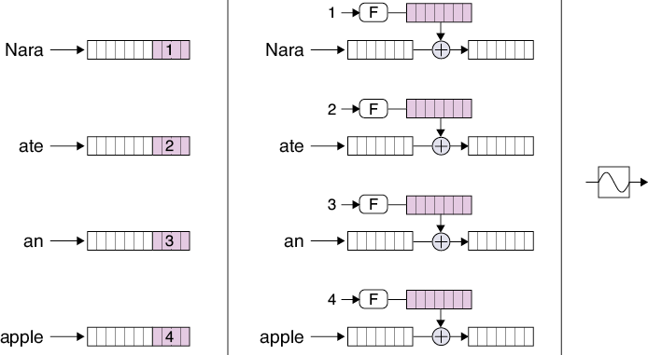
Source: Glassner, A. (2021). Deep learning: A visual approach. San Francisco, CA: No Starch Press. (Chapter 20)
Notes:
And our last transformer building block – positional encoding – was designed to solve a problem that comes up as soon as we take RNNs out of our system: we lose track of where each word is located in the input sentence. This important information is inherent in the RNN structure, because the words come in one at a time, allowing the hidden state inside a recurrent cell to remember the order in which the words arrived.
But as we’ve seen, attention mixes together the representations of multiple words. How can later stages know where each word belongs in the sentence?
The answer is to insert each word’s position, or index, into the representation for the word itself. That way, as the word’s representations get processed, the position information naturally comes along for the ride. The generic name for this process is positional encoding.
A simple approach to positional encoding is to append a few bits to the end of each word to hold its location, as shown on the left. But at some point, we might get a sentence that requires more bits than we’ve made available, and then we’d be in trouble because we wouldn’t be able to assign each word a unique number for its location. And if we make the storage too big, it’s just wasted and slows everything down. This approach is also awkward to implement, since we then need to introduce some special mechanism for handling those bits.
Alright, that wraps up our presentation of transformer building blocks. It’s time for some hands-on work.

Slide 13
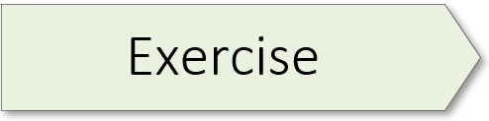
8.01 (Transformer)

