Slide 1

Transformers: Attention
Notes:
Transformers are increasingly important -- Add agenda slide…

Slide 2
Transformer Building Blocks
Source: Glassner, A. (2021). Deep learning: A visual approach. San Francisco, CA: No Starch Press. (Chapter 20)
Notes:
In our last session, we discussed three transformer building blocks: 1) Layer Norm, 2) Positional Encoding, and 3) Skip Connections. Word embeddings were covered in our NLP workshop series.

Slide 3
I saw a big dog eat his dinner
Source: Glassner, A. (2021). Deep learning: A visual approach. San Francisco, CA: No Starch Press. (Chapter 20)
Notes:
Let’s begin our presentation with a concrete example.
Suppose we want to translate the sentence “I saw a big dog eat his dinner.” Now when we translate the word ‘dog’, we probably don’t care about the word saw. But to translate the pronoun ‘his’, we need to connect that to the two words – ‘big dog.’
This same logic holds true for all the other words in a particular sentence. For each word, figure out what other words influence its translation – focus on just those words – ignore the others. The algorithm that does this job is called attention, or self-attention. Attention lets us focus our resources on only the parts of the input that matter. Let’s start with an analogy…

Slide 4
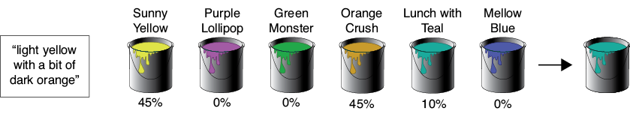
Source: Glassner, A. (2021). Deep learning: A visual approach. San Francisco, CA: No Starch Press. (Chapter 20)
Notes:
Suppose that you need to buy some paint, but all you’ve been told is that the color should be “light yellow with a bit of dark orange.”
At the only paint store in town, the clerk on duty is new to the paint department and isn’t personally familiar with the colors. You both presume you’ll need to mix a few of their standard paints to get the color you want, but you don’t know which paints to choose or how much of each to use.
The clerk suggests that you compare your desired color description with the color names on each can of paint they carry. Some names will probably match better than others. The clerk puts a funnel on top of an empty can and suggests that you pour in some of each can of paint on the shelves, guided by how well that can’s name matches your description. That is, you’ll compare your desired description “light yellow with a bit of dark orange” with what’s printed on the label of each can, and the better the match, the more of that paint you’ll pour into the funnel.
The figure here shows the idea visually for six cans of paint. It shows their names and the quality of each name’s match with your desired color’s description. We got good matches on “Sunny Yellow” and “Orange Crush,” though a little bit of “Lunch with Teal” snuck in thanks to the match with the word “with.”
There are three things to focus on in this story. First, there’s your request: “light yellow with a bit of dark orange.” Second, there’s the description on each can of paint, like “Sunny Yellow” or “Mellow Blue.” Third, there’s the content of the paint that’s actually inside each can. In the story, you compared your request with each can’s description to find out how well they match. The better the match, the more of that can’s content you used in the final mixture.
That’s attention in a nutshell. Given a request, compare it to the description of each possible item and include some of the content of each item based on how well its description matches the request.

Slide 5
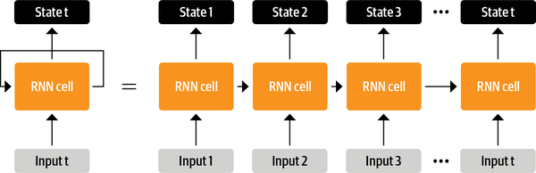
Source: Tunstall, L., et al (2022). Natural Language Processing with Transformers. Sebastopol, CA: O’Reilly Publishing. (Chapter 1)
Notes:
Prior to transformers, advanced recurrent architectures such as LSTMs were the state of the art in NLP. RNN models contain a feedback loop which allows information to propagate from one step to another, making them ideal for modeling sequential data like text. As illustrated on the left side of this image, an RNN receives some input (which could be a word or character), feeds it through the network, and outputs a vector called the hidden state. At the same time, the model feeds some information back to itself through the feedback loop, which it can then use in the next step. This can be more clearly seen if we “unroll” the loop as shown on the right side of this image: the RNN passes information about its state at each step to the next operation in the sequence. This allows an RNN to keep track of information from previous steps and use it for its output predictions.
These architectures were (and continue to be) widely used for NLP tasks, speech processing, and time series. You can find a wonderful exposition of their capabilities in Andrej Karpathy’s blog post, “The Unreasonable Effectiveness of Recurrent Neural Networks”.
=====
Though powerful, RNNs have a few drawbacks. Because all the information about an input is represented in a single piece of state memory, or context vector, the networks inside each recurrent cell need to work hard to compress everything that’s needed into the available space. And no matter how large we make the state memory, we can always get an input that exceeds what the memory can hold, so something necessarily gets lost. Another problem is that an RNN must be trained and used one word at a time. This can be a slow way to work, particularly with large databases. Let’s start by reviewing basic RNN architecture….

Slide 6
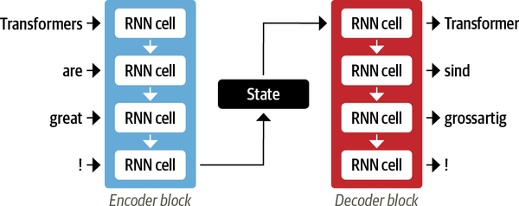
Source: Tunstall, L., et al (2022). Natural Language Processing with Transformers. Sebastopol, CA: O’Reilly Publishing. (Chapter 1)
Notes:
Recurrent Neural Networks (RNNs) made machine translation systems possible. The way in which RNNs translate text is usually done by linking an Encoder to a Decoder. This architecture works well when both the input and output sequences are of fixed length. Here a short English sentence of 3 words plus exclamation point is translated into German. The encoder ingests each sentence element sequentially while maintaining its state along the way. The encoder’s last hidden state – a numerical representation of the entire sentence – is then passed to the decoder which, in turn, generates the German elements from top to bottom.
This architecture is simple and elegant, but it has one big weakness. The encoder’s final hidden state is an information bottleneck. That is, it must represent the meaning of the entire input sequence in a compressed form. With long sequences, this creates a challenge in that information at the start of the sequence might be lost in the process of compressing everything into a single (fixed) representation. This can affect the decoder as that final state is all it has to do its job.
Fortunately, we can avoid this bottleneck altogether. What if the decoder could access all of the encoder’s hidden states and not just the final one? This is done through a process called attention. Attention is one of the reasons transformers are so versatile and effective.
=====
Original text from Natural Language Processing with Transformers, pages 3 - 4
One area where RNNs played an important role was in the development of machine translation systems, where the objective is to map a sequence of words in one language to another. This kind of task is usually tackled with an encoder-decoder or sequence-to-sequence architecture, which is well suited for situations where the input and output are both sequences of arbitrary length. The job of the encoder is to encode the information from the input sequence into a numerical representation that is often called the last hidden state. This state is then passed to the decoder, which generates the output sequence.
In general, the encoder and decoder components can be any kind of neural network architecture that can model sequences. This is illustrated for a pair of RNNs pictured here, where the English sentence “Transformers are great!” is encoded as a hidden state vector that is then decoded to produce the German translation “Transformer sind grossartig!” The input words are fed sequentially through the encoder and the output words are generated one at a time, from top to bottom.
Although elegant in its simplicity, one weakness of this architecture is that the final hidden state of the encoder creates an information bottleneck: it has to represent the meaning of the whole input sequence because this is all the decoder has access to when generating the output. This is especially challenging for long sequences, where information at the start of the sequence might be lost in the process of compressing everything to a single, fixed representation.
Fortunately, there is a way out of this bottleneck by allowing the decoder to have access to all of the encoder’s hidden states. The general mechanism for this is called attention, and it is a key component in many modern neural network architectures.

Slide 7
Image Credit: https://towardsdatascience.com/transformers-141e32e69591
Notes:
Let’s visualize the bottleneck problem. This animation shows how a RNN sequence-to-sequence model works. Each word is processed separately, with a single hidden state passed between words before being handed off to the decoder which generates the output.

Slide 8
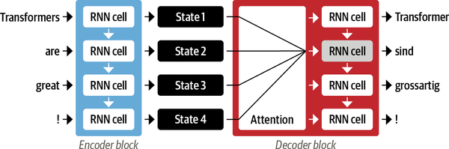
Source: Tunstall, L., et al (2022). Natural Language Processing with Transformers. Sebastopol, CA: O’Reilly Publishing. (Chapter 1)
Notes:
The main idea behind attention is that instead of producing a single hidden state for the input sequence, the encoder outputs a hidden state at each step that the decoder can access. However, using all the states at the same time would create a huge input for the decoder, so some mechanism is needed to prioritize which states to use. This is where attention comes in: it lets the decoder assign a different amount of weight, or “attention,” to each of the encoder states at every decoding timestep. This process is illustrated here, where the role of attention is shown for predicting the third token in the output sequence.
By focusing on which input tokens are most relevant at each timestep, these attention-based models are able to learn nontrivial alignments between the words in a generated translation and those in a source sentence.

Slide 9
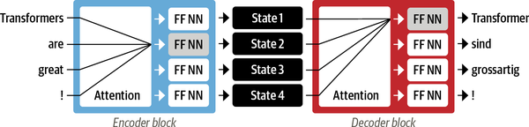
Source: Tunstall, L., et al (2022). Natural Language Processing with Transformers. Sebastopol, CA: O’Reilly Publishing. (Chapter 1)
Notes:
Although attention enabled the production of much better translations, there was still a major shortcoming with using recurrent models for the encoder and decoder: the computations are inherently sequential and cannot be parallelized across the input sequence.
With the transformer, a new modeling paradigm was introduced: dispense with recurrence altogether, and instead rely entirely on a special form of attention called self-attention. The basic idea is to allow attention to operate on all the states in the same layer of the neural network. This is shown here, where both the encoder and the decoder have their own self-attention mechanisms, whose outputs are fed to feed-forward neural networks (FF NNs). This architecture can be trained much faster than recurrent models and paved the way for many of the recent breakthroughs in NLP.

Slide 10
Image Credit: https://towardsdatascience.com/transformers-141e32e69591
Notes:
Okay – let’s simulate attention. Rather than encode the whole sentence in a single hidden state, each word’s hidden state is passed to the decoder. All of these hidden states are then used at each step of the decoding stage. The basic idea is that every word in a sentence might contain relevant information. And for the decoder to be precise, it needs to consider each word in a sentence.

Slide 11
Image Credit: https://towardsdatascience.com/transformers-141e32e69591
Notes:
When translating the sentence “Je suis étudiant” to English, the decoder differs in the level of attention it pays to the words in the original sequence as it decides what word to use in the target language. This animation shows the weight given to each hidden state when translating the sentence “Je suis étudiant” to English. The darker the color, the more weight given to the associated word(s).

Slide 12
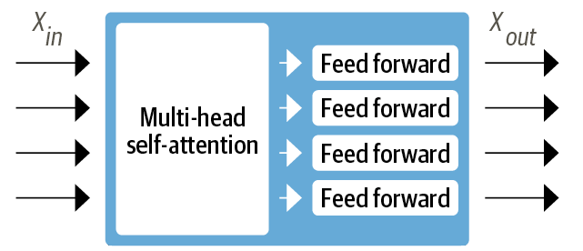
Source: Tunstall, L., et al (2022). Natural Language Processing with Transformers. Sebastopol, CA: O’Reilly Publishing. (Chapter 1)
Notes:
With multi-head attention, self-attention becomes multi-dimensional, giving it the ability to derive more nuanced translations.

Slide 13
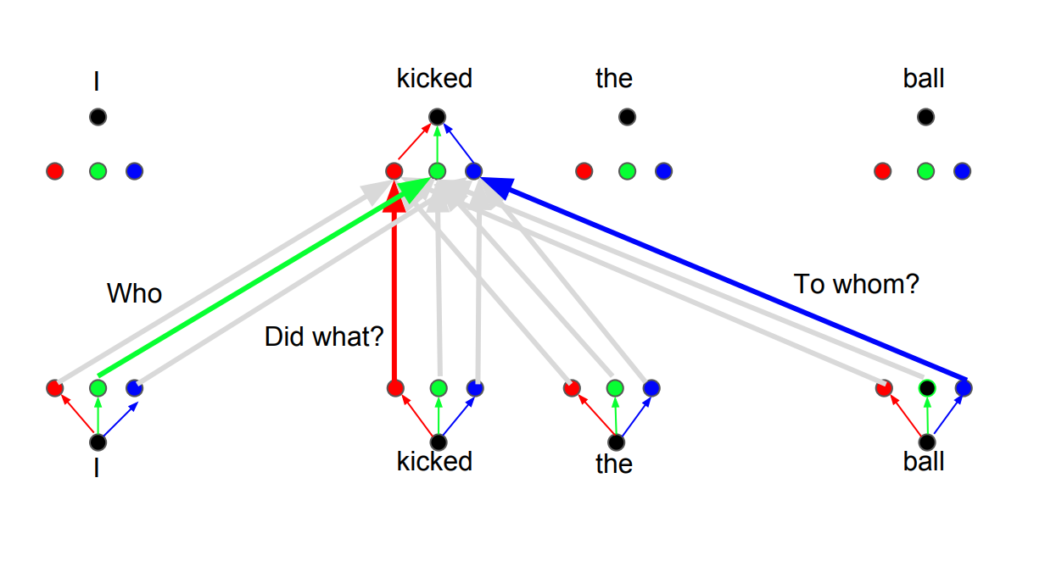
Image Credit: https://towardsdatascience.com/transformers-141e32e69591
Notes:
The basic idea behind multi-head attention is that a specific word in a sequence can be viewed in multiple ways. As pictured here, the algorithm pays attention to a different word, depending on the question being asked. The green head focuses on the question of who kicked the ball while the red head focuses on the action, what was done. And finally, the blue head focuses on the object of the action, or to whom it was done. Of course, the translation of a given word to another language can vary, depending on the answer to each question.
=====
For example, instead of only paying attention to each other in one dimension, Transformers use the concept of Multihead attention. The idea behind it is that whenever you are translating a word, you may pay different attention to each word based on the type of question that you are asking. The images below show what that means. For example, whenever you are translating “kicked” in the sentence “I kicked the ball”, you may ask “Who kicked”. Depending on the answer, the translation of the word to another language can change. Or ask other questions, like “Did what?”, etc…

Slide 14
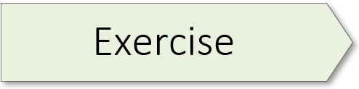
Transformer Anatomy 02.2_transformer_anatomy.ipynb

Slide 16
Emotion Detector 01.2_emotion_detector.ipynb

Slide 17

Limits of Recurrent Neural Networks
Image Credit: https://www.shutterstock.com/search/limit
Notes:
Though powerful, RNNs have a few drawbacks. Because all the information about an input is represented in a single piece of state memory, or context vector, the networks inside each recurrent cell need to work hard to compress everything that’s needed into the available space. And no matter how large we make the state memory, we can always get an input that exceeds what the memory can hold, so something necessarily gets lost. Another problem is that an RNN must be trained and used one word at a time. This can be a slow way to work, particularly with large databases. Let’s start by reviewing basic RNN architecture….
An attention network is an alternative approach. Attention networks do not have a state memory and can be trained and used in parallel. They can also be combined into larger structures called transformers; large language models capable of performing complex tasks like translation. In fact, the building blocks of transformers can be used in other architectures that provide even more powerful language models, including generators.

