Slide 1

Transformers: Attention
Notes:
Transformers are increasingly important -- Add agenda slide…

Slide 2
Transformer Attention
Source: Glassner, A. (2021). Deep learning: A visual approach. San Francisco, CA: No Starch Press. (Chapter 20)
Notes:
In our last session, we discussed three transformer building blocks: 1) Layer Norm, 2) Positional Encoding, and 3) Skip Connections. And we covered word embeddings in our NLP workshop series. In this session, we focus on attention.

Slide 3
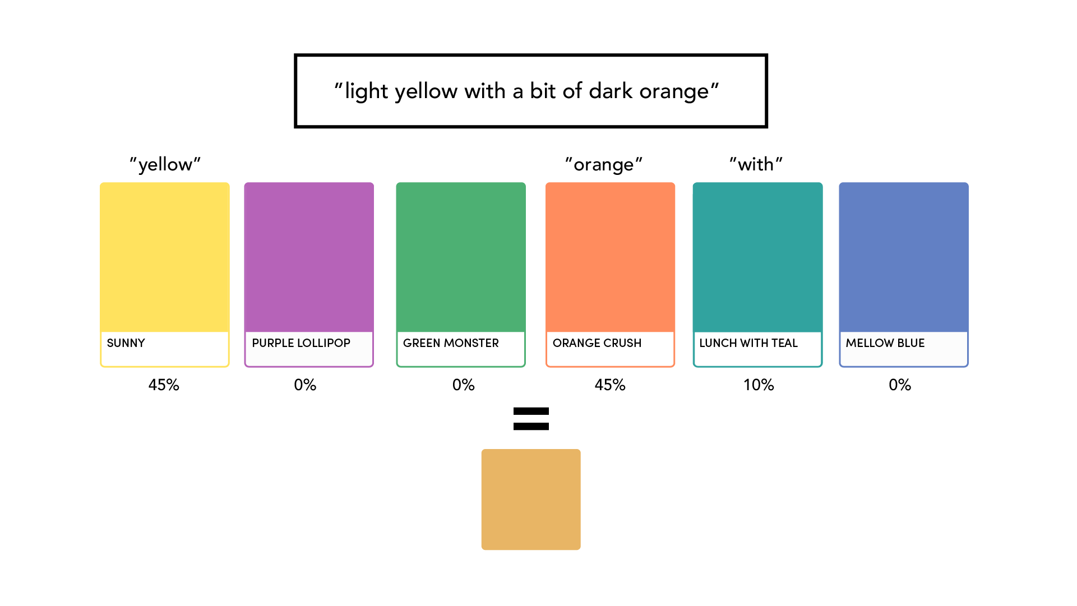
Story Source: Glassner, A. (2021). Deep learning: A visual approach. San Francisco, CA: No Starch Press. (Chapter 20)
Notes:
Let’s begin with a story.
Imagine a friend has decided to repaint her house, and she sends us to the paint store to find a color that is light yellow with a bit of dark orange. But when we get there, the store has no color like that. It looks like we'll have to mix a custom color.
But how do we do that? Well, the first step is to search the store's existing inventory, checking the description on each can's label to see how closely it matches the request. And to the extent it does, we include an appropriate amount of that color. As pictured here, equal amounts of Sunny Yellow and Orange Crush have been used. This makes sense because the labels on these two cans match our request for yellow and orange. But what about Lunch *with* Teal? Interestingly, that color is included because our request has the word 'with' in it, as does the can's label. Thus, a small amount (10%) of Lunch **with** Teal is added to the mix.
=====
Suppose that you need to buy some paint, but all you’ve been told is that the color should be “light yellow with a bit of dark orange.”
At the only paint store in town, the clerk on duty is new to the paint department and isn’t personally familiar with the colors. You both presume you’ll need to mix a few of their standard paints to get the color you want, but you don’t know which paints to choose or how much of each to use.
The clerk suggests that you compare your desired color description with the color names on each can of paint they carry. Some names will probably match better than others. The clerk puts a funnel on top of an empty can and suggests that you pour in some of each can of paint on the shelves, guided by how well that can’s name matches your description. That is, you’ll compare your desired description “light yellow with a bit of dark orange” with what’s printed on the label of each can, and the better the match, the more of that paint you’ll pour into the funnel.
The figure here shows the idea visually for six cans of paint. It shows their names and the quality of each name’s match with your desired color’s description. We got good matches on “Sunny Yellow” and “Orange Crush,” though a little bit of “Lunch with Teal” snuck in thanks to the match with the word “with.”
There are three things to focus on in this story. First, there’s your request: “light yellow with a bit of dark orange.” Second, there’s the description on each can of paint, like “Sunny Yellow” or “Mellow Blue.” Third, there’s the content of the paint that’s actually inside each can. In the story, you compared your request with each can’s description to find out how well they match. The better the match, the more of that can’s content you used in the final mixture.
That’s attention in a nutshell. Given a request, compare it to the description of each possible item and include some of the content of each item based on how well its description matches the request.

Slide 4
Everyday | Technical | Description
Request | Query | “Light yellow with a bit of dark orange…”
Description | Key | Descriptive label on each can of paint
Content | Value | Actual contents of each can of paint
Source: Glassner, A. (2021). Deep learning: A visual approach. San Francisco, CA: No Starch Press. (Chapter 20)
Notes:
In our short story, we used everyday words to describe the attention process. But in the literature, these terms are never used, only the technical equivalents listed in this table. You will encounter this technical vocabulary shortly in the hands-on exercise.

Slide 5
Time flies like an arrow
Fruit flies like a banana
Notes:
The paint story provided us with an intuitive introduction to attention. Let’s now illustrate this idea with a concrete example.
Here we see two sentences with the word flies highlighted in blue. Interestingly, the meaning of this word differs dramatically depending on the context. In the first, “flies” is a verb indicating movement whereas it acts as a subject (a pesky insect) in the second.
So, how do we arrive at a correct definition? In each sentence, the key is to figure out what other words influence the meaning of “flies” and focus on just those words while ignoring the others. We then blend our understanding of those words to arrive at a correct definition. Take, for instance, the 2nd sentence. Here “fruit” and “banana” are important as they point to a food source of interest to a mammal or insect of some sort.
Attention or self-attention mimics this same process. Attention focuses on only the parts of the context (sentence) that matter.
Let’s visualize this in color, just as we did in our paint story!

Slide 6
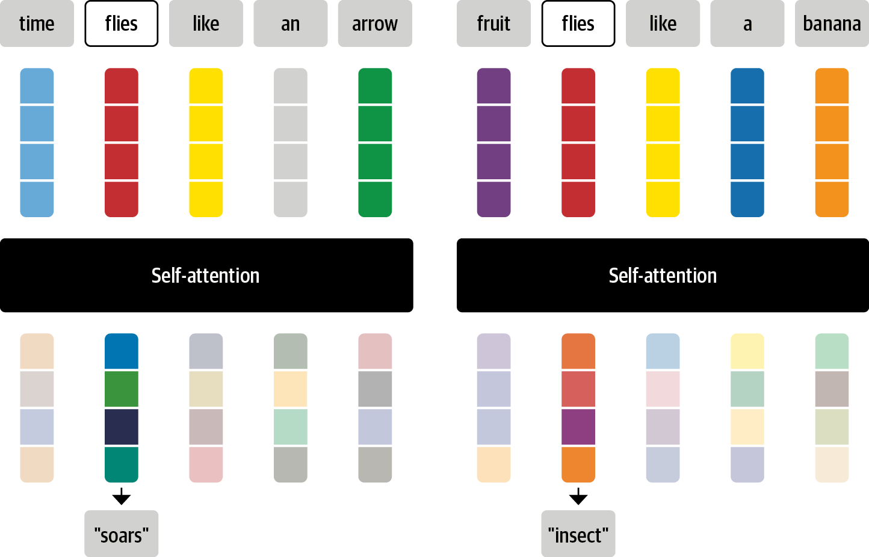
Source: Tunstall, L., et al (2022). Natural Language Processing with Transformers. Sebastopol, CA: O’Reilly Publishing. (Chapter 1)
Notes:
And here’s the visualization of the self-attention mechanism for the two sentences from the previous slide. This looks familiar, doesn’t it? Rather than talk about paint, the colors in this picture represent specific words. And as we see, self-attention has discovered the most important context words, blending their colors, creating a unique stack of mixed hues at the bottom.
For the first sentence (time flies like an arrow), the self-attention color chips are blends of blue and green. Hence, the words “time” and “arrow” act as key influencers, resulting in the word embedding for “soars”.
The context is quite different in the second sentence. Here the self-attention color chips are blends of purple, orange, and red. This indicates that the words “fruit” and “banana” play an influential role here, resulting in the word embedding for “insect”.

Slide 7
Q Query “Fly or flies – moves through the air”
K Key Descriptive label on each word
V Value Actual contents of each word
S Scoring Function How much (V) to include
Story Source: Glassner, A. (2021). Deep learning: A visual approach. San Francisco, CA: No Starch Press. (Chapter 20)
Notes:
Now that we’ve seen how transformers work at a higher level, let’s zoom in and take a closer look at the architecture.
The first neural network (red) transforms the tensor for “flies” into a new tensor representing the Query (Q).
The second neural network (blue) translates the tensor for “arrow” into its Key (K).
The third neural network (green) translates the tensor for “arrow” into its Value (V).
The scoring function (gold) compares two tensors Q & V to determine how similar they are, calculates a likeness score, and then uses that score to scale V.
Let’s summarize the process. We compare the query for “flies” against the key for every word in the sentence, including “flies” itself. We compare the query and key to see how alike they are. And we do this with a scoring function. This function compares two tensors and produces a single number. The more similar the two tensors are, the larger the number. The output from the scoring function is then used to determine how much of the value for “arrow” makes it into the final output.

Slide 8
Q | Query
K | Key
V | Value
S | Score
Story Source: Glassner, A. (2021). Deep learning: A visual approach. San Francisco, CA: No Starch Press. (Chapter 20)
Notes:
Let’s now see what it looks like to apply self-attention to all the words in our sentence. As was the case in the last slide, only three neural networks do the work – one each to compute the query, key, and value tensors. The scoring function determines how much value to include of each word. The dashed line represents a softmax function applied to all the scores, followed by a division. These two operations keep the outputs from the scoring functions from getting too big or too small. And finally, we sum up all the scaled values to get a new tensor for flies.

Slide 9
Q | Query
K | Key
V | Value
S | Score
Story Source: Glassner, A. (2021). Deep learning: A visual approach. San Francisco, CA: No Starch Press. (Chapter 20)
Notes:
The self-attention process diagrammed in the last slide is applied to all the words in a sentence simultaneously. In other words, the transformer architecture takes full advantage of parallel computing capabilities when available. That means that each of the four blocks shown here is run as a separate process at the same time as the others.

Slide 10
Q | Query
K | Key
V | Value
S | Score
Story Source: Glassner, A. (2021). Deep learning: A visual approach. San Francisco, CA: No Starch Press. (Chapter 20)
Notes:
A variant of self-attention is called Q/KV attention. With Q/KV attention, the queries come from one source and the keys and values from another. The queries in the seq2seq model, for example, come from the encoder and the keys and values from the decoder. This is sometimes called an encoder-decoder attention layer.

Slide 11
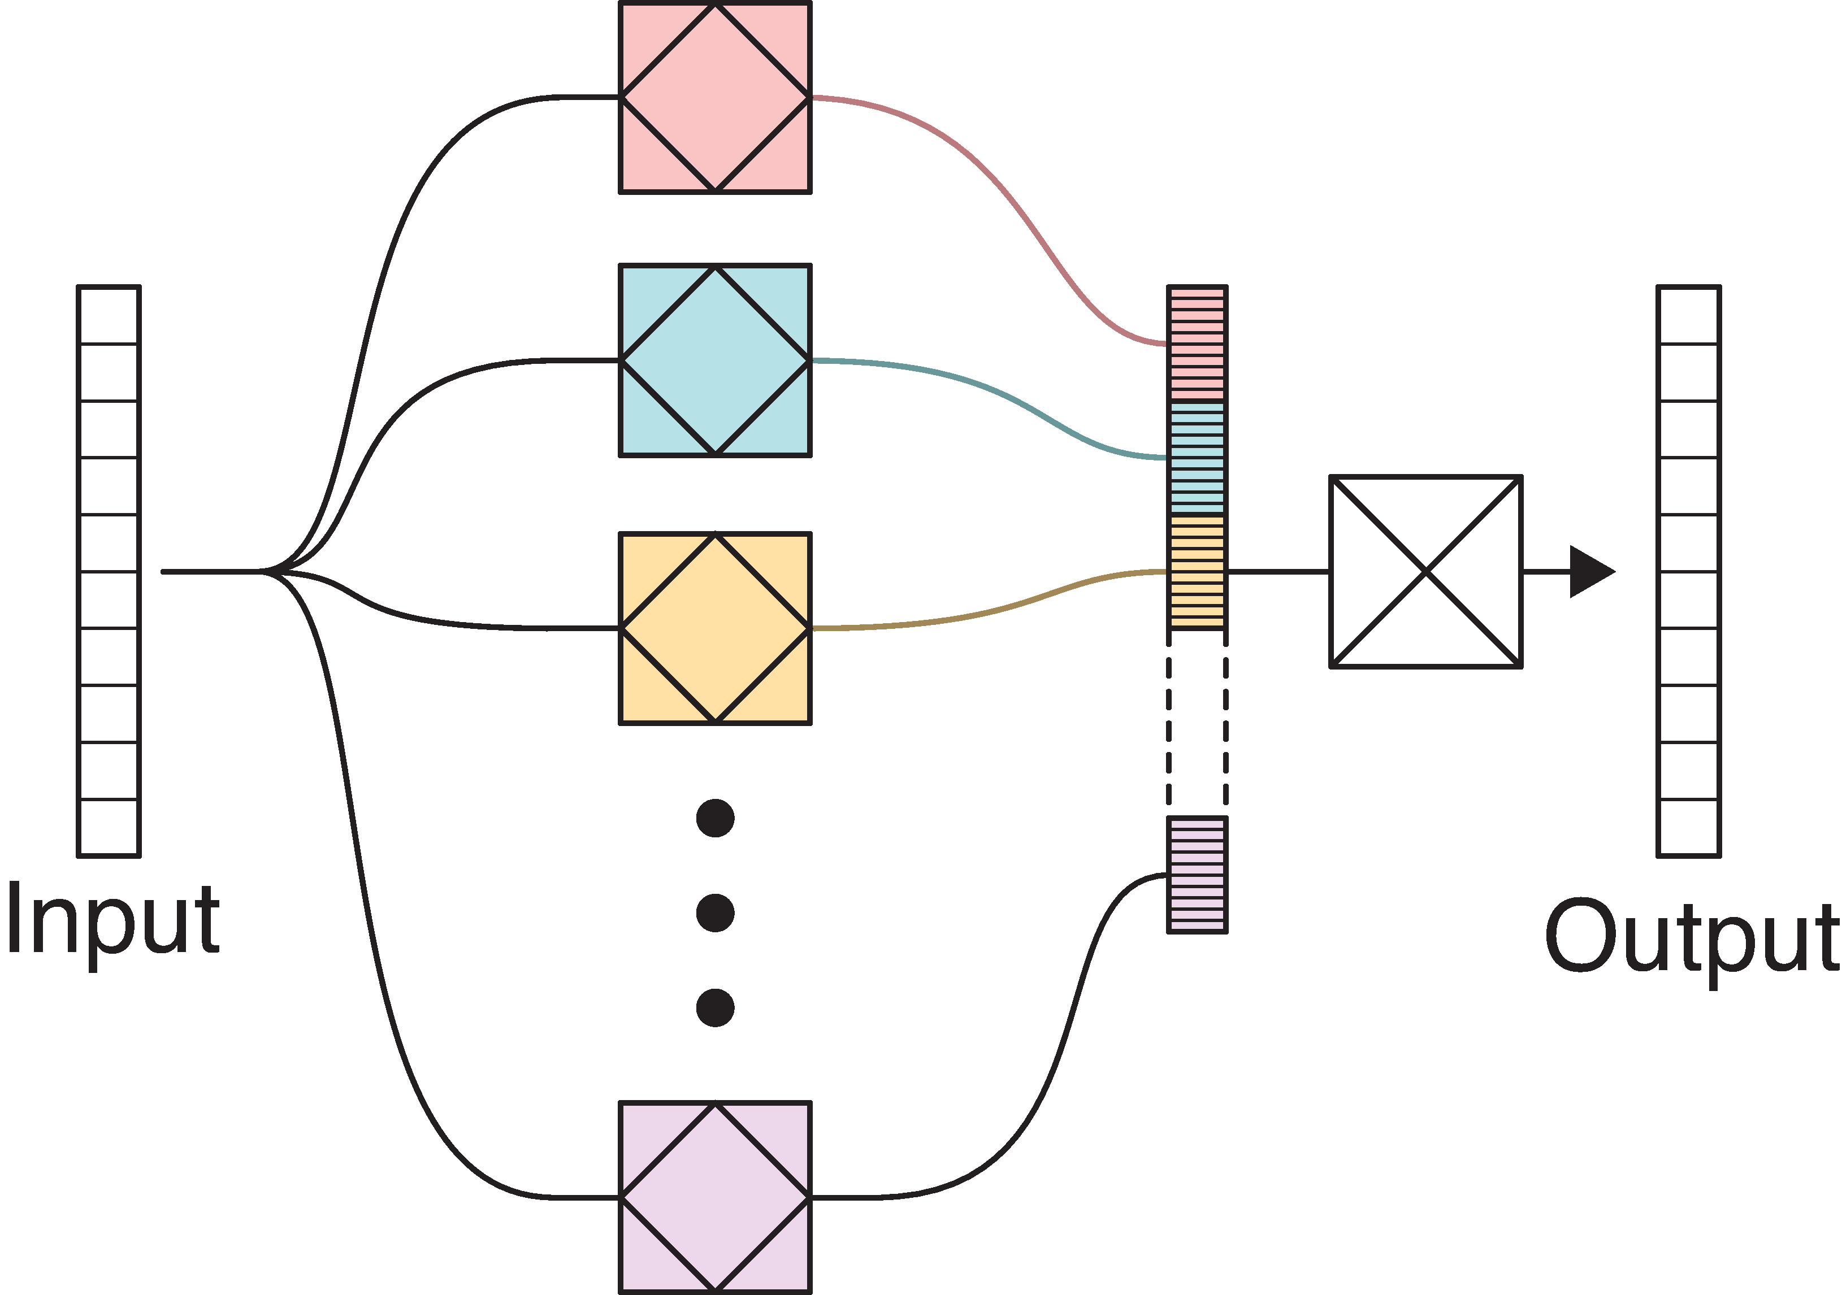
Attention Heads
List
Fully Connected Layer
Source: Glassner, A. (2021). Deep learning: A visual approach. San Francisco, CA: No Starch Press. (Chapter 20)
Notes:
Sometimes we want to pay attention to different combinations of words in a single sentence. Doing so allows us to gain a more nuanced understanding of its meaning. The diagram pictured here is of a multi-head attention network.
Each head is a distinct attention network. The more heads we have, the more different aspects of the input they can focus on.
We often combine the outputs of the head into a list and then…
Run that through a fully connected layer to create an output that is the same shape as the input

Slide 12
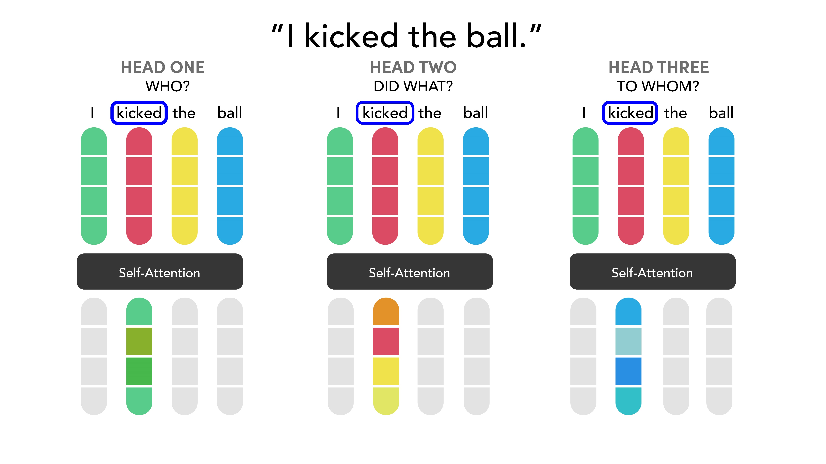
Notes:
The basic idea behind multi-head attention is that a specific word in a sequence can be viewed in multiple ways. Consider, for example, the three questions asked here, with three attention heads. As shown here, attention changes, depending on the head and the question it asks. With HEAD ONE, attention is on the first word, in response to the question of who did the action. Green predominates. With HEAD TWO, attention shifts to the second word in response to the question – ‘Did what?’ And finally, the last word is the focus of attention in HEAD THREE, in response to the question – ‘To whom?’.
=====
For example, instead of only paying attention to each other in one dimension, Transformers use the concept of Multihead attention. The idea behind it is that whenever you are translating a word, you may pay different attention to each word based on the type of question that you are asking. The images below show what that means. For example, whenever you are translating “kicked” in the sentence “I kicked the ball”, you may ask “Who kicked”. Depending on the answer, the translation of the word to another language can change. Or ask other questions, like “Did what?”, etc…
The inspiration for this image came from: https://towardsdatascience.com/transformers-141e32e69591

Slide 13
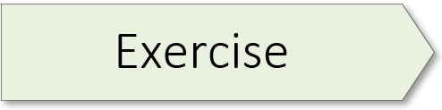
Transformer Anatomy 02.2_transformer_anatomy.ipynb

Slide 14
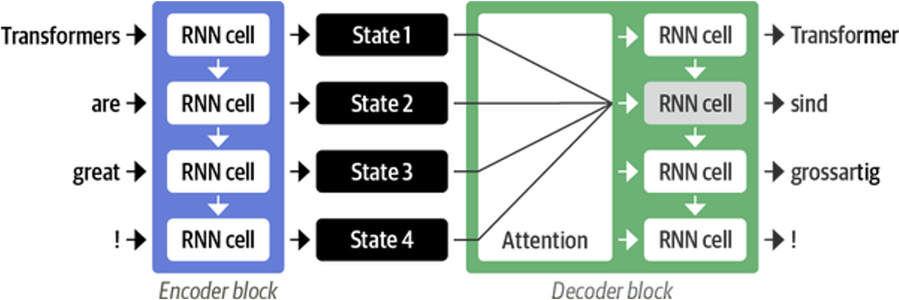
Source: Tunstall, L., et al (2022). Natural Language Processing with Transformers. Sebastopol, CA: O’Reilly Publishing. (Chapter 1)
Notes:
Okay – let’s take everything we’ve learned so far and construct a transformer. We begin with a quick review. Again, attention is a relatively simple idea. Rather than produce a single (or final) hidden state to represent an input sequence, the encoder outputs a hidden state at each step, with all states accessible to the decoder. As shown here, the hidden state for each word in the English sentence is available to the 2nd decoder cell.
=====
The key idea behind attention is as follows: rather than produce a single (or final) hidden state to represent an input sequence, the encoder outputs a hidden state at each step, with all states accessible to the decoder. However, using all those states at the same time would create a huge input for the decoder. Thus, we need a mechanism to prioritize which states to use. Attention does just that. It lets the decoder assign a different amount of weight, or “attention,” to each of the encoder states at each decoding timestep. The role of attention is shown here as the decoder predicts the second token in an output sequence.
By focusing on which input tokens are most relevant at each timestep, attention-based models can learn nontrivial alignments between the words in a generated translation and those in a source sentence.

Slide 15
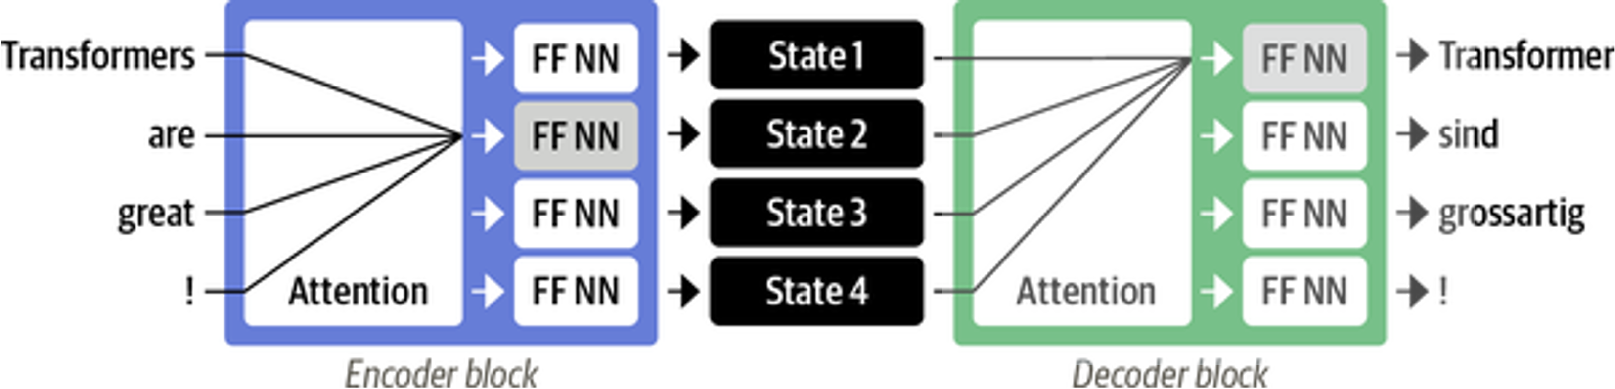
Source: Tunstall, L., et al (2022). Natural Language Processing with Transformers. Sebastopol, CA: O’Reilly Publishing. (Chapter 1)
Notes:
Transformers take attention to the next level. The transformer drops recurrence altogether and uses a special form of attention called self-attention. As shown here, both the encoder and decoder have their own self-attention mechanisms, with their outputs sent to feed-forward neural networks (FF NNs).

Slide 16
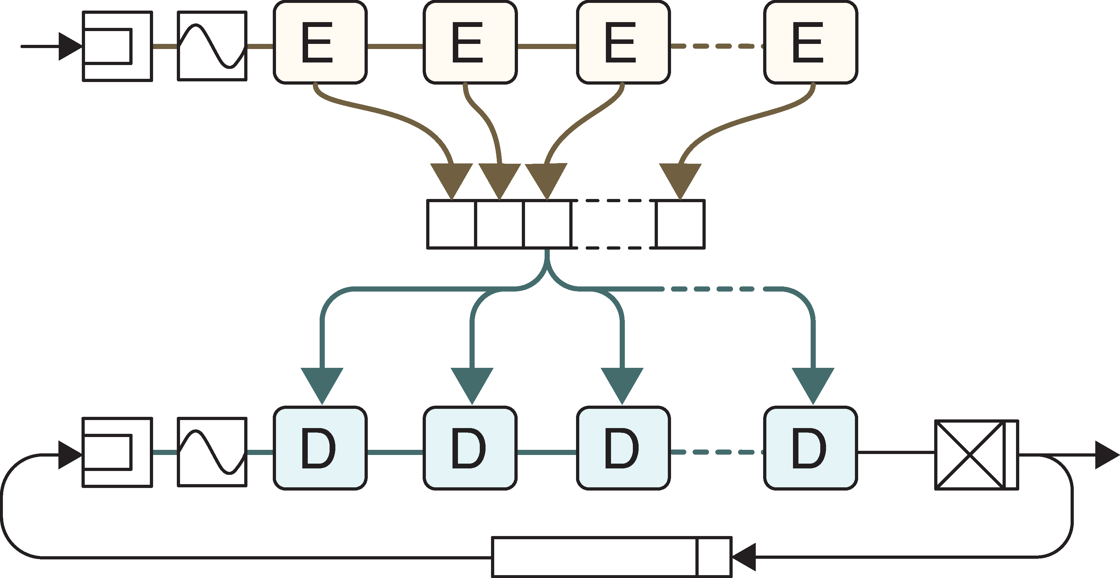
Word Embedding
Positional Embedding
Fully-Connected
Notes:
With our short review complete, it’s time to build a simple transformer! A block diagram of a transformer is shown here. The blocks marked E and D are repeated sequences of layers, built around attention layers.
Both the encoder and decoder begin with word embedding…
… followed by positional embedding.
And finally, the decoder has a fully connected layer and softmax at the end to predict the next word.

Slide 17
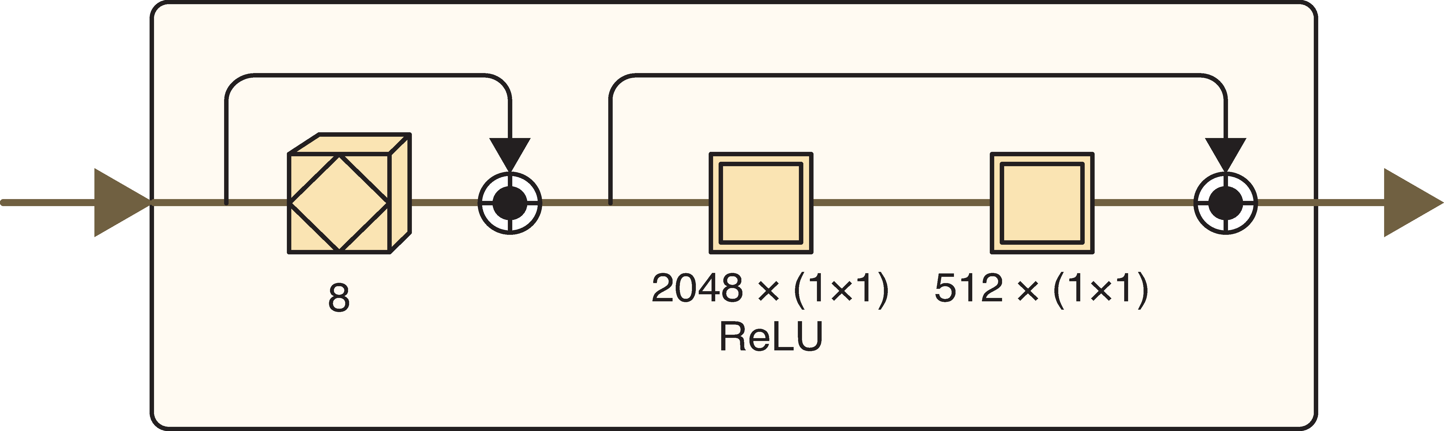
Notes:
The encoder begins with multi-head self attention layer, shown here with eight heads. In this example, the queries, keys, and values all come from the inputs fed into this layer. A norm-add skip connection surrounds this block. Its purpose is to ensure that the numbers maintain a Gaussian-like distribution and the positional embeddings are retained.
The next two layers are a pointwise feed-forward layer. Both are 1 x 1 convolutions. (Convolutional layers are presented in our CNN workshop series.) The first convolution uses a ReLU (Rectified Linear Unit) activation function, while the second has none. And like the first, these two layers are wrapped in a norm-add skip connection.

Slide 18
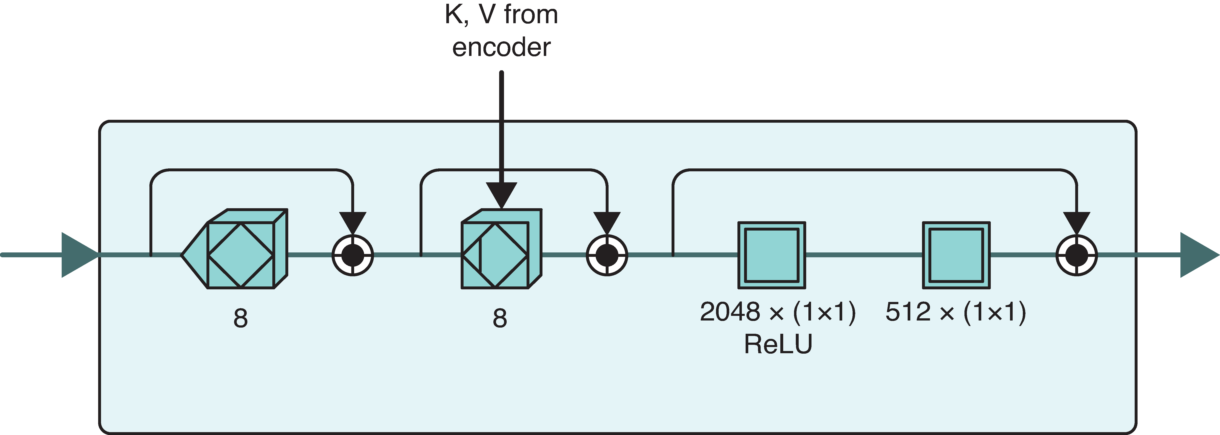
Notes:
Like the encoder, the decoder begins with a multi-head self-attention layer. The triangle indicates masking, a process to ensure that the word sequence is presented correctly to the self-attention layer.
This layer is followed by a multi-head Q/KV attention layer. The query (Q) comes from the output of the previous layer. The keys and values (K & V), on the other hand, come from the concatenated outputs of all the encoder blocks.
And finally, three skip connections surround each of the blocks / block sets.

Slide 19
Image Credit: https://towardsdatascience.com/transformers-141e32e69591
Notes:
And here’s what attention looks like in a simulation – with the decoder accessing hidden state 1, 2, and 3 at each step of the decoding process.

Slide 20
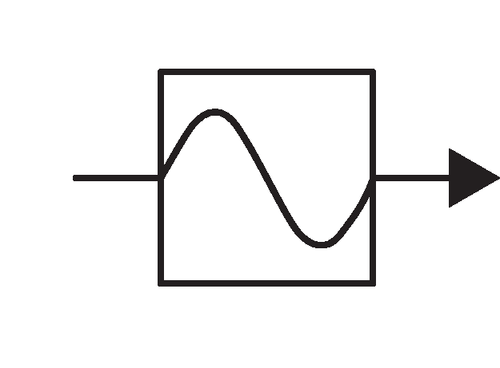
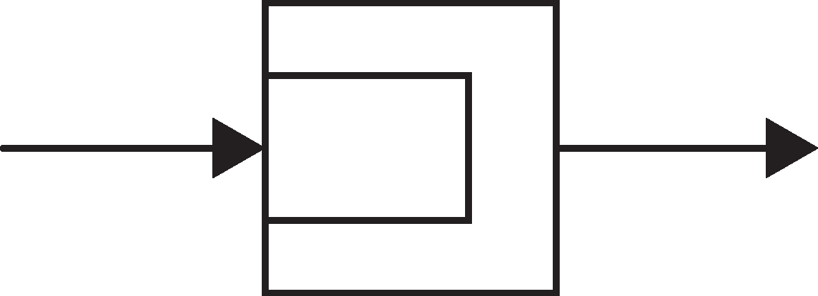
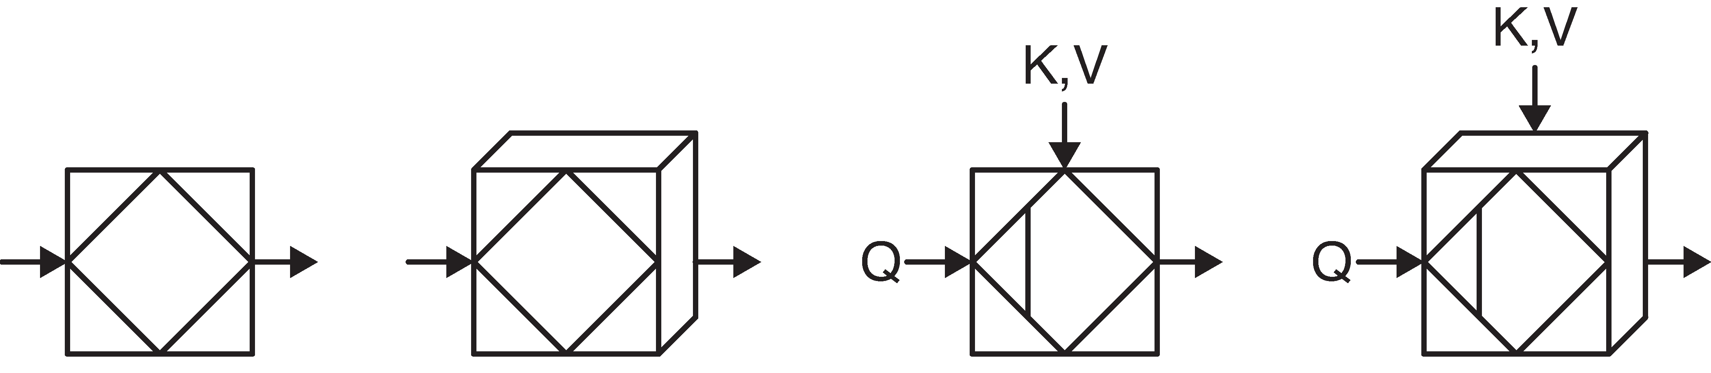
Embedding
Positional Embedding
Self Attention
Multi-Head Self Attention
Q/KV Attention
Multi-Head Q/KV Self Attention
Story Source: Glassner, A. (2021). Deep learning: A visual approach. San Francisco, CA: No Starch Press. (Chapter 20)
Notes:
And finally, here are some of the icons that you may see in a transformer block diagram:
Self-Attention
Multi-Head Self Attention
Q/KV Attention
Multi-Head Q/KV Self Attention
Embedding
Positional Embedding

Slide 21
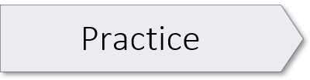
Emotion Detector 02.1_emotion_detector.ipynb Part II

Slide 23
Lesson Overview
Learning Objective 1
Learning Objective 1
Learning Objective 1
Learning Objective 1

Slide 24
Image Credit: https://towardsdatascience.com/transformers-141e32e69591
Notes:
Here we see how a decoder differs in the level of attention it pays to the words in a French sentence as it predicts English equivalents. This animation shows the weight given to each hidden state when translating the sentence “Je suis étudiant” to English. The darker the color, the more weight given to the associated word(s).

