Slide 1

Transformers: Getting Started
Notes:
Transformers are increasingly important -- Add agenda slide…

Slide 2

Limits of Recurrent Neural Networks
Image Credit: https://www.shutterstock.com/search/limit
Notes:
Though powerful, RNNs have a few drawbacks. Because all the information about an input is represented in a single piece of state memory, or context vector, the networks inside each recurrent cell need to work hard to compress everything that’s needed into the available space. And no matter how large we make the state memory, we can always get an input that exceeds what the memory can hold, so something necessarily gets lost. Another problem is that an RNN must be trained and used one word at a time. This can be a slow way to work, particularly with large databases. Let’s start by reviewing basic RNN architecture….
=====
An attention network is an alternative approach. Attention networks do not have a state memory and can be trained and used in parallel. They can also be combined into larger structures called transformers; large language models capable of performing complex tasks like translation. In fact, the building blocks of transformers can be used in other architectures that provide even more powerful language models, including generators.

Slide 3
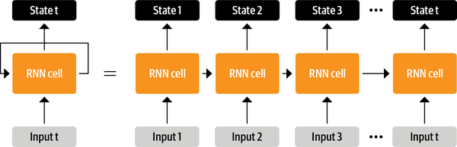
Source: Tunstall, L., et al (2022). Natural Language Processing with Transformers. Sebastopol, CA: O’Reilly Publishing. (Chapter 1)
Notes:
Prior to transformers, advanced recurrent architectures such as LSTMs were the state of the art in NLP. RNN models contain a feedback loop which allows information to propagate from one step to another, making them ideal for modeling sequential data like text. As illustrated on the left side of this image, an RNN receives some input (which could be a word or character), feeds it through the network, and outputs a vector called the hidden state. At the same time, the model feeds some information back to itself through the feedback loop, which it can then use in the next step. This can be more clearly seen if we “unroll” the loop as shown on the right side of this image: the RNN passes information about its state at each step to the next operation in the sequence. This allows an RNN to keep track of information from previous steps and use it for its output predictions.
These architectures were (and continue to be) widely used for NLP tasks, speech processing, and time series. You can find a wonderful exposition of their capabilities in Andrej Karpathy’s blog post, “The Unreasonable Effectiveness of Recurrent Neural Networks”.

Slide 4
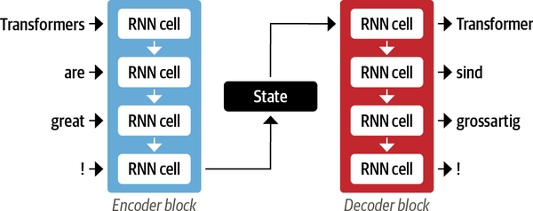
Source: Tunstall, L., et al (2022). Natural Language Processing with Transformers. Sebastopol, CA: O’Reilly Publishing. (Chapter 1)
Notes:
One area where RNNs played an important role was in the development of machine translation systems, where the objective is to map a sequence of words in one language to another. This kind of task is usually tackled with an encoder-decoder or sequence-to-sequence architecture, which is well suited for situations where the input and output are both sequences of arbitrary length. The job of the encoder is to encode the information from the input sequence into a numerical representation that is often called the last hidden state. This state is then passed to the decoder, which generates the output sequence.
In general, the encoder and decoder components can be any kind of neural network architecture that can model sequences. This is illustrated for a pair of RNNs pictured here, where the English sentence “Transformers are great!” is encoded as a hidden state vector that is then decoded to produce the German translation “Transformer sind grossartig!” The input words are fed sequentially through the encoder and the output words are generated one at a time, from top to bottom.
Although elegant in its simplicity, one weakness of this architecture is that the final hidden state of the encoder creates an information bottleneck: it has to represent the meaning of the whole input sequence because this is all the decoder has access to when generating the output. This is especially challenging for long sequences, where information at the start of the sequence might be lost in the process of compressing everything to a single, fixed representation.
Fortunately, there is a way out of this bottleneck by allowing the decoder to have access to all of the encoder’s hidden states. The general mechanism for this is called attention, and it is a key component in many modern neural network architectures.

Slide 5
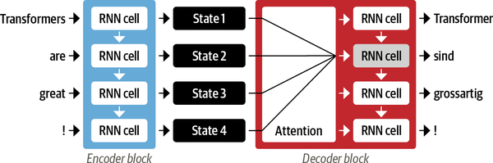
Source: Tunstall, L., et al (2022). Natural Language Processing with Transformers. Sebastopol, CA: O’Reilly Publishing. (Chapter 1)
Notes:
The main idea behind attention is that instead of producing a single hidden state for the input sequence, the encoder outputs a hidden state at each step that the decoder can access. However, using all the states at the same time would create a huge input for the decoder, so some mechanism is needed to prioritize which states to use. This is where attention comes in: it lets the decoder assign a different amount of weight, or “attention,” to each of the encoder states at every decoding timestep. This process is illustrated here, where the role of attention is shown for predicting the third token in the output sequence.
By focusing on which input tokens are most relevant at each timestep, these attention-based models are able to learn nontrivial alignments between the words in a generated translation and those in a source sentence.

Slide 6
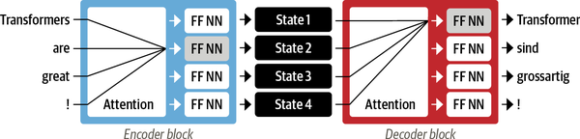
Source: Tunstall, L., et al (2022). Natural Language Processing with Transformers. Sebastopol, CA: O’Reilly Publishing. (Chapter 1)
Notes:
Although attention enabled the production of much better translations, there was still a major shortcoming with using recurrent models for the encoder and decoder: the computations are inherently sequential and cannot be parallelized across the input sequence.
With the transformer, a new modeling paradigm was introduced: dispense with recurrence altogether, and instead rely entirely on a special form of attention called self-attention. The basic idea is to allow attention to operate on all the states in the same layer of the neural network. This is shown here, where both the encoder and the decoder have their own self-attention mechanisms, whose outputs are fed to feed-forward neural networks (FF NNs). This architecture can be trained much faster than recurrent models and paved the way for many of the recent breakthroughs in NLP.

Slide 7
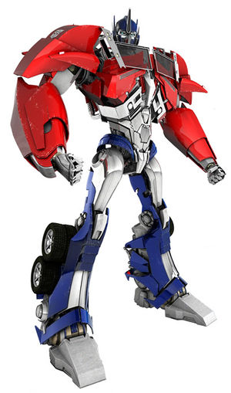
Transformer Architecture
Image Credit: https://tfwiki.net/wiki/Optimus_Prime_(WFC)

Slide 8
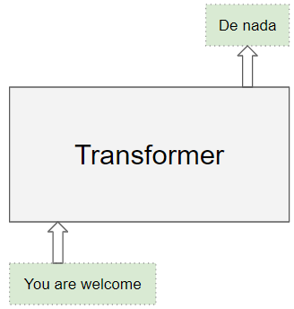
Source: Doshi, K. (2020). https://towardsdatascience.com/transformers-explained-visually-part-1-overview-of-functionality-95a6dd460452
Notes:
We begin with a simple image… first off, the Transformer architecture excels at handling text data which is inherently sequential. It takes a text sequence as input and produces another text sequence as output; for example, to translate an input English sentence to Spanish.
As opposed to directional models, which read the text input sequentially (left-to-right or right-to-left), the Transformer encoder reads the entire sequence of words at once. Therefore, it is considered bidirectional, though it would be more accurate to say that it’s non-directional. This characteristic allows the model to learn the context of a word based on all of its surroundings (left and right of the word).

Slide 9
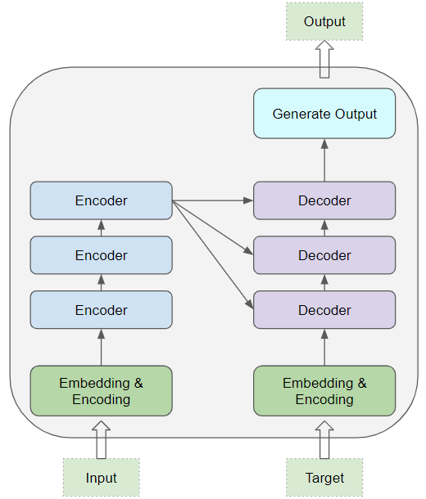
Source: Doshi, K. (2020). https://towardsdatascience.com/transformers-explained-visually-part-1-overview-of-functionality-95a6dd460452
Notes:
At its core, a transformer contains a stack of Encoder and Decoder layers. To avoid confusion, we will refer to the individual layer as an Encoder or a Decoder and will use Encoder stack or Decoder stack for a group of Encoder layers.
The Encoder stack and the Decoder stack each have their corresponding Embedding layers for their respective inputs. And finally, there is an Output layer to generate the final output.

Slide 10
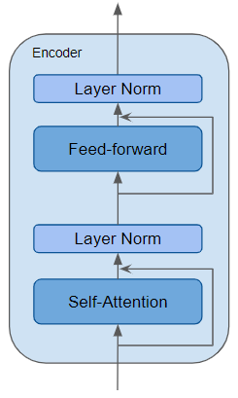
Skip Connection
Source: Doshi, K. (2020). https://towardsdatascience.com/transformers-explained-visually-part-1-overview-of-functionality-95a6dd460452
Notes:
The Encoder is a reusable module that is the defining component of all Transformer architectures. Here we see an encoder comprised of a self-attention layer as well as a couple of layer norm layers. Additionally, residual skip connections allow this encoder to bypass the self-attention and feed forward layers as needed. We will discuss these unique transformer building blocks in just a moment…

Slide 11
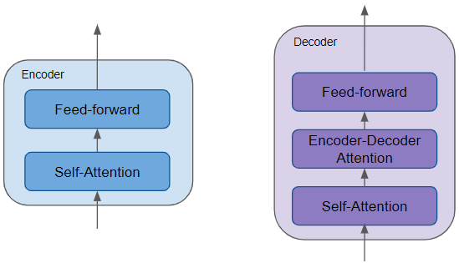
Source: Doshi, K. (2020). https://towardsdatascience.com/transformers-explained-visually-part-1-overview-of-functionality-95a6dd460452
Notes:
All the Encoders are identical to one another. Similarly, all the Decoders are identical.
The Encoder contains the all-important Self-attention layer that computes the relationship between different words in the sequence.
The Decoder also contains the Self-attention layer and the Feed-forward layer, as well as a second Encoder-Decoder attention layer.
Each Encoder and Decoder has its own set of weights.

Slide 12
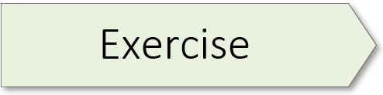
Jay Alamaar (Illustrated Transformer) 01.1_alamaar.ipynb

Slide 13
Transformer Building Blocks
Source: Glassner, A. (2021). Deep learning: A visual approach. San Francisco, CA: No Starch Press. (Chapter 20)
Notes:
Now that you’ve completed a hands-on exercise, let’s consider some of the building blocks which make transformers unique. Note: I will not discuss word embeddings as that topic has already been covered in the last workshop of our NLP sequence. Some of the content in this mini-lecture is a review and extension of what was presented in our first mini-lecture. Now it’s time to dive into the details…

Slide 14
I saw a big dog eat his dinner
Source: Glassner, A. (2021). Deep learning: A visual approach. San Francisco, CA: No Starch Press. (Chapter 20)
Notes:
Although we covered attention in our 1st mini-lecture, this concept is important and worth reviewing again – this time with concrete and memorable examples.
Suppose we want to translate the sentence “I saw a big dog eat his dinner.” When we’re translating dog, we probably don’t care about the word saw, but to translate the pronoun his correctly may require us to connect that to the two words big dog.
If we can work out, for each word in the input, which other words can influence our translation, then we can focus just on those words and ignore the others. This would be a big savings in both memory and computation time. And if we can work this out in a way that doesn’t depend on processing the words serially, we can even do it in parallel.
The algorithm that does this job is called attention, or self-attention. Attention lets us focus our resources on only the parts of the input that matter. Let’s start with an analogy…

Slide 15
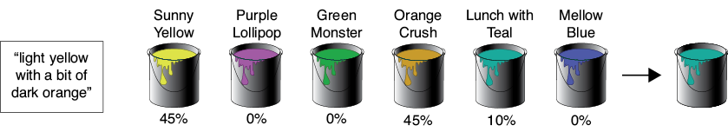
Source: Glassner, A. (2021). Deep learning: A visual approach. San Francisco, CA: No Starch Press. (Chapter 20)
Notes:
Suppose that you need to buy some paint, but all you’ve been told is that the color should be “light yellow with a bit of dark orange.”
At the only paint store in town, the clerk on duty is new to the paint department and isn’t personally familiar with the colors. You both presume you’ll need to mix a few of their standard paints to get the color you want, but you don’t know which paints to choose or how much of each to use.
The clerk suggests that you compare your desired color description with the color names on each can of paint they carry. Some names will probably match better than others. The clerk puts a funnel on top of an empty can and suggests that you pour in some of each can of paint on the shelves, guided by how well that can’s name matches your description. That is, you’ll compare your desired description “light yellow with a bit of dark orange” with what’s printed on the label of each can, and the better the match, the more of that paint you’ll pour into the funnel.
The figure here shows the idea visually for six cans of paint. It shows their names and the quality of each name’s match with your desired color’s description. We got good matches on “Sunny Yellow” and “Orange Crush,” though a little bit of “Lunch with Teal” snuck in thanks to the match with the word “with.”
There are three things to focus on in this story. First, there’s your request: “light yellow with a bit of dark orange.” Second, there’s the description on each can of paint, like “Sunny Yellow” or “Mellow Blue.” Third, there’s the content of the paint that’s actually inside each can. In the story, you compared your request with each can’s description to find out how well they match. The better the match, the more of that can’s content you used in the final mixture.
That’s attention in a nutshell. Given a request, compare it to the description of each possible item and include some of the content of each item based on how well its description matches the request.

Slide 16

Source: Glassner, A. (2021). Deep learning: A visual approach. San Francisco, CA: No Starch Press. (Chapter 20)
Notes:
Moving on, our second transformer building block is the skip connection, also known as a residual connection. The inspiration for this innovation lies in our desire to reduce the amount of work that’s required of a deep network layer.
Let’s start with an analogy. Suppose you’re painting a real, physical portrait using acrylic paints on canvas. After weeks of sittings, the portrait is done, and you send it to your subject for their approval. They say that they like it, but they regret having worn a particular ring on one finger, and wish they’d worn a different one that they like more. Can you change that?
One way to proceed would be to invite your subject back to the studio and paint a whole new portrait from scratch on a blank canvas, only this time with the new ring on their finger. That would require a lot of time and effort. If they’d allow it, a more expeditious approach would be to take the portrait you have, and unobtrusively paint the new ring over the old one.
Now consider a layer in a deep network. A tensor comes in, and the layer does some processing to change that tensor. If the layer only needs to change the input by small amounts, or only in some places, then it would be wasteful to expend resources processing the parts of the tensor that don’t need to change. Just as with the painting, it would be much more efficient for the layer to compute only the changes it wants to make. Then it can combine those changes with the original input to produce its output.
The extra line in the drawing (red) that carries the input to the addition node is called a skip connection, or a residual connection because of its mathematical interpretation. We can place a skip connection around multiple layers in sequence, if we like, as shown here on the right.

Slide 17

Source: Glassner, A. (2021). Deep learning: A visual approach. San Francisco, CA: No Starch Press. (Chapter 20)
Notes:
Layer norm is our third building block. In transformers, we usually apply a regularization step called layer normalization, or layer norm, to the outputs of a layer, as shown here on the left. Layer norm belongs to the class of regularization techniques, such as dropout and batchnorm, which help control overfitting by keeping the values flowing through the network from getting too big or too small. The layer norm step learns to adjust the values coming out of a layer so that they approximate the shape of a Gaussian bump with a mean of 0 and standard deviation of 1.

Slide 18
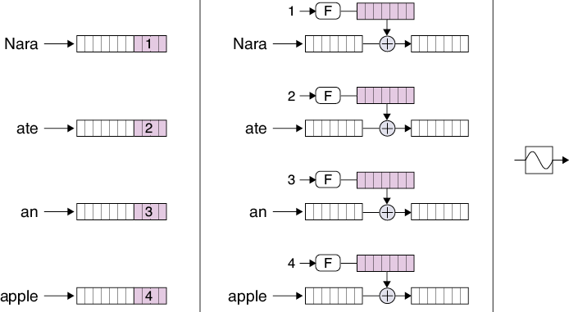
Source: Glassner, A. (2021). Deep learning: A visual approach. San Francisco, CA: No Starch Press. (Chapter 20)
Notes:
And our last transformer building block – positional encoding – was designed to solve a problem that comes up as soon as we take RNNs out of our system: we lose track of where each word is located in the input sentence. This important information is inherent in the RNN structure, because the words come in one at a time, allowing the hidden state inside a recurrent cell to remember the order in which the words arrived.
But as we’ve seen, attention mixes together the representations of multiple words. How can later stages know where each word belongs in the sentence?
The answer is to insert each word’s position, or index, into the representation for the word itself. That way, as the word’s representations get processed, the position information naturally comes along for the ride. The generic name for this process is positional encoding.
A simple approach to positional encoding is to append a few bits to the end of each word to hold its location, as shown on the left. But at some point, we might get a sentence that requires more bits than we’ve made available, and then we’d be in trouble because we wouldn’t be able to assign each word a unique number for its location. And if we make the storage too big, it’s just wasted and slows everything down. This approach is also awkward to implement, since we then need to introduce some special mechanism for handling those bits.
Alright, that wraps up our presentation of transformer building blocks. It’s time for some hands-on work.

Slide 19
Emotion Detector 01.2_emotion_detector.ipynb

