Slide 1

What is AI – Part 1
Notes:
Hello and welcome to our class (Frontiers of AI). So, let’s start with Course goals…

Slide 2
Agenda
Artificial Intelligence Defined
How do Machines Learn
Google Teachable Machine
Notes:
=====
Bullet points for the Frontiers of AI class
What is artificial intelligence? (What is it not?)
What are the main approaches to AI and how do they work?
How is AI applied to real-world problems?
How are AI systems evaluated?
How can we ensure that AI systems are fair and equitable?
Equip you to think about how AI might be applied in your own areas of interest!

Slide 3
Artificial Intelligence Defined
Notes:
Here’s the question we will focus on in our first set of presentations. What are we talking about?

Slide 4
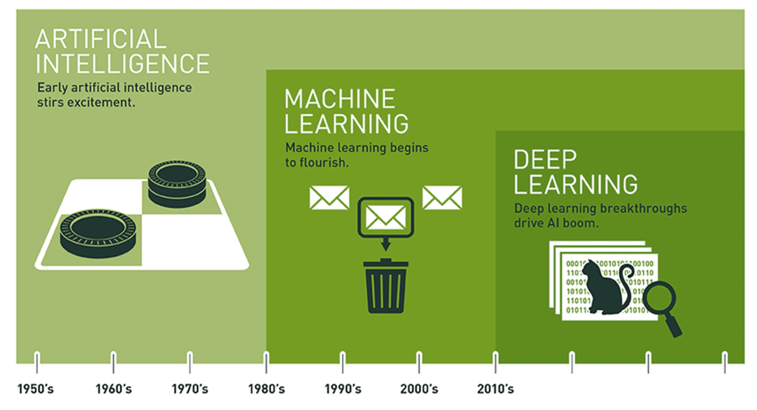
AI is Expansive
Source: Copeland, M. Retrieve from https://blogs.nvidia.com/blog/2016/07/29/whats-difference-artificial-intelligence-machine-learning-deep-learning-ai/
Notes:
Expansive AI
AI encompasses ML and DL
Distinct domains
Uneven progress since the 1950’s, with multiple ‘winters’ where interest and funding dried up
Let’s take a closer look at the history of AI
=====
The field of AI is expansive…
Often, the terms AI, Machine Learning, and Deep Learning are used interchangeably. But as pictured here, they are distinct domains, with AI encompassing the other two. Indeed, AI has a long and distinguished history. In fact, a lot of interesting AI research happened in the 1950s.
Let’s consider a couple definitions…

Slide 5
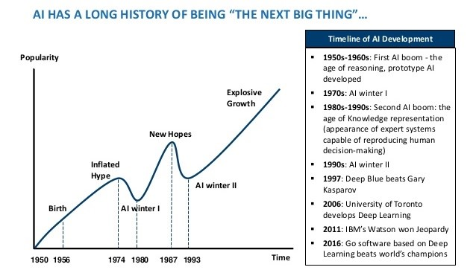
Image Credit: https://www.mdpi.com/2079-9292/10/4/514/htm
Notes:
In the past, AI has experienced multiple “winters.”
1st AI winter: mid-1970’s – neural network research abandoned after Minsky & Papert argue in their book (Perceptron) that neural networks are a dead-end.
2nd AI winter: early-1990’s – expert systems fail – too difficult to construct and maintain
The problem is one of over-promising and under-delivering. But here are some key points to keep in mind
AI researchers have been making steady progress since the 1950s.
AI is seductive.
AI winters were mostly about over-hyped commercial and government interest and expectations.
AI winters weren't really about failures of AI. AI technologies, including many “failures” are relevant and widely useful today.
Now for definitions…

Slide 6
Artificial Intelligence is the study of “rational agents”: any system that perceives its environment and takes actions that maximize its chance of achieving its goals.
-- Russell & Norvig (2003)
Notes:
Leading AI textbooks define the field of Artificial Intelligence as the study of “intelligent or rational agents” – any system that perceives its environment and takes actions that maximize its chance of achieving its goals.
Restatement of Russell & Norvig’s definition – Artificial Intelligence: A Modern Approach, 2nd edition – most widely used introductory text.
AI system performance = humans in many cases.
Broad array of applications.
=====
Leading AI textbooks define the field of Artificial Intelligence as the study of “intelligent agents”: any system that perceives its environment and takes actions that maximize its chance of achieving its goals. Such systems are now able to perform tasks humans are good at; for example, recognizing objects, making sense of speech, and decision making in a constrained environment. As our computer programs have become more sophisticated, our ideas of which tasks require human intelligence have evolved. Thus, AI is now used in a wide variety of tasks.

Slide 7
Machine learning is the field of study that gives computers the ability to learn without being explicitly programmed.
-- Arthur Samuel (1959)
Machine learning is the science and art of programming computers so they can learn from data.
Notes:
… and here’s a definition of machine learning coined by Arthur Samuel in 1959. This is concise and one of my personal favorites. However, I also like this second definition: Machine learning is the science (and art) of programming computers so they can learn from data.
Now, the key word in that second definition is data. In fact, deep learning is not possible without data. In the second half of today’s presentation, we will talk about the various types of data and the AI techniques used on them. But first, let’s dive into the details of our Practicum AI workshop program.
=====
Machine Learning algorithms parse data, learn from it, and then make a prediction about something in the world. So rather than hand-coding software routines with a specific set of instructions to accomplish a particular task, the machine is “trained” using large amounts of data and algorithms that give it the ability to learn how to perform the task.

Slide 8

Deep Learning
Image Credit: https://www.bettycrocker.com/recipes/rainbow-layer-cake/4969fed8-141e-45f5-9a04-e03addd20fbb
Notes:
Deep learning is a subfield of machine learning with a focus on neural networks
A neural network is a special type of learning algorithm, inspired by the billions of interconnected neurons in the human brain.
In a NN, neurons grouped together in layers – image of a multi-layered cake – if you have many layers, the cake is “deep” when viewed from above.
Since 2010, deep learning became possible because:
Enhanced hardware – GPUs from Nvidia and other suppliers
Open AI software frameworks – Tensorflow, Pytorch, Keras, etc…
Big Data

Slide 9

Enter a single word to describe artificial intelligence

Slide 10
What is AI – Part 2
Notes:
Hello and welcome to our class (Frontiers of AI). So, let’s start with Course goals…

Slide 11

Notes:
Interestingly, AI now enables auto-grading in a significant number of educational packages. For example, Perusall – the popular social e-reader – uses an AI algorithm to grade the quality of written posts. How would you like to have your posts graded by an algorithm? It’s largely a black box, though the software does allow the instructors to adjust multiple settings.

Slide 12
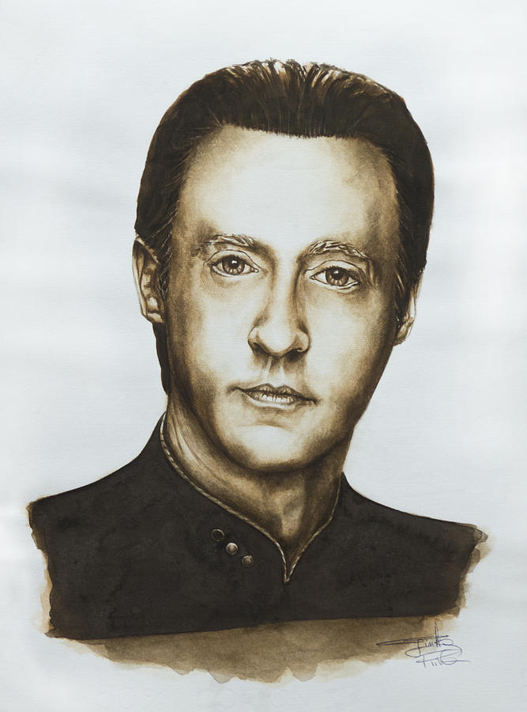
Image Credit: https://fineartamerica.com/featured/lieutenant-commander-data-star-trek-tng-giulia-riva.html
Notes:
In last week’s class, we asked the question, “What is intelligence? And what criteria would you use to assess whether an entity is intelligent? This question is directly considered in a Star Trek: The Next Generation episode entitled “The Measure of a Man.” In this episode, Data finds himself on trial for his life — not for a crime but simply for being. Starfleet scientist Bruce Maddox wants to perform experiments on Data, but Data is worried he won't survive them. And when Maddox forces the issue, Data tries to resign his commission. Maddox argues Data is a machine – Starfleet property – and doesn't have the right to resign his commission, so Picard is forced to face-off against Riker in a legal proceeding to determine whether Data has sentience. He famously tells the judge, "Your Honor, Starfleet was founded to seek out new life." Then, pointing to Data, he says, "Well, there it sits.“
As you can see, the question of what constitutes intelligence is important, and it lies at the heart of this emerging field. For without a clear definition, how do we know when we have succeeded?
At this point, I’d like to jump back in time to the 1950’s and consider how the definition of intelligence in this field has evolved over time.
https://fineartamerica.com/featured/lieutenant-commander-data-star-trek-tng-giulia-riva.html

Slide 13
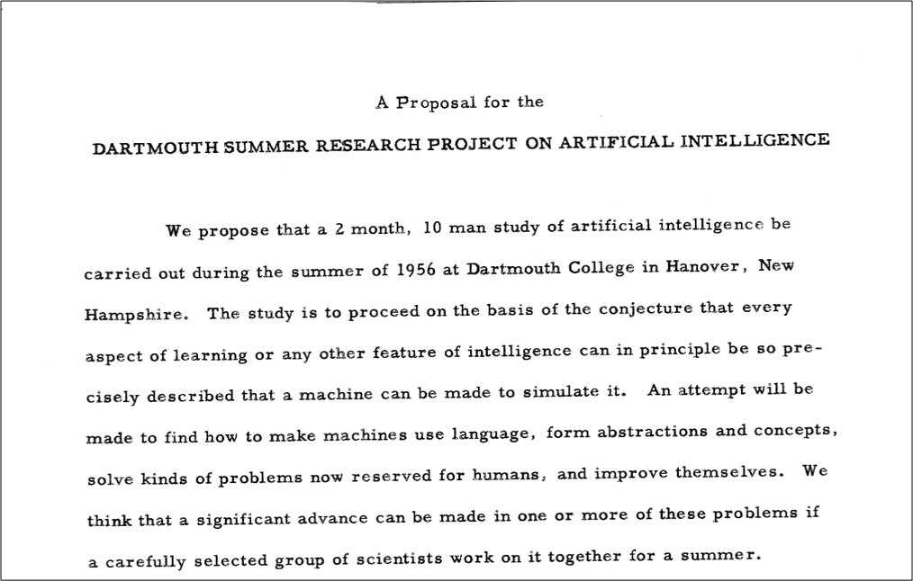
Origin of “AI”!
Notes:
In 1955, John McCarthy accepted a position as an Assistant Professor of Mathematics at Dartmouth College. Soon after, he decided to organize a group to clarify and develop ideas about thinking machines. McCarthy picked the name 'Artificial Intelligence' for the new field. He chose it partly for its neutrality. But he also wanted to avoid any phrase that might place him in conflict with Norbert Wiener, the assertive founder of cybernetics.
Later that year, McCarthy approached the Rockefeller Foundation to request funding for a summer seminar at Dartmouth for about 10 participants. In June, he and Claude Shannon (a founder of information theory) met with Robert Morison, Director of Biological and Medical Research to discuss the idea and possible funding, though Morison was unsure whether money would be made available for such a visionary project.
On September 2, 1955, John McCarthy, Marvin Minsky, Nathaniel Rochester and Claude Shannon submitted the proposal to the foundation. Today, it is credited with introducing the term 'artificial intelligence’. Fortunately, the Rockefeller Foundation funded the proposal and the rest, as they say, “is history…”

Slide 14
Dartmouth Proposal (McCarthy et al. 1955): “The study is to proceed on the basis of the conjecture that every aspect of learning or any other feature of intelligence can in principle be so precisely described that a machine can be made to simulate it.”
John McCarthy (2007): “It is the science and engineering of making intelligent machines, especially intelligent computer programs.” “The ultimate effort is to make computer programs that can solve problems and achieve goals in the world as well as humans.”
Wallace Marshall (1987): “Artificial stupidity (AS) may be defined as the attempt by computer scientists to create computer programs capable of causing problems of a type normally associated with human thought.”
Notes:
With that history in place, let’s consider some definitions – starting with the one advanced in the Dartmouth Proposal…

Slide 15
McCarthy (2007): “Intelligence is the computational part of the ability to achieve goals in the world. Varying kinds and degrees of intelligence occur in people, many animals and some machines.”
Allen Newell (1990): An intelligent system “operates in real-time; exploits vast amounts of knowledge; tolerates erroneous, unexpected, and possibly unknown inputs; uses symbols and abstractions; communicates using some form of natural language; learns from the environment; and exhibits adaptive goal-oriented behavior.”
Kurzweil (1990): “In summary, there appears to be no simple definition of intelligence that is satisfactory to most observers, and most would-be definers of intelligence end up with long checklists of its attributes.”
Notes:
… and some more definitions to consider.

Slide 16

What do you think? What is the defining feature of “intelligence”?
Image Credit: https://worqiq.com/2018/09/open-to-think-pure-thinking-power/
Notes:
Okay – given these definitions and your reading for this week – has your initial definition of A.I. changed?
Let’s discuss these questions in the breakout rooms.

Slide 17
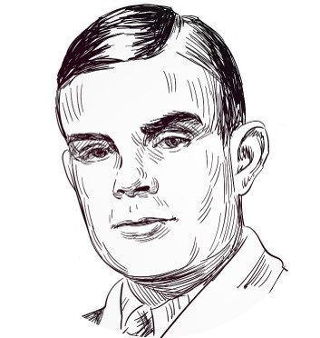
Image Credit: https://www.dreamstime.com/alan-turing-famous-vector-sketch-portrait-isolated-image189405803
Notes:
This week’s reading introduced you to Alan Turing and the foundational work he did in the field of artificial intelligence. The Turing test of intelligence was first proposed in 1950, in an article entitled, Computing Machinery and Intelligence. This is a foundational document… Let’s review that part of the reading…
Turing, AM (1950) Computing Machinery and Intelligence. Mind: 54

Slide 18
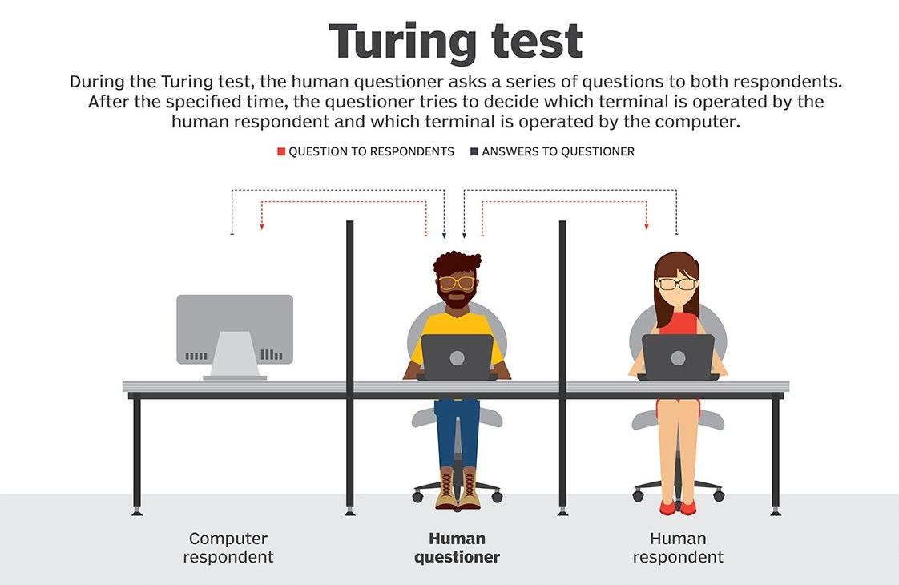
Image Credit: https://searchenterpriseai.techtarget.com/definition/Turing-test
Notes:
At the heart of our reading this week is the Turing test. This test has been hugely influential since Turing first described it in 1950.
Turing got the idea from a Victorian parlor game where a man and a woman sat in a separate room. The other players then passed a series of written questions to them and would try to guess the sex of the respondent by the answers they gave.
The Turing Test is a computer version of that game. In the image here, we see a Human questioner in the middle, sending questions to both a computer and another human. The interaction is purely in the form of text and answers: the human questioner types a question, and a response is displayed. Now the task of that person is to determine whether the thing being interrogated is a person or a computer program.
Now, suppose that the thing being interrogated is indeed a computer program, but after some reasonable amount of time, the questioners cannot reliably tell whether they are interacting with a program or a person. Then surely, Turing argued, you should accept that the program has some sort of human level intelligence because the system is doing something that makes it indistinguishable from the real thing. The key word here is indistinguishable…
https://searchenterpriseai.techtarget.com/definition/Turing-test

Slide 19
ELIZA
Notes:
Michael Woolridge discusses ELIZA, a computer program written in the 1960’s by the German MIT computer scientist Joseph Weizenbaum. Eliza takes the role of a psychiatrist talking to a patient to get the interviewee to contemplate themselves. Strangely, they discovered that many humans preferred Eliza over
ELIZA’s legacy lives on to this day, in the form of the annual Loebner Prize competition. It is unclear whether Turing imagined that anyone would ever actually try out his test for real, but in 1990 that is precisely what American millionaire inventory Hugh Loebner decided to do. Every year, the Loebner Prize invites the submission of computer programs to engage in the Turing test, attempting to convince a panel of judges that they are in fact people.
We’re going to give you time to chat with this year’s winner of the Loebner prize. Her name is Kuki…
Woolridge concludes, “ELIZA is the direct ancestor of a phenomenon that makes AI researchers groan whenever it is mentioned: the internet chatbot.

Slide 20
kuki.ai
Notes:
Breakout conversations – Is Kuki exhibiting intelligent behavior, is this intelligence? (Yes/No)
Team debate

Slide 21


Multi-Select Multiple Choice
Single Answer Multiple Choice
Word Cloud

