Slide 1

AI Systems

Slide 2
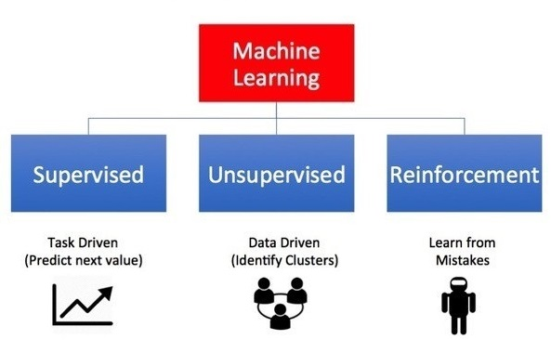
Image Credit: https://towardsdatascience.com/what-are-the-types-of-machine-learning-e2b9e5d1756f
Notes:
I want to introduce you to the different kinds of A.I. learning systems. There are three principal types of machine learning systems (supervised, unsupervised, and reinforcement).
Supervised Learning is Task Driven (Predict next value)
Unsupervised Learning is Data Driven (Identify Clusters)
Reinforcement Learning is Experience Driven (Learn from Mistakes)
Let’s dive into the details…

Slide 3
Source: Palmas, A. (2019). The Reinforcement Learning Workshop. Birmingham, UK: Packt Publishing. (Chapter 1)
Notes:
1. Supervised learning minimizes the error of the output of the model with respect to a target (label) specified in the training set.
2. Reinforcement Learning maximizes the reward signal of the actions.
3. Unsupervised learning has no target and no reward; it tries to learn a data representation that can be useful.

Slide 4
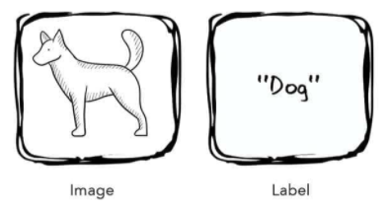
Supervised Learning
Source: Taylor, M. (2017). Neural Networks: A Visual Introduction for Beginners. Sebastopol, CA: Blue Windmill Media.
Notes:
The first kind of learning is supervised learning. Supervised learning are algorithms which work with data that is labelled (annotated). In this example, we present the algorithm with the image of a dog and its label. The label is the correct answer. And through the process of training, the system uses these labels to assess its predictions, correcting and then adjusting itself as it does so. Eventually, the algorithm is fully trained and should make accurate predictions.
Here’s a concrete example…

Slide 5
Supervised Learning
Figure 1-1. A labeled training set for spam classification.
Source: Geron, A. (2019). Hands-On Machine Learning w/Scikit-Learn, Keras & Tensorflow . Sebastopol, CA: O'Reilly Media, Inc. (Chapter 1)
Notes:
… consider a spam filter. Classification is a typical supervised learning task, and a spam filter is a good example of this. It is first trained with many example emails along with their class (spam or ham), and it must learn how to classify new emails.

Slide 6
Supervised Learning
Figure 1-2. A regression problem: predict a value, given an input feature.
Source: Geron, A. (2019). Hands-On Machine Learning w/Scikit-Learn, Keras & Tensorflow . Sebastopol, CA: O'Reilly Media, Inc. (Chapter 1)
Notes:
Another typical supervised learning task is to predict a target numeric value, such as the price of a car, given a set of features (mileage, age, brand, etc.) called predictors. This sort of task is called regression. To train the system, you need to give it many examples of cars, including both their predictors and their labels (i.e., their prices).
In Machine Learning an attribute is a data type (e.g., “mileage”), while a feature has several meanings, depending on the context, but generally means an attribute plus its value (e.g., “mileage = 15,000”). Many people use the words attribute and feature interchangeably. Feature is used predominantly in the AI literature.
Some other examples of supervised learning algorithms include:
• Linear Regression
• Logistic Regression
• Support Vector Machines (SVMs)
• Decision Trees and Random Forests
• Neural networks

Slide 7
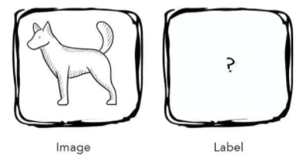
Unsupervised Learning
Source: Taylor, M. (2017). Neural Networks: A Visual Introduction for Beginners. Sebastopol, CA: Blue Windmill Media.
Notes:
The second kind of learning is unsupervised learning. Unsupervised learning is an algorithm which discovers hidden patterns in a dataset that is not labelled (annotated). In other words, the algorithm is presented with a set of inputs but no correct answers or desired outputs – it must discover the structure and patterns in the data on its own. Consider, for example, the following dataset.

Slide 8
Unsupervised Learning
Source: Geron, A. (2019). Hands-On Machine Learning w/Scikit-Learn, Keras & Tensorflow . Sebastopol, CA: O'Reilly Media, Inc. (Chapter 1)
Notes:
Here we see an unlabeled training dataset of visitors to a popular blog. In this case, we might want to run a clustering algorithm to try and detect groups of similar visitors. Through visual inspection, we can quickly identify at least four groups. But will the AI algorithm be able to mimic this capability?

Slide 9
Unsupervised Learning
Source: Geron, A. (2019). Hands-On Machine Learning w/Scikit-Learn, Keras & Tensorflow . Sebastopol, CA: O'Reilly Media, Inc. (Chapter 1)
Notes:
… it appears that a clustering algorithm has in fact detected those four groups, separated by the dashed lines. At no point did we tell the algorithm which group a visitor belongs to: it finds those connections without our help. For example, it might find that 40% of the blog’s visitors are males who love comic books and generally read the blog in the evening, while 20% are young sci-fi lovers who visit during the weekend. Let’s consider another example…

Slide 10
Unsupervised Learning
Figure 1-6. Data visualization.
Source: Geron, A. (2019). Hands-On Machine Learning w/Scikit-Learn, Keras & Tensorflow . Sebastopol, CA: O'Reilly Media, Inc. (Chapter 1)
Notes:
Visualization algorithms are also good examples of unsupervised learning algorithms: you feed them a lot of complex and unlabeled data, and they output a 2D or 3D representation of your data that can easily be plotted. These algorithms try to preserve as much structure as they can so you can understand how the data is organized.
Some other examples of unsupervised learning algorithms include:
• Clustering
• Anomaly detection and novelty detection
• Visualization and dimensionality reduction
• Association rule learning

Slide 11
Reinforcement Learning
Source: Geron, A. (2019). Hands-On Machine Learning w/Scikit-Learn, Keras & Tensorflow . Sebastopol, CA: O'Reilly Media, Inc. (Chapter 1)
Notes:
Reinforcement Learning is a very different beast. The learning system, called an agent in this context, observes the environment, selects and performs actions, and is then rewarded or penalized for each action. On its own, the agent must discover the best strategy, called a policy, to get the most reward over time. A policy defines what action the agent should choose when it is in a particular situation.
For example, many robots implement Reinforcement Learning algorithms to learn how to walk. DeepMind’s AlphaGo program is also a good example of Reinforcement Learning: it made the headlines in May 2017 when it beat the world champion at the game of Go. It learned its winning policy by analyzing millions of games, and then playing many games against itself.

Slide 12

Detecting and Classifying Dogs and Cats in an Image
Supervised
Unsupervised
Reinforcement
Source: Palmas, A. (2019). The Reinforcement Learning Workshop. Birmingham, UK: Packt Publishing. (Chapter 1)
Notes:
Why Not Unsupervised Learning?
As in the previous example, here, we have a determined output given an input (an image). We do not want to extract unknown patterns in the data.
Why Not RL?
Detection and classification are not tasks that are suited to the RL framework. We do not have a set of actions the agent should take to solve a problem. Also, in this case, the sequential structure is absent.

Slide 13
Identifying Clusters in a Dataset
Supervised
Unsupervised
Reinforcement
Source: Palmas, A. (2019). The Reinforcement Learning Workshop. Birmingham, UK: Packt Publishing. (Chapter 1)

Slide 14
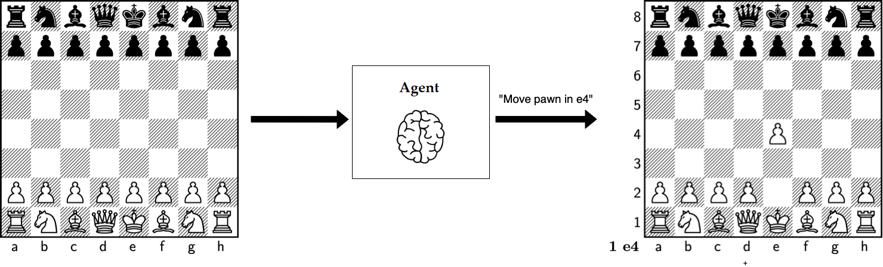
Playing Chess
Supervised
Unsupervised
Reinforcement
Source: Palmas, A. (2019). The Reinforcement Learning Workshop. Birmingham, UK: Packt Publishing. (Chapter 1)
Notes:
Playing chess can be seen as an RL problem. The program can perceive the current state of the board (for example, the positions and types of pawns), and, based on
that, it should decide which action to take.
Why Not Supervised?
We can think of playing chess as a supervised learning problem, but we would need to have a dataset, and we should incorporate the sequential structure of the game into the supervised learning problem.
Why Not Unsupervised?
Unsupervised learning does not fit this problem as we are not dealing with learning a representation of the data; we have a defined objective, which is winning the game.

Slide 15
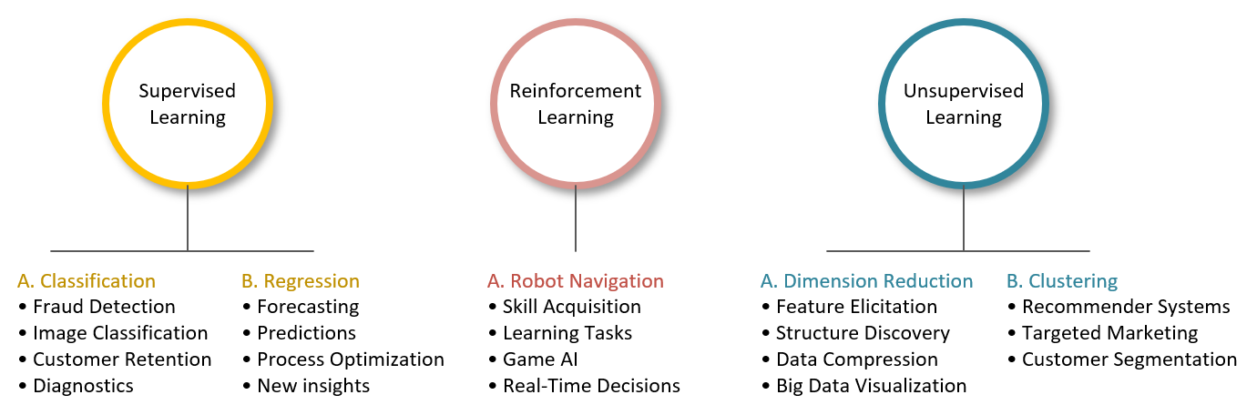
Applications
Notes:
… and finally, this image summarizes some of the primary ways in which AI is being used today. I present these applications because background knowledge is key to helping you imagine AI possibilities in your domain. And it’s the reason why I asked Jim Cusick to provide additional bibliographic support. Of course, the challenge is to take an application in another area and then modify it, so it works in yours. I believe this is where a lot of innovation is going to happen in the near future.

Slide 16

Questions
Notes:
Post general questions (entire class) in Chat…
Discuss specific implementation questions at the Help table during exercise…

Slide 18
Notes:
Here are the steps one usually takes in a typical machine learning project. Note that the entire process is completely dependent on “Lots” of data. This truth can be stated simply as, “No data. No machine learning.”

Slide 19
Semi-Supervised Learning
Source: Geron, A. (2019). Hands-On Machine Learning w/Scikit-Learn, Keras & Tensorflow . Sebastopol, CA: O'Reilly Media, Inc. (Chapter 1)
Notes:
Semi-supervised learning is a mixture of the previous two learning types, which means it is fed a combination of labeled and unlabeled inputs. In this image, we see two classes with labeled examples indicated by the green triangles and light-yellow boxes. The proximity of the unlabeled examples to their labeled counterparts allows the algorithm to divide the data set into two groups, thereby inferring group membership of any new data points.
Often, you will not have the resources to label every item in a dataset. And so semi-supervised learning provides a middle way forward, between supervised and unsupervised learning. Here you only need to label a sub-set of instances while still gaining all of the advantages of a trained model.

Slide 20


Multi-Select Multiple Choice
Single Answer Multiple Choice
Word Cloud

