Slide 1

Program Overview (Beginner)
Notes:
Hello and welcome to an overview of the Practicum AI workshop series. I’m Dan Maxwell and I’m an AI trainer in the Research Computing department.

Slide 2

Arts
Humanities
Science
Social Sciences
Business
Other

Slide 3
Think about and creatively apply AI to make the world a better place
Notes:
AI is a CREATIVE challenge of the 1st order
Most important question is: “What do you want to do? What problems or research questions interest you?”
Start with your questions, everything else falls into place.
=====
So, let’s start with the big picture. The Practicum AI program is designed to help you think about and creatively apply AI to make the world a better place.
You might be surprised to learn that we view the AI opportunity as a creative challenge of the first order. Of course, you will participate in a considerable number of technical activities in this workshop series. But the more important question is, “What do you want to do? What problems or research questions interest you?” Once you answer that, everything else falls into place. The best learning happens when you have a clear goal in mind.
So, I encourage you to think of AI - not from a technical point-of-view - but as a new way of answering questions, delivering services, and solving problems.

Slide 4
Unique Instructional Features
Visual
Story-Driven
Hands-On Learning
Notes:
A picture is worth a thousand words or in this case, a thousand mathematical symbols
Dual-coding – visual / verbal channels
The human brain is a story machine.
Stories are the best way to deliver content
Stories are the best way to retain content
Hands-on learning via Jupyter Notebooks
=====
Let’s start with a quick statement of the Practicum AI approach to learning.
The three elements highlighted in blue are distinguishing features of Practicum AI. First, AI content is presented in a visual way rather than mathematically. As they say, “A picture is worth a thousand words.” Or in this case, a thousand mathematical symbols. Second, narrative (or story-driven) forms of instruction are used, especially at the advanced levels where case-studies are prominently featured. And finally, abundant hands-on coding exercises develop student programming skills.
Four levels of hands-on coding. Level 1: student retypes example code. Level 2: student modifies and/or extends example code. Level 3: student writes code from scratch, given an algorithm. Level 4: student solves a problem by defining an algorithm and then writing the code to instantiate it.

Slide 5
Our target audience is…
Non-technical
Curious about A.I.
Committed to Tinker & Play learning
Notes:
Non-technical students – not majoring in computer science, statistics, or math
Curious
Tinker & Play
Nvidia Deep Learning Institute workshops for advanced students
=====
Our target student audience is beginners who have little-to-no technical background. That is, our program will benefit those who are curious about AI but have little-to-no knowledge of the field. And lastly, the Practicum AI workshops are designed for those who take a tinker and play approach to learning. This final point is important as these workshops feature extensive hands-on coding exercises.
Again – this program is not designed for a highly technical audience. If you already have a strong technical background or multiple years of programming experience, we encourage you to take the advanced AI workshops offered by Nvidia’s Deep Learning Institute. Please contact us for details.

Slide 6
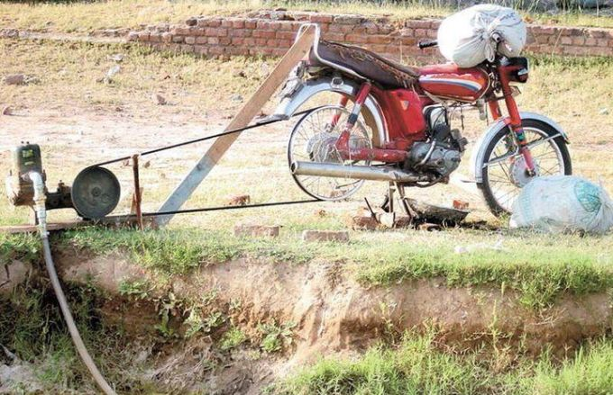
Image Credit: https://gagandeep.org/2016/06/02/bricolage-jugaad-and-indianness-part-1/
Notes:
Do you want to build AI systems like this?
Claude Levi-Strauss
Bricoleur
Bricolage – art of mashing things up to create something new
=====
Okay – let’s visualize the message of that last slide. If you are someone who can appreciate the ingenuity and resourcefulness of whoever created the contraption pictured here – and you want to do something similar with AI – then you’re the kind of student we’re looking for. We’re not seeking mathematical prodigies or technical whiz kids. However, we are looking for individuals who color outside the lines.
The anthropologist Levi Straus had a name for these kinds of people, calling them Bricoleurs. A bricoleur is a playful tinkerer who uses whatever is at hand to solve an immediate problem. A bricoleur enjoys mashing things up, taking ideas from one domain and using them in another. And most importantly, a bricoleur is not boxed in by disciplinary norms. Or, as we used to say on the farm, “I’m a jack of all trades, master of none.”
Is this you? If so, you should enjoy these learning experiences.

Slide 7
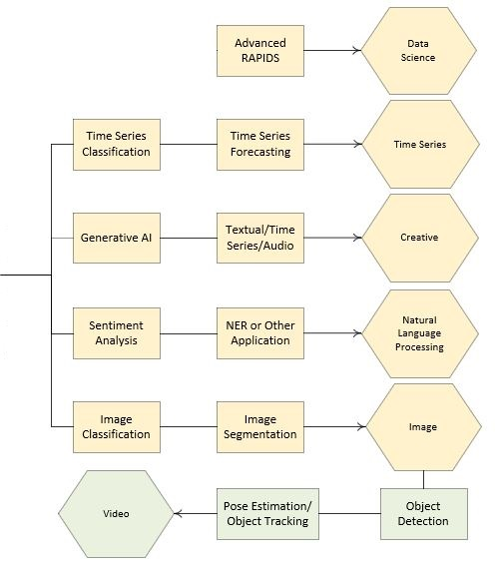
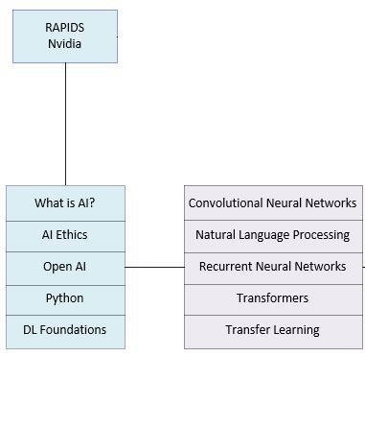
Notes:
Overview
Blue (beginner); Purple (intermediate); Yellow (advanced); Green (specialization)
Hexagons are badges
=====
… and this is an overview of the Practicum AI badge program. Blue boxes are foundational learning experiences. Purple is intermediate. Yellow is advanced and green is a specialty. The hexagons are badges students can earn, after completing the requisite workshops in the series. The What is AI, AI Ethics, Python, and Deep Learning Foundations workshops constitute the Practicum AI (Beginner) series.
And a final note: the Practicum AI badging program, as presently conceived, is flexible and we envision additional badges being added over time. In fact, we recently received funding to create a series of workshops leading to a FAIR Data badge.

Slide 8
Practicum AI (Beginner) | Sessions
Introduction | 1
AI Ethics | 1
What is AI | 1
Python | 4
Reproducible AI | 1
Deep Learning Foundations | 3
Notes:
… and the list of workshops we plan to offer this semester.

Slide 9
Start with your Interests, not the Technology
Notes:
Interests not technology
=====
So, to summarize this section, we believe that your journey to AI mastery ought to start with your interests, not the technology. All too often, however, this gets turned around. We get caught up in technical details, without first having a clear idea of the questions to be answered or the problem at hand.
The Practicum AI badges will allow you to create a custom learning path that supports your goals.
And that brings us to our first interactive exercise…

Slide 10


How do you plan to use AI?
Research
Create a Service
Consult / Teach

Slide 11

What do you want to do?
What do you currently know about AI?
What would you like to know about AI?
Image Credit: https://www.ucop.edu/procurement-services/for-ucstaff/it-strategic-sourcing/it-sourcing-roundtable.html
Notes:
Group discussion…

Slide 12

Questions
Notes:
And finally, do we have any questions? For next week, you have a couple readings. And I hope you will take time to make an entry in your AI journal and join the conversation on the Discussion Board.

Slide 13
Program Overview (Intermediate)
Notes:
Hello and welcome to an overview of the Practicum AI workshop series. I’m Dan Maxwell and I’m an AI trainer in the Research Computing department.

Slide 14
Arts
Humanities
Science
Social Sciences
Business
Other

Slide 15
Pre-Requisites
Python Experience
Deep Learning Vocabulary
Notes:
Python experience or other programming language experience – faculty member with extensive MatLab coding experience
We provide the code in these workshops – you’re not writing programs from scratch
Working knowledge of programming vocabulary, looping constructs, functions, etc…
Deep Learning Vocabulary
We do not provide definitions of basic deep learning terms and concepts in this series.
Know what a layer, a node or neuron, a loss function, etc… is
Please consider our Practicum AI Beginner sequence if you do not have these pre-requisites

Slide 16
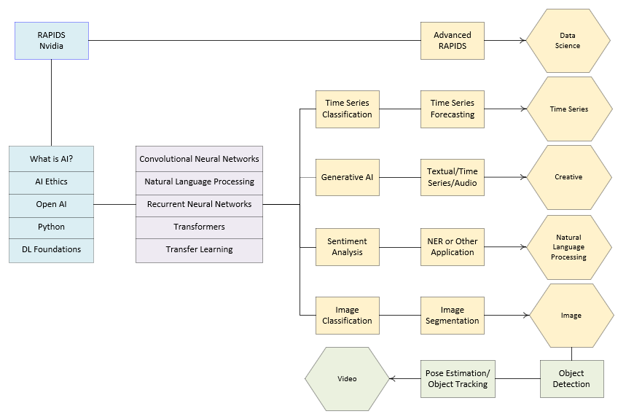
DATA Focus
Visual / Hands-On
Case-Study / Project
Notes:
Overview
Blue (beginner); Purple (intermediate); Yellow (advanced); Green (specialization)
Hexagons are badges
Intermediate – setup for advanced workshops & project learning
Dashed line – data emphasis
Identified research question or problem
Identified data to execute a given project
Data is important
Delimits range of AI tools
Data – Questions – Tools
=====
Earlier, I mentioned that today’s presentation would be divided into two parts. In the last section, I presented the Practicum AI curriculum, and the image of the complete program is presented here once again. Except – in this case – I add an instructional continuum at the top. As pictured here, our introductory and intermediate workshops deliver content visually, supported by extensive hands-on (programming) exercises. That shifts, however, in the advanced workshops where the learning process is now project-driven – defined by the interests of the student – with case-studies providing inspiration.
A shift to project-based learning, however, assumes that you – the student – has identified a problem or research question to work on. That, in turn, assumes that you have identified the data needed to execute a project. Hence, data is an important consideration, especially in the advanced workshops. So, in the second half of today’s workshop, I want to introduce you to the different types of data and the suitable AI tools for each.
Note: we provide the data sets for the entry-level and intermediate workshops. But once you transition into our advanced workshops, the content presented in this half of today’s presentation is important and worth your time.

Slide 17
Practicum AI (Intermediate) | Sessions
Introduction | 1
Convolutional Neural Networks | 3
Transfer Learning | 1
Natural Language Processing | 2
Recurrent Neural Networks | 2
Transformers | 1
Generative Adversarial Networks | 2
Notes:
… and the list of workshops we plan to offer this semester.

Slide 18
Data is the New Oil
Notes:
Clive Humby, 2006.
Data powers deep learning AI systems
=====
In 2006, a British entrepreneur named Clive Humby coined the phrase “Data is the new oil.” Data powers A.I. systems, and it comes in a variety of formats. Thus, data is a logical starting point for thinking about AI. So, what kinds of data are you presently working with?

Slide 19
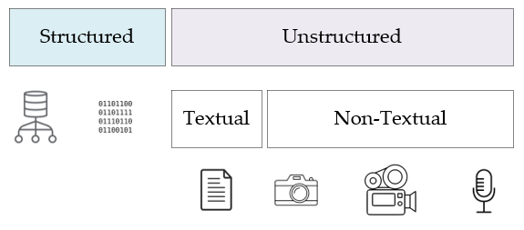
Source: Inmon, W. H. (2019). Data architecture: A primer for the data scientist. Cambridge, MA: Academic Press
Notes:
Bill Inman – Data Architecture: A Primer for the Data Scientist – structured / unstructured data – most data is unstructured
Structured data – contained in rows and columns – two types
Database management systems (Oracle, SQLServer, MySQL, and PostGres)
Repetitive data (sensor output, telephone call records, metered data, etc…)
Unstructured data – not contained in row-column databases – each record is unique – two types
Textual – emails, transcribed conversations, literary texts
Non-Textual – images, video, and audio recordings
=====
In his book, Data Architecture: A Primer for the Data Scientist, Bill Inman makes a distinction between two foundational types of data – between structured data and its unstructured counterpart. As he points out, most of the world’s data is unstructured. So, what’s the difference between the two?
Structured data is easy to search and organize because it is usually contained in rows and columns and its elements can be mapped into fixed, pre-defined fields. Structured data is of two types. The first type is data which comes from a database management system – Oracle, SQLServer, etc… The Epic healthcare system – used by UF Health – is a structured data source, though it also stores unstructured text data in the form of physician notes. The second is repetitive data, consisting of structured records coming from a variety of non-database sources. Some examples of repetitive data include sensor output, telephone call records, metered data, and so forth.
Unstructured data is data that cannot be contained in a row-column database and does not have an associated data model. Each record is unique in terms of its structure and content. Now there are two types of unstructured data – textual and non-textual. Examples of textual data include emails, transcribed conversations, literary texts, and so on. Non-textual data includes images, video, and audio recordings.

Slide 20
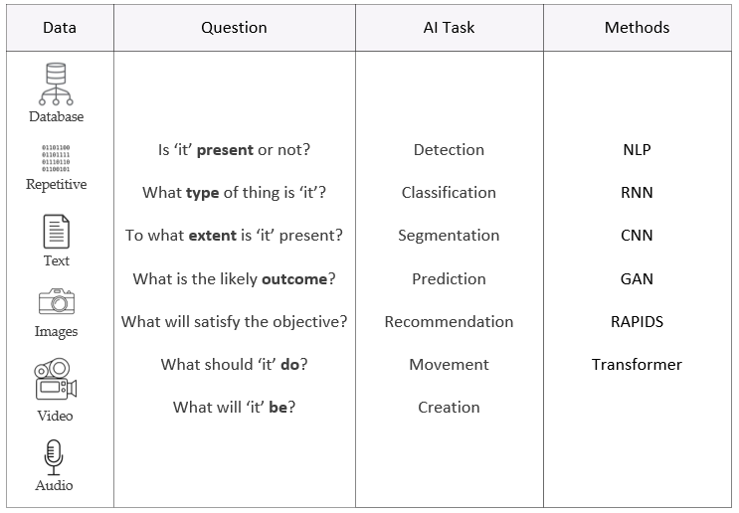
Notes:
Review acronyms in Methods column
=====
With our primary data sources identified, let’s organize everything in a table. On the leftmost column, our data sources are listed, followed by a column of generic questions we might like to ask of our data, another column which lists the related AI task for each question, and finally a column of AI methods and technologies. This table, then, becomes a roadmap to guide your AI learning. The question and AI task columns are self-explanatory, but I’d like to take a few seconds to unpack the abbreviations in the Methods column. Don’t worry about the vocabulary at this point as these terms will be defined in our workshops. But let’s quickly run through the acronyms in the Methods column. NLP – Natural Language Processing; RNN – Recurrent Neural Network; CNN – Convolutional Neural Network; GAN – Generative Adversarial Network; RAPIDS – Nvidia’s data science framework; Transformer – A new kind of neural network.
We will now consider each data source, the types of questions one can ask of each, and the associated AI methods.

Slide 21
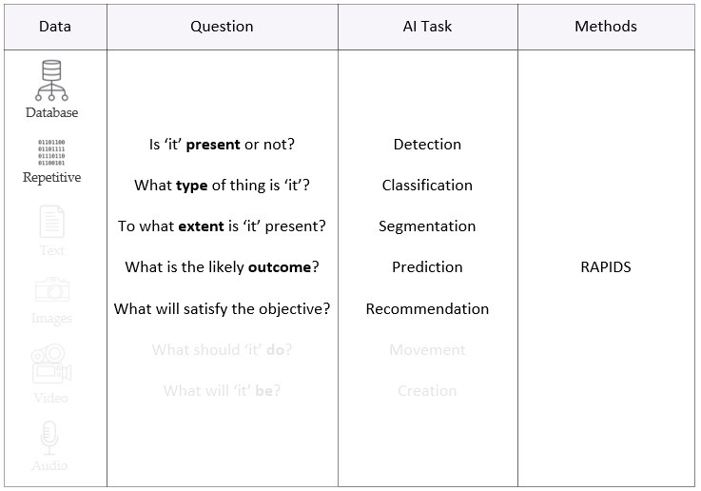
Notes:
Nvidia’s RAPIDS development environment best for structured data
cuDF similar to popular Pandas library
Support for dataframes, data cleaning, and data management
Huge performance boost – 10 to 100 times faster
=====
In the case of structured data – data derived from databases or repetitive data from sensors – the Nvidia RAPIDS development environment is your best starting point. RAPIDS provides a set of useful libraries, with machine learning functions for almost any research task. The RAPIDS cuDF library, for example, is equivalent to the popular Pandas library which supports dataframes as well as basic data management and cleaning.

Slide 22
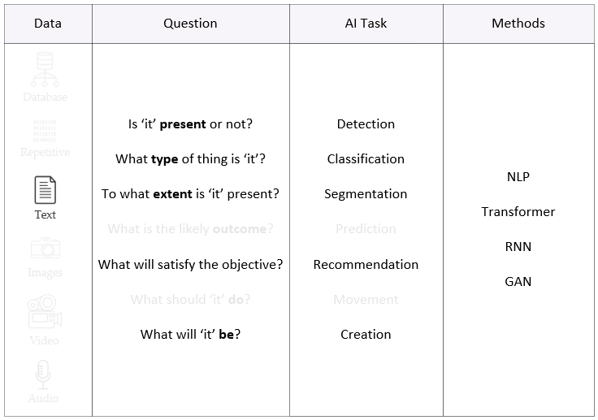
Notes:
Text generating GANs are a unique animal, different from GANs used to generate images
=====
With text data, transformers and recurrent neural networks are established deep learning technologies, appropriate for detection, classification, segmentation, recommendation, and creation tasks. These will solve most text problems, or at least get you started in the right direction. Generative Adversarial Networks or GANs are another choice. However, keep in mind that text generating GANs are a unique animal, different and distinct from GANs used to generate images.

Slide 23
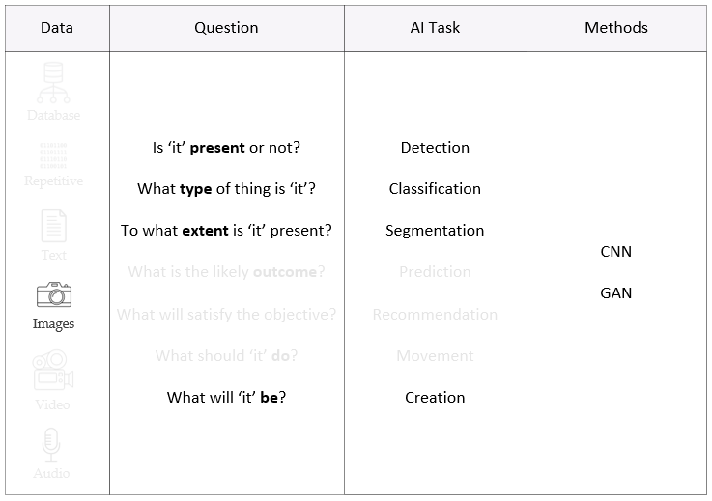
Notes:
Convolutional neural networks – bread and butter of image work.
Recent development -- transformers + GANs = TransGAN.
Special models for single shot detection and real time object detection.
=====
Convolutional neural networks (CNNs) have been the bread and butter of the image world for some time now. In short, CNNs do it all. For image creation, GANs continue to be the tool of choice, typically constructed with CNN components. Another recent development has been the merging of transformers and GANs, with TransGAN being a prominent example.
For detection, consider single shot detection models (SSDs) or YOLO (real-time object detection). Faster-RCNN or EfficientDet are also options, depending on the computational resources available. Classification is a typical CNN task, with ResNet and its variants being popular. And finally – for segmentation tasks – Mask-RCNN or Unet ought to be considered.

Slide 24
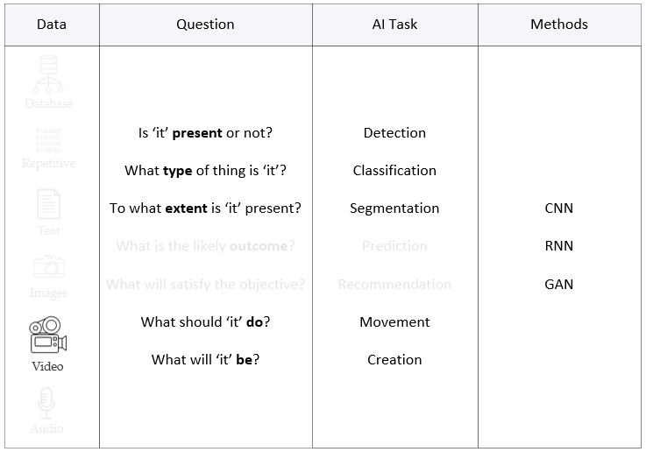
Notes:
Video data is unique in that it is a time series of images
CNNs paired with RNNs as there is both temporal and spatial characteristics
New development is video GANs which generate new frames, one by one – Cutting edge technology
=====
Video data is unique, being a time series of images. As with image data, convolutional neural networks have captured most of this market, though CNNs are frequently paired with RNNs as there is both temporal and spatial characteristics in each image frame. With video, single and multi-object tracking is also possible. Interestingly, there are now video GANs, which basically build frame by frame what it thinks the video should look like. This is cutting-edge technology.

Slide 25
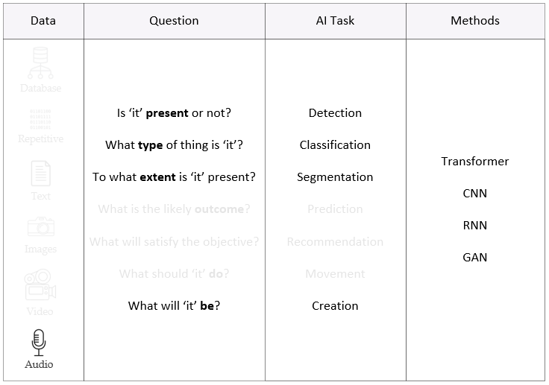
Notes:
Audio interesting format
MEL spectrum representation – 2D spectrogram of a recording
Audio is time series, just like video
=====
Audio is another interesting format. Many audio methods are derived from a MEL spectrum representation, a 2D spectrogram of the recording. Like video, audio is also a time series. Transformers, CNNs, RNNs, and GANs can all be used with audio data. Now that we have covered the various types of data and their associated methods, it’s time to do something practical.

Slide 26

What does your data look like?
Structured (Databases)
Repetitive (Sensors, Instruments)
Textual (Documents, Email, Web Content)
Non-Textual (Images, Video, Audio)
Notes:
We have now arrived at our hands-on activity. Let’s take a poll, I would like for you to describe the data you’re currently working with and possible AI methods to use on that data. Grab a pen and a pad of paper or fire up your word processor and write out a response.

Slide 27
Questions
Notes:
And finally, do we have any questions?

Slide 28

Multi-Select Multiple Choice
Single Answer Multiple Choice
Word Cloud

