Slide 1
AquaShield
Physics-Informed Attack Localization & Zero-Downtime Resilience
Critical Infrastructure Security · CPS Architecture · Real-Time Resilience

Slide 2

THE PROBLEM
Cybersecurity Tools Are Flying Blind
Conventional IDS solutions detect anomalies — but cannot pinpoint which layer of the CPS stack is under attack. The result: operators trigger emergency shutdowns based on guesswork, wasting hundreds of thousands of liters and burning out hardware.
The Core Gap
Detection ≠ Localization. Without knowing where the attack lives in the stack, every response is a gamble.
Cybersecurity tools detect anomalies but cannot pinpoint root cause — causing false emergency shutdowns and water waste.
Anomaly Detected
Operator Guesses
False Shutdown
System flags a deviation — but offers no causal explanation.
Manual triage across 5 attack layers takes hours, not milliseconds.
Emergency halt triggered — water dumped, service interrupted, hardware stressed.

Slide 3
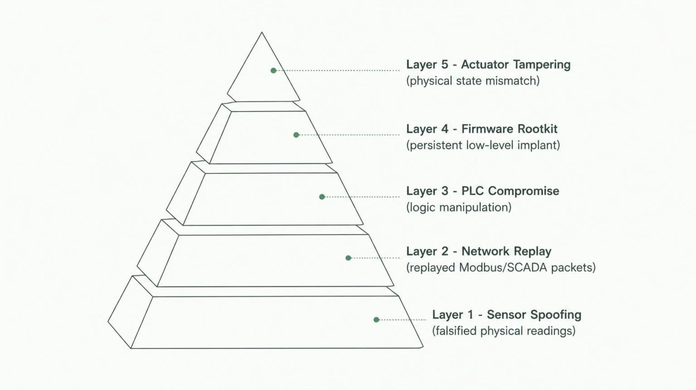
ATTACK SURFACE
The 5-Layer CPS Attack Surface
Each layer demands a different detection mechanism — a single IDS cannot cover all five simultaneously.

Slide 4


CURRENT COST
The Cost of Guessing Wrong
4.5h
100%
Attack Isolation Time
False Emergency Rate
Manual triage across layers under legacy IDS
Every anomaly triggers an unverified shutdown
100Ks
$0
Liters Dumped
Surgical Precision
Per incident — hundreds of thousands wasted
Legacy IDS offers zero root-cause localization
Hardware burnout and service interruption compound every false shutdown — the operational damage extends far beyond water loss.

Slide 5

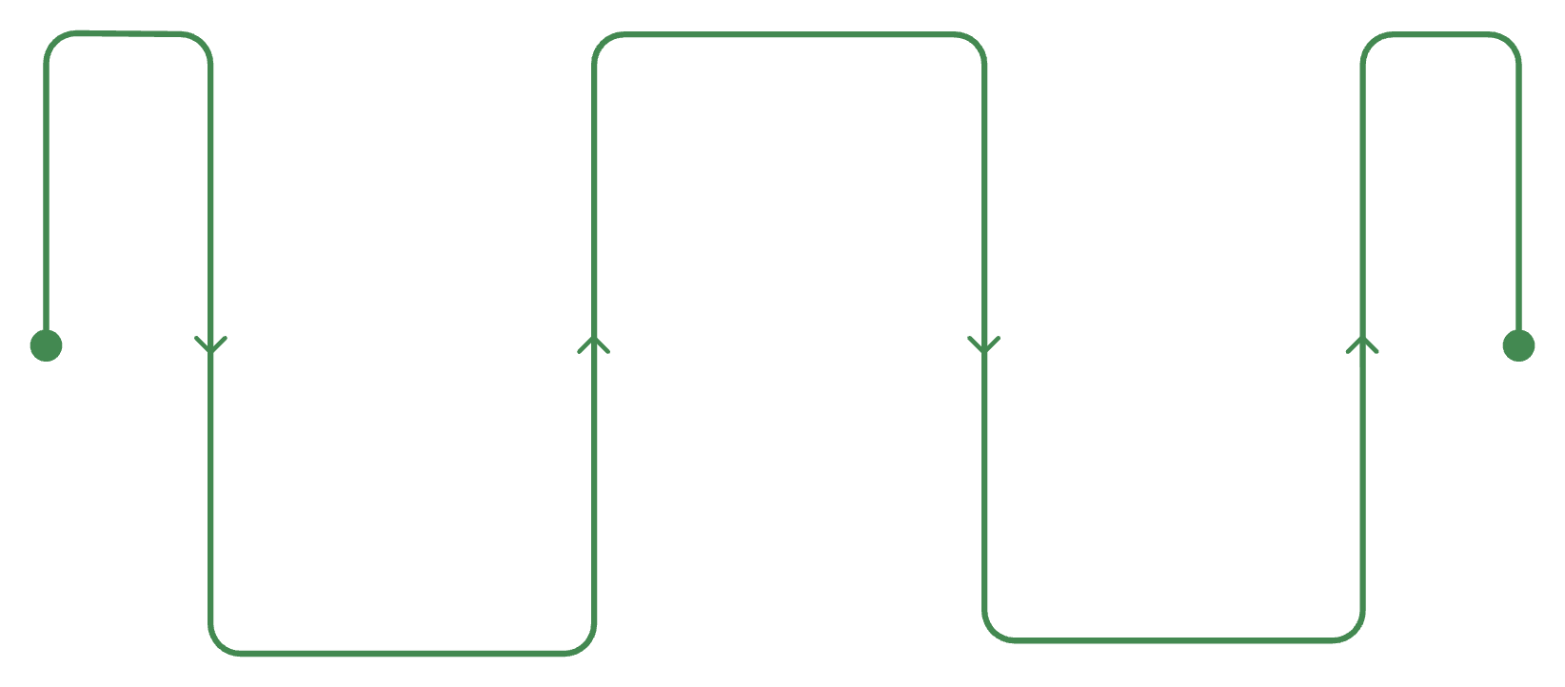
THE SOLUTION
AquaShield: Surgical Localization at Physics Speed
The Core Principle
AquaShield deploys a physics-informed digital twin that continuously validates every sensor reading against fundamental physical laws — Mass Balance, Bernoulli's Equation — in real time.
When data violates physics, the attack is not just detected — it is surgically localized to the exact CPS layer, and the system self-heals without stopping operations.
ODE Solver
Detects physics violation under 40ms
Quarantine & Estimator
Digital Twin
Isolate node; virtual estimator substitutes
Monitors live sensor data
Physics-informed digital twin that surgically localizes attacks and self-heals without stopping operations.

Slide 6

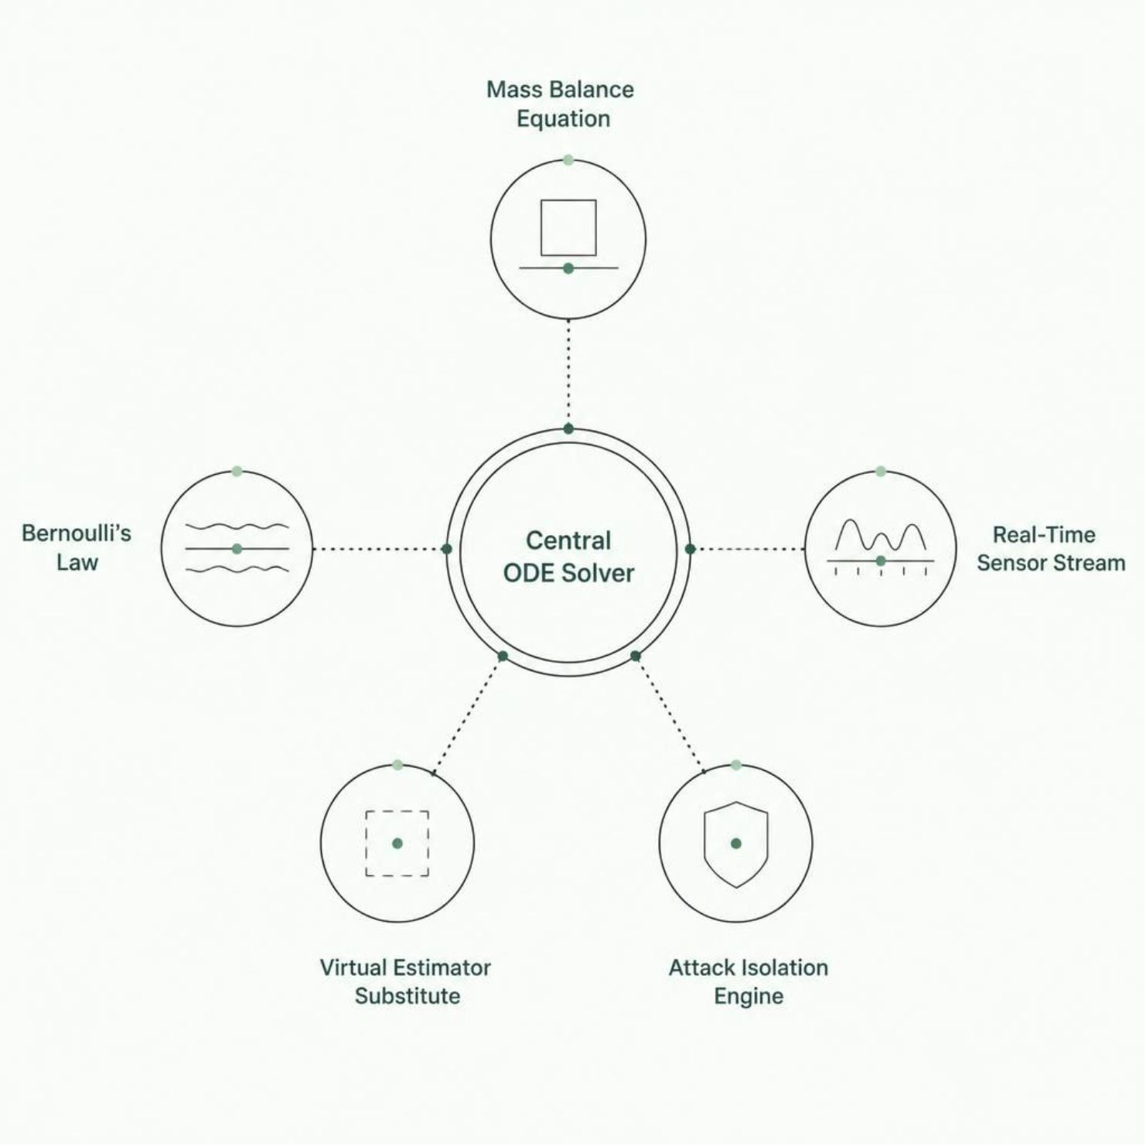
MECHANISM
Physics-Informed Cross-Validation
1
Real-Time ODE Solver
Continuously validates live sensor data against Mass Balance and Bernoulli's Law — every reading, every millisecond.
2
Physics Violation → Instant Isolation
When sensor data contradicts physical laws, the attack is isolated in <40ms — no human triage required.
3
Quarantine & Virtual Substitution
Compromised node is quarantined; a virtual estimator seamlessly substitutes — operations continue uninterrupted.

Slide 7
5-LAYER LOCALIZATION
Surgical Precision Across Every Layer
Sensor Spoofing
1
Detected via physics violation — falsified readings contradict ODE solver output instantly.
Network Replay
2
Caught by cryptographic audit trail — replayed Modbus/SCADA packets fail timestamp verification.
PLC Compromise
3
Verified via immutable control logs — unauthorized logic changes surface against signed baselines.
Firmware Rootkit
4
Detected via control-flow anomaly analysis — persistent implants deviate from verified execution paths.
Actuator Tampering
5
Isolated via state mismatch detection — commanded vs. observed actuator state divergence triggers alert.

Slide 8

LIVE DEMO
Live Interactive Demo
Animated SCADA Digital Twin
Attack Scenarios Available
Real-time fluid dynamics visualization — watch pressure, flow, and tank levels respond live to attack injection.
Each scenario demonstrates full localization, quarantine, and self-healing — with zero operational downtime.
Dynamic Causal Laser Tracing
Visual beam locks onto the compromised node the instant physics violation is detected — sub-40ms.
Chaos Injection Studio
1-click attack injection: Sensor Spoofing, Modbus Replay, Stuxnet Rootkit — watch AquaShield respond in real time.
🎯 Sensor Spoofing
🔁 Modbus Replay
☣️ Stuxnet Rootkit

Slide 9

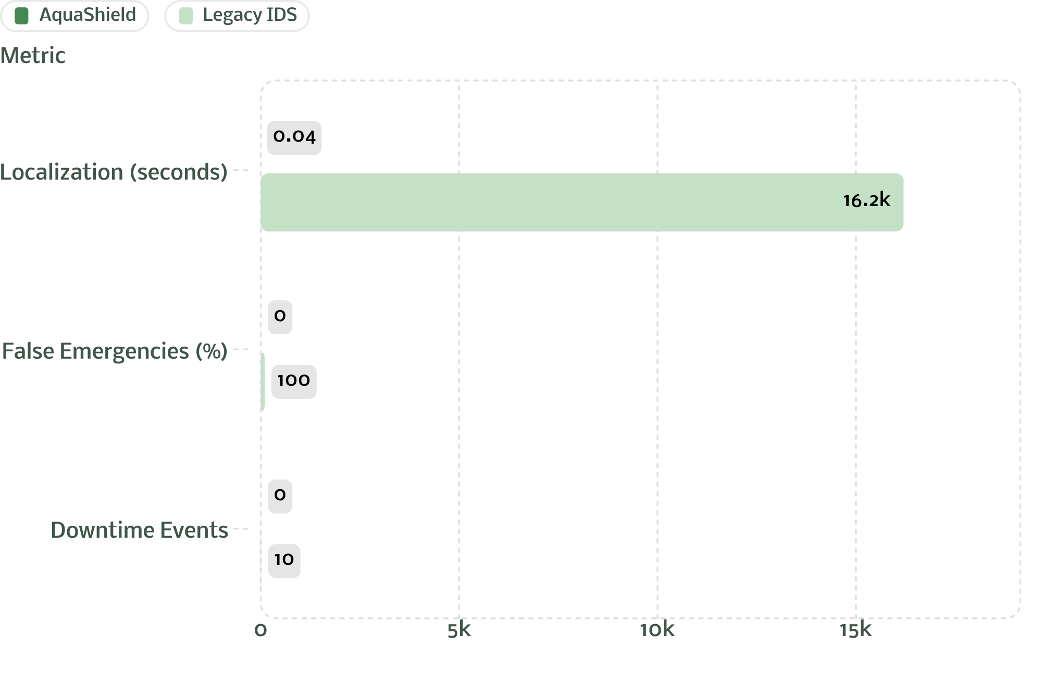
IMPACT
AquaShield vs. Legacy IDS
38ms
Attack localization — vs. 4.5 hours legacy
0%
False emergency rate — 100% prevention
Zero
Downtime — vs. repeated service interruption
100%
Water saved — zero liters dumped per incident

Slide 10



Securing Critical Infrastructure at Physics Speed
38ms. Zero Downtime. Clean Water.
The AquaShield Promise
Sub-40ms Localization
Zero-Downtime Self-Healing
Physics-informed ODE cross-validation isolates attacks faster than any human operator can respond.
Sub-40ms localization + zero-downtime self-healing = uninterrupted clean drinking water and resilient energy systems.
Virtual estimator substitution keeps operations running — no shutdown, no water waste, no hardware stress.
Physics is the ultimate ground truth. AquaShield makes it the foundation of critical infrastructure defense.
UN SDG 6 & 9 Aligned
PHYSICS-SPEED SECURITY
SDG 6
SDG 9
Uninterrupted clean drinking water and resilient critical energy infrastructure — at scale.

