Slide 1
BATTLE OF NEIGHBOURHOODS CAPSTONE PROJECT IBM APPLIED DATA SCIENCE CAPSTONE
Opening an Indian Restaurant in the suburbs near
Mumbai, India
Pradnyesh CHOUDHARI
APRIL 2020

Slide 2
Business Problem
The objective of the capstone project is to analyze the neighborhoods using the techniques of data science and a few machine learning techniques such as clustering, to select the best location for opening an Indian restaurant in the suburbs surrounding to Mumbai, India.
If a restaurant chain wants to open a new restaurant in the suburbs near Mumbai where should you open it?

Slide 3
Data Requirements
Data Required
List of the Suburbs near Mumbai, India.
Latitude and Longitude coordinates of these cities.
Venue data, related to Indian Restaurants.
Sources of Data
Wikipedia Page (https://en.wikipedia.org/wiki/Category:Suburbs_of_Mumbai)
Python Geocoder Package.
Foursquare API

Slide 4
Methodology
Scraping data from Wikipedia page using library beautifulsoup.
Get latitude and longitude data using geocoder library.
Get the venues JSON file using Foursquare API.
Clean the data for Indian Restaurants.
Apply the k-means ML algorithm on the data.
Find the results by plotting the map using Folium.

Slide 5
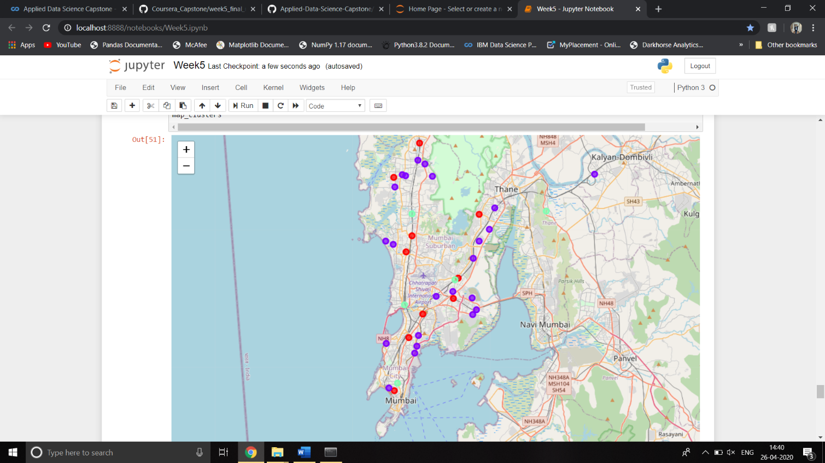
Result
After applying the k-means cluster we obtain a result which we have again plotted on a map using the folium library.
We have clustered the data for Indian Restaurants in 3 clusters
Cluster 1: Red Colour: Neighborhood with moderate number of Indian Restaurants.
Cluster 2: Purple Colour: Neighborhood with low number of Indian Restaurants.
Cluster 3: Mint Green Colour: Neighborhood with high number of Indian Restaurants.

Slide 6
Inference
As the map in the result section suggests and from the observations there are very less places across the suburbs which have very high number of Indian Restaurant and most of the places have moderate number of restaurants from which we can easily find that there is a lot of scope in the business for opening restaurant. The cluster 2 gives the list of all those places where one can think about opening a new restaurant and those places which fall in the cluster 3 should be avoided while choosing a location for the new restaurant. If these results are taken into consideration, cluster 1 and 2 are good options for opening a new restaurant and cluster 3 are not.

Slide 7
Limitations and Further Scope
Due to lack of data many suburbs were not even considered during this project. The other major problem is that we have only considered the number of restaurants around that place and which is only a single factor while considering the facts. There are a lot of other factors such as population density, economic conditions of the location. However, due to lack of the data for all such factors could not be considered while applying the ML model. The API used in the project is a basic and free version of the Foursquare API and there were restrictions to the data and number of calls that we make on daily basis. For the further research if this topic is chosen then all these factors should be taken into consideration and the paid version of the Foursquare API can be used.

Slide 8
References
Wikipedia Page https://en.wikipedia.org/wiki/Category:Suburbs_of_Mumbai
Foursquare API https://foursquare.com/developers/apps

