Slide 1
Microsoft : Classifying Cybersecurity Incidents with Machine Learning

Slide 2
Problem Statement:
Imagine you are working as a data scientist at Microsoft, tasked with enhancing the efficiency of Security Operation Centers (SOCs) by developing a machine learning model that can accurately predict the triage grade of cybersecurity incidents.
Utilizing the comprehensive GUIDE dataset, your goal is to create a classification model that categorizes incidents as true positive (TP), benign positive (BP), or false positive (FP) based on historical evidence and customer responses.

Slide 3
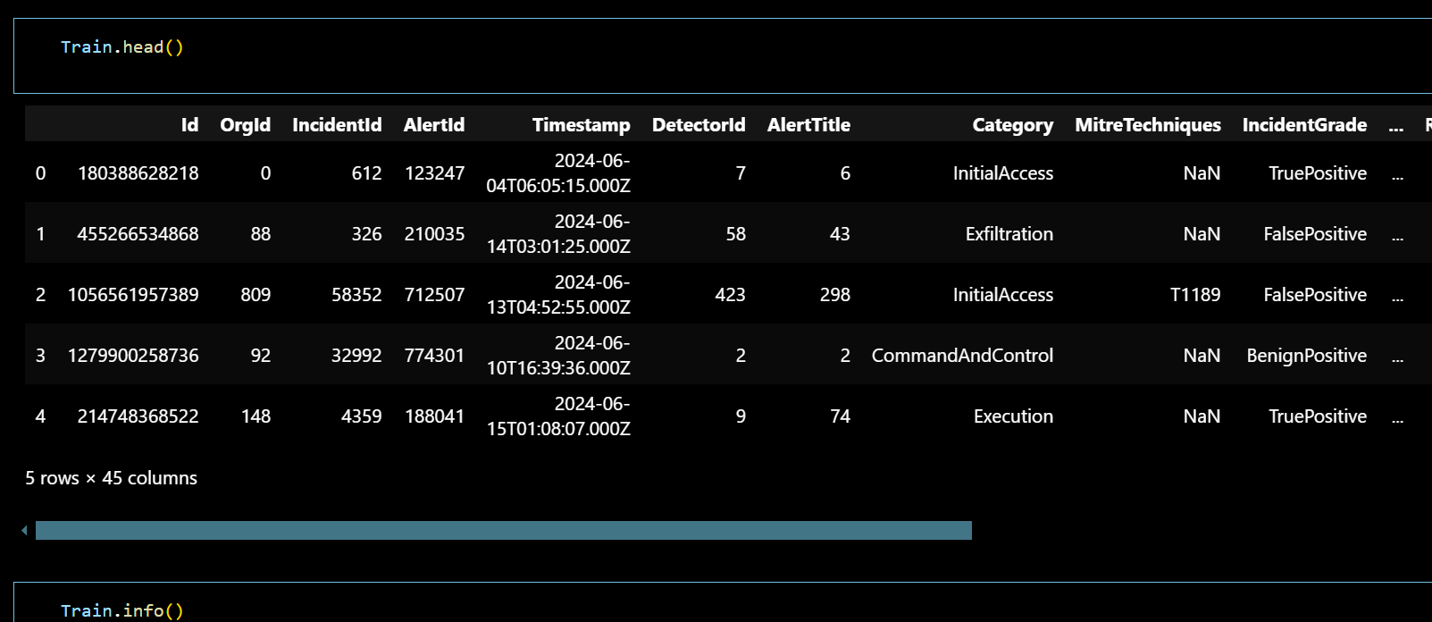
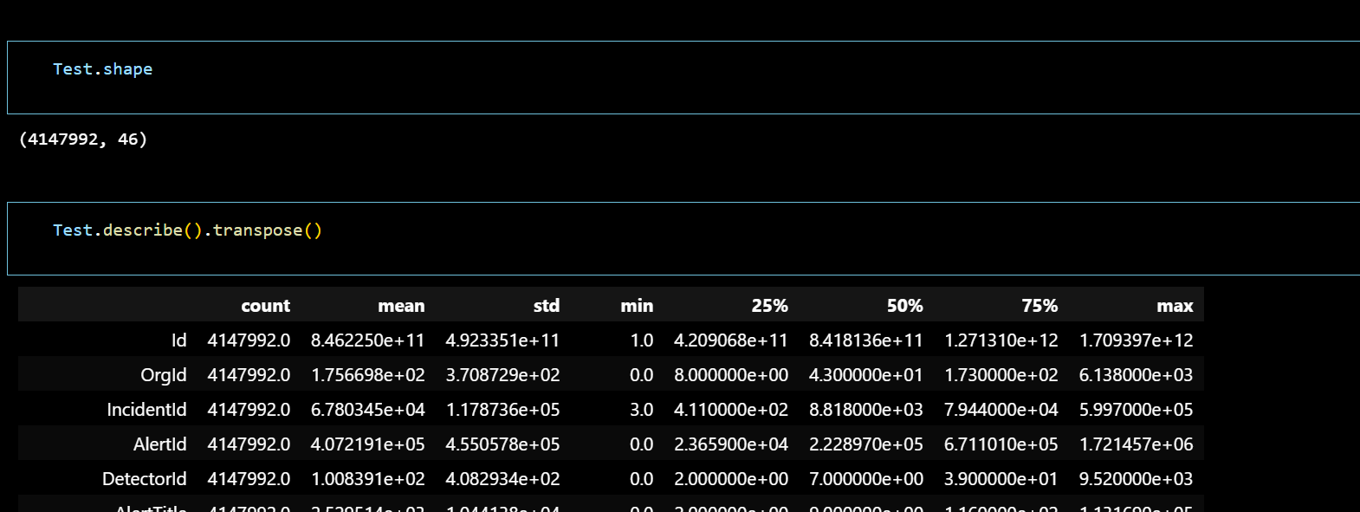
Approach: 1. Data Exploration and Understanding

Slide 4
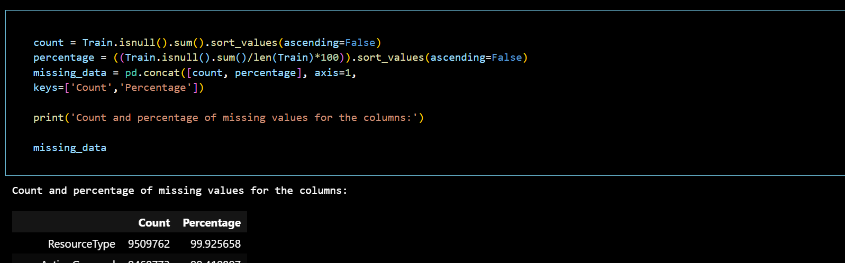
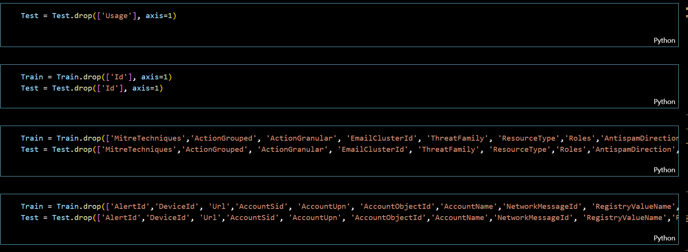
2. Data Preprocessing: Handling missing values – droping column that has most null values

Slide 5
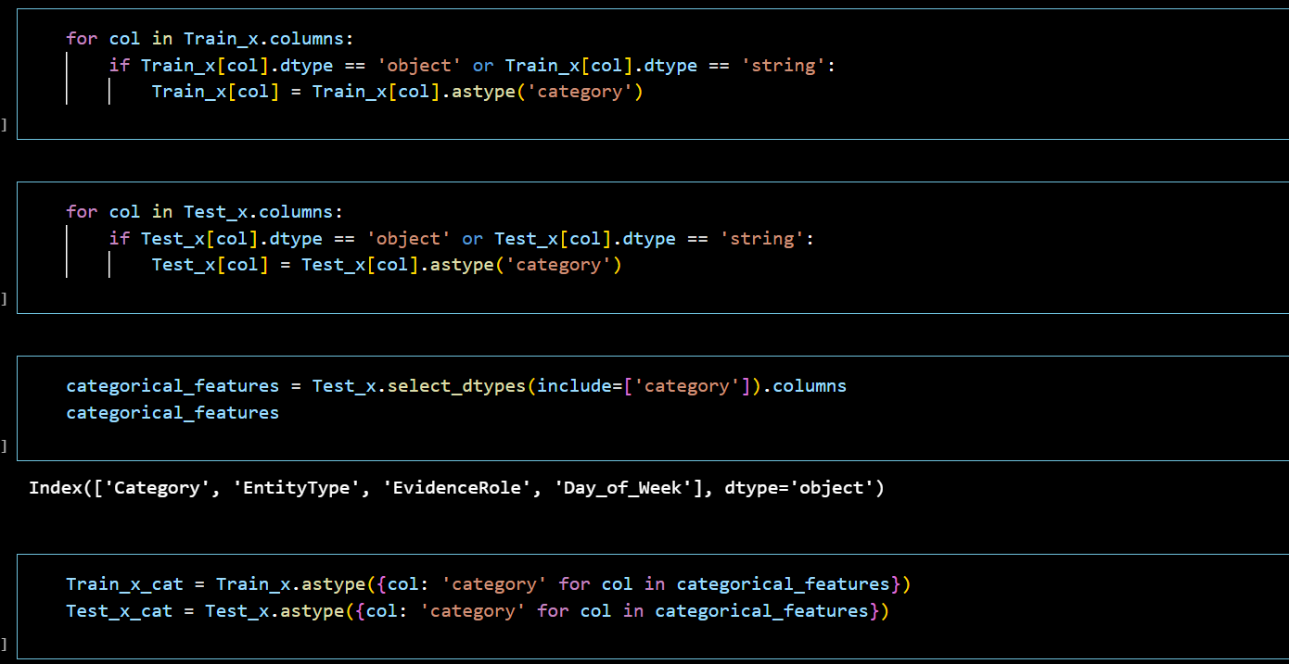
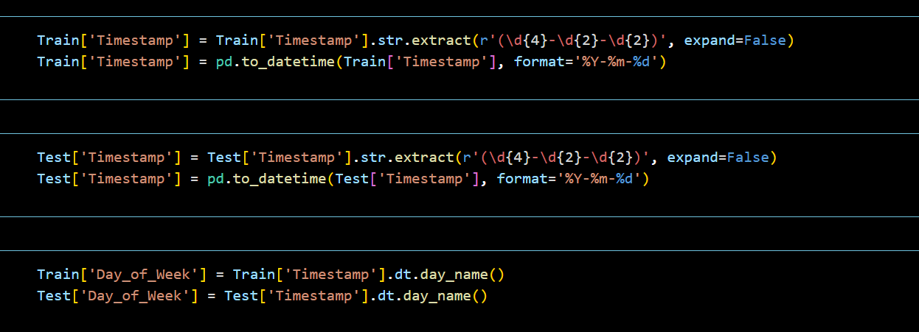
Categorizing the columns

Slide 6
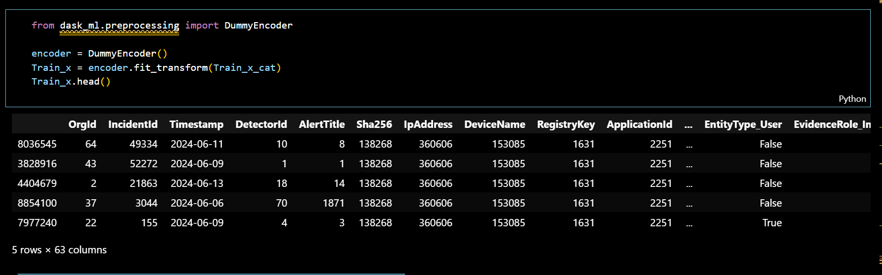
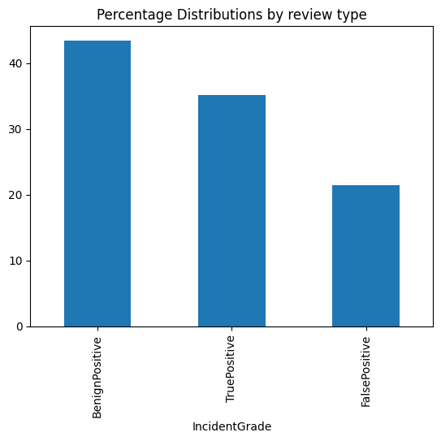
Encoding the categorical features:

Slide 7
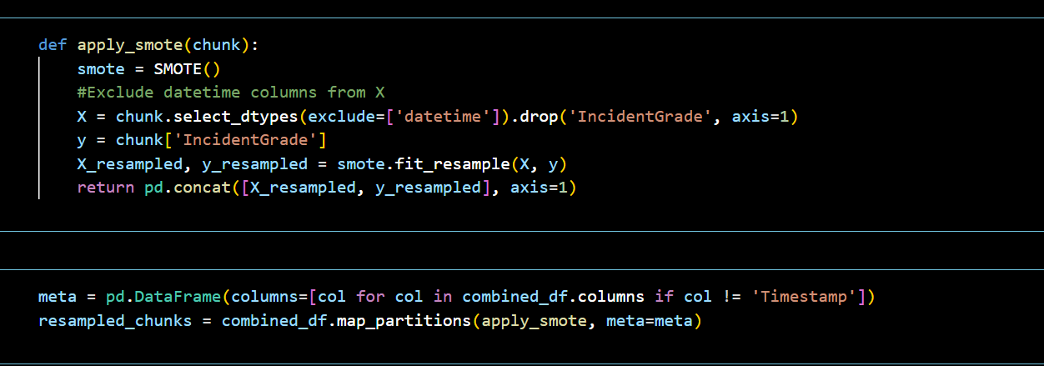
Sampling the imbalance using SMOTE

Slide 8
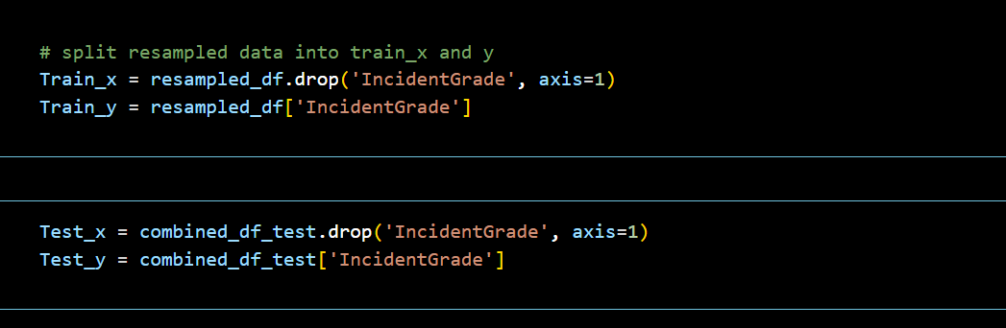
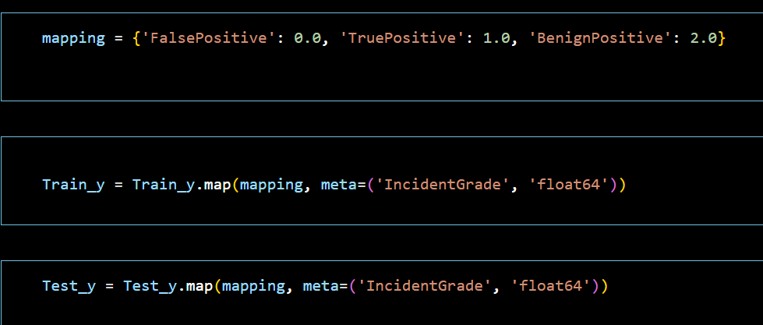
Splitting the resampled data for training and mapping the target values to numeric values

Slide 9
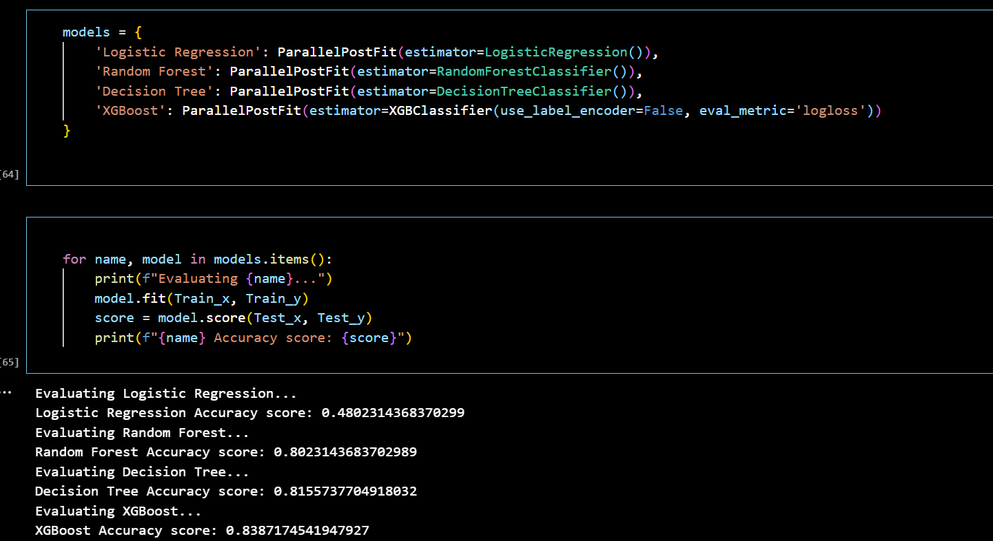
Model selection and training

Slide 10
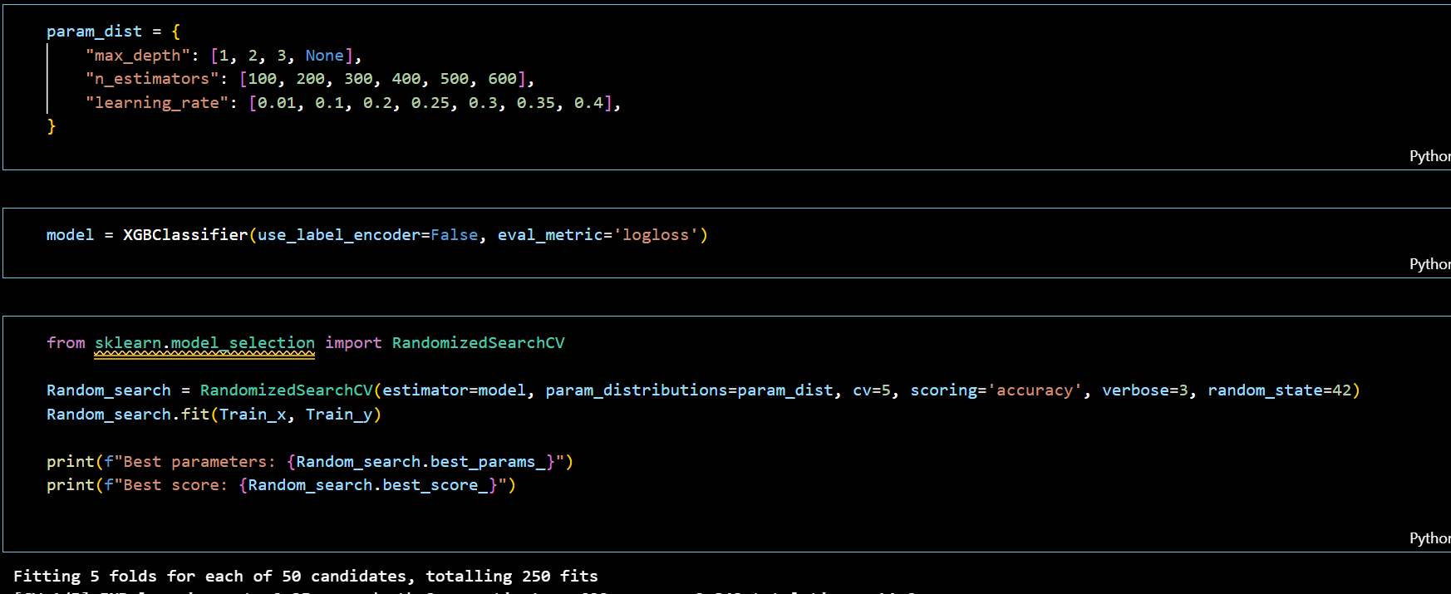
Model evaluation and tuning

Slide 11
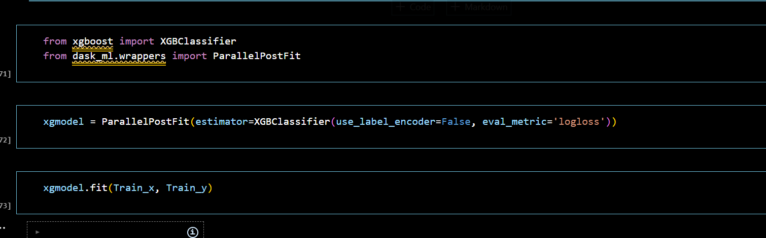
Error analysis

Slide 12
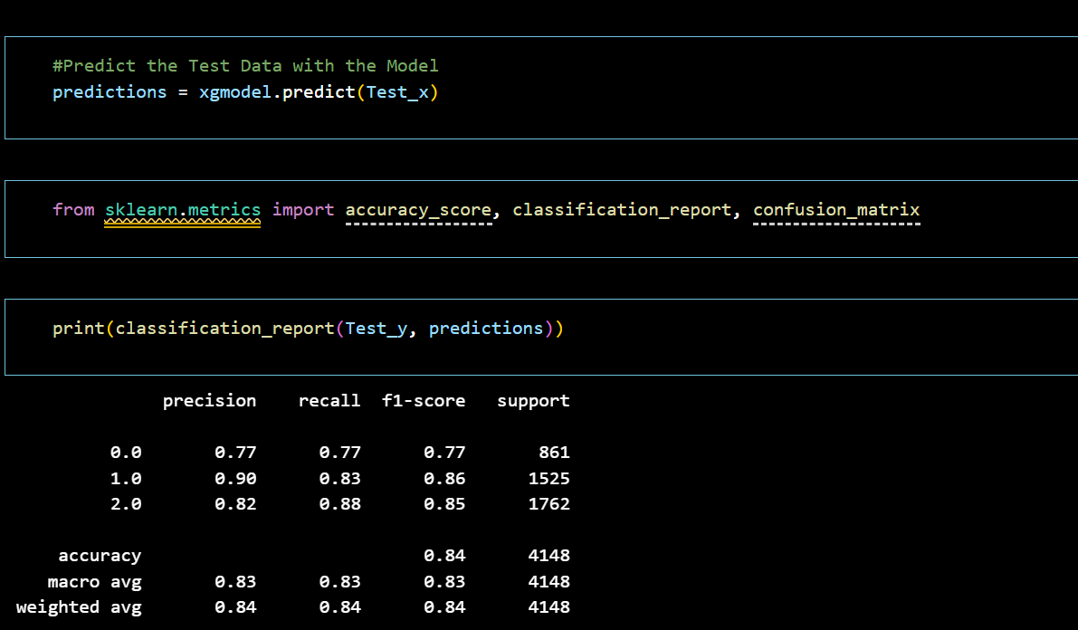
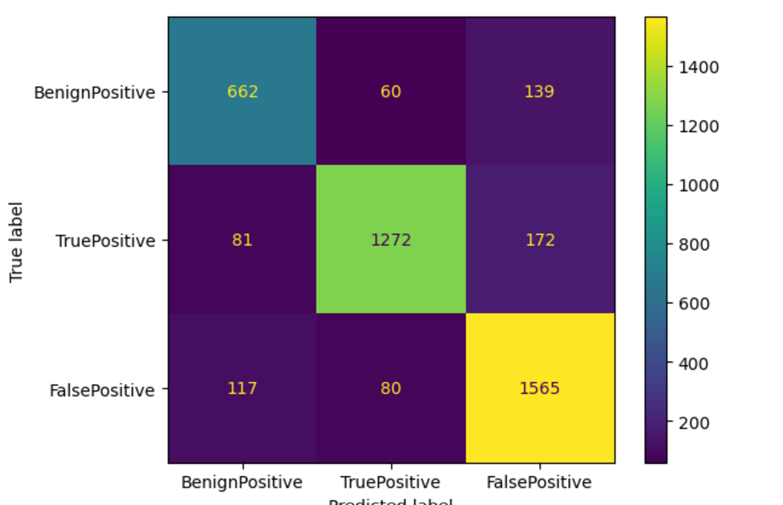
Model evaluation on test data

