Slide 1
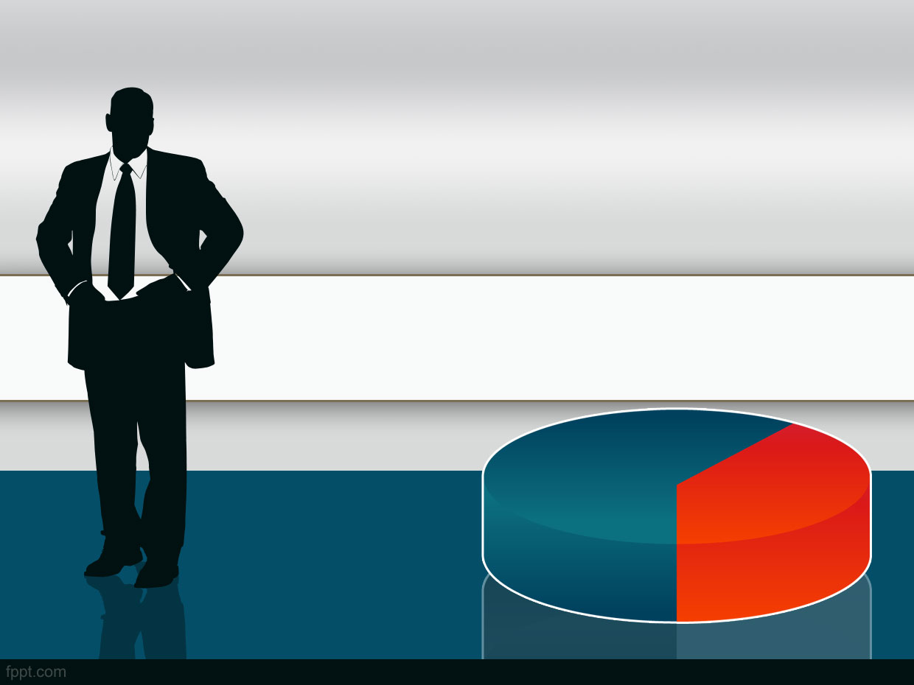
CUSTOMER SEGMENTATION FOR MARKETING TEAM
Pradana Indra
JCDS0804

Slide 2
OUTLINE
OVERVIEW
CASE STUDY
DATA INFORMATION
MODEL & SUGGESTION
CONCLUSION

Slide 3
OVERVIEW
Market Segmentation is a process of grouping customers in markets with some heterogeneity into smaller, more similar or homogeneus segments with similar requirements and buying characteristics. By carrying out market segmentation, companies are able to develop products and services that are appropriate for particular target segments and to be supported by an appropriate marketing mix.

Slide 4
CASE STUDY
Benefits:
Helped build a loyal customer base and enhance sales
Predictive Insights:
Increasing customer engagement and building brand loyalty
Business Challenge:
To identify the most profitable customer segments and efficiently engage with target customer to boost profitability

Slide 5
Data Information
Dataset is buying and selling retail store data Form Kaggle: https://www.kaggle.com/arawind/retail-marketing
Feature: 10 Columns, 1000 Rows each
Age : Customer age in years
Gender : Customer gender Male/Female
OwnHome : Customer House Status Rent/Own
Married : Customer Marital Status
Location : Data shows customer location from store (far/close)
Salary : Customer annual income (yearly)
Children : The number of children that customer have
History : Data Unclear no description etc. Possible to drop.
Catalogs : Data unclear no description etc. (Specific Item)
AmountSpent : Customer Spending Amount

Slide 6
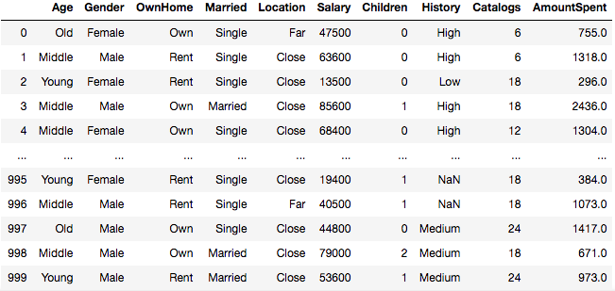
Data Information

Slide 7
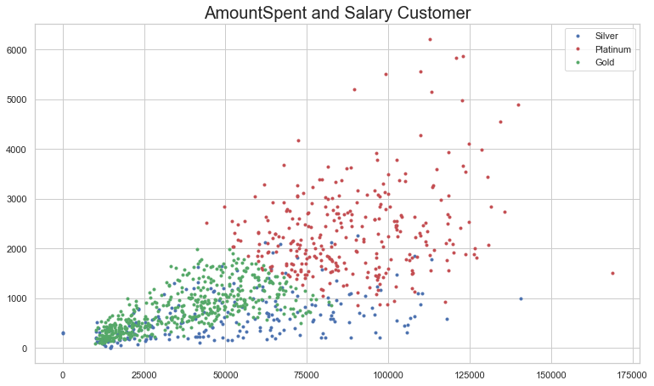
MODEL
CLUSTERING

Slide 8
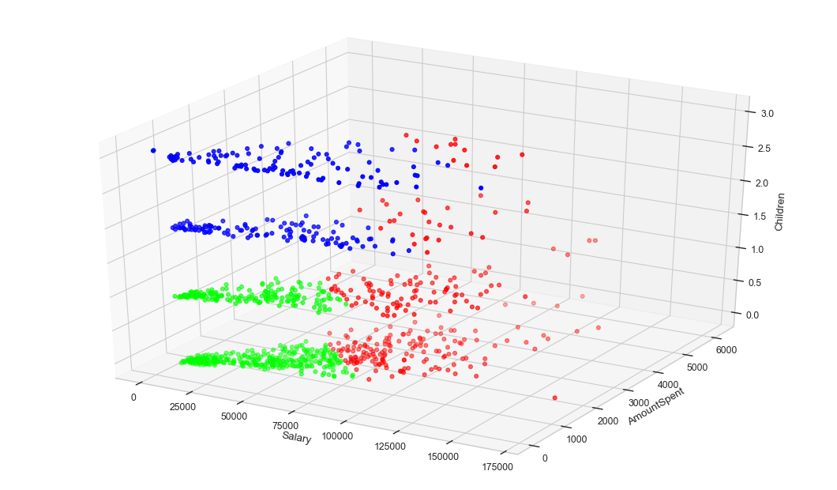
MODEL

Slide 9
Suggestion
Silver
Lowest priority of the target. Offered a silver membership that benefits 10% discount
Gold
Moderate priority of the target. Offered a gold membership that benefits 15% discount
Platinum
The highest priority. Offered platinum membership that benefits 20% discount

Slide 10
Conclusion
Each cluster is represent by Salary and Amountspent.
The Demography Segmentation is followed by each cluster it self.
Target group can be use to make another marketing decision besides membership.

Slide 11
THANKYOU

