Slide 1



22ITT31 - Design & Analysis of Algorithm
Transform and Conquer – Computing LCM using Euclid’s Algorithm
Presented by: Pradeep.B
23ITR116 B.Tech IT-B

Slide 2

?
To compute the Least Common Multiple (LCM) of two positive integers m and n, and analyze the efficiency when Euclid’s algorithm is used.
Definition: lcm(m, n) is the smallest positive integer that is divisible by both m and n.
Examples:
lcm(24, 60) = 120
lcm(11, 5) = 55
Challenge: Directly computing LCM can be inefficient for large numbers. The question is: What is the efficiency of computing lcm(m, n) using Euclid’s Algorithm

Slide 3
Objectives
To compute the LCM of two integers efficiently.
To apply Transform-and-Conquer by converting the LCM problem into a GCD problem.
To implement Euclid’s Algorithm for GCD as a subroutine.
To analyze the time and space complexity of the overall algorithm.
To understand why this method is better than naive approaches.
3

Slide 4
Assumption
Assumptions
The input values `m` and `n` are positive integers (`m > 0`, `n > 0`).
The values of `m` and `n` can be very large, so an efficient algorithm is preferred.
Euclid’s Algorithm is used to compute the GCD of `m` and `n`.
Integer multiplication `(m × n)` and division `( / )` are assumed to be constant-time operations (though in practice, they may take longer for very large integers).
There is **no overflow** during the computation of `(m × n)` — or a language/data type (e.g., `long` or `BigInteger`) is used to handle large values.
4

Slide 5
Workflow
START
↓
Read input values m and n
↓
Compute GCD of m and n using Euclid’s Algorithm
↓
Calculate LCM using the formula:
LCM = (m × n) / GCD
↓
Display the result
↓
END
5

Slide 6
//Input: Two positive integers m and n //Output: Least Common Multiple of m and n Step 1: Check if m > 0 and n > 0 If not, return "Invalid input" Step 2: Compute GCD of m and n using Euclid’s Algorithm while n ≠ 0: temp ← n n ← m % n m ← temp GCD ← m Step 3: Compute LCM using the formula LCM = (original_m × original_n) / GCD Step 4: Return/display the LCM result
Algorithm

Slide 7
Pseudocode
//Compute GCD using Euclid’s Algorithm
While b ≠ 0 do
temp ← b
b ← a mod b
a ← temp
End While
GCD ← a
Compute LCM using the formula
LCM ← (m × n) / GCD
Display "LCM of m and n is", LCM
End Procedure
Procedure LCM(m, n)
Input: Two positive integers m and n
Output: Least Common Multiple of m and n
If m ≤ 0 or n ≤ 0 then
Display "Invalid Input"
Exit
Set a ← m
Set b ← n

Slide 8
Basic operation
GCD Calculation (Transform Phase)
Operation:
Uses Euclid’s algorithm (recursive) to calculate the GCD (Greatest Common Divisor):
LCM Calculation (Conquer Phase)
Operation:
Uses the relationship:
LCM(m, n) = (m × n) / GCD(m, n) ​

Slide 9
coding
LCM using GCD
def compute_lcm(m, n):
gcd = compute_gcd(m, n)
return (m * n) // gcd
@app.route('/', methods=['GET', 'POST'])
def index():
result = ""
if request.method == 'POST':
try:
m = int(request.form['m'])
n = int(request.form['n'])
if m <= 0 or n <= 0:
result = "Please enter positive integers only."
else:
gcd = compute_gcd(m, n)
lcm = compute_lcm(m, n)
result = f"GCD of {m} and {n} is: {gcd}<br>LCM of {m} and {n} is: {lcm}"
except ValueError:
result = "Invalid input. Please enter numbers."
return f
from flask import Flask, request
app = Flask(__name__)
# GCD using Euclid's algorithm
def compute_gcd(a, b):
if b == 0:
return a
return compute_gcd(b, a % b)

Slide 10
<!DOCTYPE html>
<html>
<head>
<title>LCM Calculator</title>
<style>
body {{
font-family: Arial, sans-serif;
padding: 20px;
background: #f0f4f8;
}}
.container {{
background: white;
padding: 20px;
border-radius: 10px;
box-shadow: 0 0 10px #ccc;
}}
#result {{
margin-top: 20px;
font-weight: bold;
color: #006400;
}}
</style>
</head>
<body>
<div class="container">
<h2>LCM Calculator</h2>
<form method="post">
<label>Enter first positive integer (m):</label>
<input type="number" name="m" min="1" required>
<label>Enter second positive integer (n):</label>
<input type="number" name="n" min="1" required>
<button type="submit">Compute LCM</button>
</form>
<div id="result">{result}</div>
</div>
</body>
</html>
"""
if __name__ == '__main__':
app.run(debug=True)

Slide 11
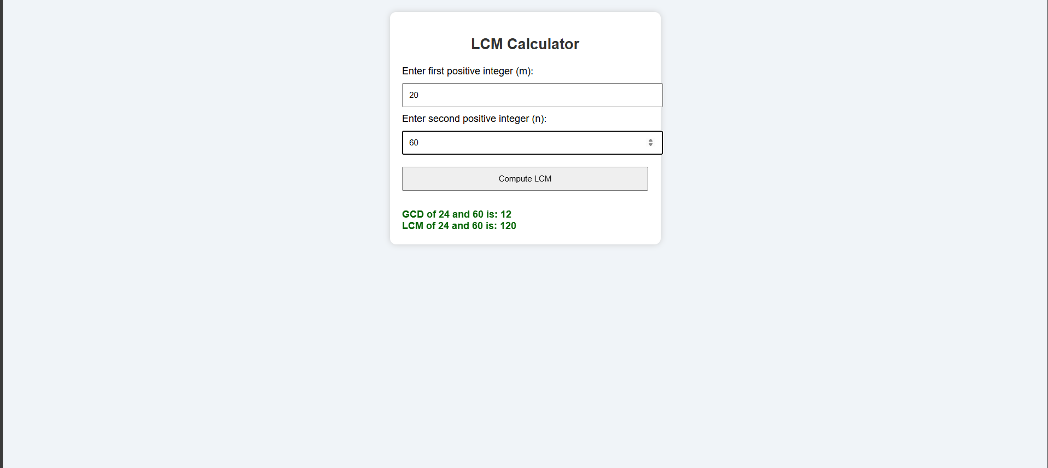
Output

Slide 12
Time and space complexity
Function | Time Complexity | Space Complexity
compute_gcd(a,b) | O(log(min(a, b))) | O(log(min(a, b)))
compute_lcm(m,n) | O(log(min(m, n))) | O(log(min(m, n)))

