Slide 1



Students grade calculator
Team members : Team ID : DS_16
23ITR118-R.PRANESH
23ITR116-B.PRADEEP
23ITR092-K.MANIVEL KARTHICK
23ITL186-JEEVAN SAMBATH

Slide 2
.
PROBLEM DECRIPTION
Pharmacy staff face challenges in keeping an updated list of medicines, including details like name, company, availability, and expiry date.
The system must be capable of easily adding, updating, and removing medicine records as stock changes It requires place for storing the data records.
Manage online reservations and waitlists for medicines..

Slide 3
Objectives
To develop a Pharmacy Management System that efficiently manages medicine records
To implement searching and sorting functionalities for quick retrieval of medicines.
To enable online reservations and waitlist management with priority handling.
To provide a user-friendly interface for pharmacists and customers for seamless interaction
3

Slide 4
Software & Concepts
Software :
Eclipse
Github
Concepts :
Awt
Array
Linear Search Algorithm
Quick Sorting Algorithm
Object Oriented Programming
File Handling
4

Slide 5
Modules
Add_medicine()
Delete_medicine()
Update_medicine()
Quick_sort()
Linear_search()
Read_writefile()
Class_calculate()
Lower_price()
Higher_price()
Weighted_calculate()

Slide 6

Sign in

Slide 7
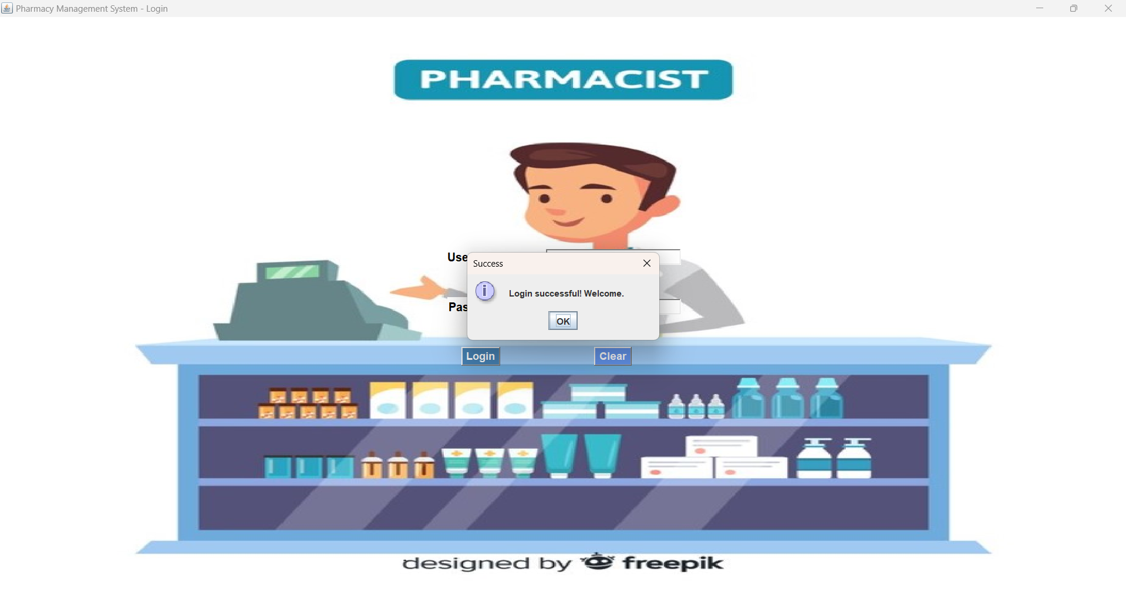
Login

Slide 8
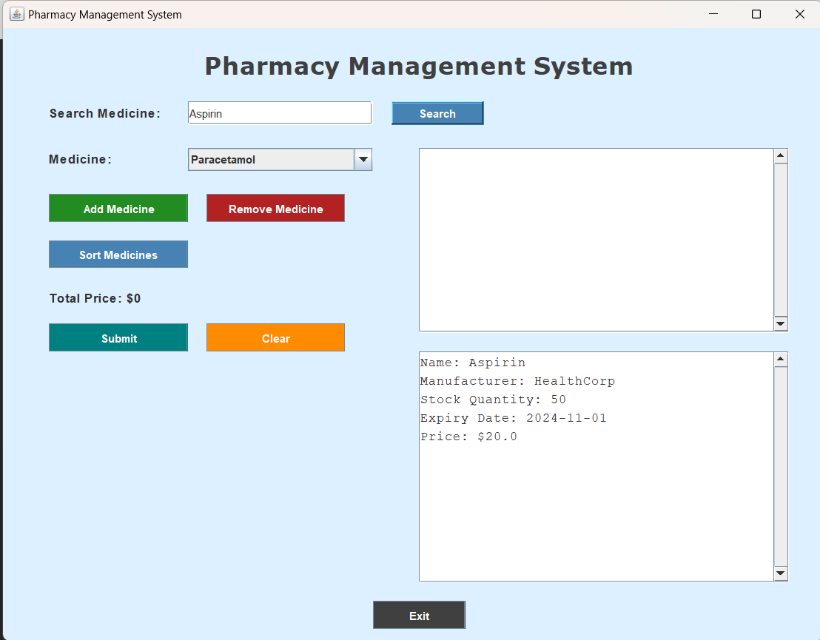
Search

Slide 9
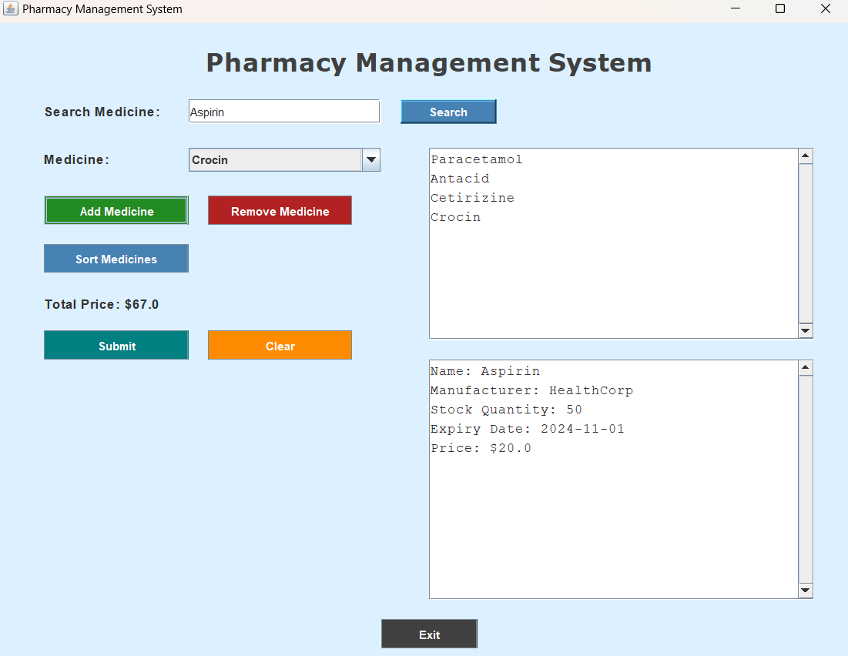
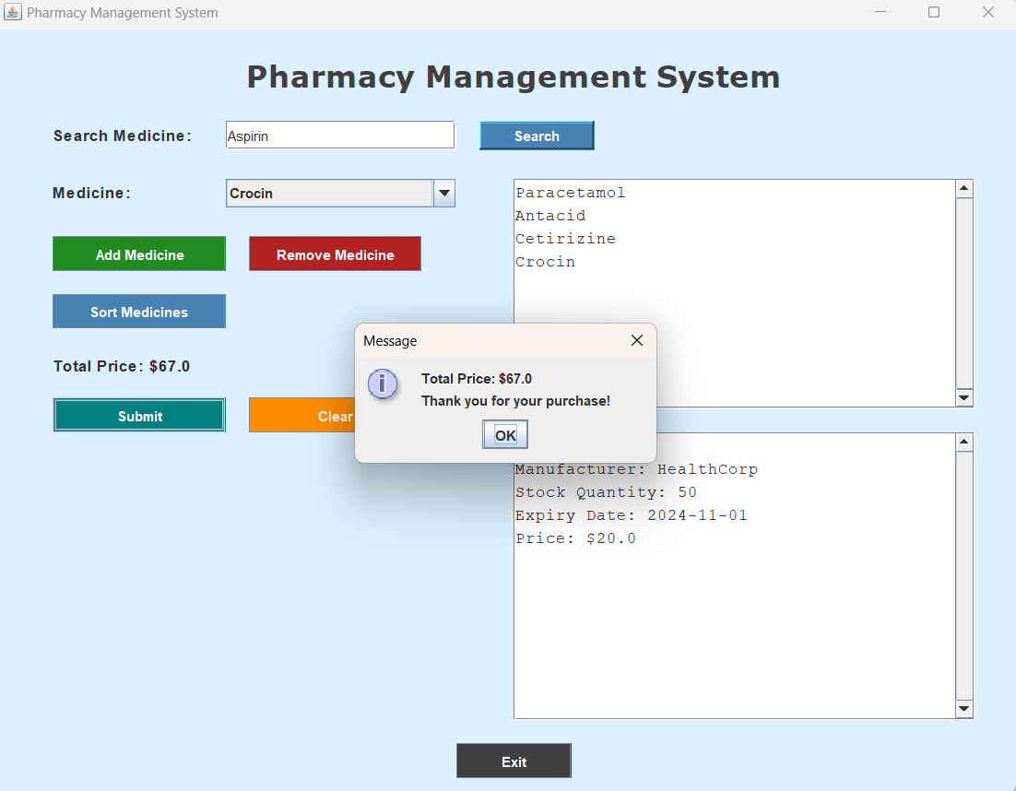
Adding and submit

Slide 10
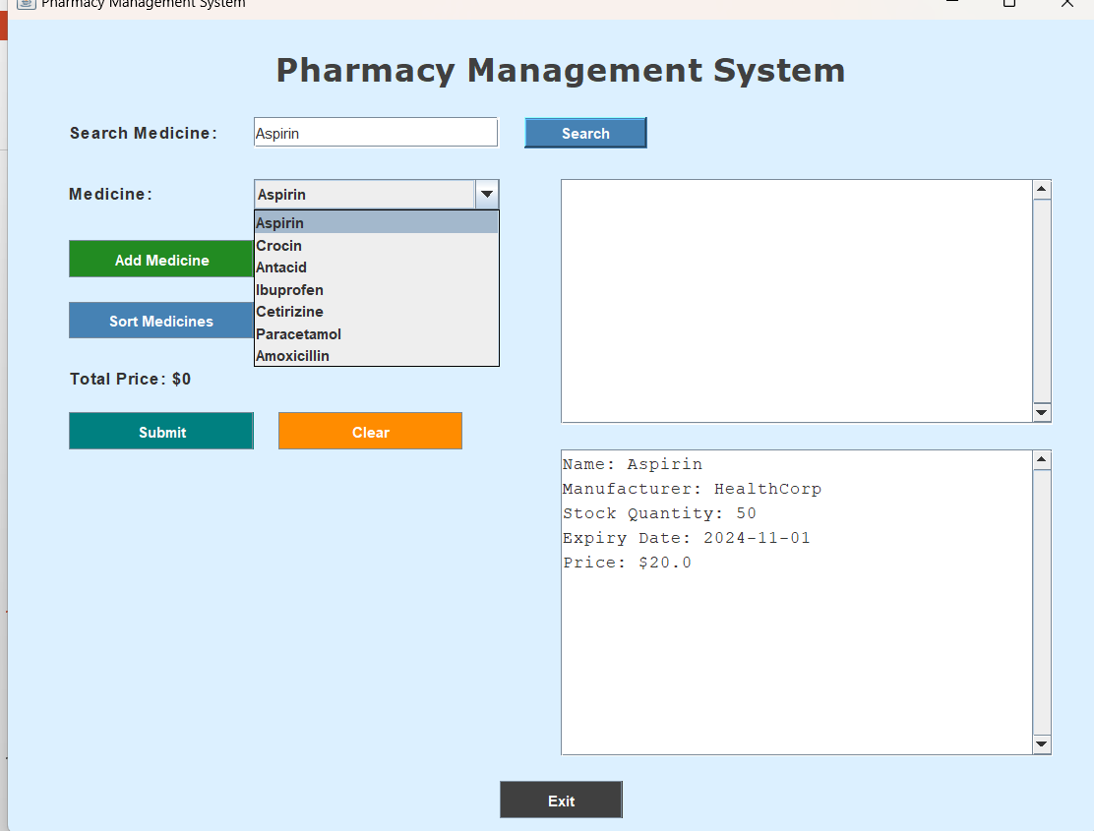
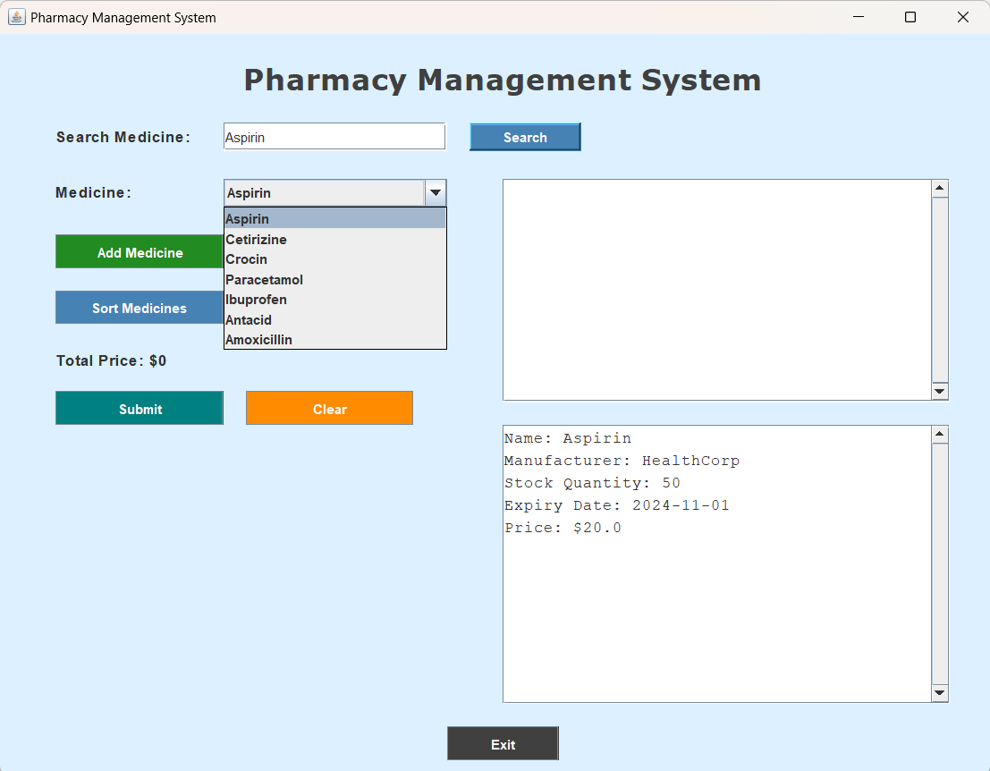
Sorting based on expiry and stock

Slide 11
Thank you!

