Slide 1
New York Child Care Regulated Programs
Presented by
K. Rohitha -46005374

Slide 2
Abstract of the project
The project is to develop Analysis & Reporting System of Child Care Programs in New York City. Here we have gathered a data set from an authentic source which contains data for all the Child Care programs running in the New York City. There are more than 15000 data rows which have the information about the type of Child Care Program running at a particular place, the capacity of the facility, the facility’s License issue & expiry date, the facility’s address, phone number, etc.

Slide 3
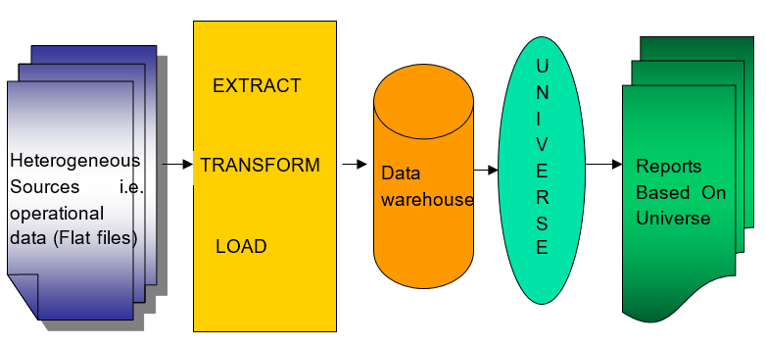
Project flow

Slide 4
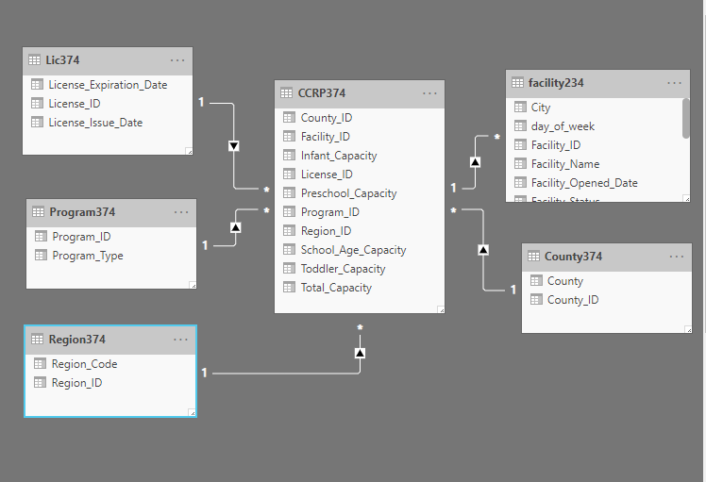
Schema Design

Slide 5
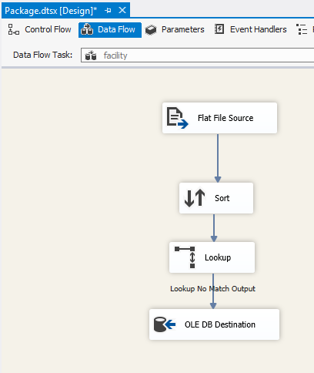
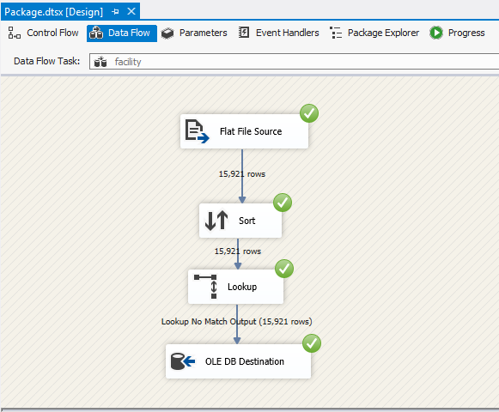
Facility Dimension Table

Slide 6
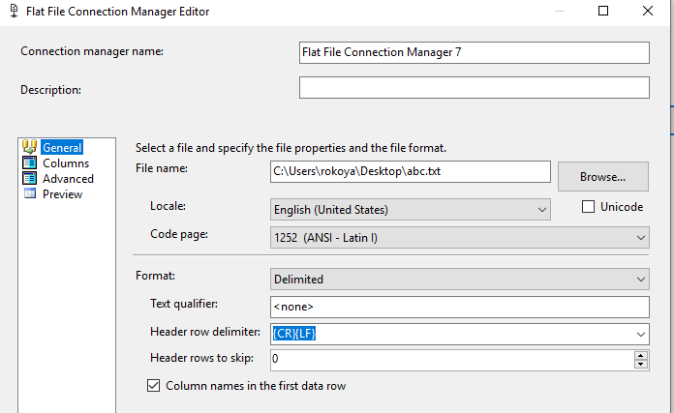
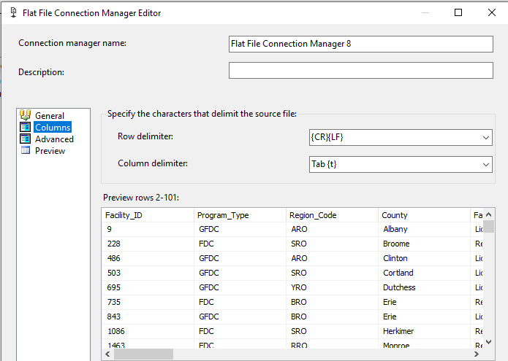
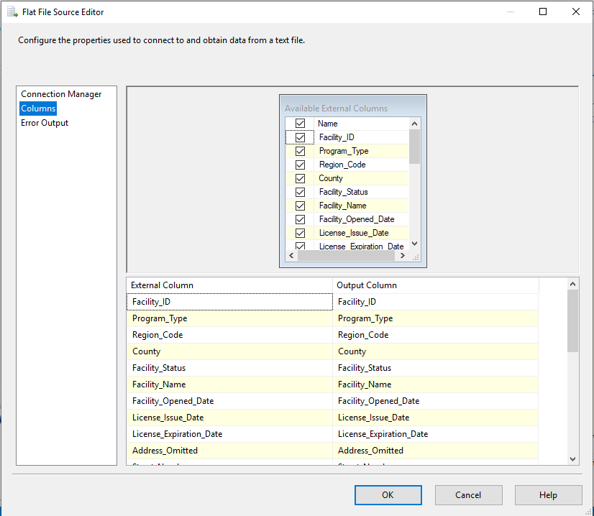
process of extracting flat file

Slide 7
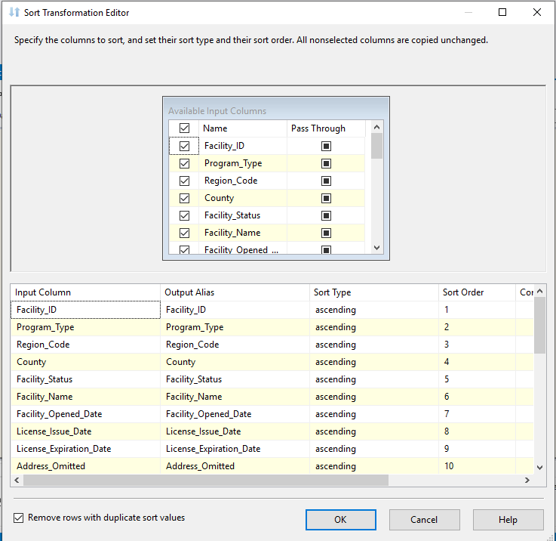
Sorting

Slide 8
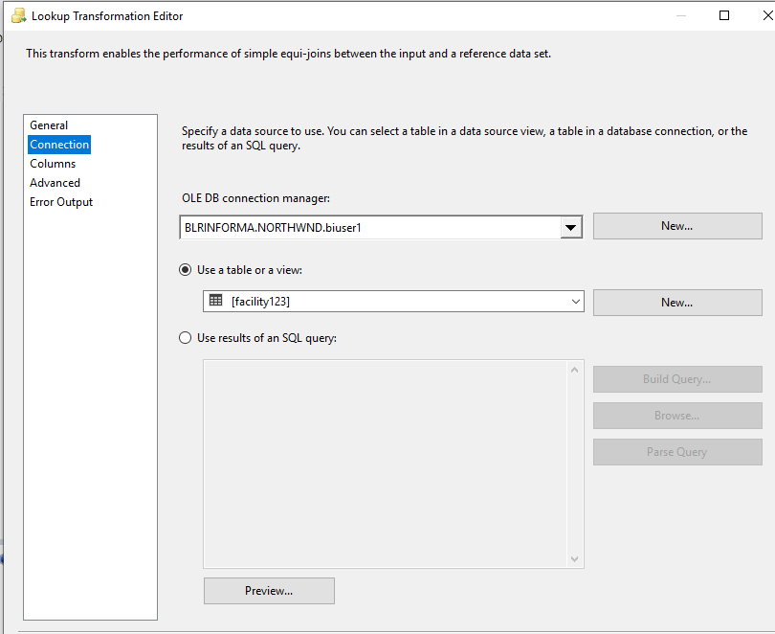
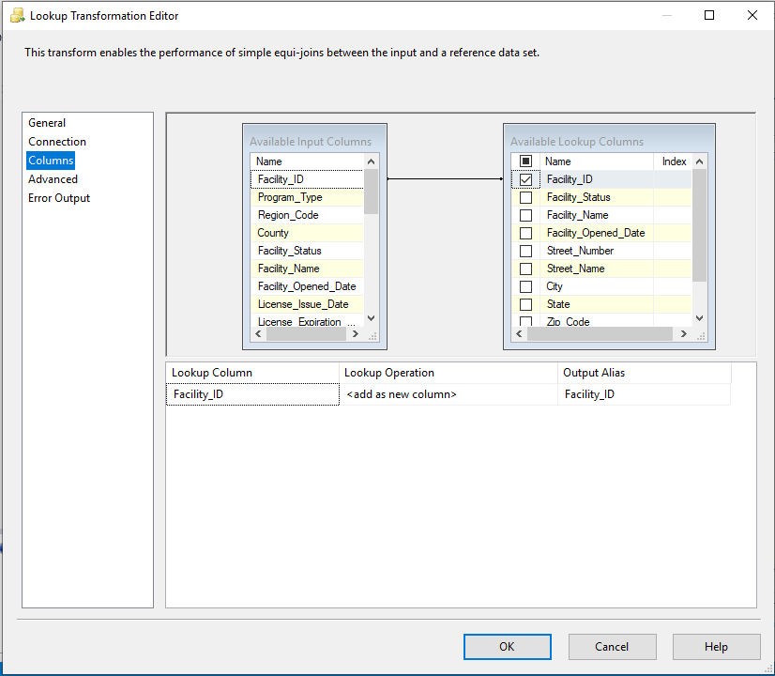
Lookup

Slide 9
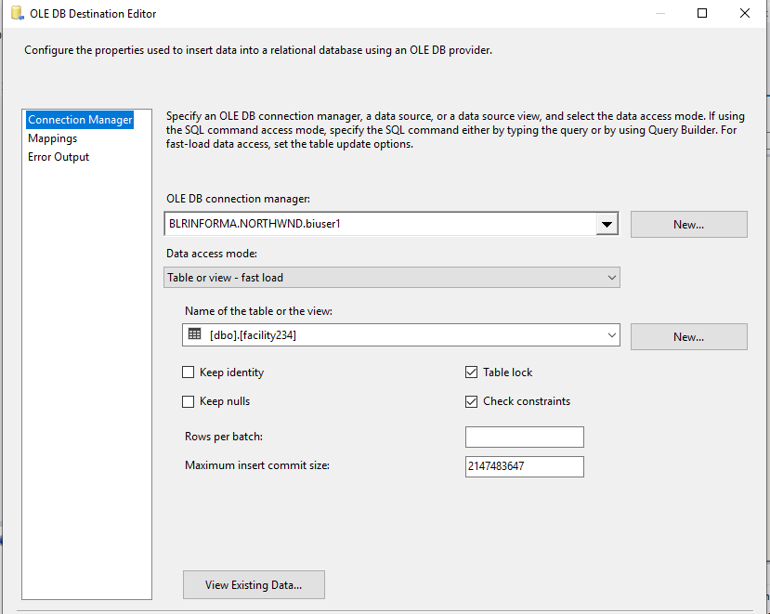
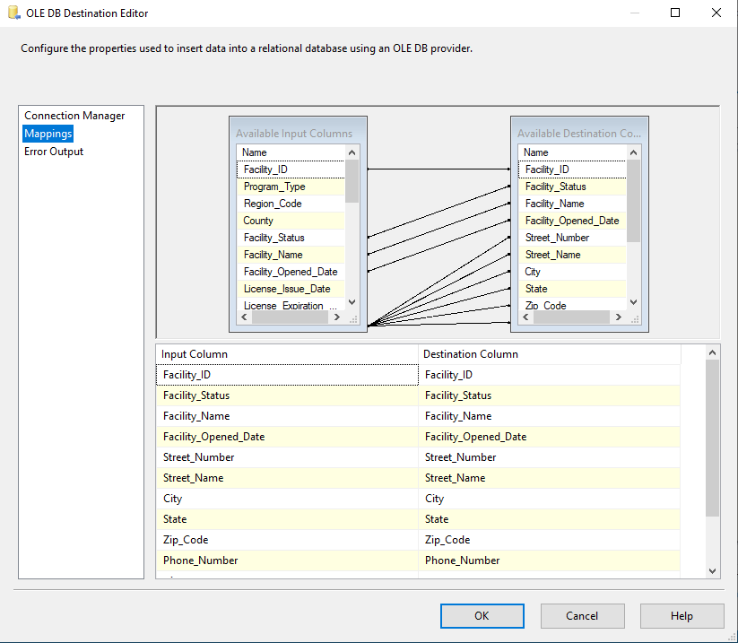
Loading data to Destination

Slide 10
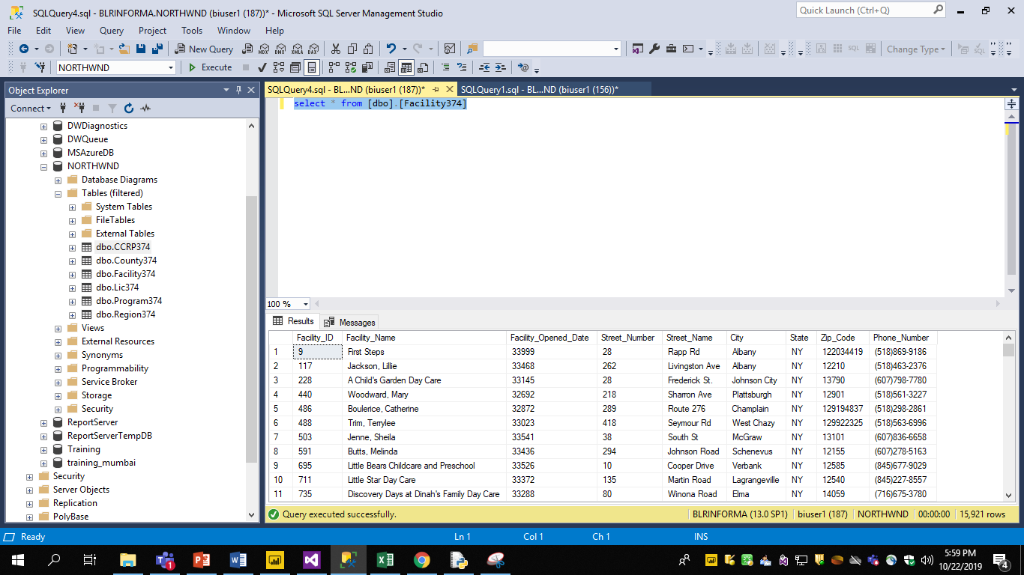
Data Loaded to Database

Slide 11
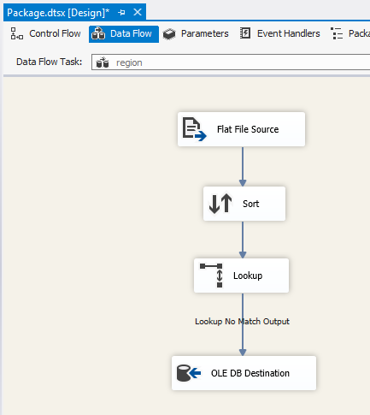
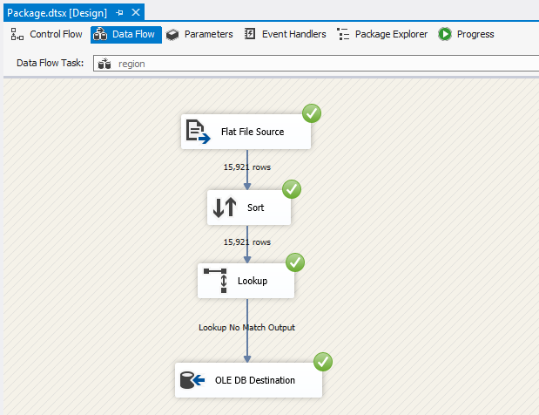
Region Dimension Table

Slide 12
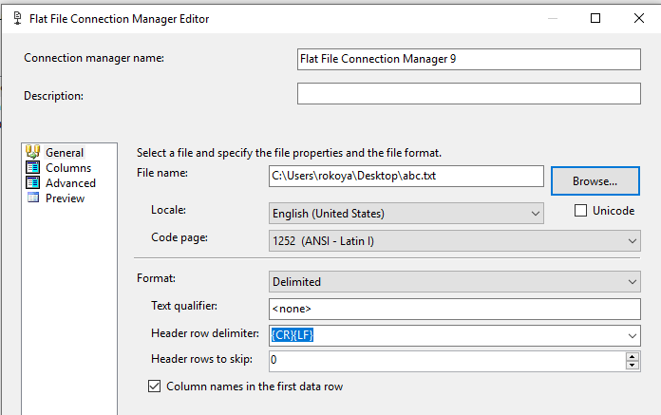
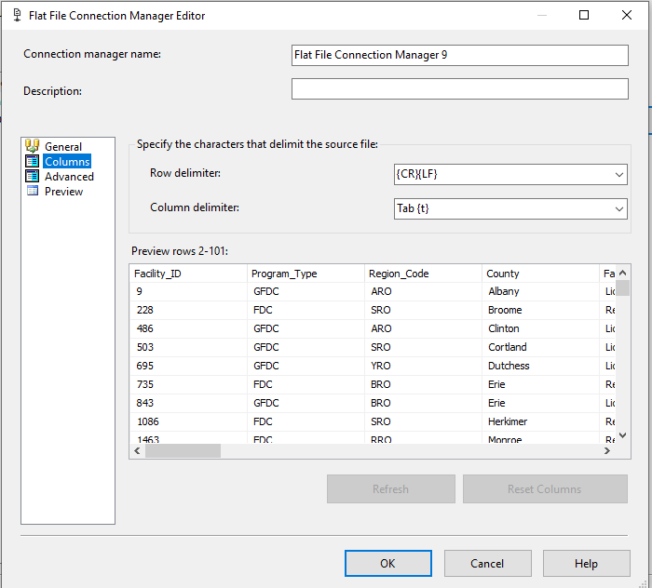

process of extracting flat file

Slide 13

Sorting

Slide 14
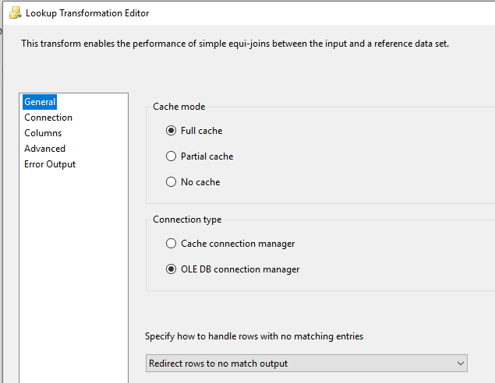
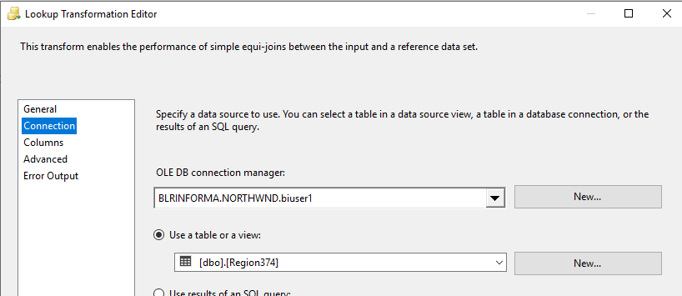
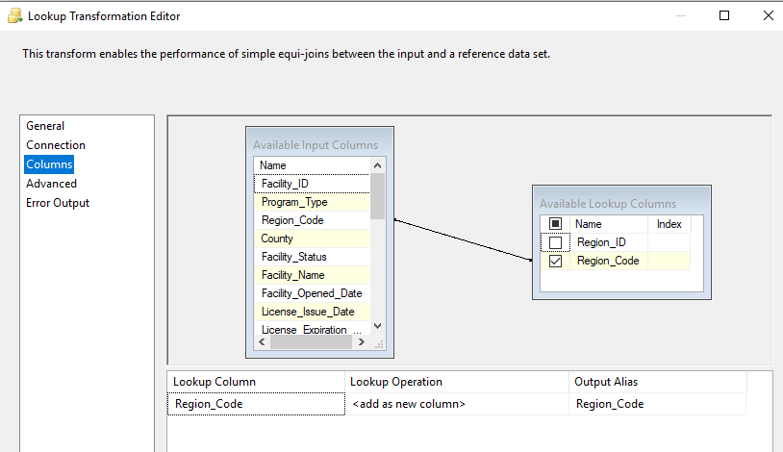
Lookup

Slide 15
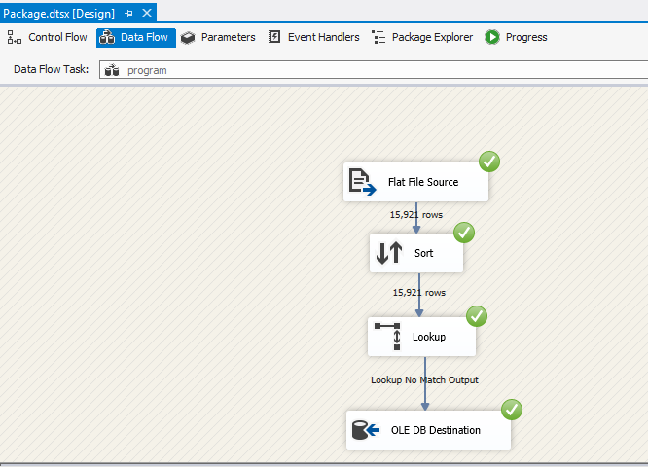
Program Dimension Table

Slide 16
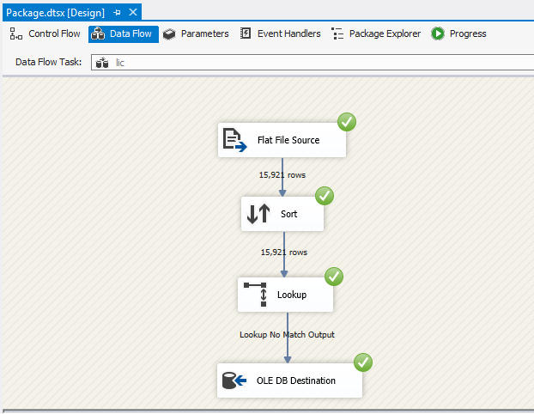
LIC Dimension Table

Slide 17
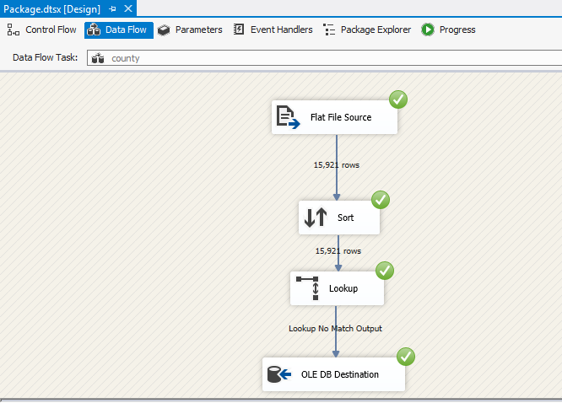
County Dimension Table

Slide 18
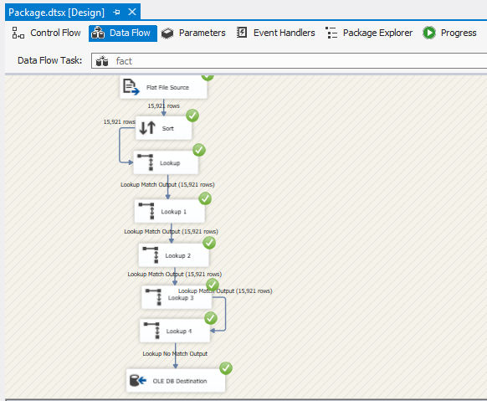
CCRP Fact Table

Slide 19
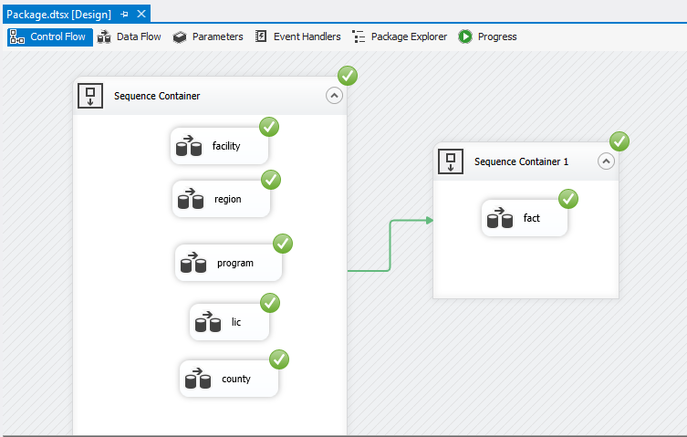
ETL Process

Slide 20
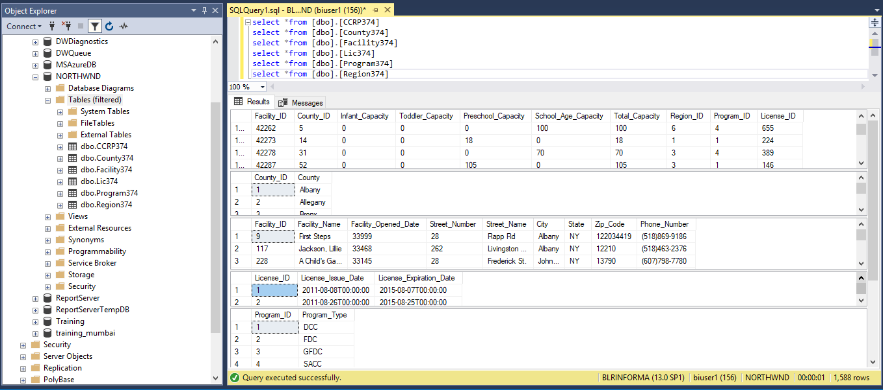
Loading data to the SQL Server

Slide 21
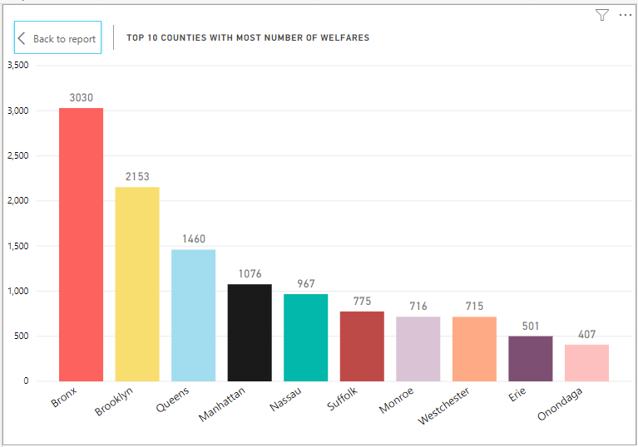
Reports Top 10 Counties with most number of welfares

Slide 22
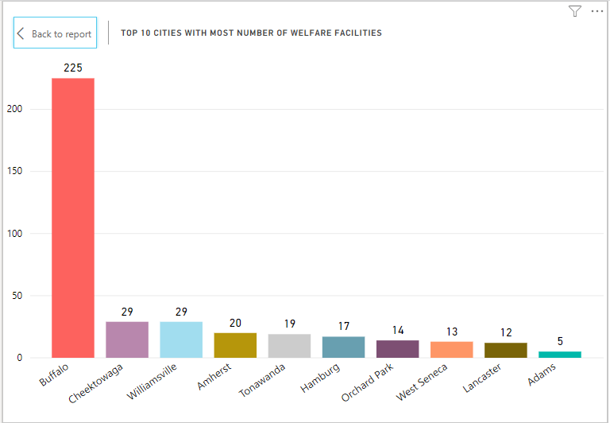
Top 10 cities with most number of welfare

Slide 23
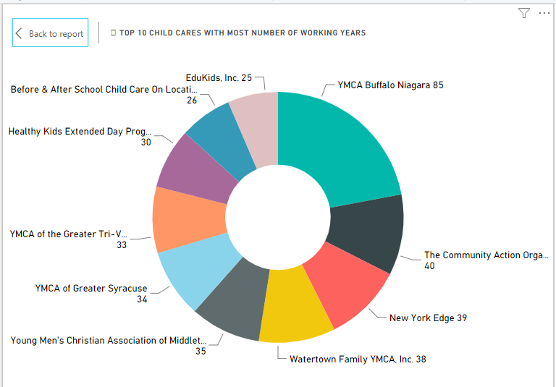
Top 10 Child Cares with most number of working years

Slide 24
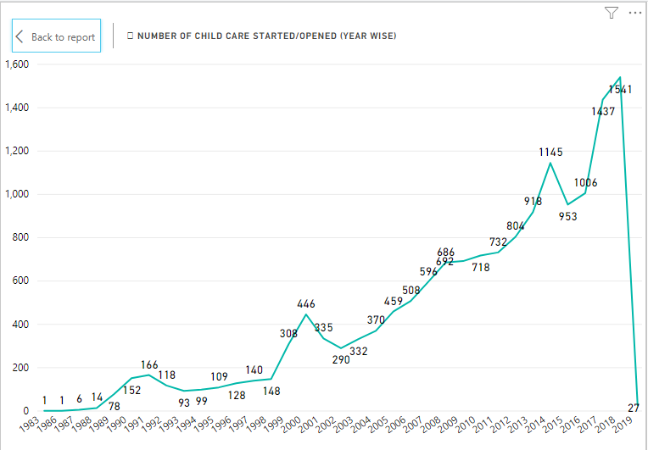
Number of Child Care started/opened (Year Wise)

Slide 25
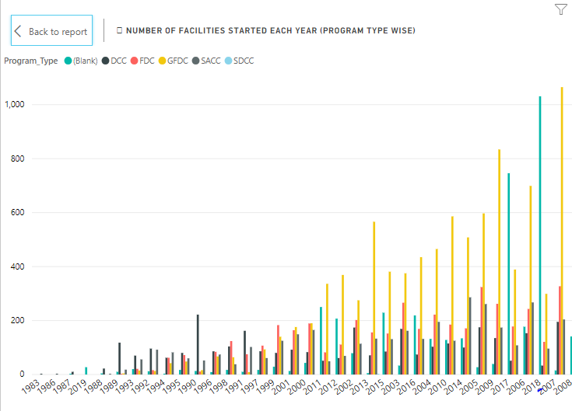
Number of facilities started each year (Program Type Wise)

Slide 26
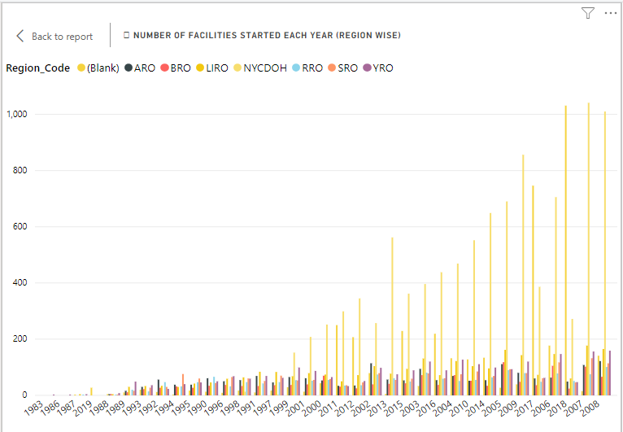
Number of facilities started each year (Region Wise)

Slide 27
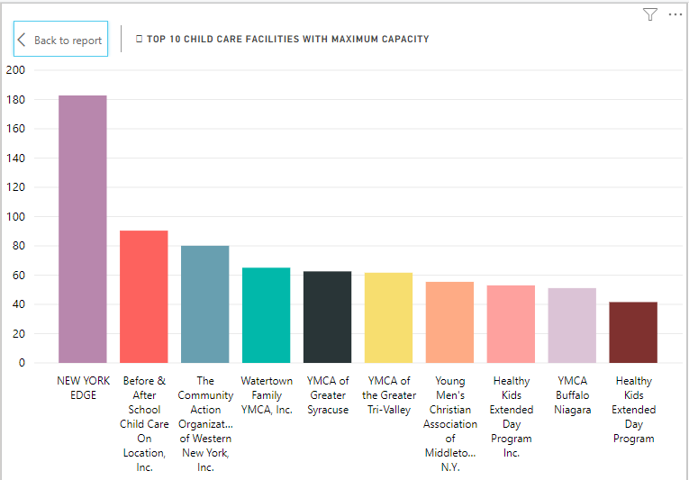
Top 10 Child Care Facilities With Maximum Capacity

Slide 28
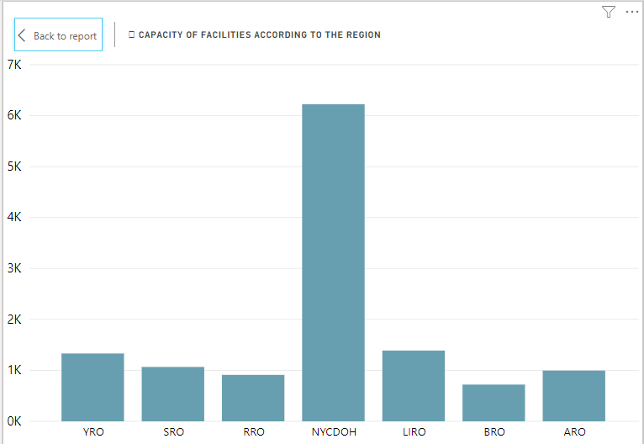
Capacity of facilities according to the Region

Slide 29
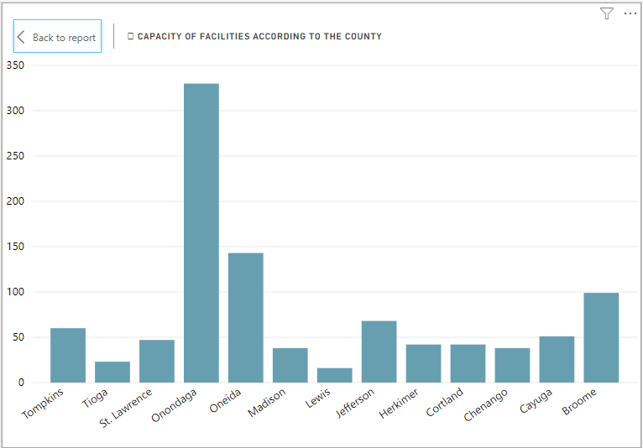
Capacity of facilities according to the County

Slide 30
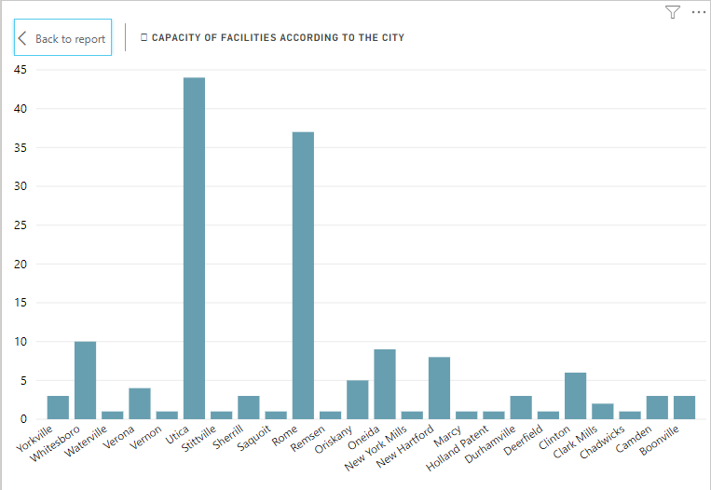
Capacity of facilities according to the City

Slide 31


