Slide 1
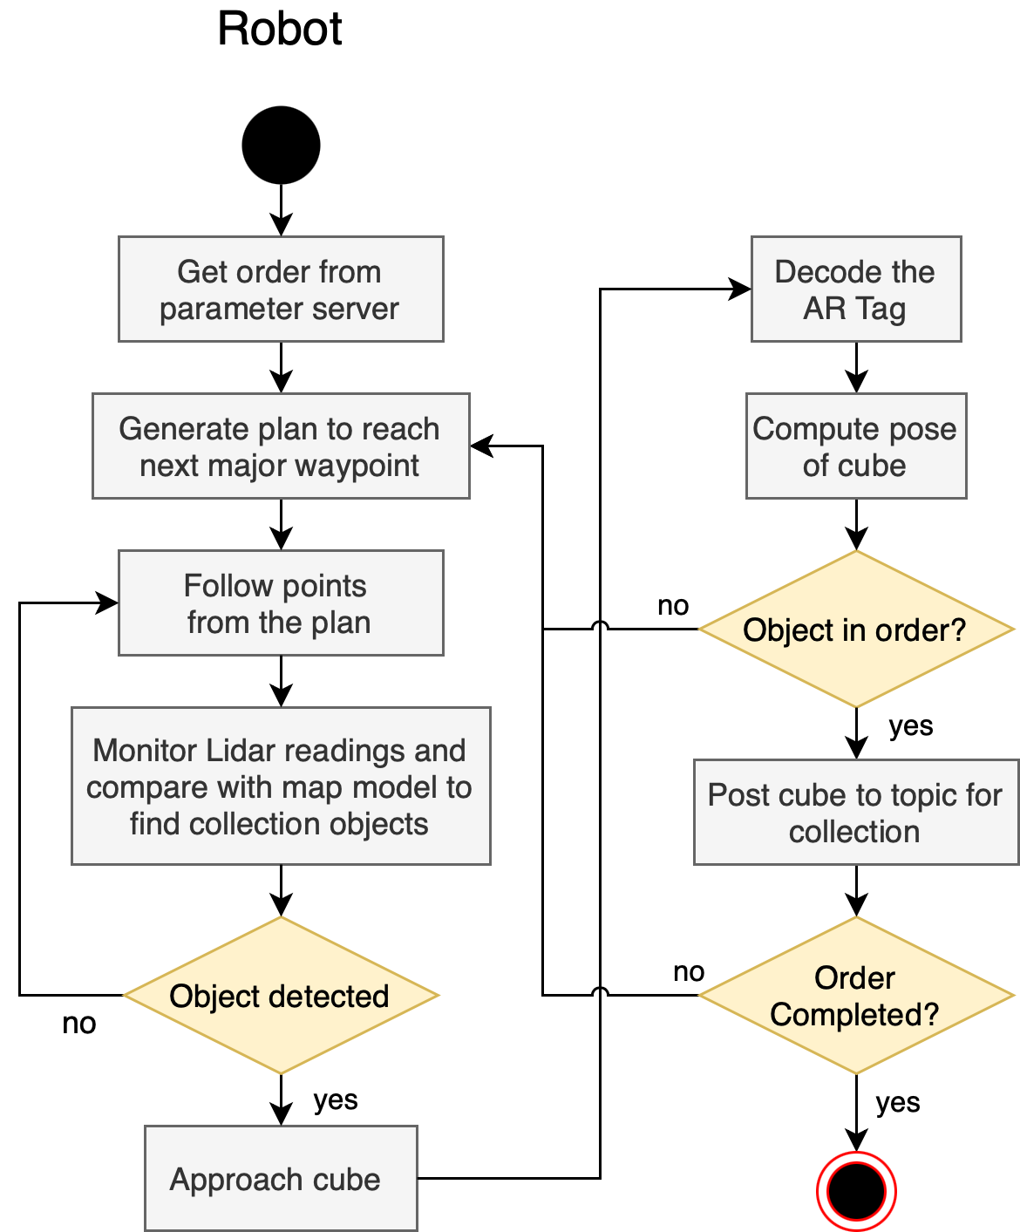
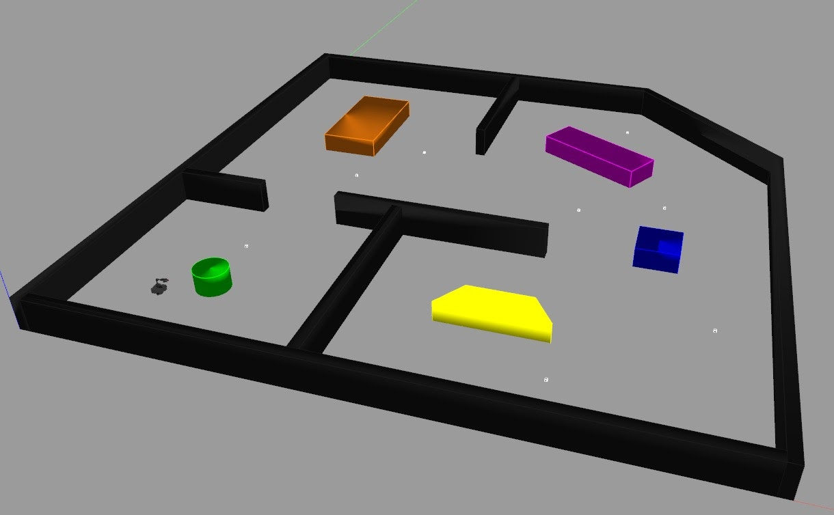
Title : ROS Collection Robot Justin Albrecht, Pradeep Gopal, Govind Ajith Kumar
Overview:
Simulation of an autonomous collection robot in a warehouse with multiple rooms and obstacles
Multiple collection cubes are scattered in the warehouse
The robot is tasked with searching the space and collecting a subset of the cubes.
The cubes contain an AR tag that contains information about what type the object is.
Methodology:
Develop a simulation on Gazebo using ROS and C++ to scan the environment for objects using LIDAR.
Traverse the pre-fed waypoints using A* to cover the entire warehouse.
Use the Camera on the Turtlebot to decode the AR Tag on the cube and determine if the cube is part of the order.
Approach the cube and delete the cube from the environment if the cube is in the order.
Continue traversing the workspace until all cubes are read.
Timeline
Sprint 1 Planning – 28 November, 2020
Create world, objects and spawn Turtlebot – 30 November, 2020
Sprint 2 Planning – 4 December, 2020
Write code stubs for all classes– 5 December, 2020
Spawn cubes on pedestals – 7 December, 2020
Write A star function to follow path– 8 December, 2020
Sprint 3 Planning– 10 December, 2020
Generate waypoints and follow path– 11 December, 2020
Detect cubes, decode and extract pose– 13 December, 2020
Delete cubes in order– 14 December, 2020
Project Completion and Documentation– 15 December, 2020

