Slide 1
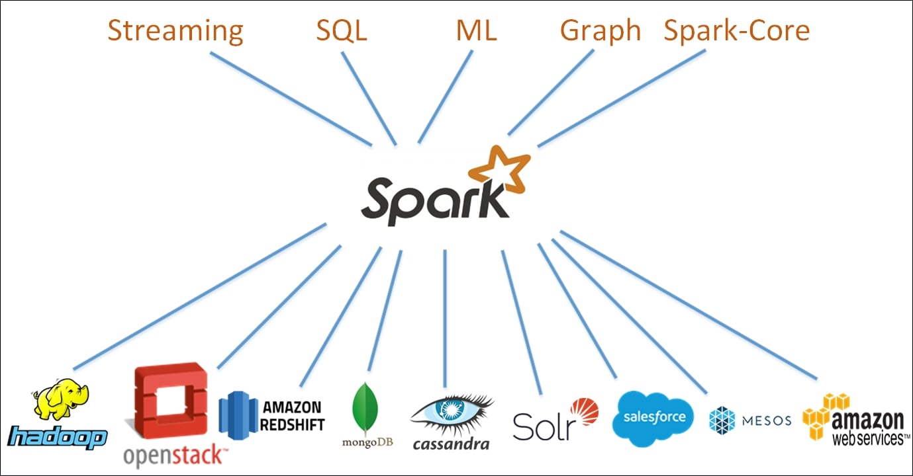
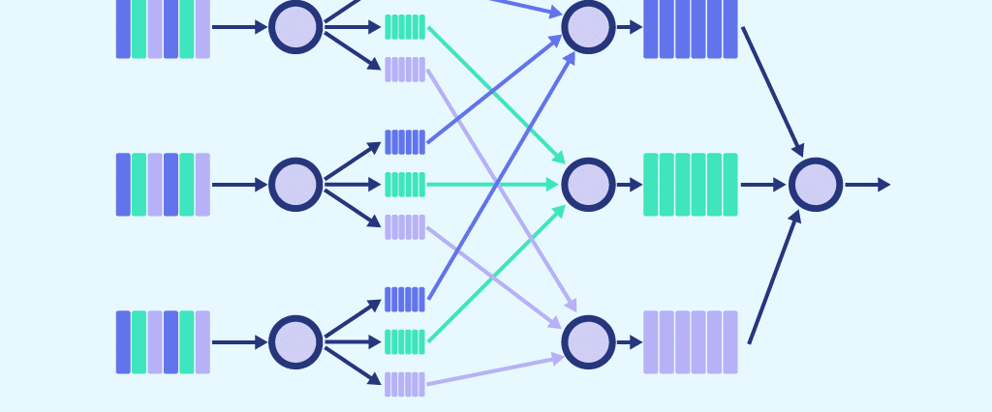
MapReduce and Apache Spark
Name: Premakumara K P S
Index No: 248260A
Module: CS 5229 Big Data Analytics Technologies

Slide 2
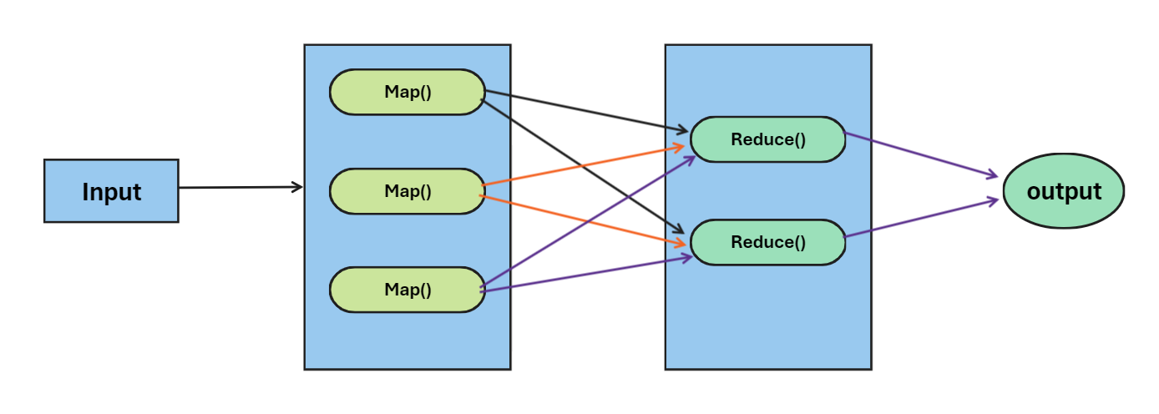
Introduction to MapReduce …
A data processing technique/programming model used to generate and process large scale data sets on distributed clusters.

Slide 3
Introduction to Apache Spark …
An opensource, distributed computing system which provides an advanced and fast data processing engine.
Key Components:
Spark Core: Provides the basic functionality of Spark, including memory management, task scheduling, and fault recovery
Spark SQL: Enables querying structured data using SQL, integrating seamlessly with Spark applications
Spark on YARN: Integration with Hadoop YARN for resource management

