Slide 1
MICRO CREDIT finance PROJECT on Telecom
Submitted By-
Pradeep Kumar Singh

Slide 2
Project details
Project Source : FlipRobo Technologies
Mentor : Astha Mishra
Guidelines taken from : Youtube data Science Channels , Medium. com and Kdnuggets.
Platform used : Python Notebook from Google Colab.
Libraries Used : Pandas,Sklearn,Imblearn,Scipy, Seaborn, Matplotlib

Slide 3
Micro Finance Credit info
Microfinance is a category of financial services targeting individuals and small businesses who lack access to conventional banking and related services. Microfinance services are designed to reach excluded customers, usually poorer population segments, possibly socially marginalized, or geographically more isolated, and to help them become self-sufficient.
Microfinance was defined initially as the provision of microloans to poor entrepreneurs and small businesses lacking access to credit. The two main mechanisms for the delivery of financial services to such clients were: (1) relationship-based banking for individual entrepreneurs and small businesses and (2) group-based models, where several entrepreneurs come together to apply for loans and other services as a group.

Slide 4
Data preprocessing
The whole dataset has checked for the null value at first and checked for the datatype of each feature because sometimes it seems to be a numeric value but appears as a object datatype. The target column which is ‘Label’ here shows the data which is imbalanced. On displaying the statistical summary for the data, it is observed that each and every feature here has the outliers so applying z-score to cut it off.
Some of the columns that are not adding any value to the predicted variable are dropped off such as Unnamed:0,msisdn,pcircle,pdate.On verifying the correlation among the data, some of the feature seems to be highly correlated through the data,so I drop it to remove the ambiguity while operations.
The Statistical summary gives the result and how data is according to mean median and other aspects.

Slide 5
Applied Algorithms
Following are the algorithms that I applied on this dataset
Logistic Regression
Random Forest without hyperparameter tuning
Random Forest with under-sampling
SMOTE tomek

Slide 6
Performance metrics
As this is a imbalanced data set. The most important metrics to be taken into consideration are as follows:
F1-Score
Precision
Recall
ROC-AUC Curve

Slide 7
Best Model After deployment
Oversampling and SMOTETomek are really good performing model according the above observations done. Random Forest without any hyperparameter tuning gives such a good results also shows it is also above the acceptance margin.

Slide 8
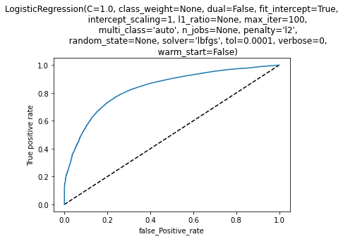
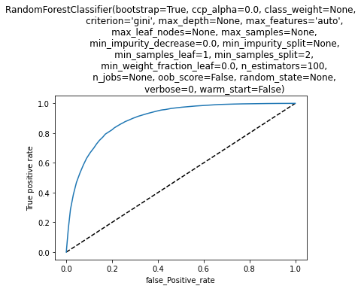


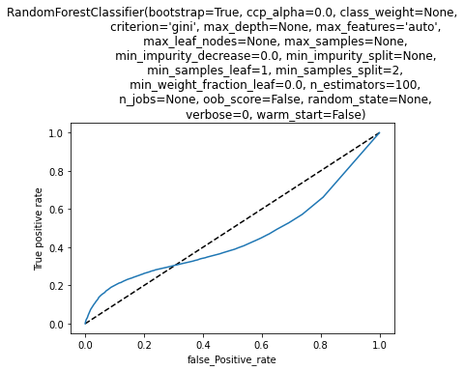
ROC-AUC Graph of applied models
Logistic Regression
Random Forest
OverSampling
SMOTE
Under-Sampling

Slide 9
Thank You

