Slide 1

Concertz: The Future of Event Management
A unified SaaS platform designed to streamline concert production — empowering hosts, maintainers, and attendees through intelligent, role-based orchestration.

Slide 2




Defining the Roles: Who Does What?
Host
Maintainers
Orchestrates the event vision, assigns team responsibilities, and oversees financial health from a central dashboard.
The backbone team managing logistics, equipment, and on-site operations to keep every show running smoothly.
Attendees
The audience enjoying a seamless, frictionless experience — from discovering events to walking through the gates.

Slide 3


The Attendee Experience: From Booking to Entry
A Frictionless Journey
Concertz removes every barrier between discovery and entry, giving attendees confidence at every step.
Discover
Book & Receive
Enter
Browse ongoing concerts through an intuitive, curated dashboard.
QR-code tickets are delivered instantly to the attendee's Gmail inbox.
Contactless gate validation eliminates queues and counterfeit risks.

Slide 4

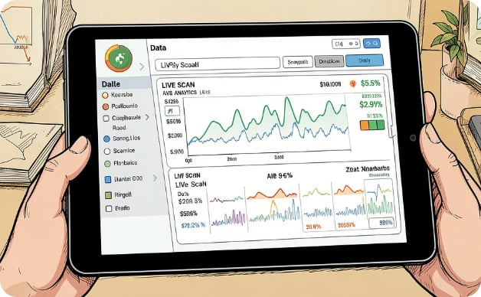

Operational Excellence: The Maintainer's Toolkit
Escorts and staff are equipped with a dedicated mobile interface built for speed, accuracy, and real-time awareness.
Mobile Validation
Automated Sync
Upfront Tips by AI
Dedicated mobile interface for real-time ticket scanning at any gate or checkpoint.
Every scan is tracked and synced instantly across the platform — no manual updates required.
Optimized for peak entry periods, gives insights to reduce queue wait times and unexpected problems.

Slide 5
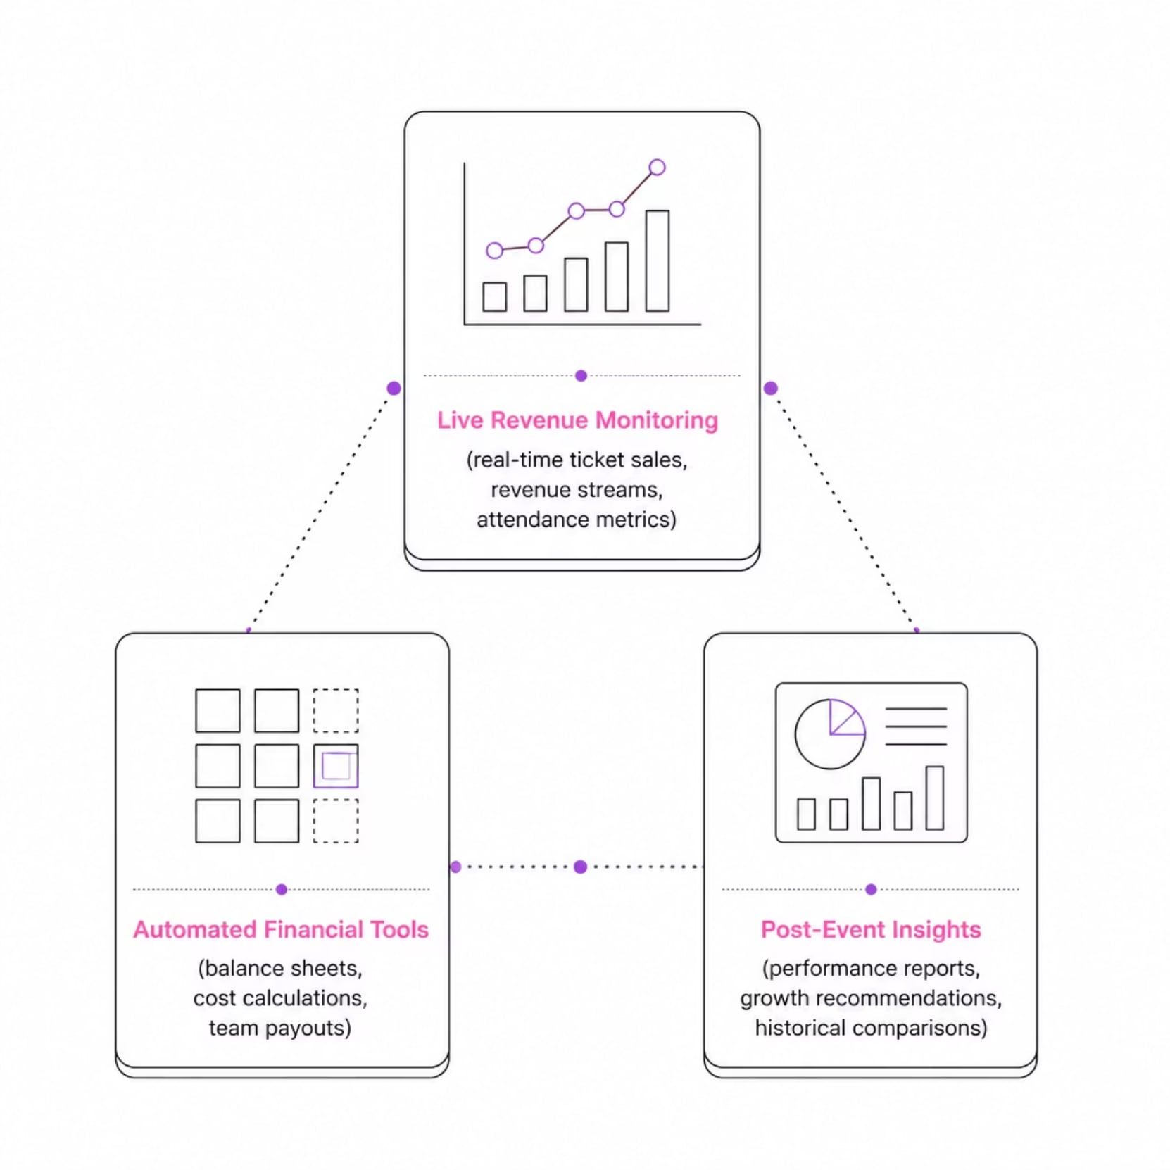

Financial Control: The Host's Dashboard
Full Visibility, Zero Guesswork
Hosts maintain complete financial oversight — from the first ticket sold to the final balance sheet.
Live Revenue Monitoring
Automated Calculations
Actionable Insights
Track ticket sales and revenue streams in real time as the event unfolds.
Integrated tools generate balance sheets and financial summaries without manual effort.
Close out each event with data-driven learnings to improve future productions.

