Slide 1
COURSE CONTENT SIMPLIFICATION AGENT
CAPSTONE PROJECT
Presented By:
Settipalle Pradeep Reddy – RGUKT RK Valley – Computer Science & Engineering

Slide 2
OUTLINE
Problem Statement (Should not include solution)
Proposed System/Solution
System Development Approach (Technology Used)
Algorithm & Deployment
Result (Output Image)
Conclusion
Future Scope
References

Slide 3
Problem Statement
Educational materials often vary in complexity and are not always accessible to learners with different levels of prior knowledge. Students may struggle to grasp key concepts due to jargon-heavy or overly advanced explanations in faculty notes and textbooks. The challenge is to develop an AI-powered agent that can intelligently analyze academic content and reframe explanations based on the learner's current proficiency—ranging from beginner to expert. This would support more inclusive learning and personalized education delivery at scale.

Slide 4
Proposed Solution
The proposed system aims to address the challenge of simplifying complex academic course content to make it understandable for students with varying levels of prior knowledge. This involves leveraging natural language processing (NLP) techniques and cloud-based AI services to analyze and rewrite academic text in simpler terms. The solution will consist of the following components:
Data Collection:
Accept input academic content from students or faculty through a simple web interface.
Allow users to input text manually or paste content from course materials, notes, or textbooks.
Data Preprocessing:
Process the input text to clean unnecessary symbols, HTML tags, or formatting issues.
Prepare the text for NLP analysis by tokenizing sentences and handling language inconsistencies.
Natural Language Processing (NLP):
Use IBM Watson Natural Language Understanding (NLU) to analyze the input text.
Extract key features such as keywords, sentiment, and entities to understand context.
Generate simplified output using defined language rules and the extracted insights.

Slide 5
Proposed Solution
Natural Language Processing (NLP):
Use IBM Watson Natural Language Understanding (NLU) to analyze the input text.
Extract key features such as keywords, sentiment, and entities to understand context.
Generate simplified output using defined language rules and the extracted insights.
Deployment:
Develop a user-friendly web application using Node.js for backend logic and EJS, HTML, CSS for the frontend interface.
Use IBM Cloudant to store original and simplified text securely for future reference and analysis.
Host the application on IBM Cloud Lite services for free, ensuring accessibility and scalability.
Evaluation:
Evaluate the quality of the simplified output through user feedback and manual checks.
Monitor the system’s performance by ensuring the API requests to NLU and database operations are reliable and fast.
Continuously refine the simplification logic to handle different subjects and complexity levels.
Result:
The solution successfully takes complex course material as input, processes it through IBM Watson NLU, and generates a simpler version for better student understanding.
The output and input are securely stored in IBM Cloudant for record-keeping and future improvement.
The user-friendly web interface allows students to easily simplify their study materials anytime.

Slide 6
System Approach
Technology Used:
Node.js (Backend)
EJS, HTML, CSS, Bootstrap (Frontend)
IBM Watson Natural Language Understanding (NLU)
IBM Cloudant Database
IBM Cloud Lite Platform
The web app collects user input, analyzes it via NLU API, generates a simplified version, and stores both original and simplified text in Cloudant.

Slide 7
Algorithm & Deployment
Algorithm Selection: The project uses a rule-based natural language processing (NLP) approach combined with IBM Watson Natural Language Understanding (NLU). Watson NLU is chosen because it provides reliable text analysis capabilities such as keyword extraction, sentiment analysis, and entity recognition, which help understand the input content’s complexity. A simple rule-based logic then uses this information to generate a clearer, simplified version of the input text.
Data Input: The input is the original course content entered by the user. Watson NLU extracts keywords and entities, which guide the simplification. No large training dataset is required
Training Process: The current system does not rely on a traditional machine learning training process. Instead, it uses Watson’s pre-trained NLP models to analyze the input text. The system logic applies custom text-processing rules and mappings to simplify jargon and technical terms into easier language. Future enhancements could involve training custom models to adapt explanations based on user feedback.
Prediction Process: When the user submits text, the system analyzes it live with Watson NLU and applies the rules to generate simplified output. The result is stored in Cloudant and shown to the user instantly.
Deployment: The solution is deployed as a web application built with Node.js and Express.js. The frontend uses EJS templates, HTML, CSS, and Bootstrap for a clean user interface. The application connects securely to Watson NLU and Cloudant through API keys stored in environment variables. The entire system runs on IBM Cloud Lite to ensure easy access and scalability without additional cost.

Slide 8
Result
The system successfully accepts complex course content, generates a simplified version, and stores both for reference. Users receive the simplified output instantly through the web interface. All data is securely saved in the Cloudant database for further use.

Slide 9
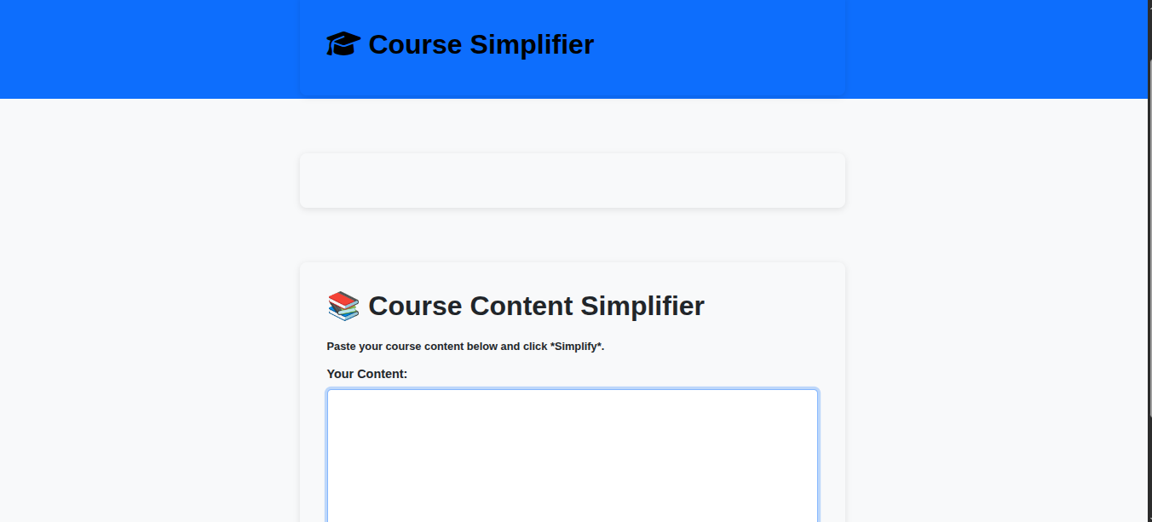
Result Images
Home Page: The landing page welcomes users with a clear Course Simplifier title and navigation bar.

Slide 10
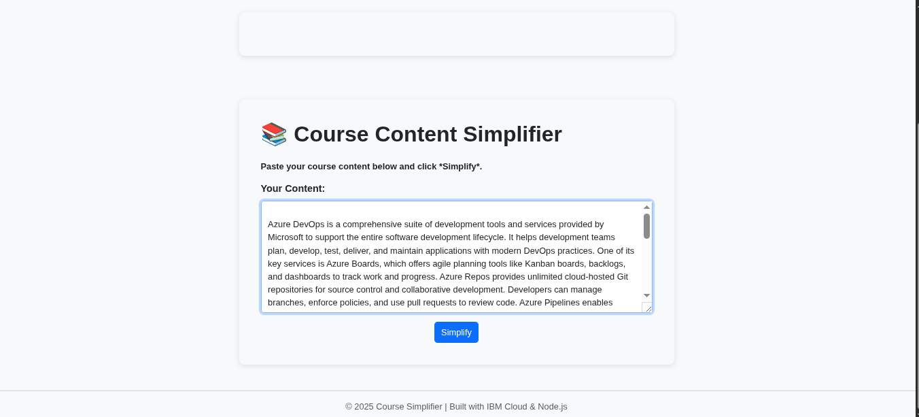
Result Images
Input Page: Users paste course content in the input form and click the Simplify button.

Slide 11
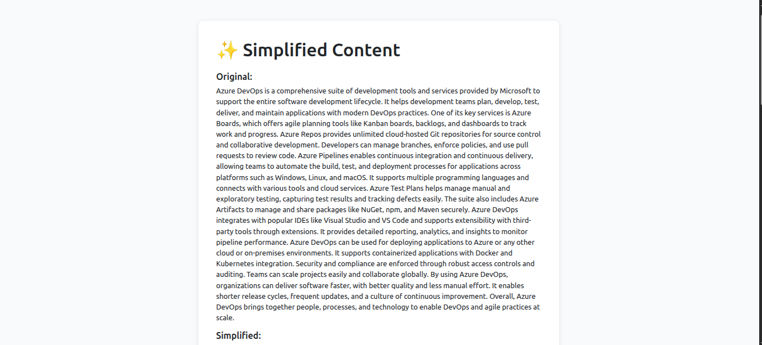
Result Images
Output Pages: The result pages displays the original version of content entered by the User.

Slide 12
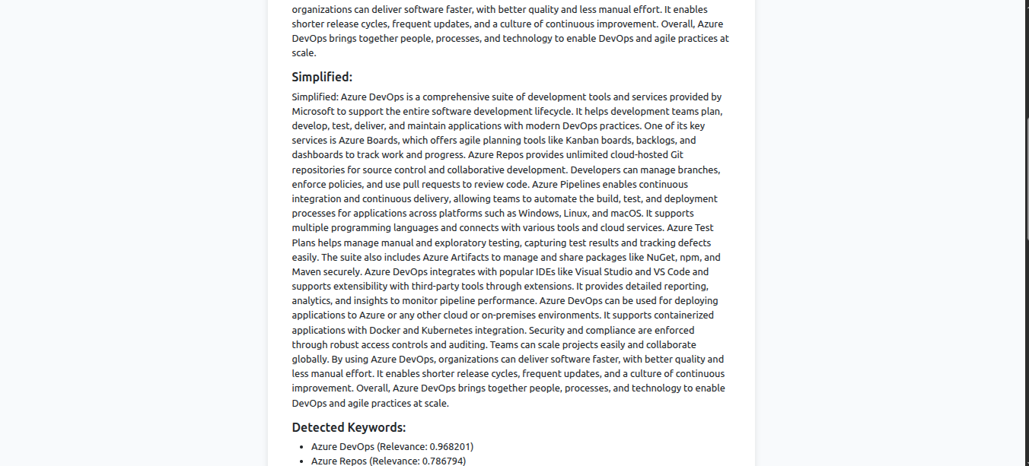
Result Images
Output Pages: The result pages displays the simplified version generated.

Slide 13
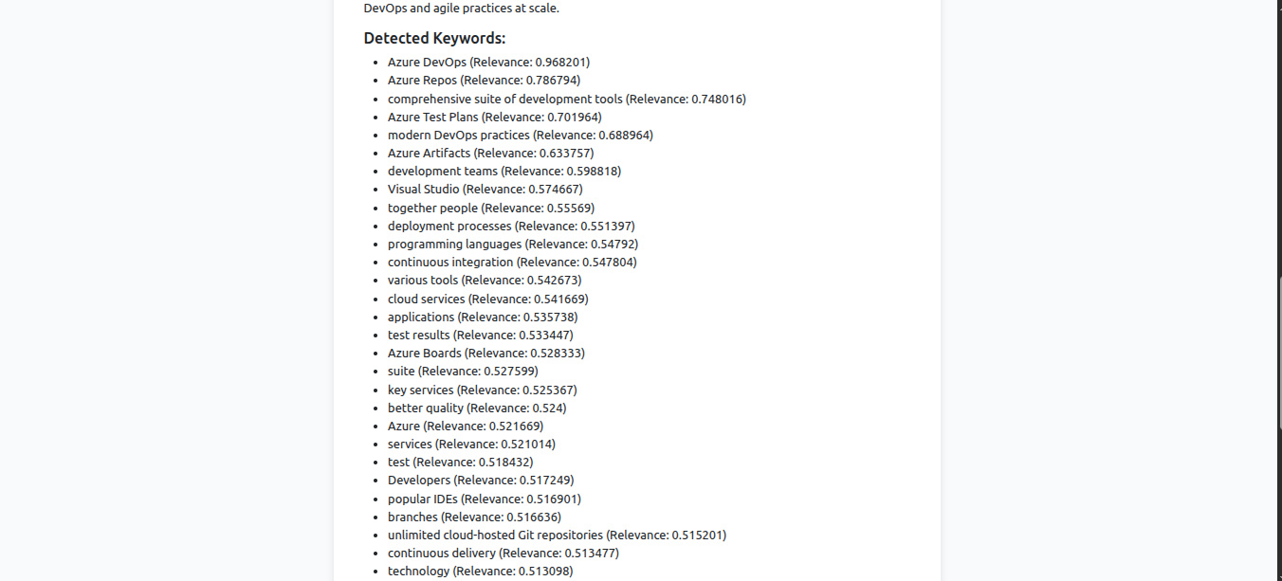
Result Images
Output Pages: The result pages displays the Detected Keywords.

Slide 14
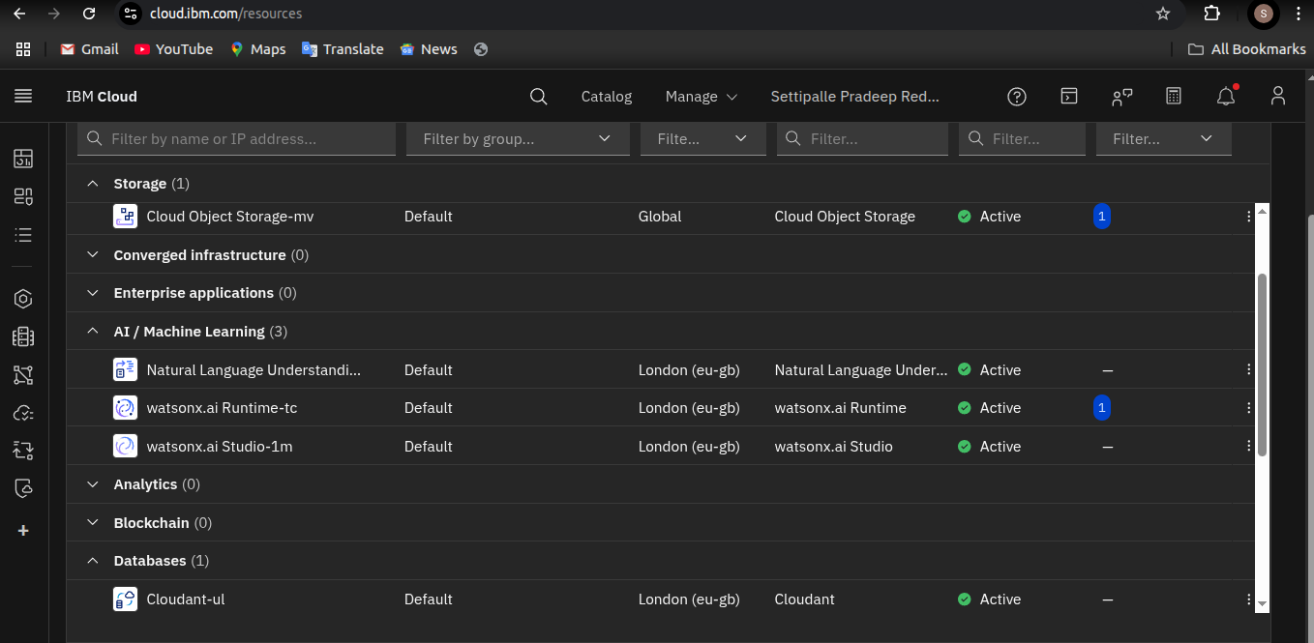
IBM Cloud pages
IBM Cloud Resource List: This page shows what are IBM Cloud services are created for the project.

Slide 15
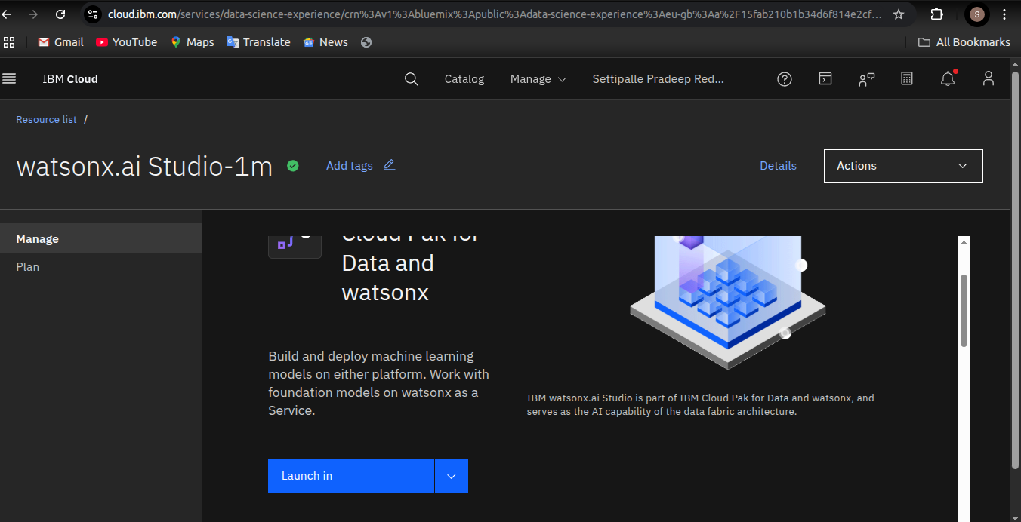
IBM Cloud pages
IBM Cloud Instance Creation: This page shows how a new IBM Cloud service instance is created for the project.

Slide 16
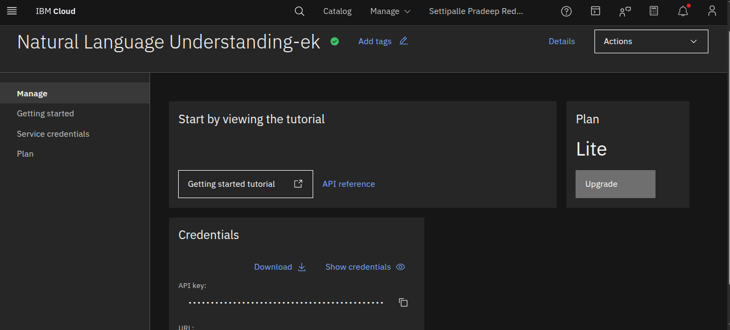
IBM Cloud pages
IBM Cloud Instance Details of NLU: The IBM Cloud page confirms the active instance with credentials ready for integration.

Slide 17
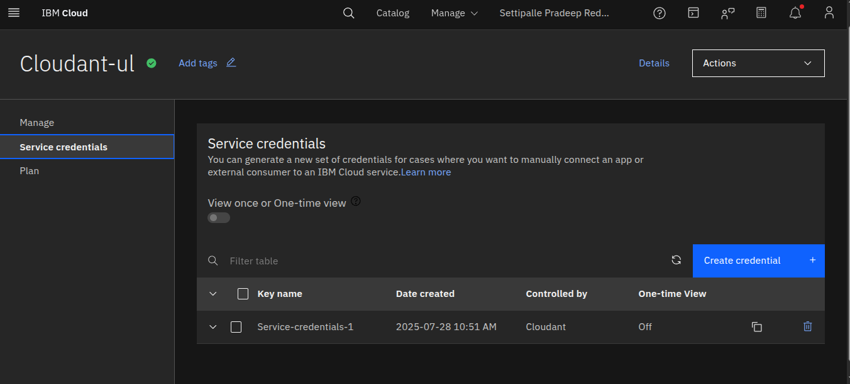
IBM Cloud pages
IBM Cloud Instance Details of Cloudant: The IBM Cloud page confirms the active instance with credentials ready for integration.

Slide 18
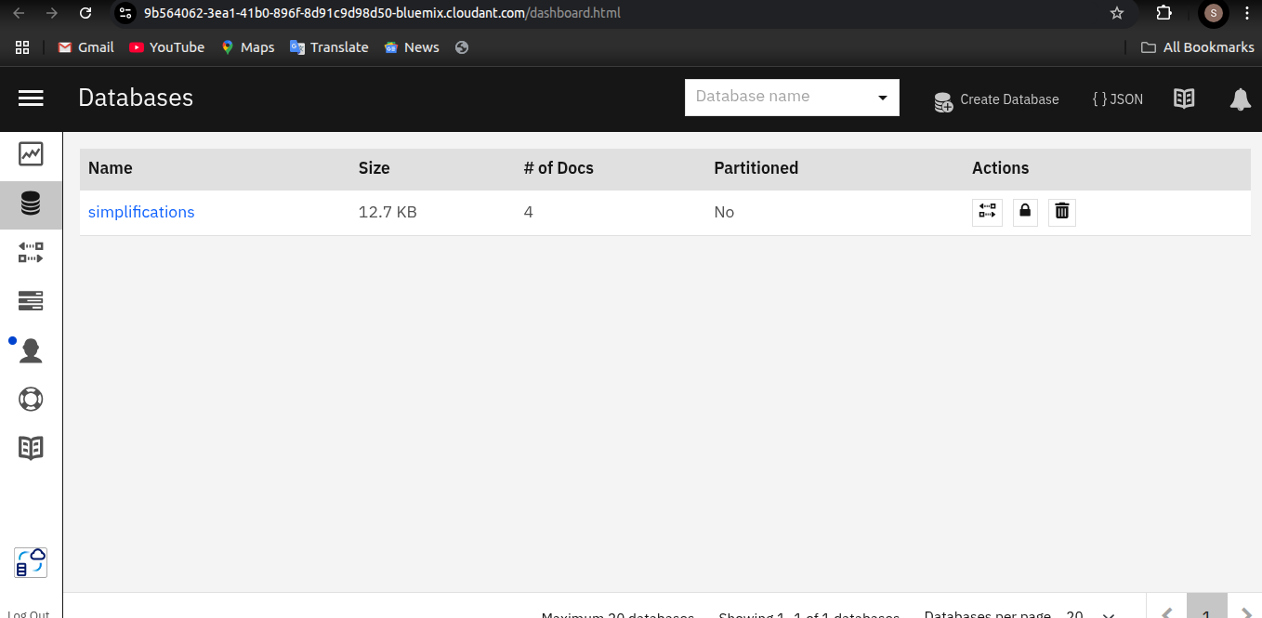
IBM Cloud pages
Cloudant Database Name: Displays the Cloudant database ‘simplifications’ used for storing course data.

Slide 19
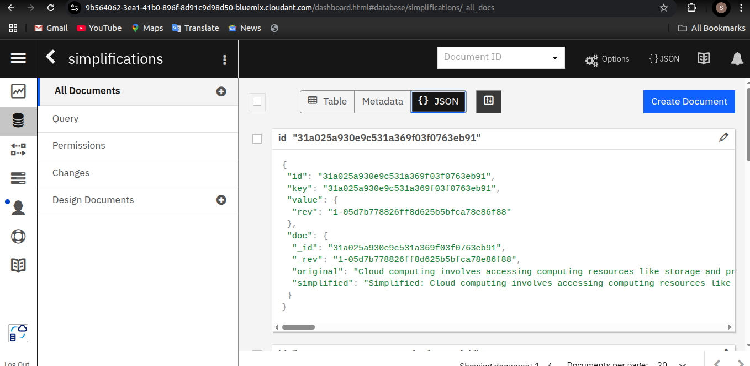
IBM Cloud pages
IBM Cloudant Database Document View:Shows how course content is stored and simplified using IBM Cloudant.

Slide 20
Conclusion
The Course Content Simplification Agent improves accessibility of academic material for students with different levels of prior knowledge. It saves time, increases comprehension, and supports inclusive learning. The project demonstrates how AI and cloud services can transform education.

Slide 21
Future scope
Enhance the agent with multi-language support.
Integrate voice and image inputs for more flexibility.
Use advanced AI models to automatically adapt explanations to beginner, intermediate, or expert levels.
Scale to support large educational institutions.

Slide 22
References
IBM Cloud Documentation
IBM Watson Natural Language Understanding API Docs
IBM Cloudant Docs
Node.js Express Official Docs
Bootstrap Official Docs

Slide 23
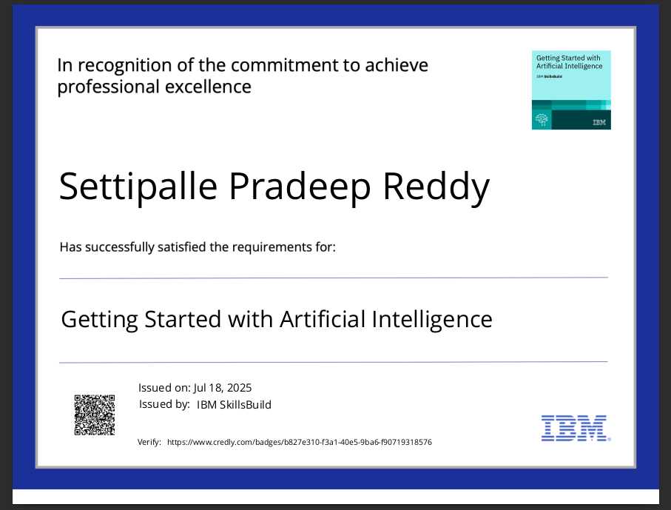
IBM Certifications
Screenshot/ credly certificate( getting started with AI)

Slide 24
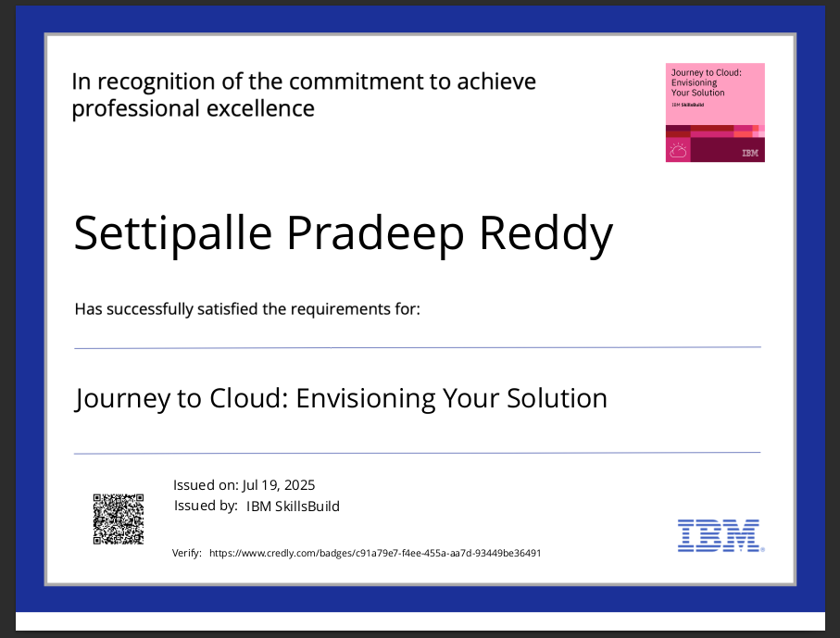
IBM Certifications
Screenshot/ credly certificate( Journey to Cloud)

Slide 25
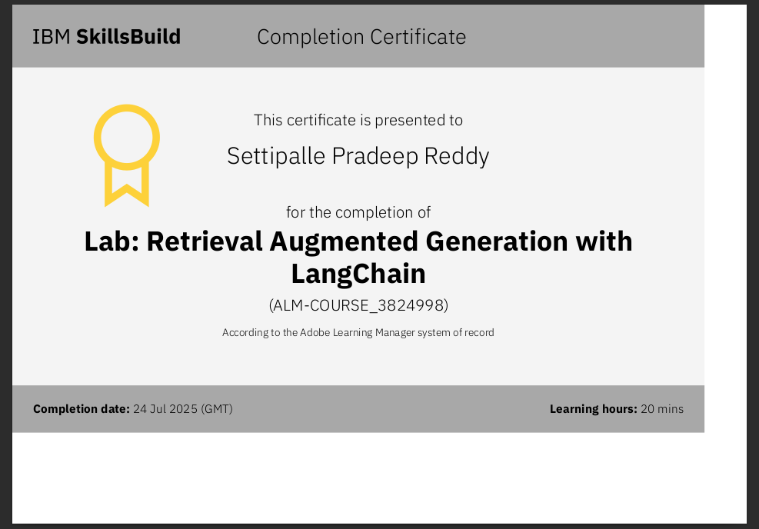
IBM Certifications
Screenshot/ credly certificate( RAG Lab)

Slide 26
Git hub link:
Click this: View Project on GitHub
(Ctrl+click)

Slide 27
THANK YOU

