Slide 1

INDIAN INSTITUTE OF INFORMATION TECHNOLOGY BHOPAL
Submitted by
Yeluri Bharath Raj (20U01031)
Puli Pradeep (20U01053)
Amgothu Jayaram Naik (20U01033)
Banala Abhishek Satwik (20U01027)
Under the supervision of
Dr. Bhupendra Singh Kirar
A.P. (Electronics and Communication Engineering)
Dr. Afreen Khursheed
Major Project coordinator
Electronics and Communication Engineering IIIT Bhopal

Slide 2
PREDICTION OF MELANOMA DETECTION USING CNN
CNN(Convolutional Neural Networks)

Slide 3
OVERVIEW
INTRODUCTION
ABOUT DATA
METHODOLOGY
TECHNOLOGIES AND METHODOLOGIES
FLOW CHART
RESULT AND CONCLUSION

Slide 4
INTRODUCTION
Melanoma is a potentially deadly form of skin cancer that originates in melanocytes, the pigment-producing cells of the skin, and can spread to other parts of the body if not detected and treated early.
Melanoma detection using Convolutional Neural Networks (CNN) harnesses the power of deep learning to significantly improve the accuracy and efficiency of identifying malignant skin lesions, offering the potential to save lives through early diagnosis.
CNN are specialized deep learning models designed for image and pattern recognition tasks, leveraging layers of convolution and pooling to extract features and make them a cornerstone of computer vision and image processing applications.

Slide 5
ABOUT DATA
Data set was actually downloaded from Kaggle, Kaggle is a popular online platform for data science and machine learning competitions, as well as a community where data scientists and machine learning practitioners can collaborate, learn, and share their work. It was founded in 2010 and has since become a key resource for those interested in data science, artificial intelligence, and related fields
Kaggle offers a vast collection of datasets that users can explore, download, and analyze. These datasets cover a wide range of topics, making them a valuable resource for research and analysis.

Slide 6
Our data consist of 2493 Images of 9 classes.
Which are divided images into Train and Test Datasets.
Total Training Datasets are 2349 and Total Test Datasets are 144.
Create a CNN model, which can accurately detect 9 classes present in the dataset. The RGB channel values are in the [0, 255] range. This is not ideal for a neural network. Here, it is good to standardize values to be in the [0, 1].
After training and validation of the model, As we can see that now the Training and Validation accuracy are almost in the same level and the highest accuracy achieved is around 88.5% , this shows the impact of how performing Data Augmentation can improve the model performance

Slide 7
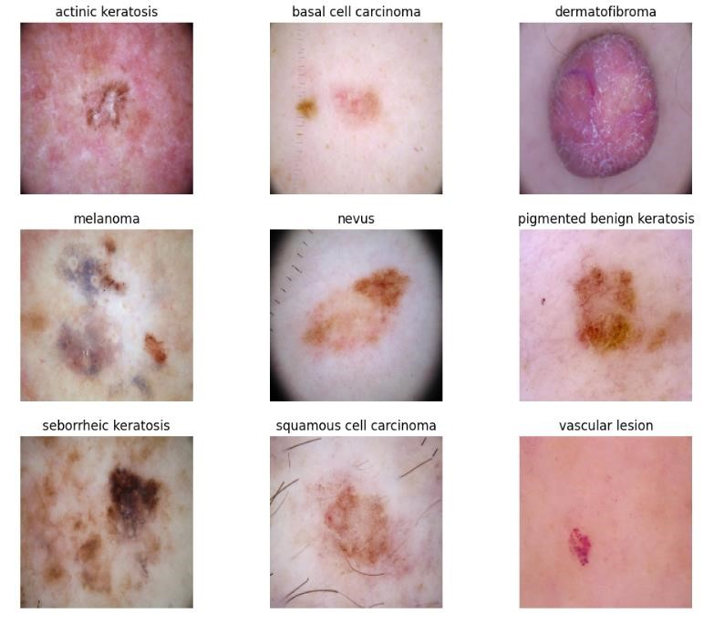
9 Classes of the Datasets

Slide 8
Technologies and Methodologies
We did this project using python language on platform of google collab
Image preprocessing plays a crucial role in melanoma detection using computer vision or machine learning techniques. Common preprocessing steps for melanoma detection include:
Color Space Conversion, Image Enhancement, Resizing, Noise Reduction, Segmentation, Feature Extraction, Data Augmentation, Normalization, Data Balancing.
These preprocessing steps help improve the quality of input data for machine learning models or computer vision algorithms, leading to more accurate melanoma detection.

Slide 9
We must train our CNN network till our generative images should be looks like real images.
Training a model involves optimizing its parameters on a labeled dataset, typically by iteratively adjusting them to minimize a loss function, which measures the difference between model predictions and actual target values.
Validation is the process of evaluating the trained model's performance on a separate dataset not used during training, allowing us to assess its generalization capabilities and detect potential overfitting or underfitting.
Data augmentation is a technique used in machine learning and computer vision to artificially increase the diversity and size of a dataset by applying various transformations to the existing data. Here are two key points about data augmentation.

Slide 10
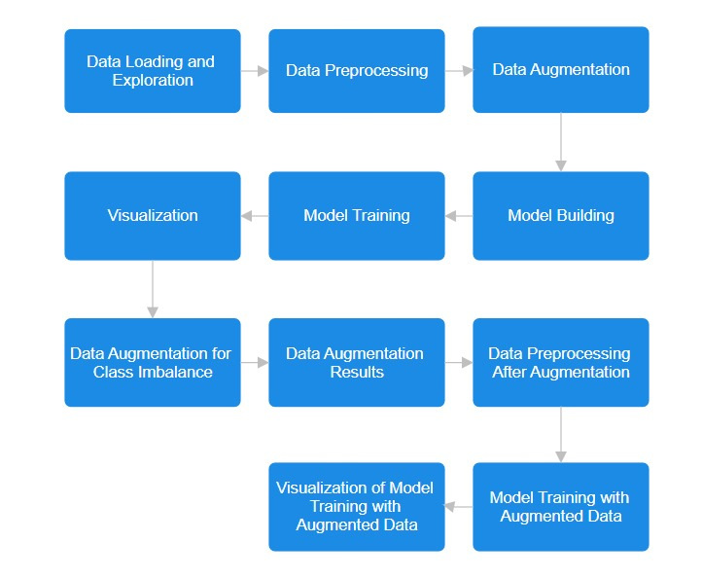

Slide 11
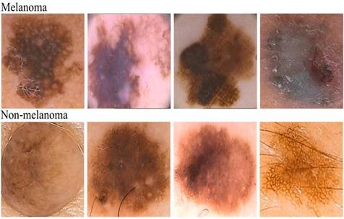
RESULT
After 20 epochs our generated image shows the difference between Melanoma and
Non-Melanoma

Slide 12
we had to make sure that the generator and discriminator are on a similar level throughout the training process.
During the experiment we noticed :
Our generator was proficient enough to trick the discriminator thus proving that the discriminator was not able to extract the finer detail features in the skin lesion image data during the training process.
But When we train our dataset with 20 epochs, we got an accuracy of 88%.

Slide 13
3rd International Conference on Computational Electronics for Wireless Communications

Slide 14
It is an academic conference that focuses on the intersection of computational electronics and wireless communications.
It provides a platform for researchers, academics, engineers, and professionals to come together and share their research findings, discuss emerging trends, and collaborate on various aspects related to computational electronics and its applications in the field of wireless communications.
In this conference we have successfully submitted our article and I’m glad to inform you that our paper has provisionally been Accepted for publication in 3rd International Conference on Computational Electronics for Wireless Communications .

Slide 15
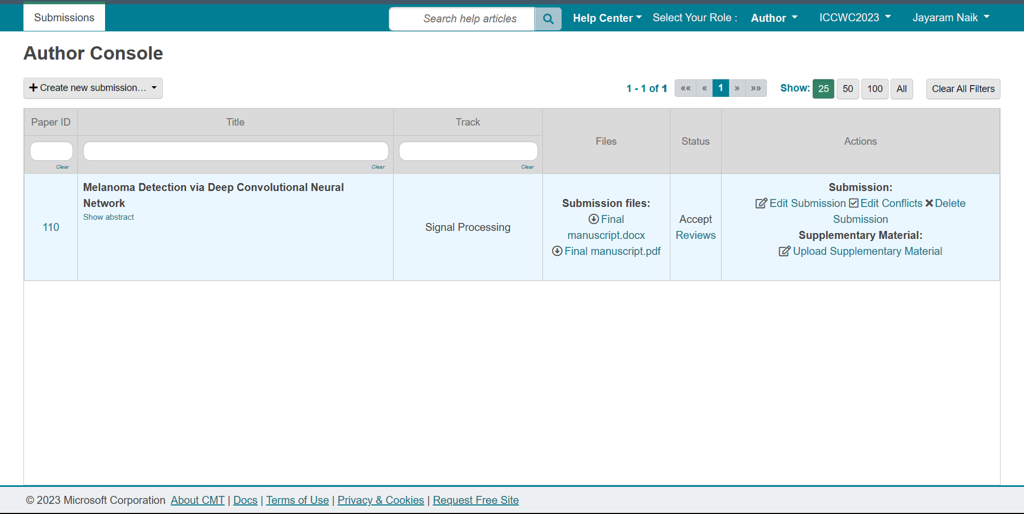

Slide 16
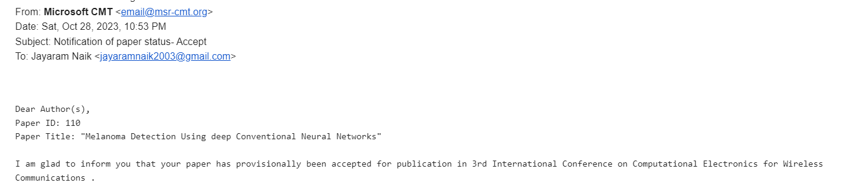



Slide 17
THANK YOU

