Slide 1

INDIAN INSTITUTE OF INFORMATION TECHNOLOGY BHOPAL
Under the supervision of
Dr. Bhupendra Singh Kirar
Assistant Professor
Electronics and Communication Engineering
Dr. Afreen Khursheed
Major Project coordinator
Electronics and Communication Engineering
Submitted by
Yeluri Bharath Raj (20U01031)
Puli Pradeep (20U01053)
Amgothu Jayaram Naik (20U01033)
Banala Abhishek Satwik (20U01027)

Slide 2
MELANOMA DETECTION USING DEEP CONVOLUTIONAL NEURAL NETWORKS

Slide 3
CONTENTS
INTRODUCTION
ABOUT DATA
METHODOLOGY
TECHNOLOGIES AND METHODOLOGIES
FLOW CHART
RESULT AND CONCLUSION

Slide 4
INTRODUCTION
CNN: Yann LeCun invented the first convolutional neural network (CNN), these are a type of deep learning algorithm that can be used to identify melanoma. CNNs are often used for visual recognition and image analysis, and have been shown to be effective in diagnosing melanoma from images.[1]
LeNet: Developed by Yann LeCun and his team in the 1990s, LeNet was one of the earliest successful CNN architectures, primarily used for handwritten digit recognition.[2]
MobileNet: Developed by Google in 2017, MobileNet is optimized for mobile and embedded devices, achieving a good balance between model size and accuracy through depthwise separable convolutions.[3]

Slide 5
XceptionNet: Introduced by François Chollet in 2017, XceptionNet is an extension of the Inception architecture. It replaces the standard inception modules with depthwise separable convolutions, which significantly reduces the number of parameters while maintaining representational power.[4]
DenseNet : Proposed by Gao Huang et al. in 2017, DenseNet introduced dense connectivity patterns between layers, facilitating feature reuse and gradient flow throughout the network.[5]
VGG Net: Proposed by the Visual Geometry Group at the University of Oxford in 2014, VGGNet is characterized by its simplicity and uniform architecture, with a focus on depth.[6]

Slide 6
ABOUT DATA
Data set was actually downloaded from Kaggle, Kaggle is a popular online platform for data science and machine learning competitions, as well as a community where data scientists and machine learning practitioners can collaborate, learn, and share their work.
It was founded in 2010 and has since become a key resource for those interested in data science, artificial intelligence, and related fields
Kaggle offers a vast collection of datasets that users can explore, download, and analyze. These datasets cover a wide range of topics, making them a valuable resource for research and analysis.
Reference: https://www.kaggle.com/datasets/nodoubttome/skin-cancer9-classesisic

Slide 7
Our data consist of 2322 Images of 9 classes.
Which are divided images into Train and Test Datasets.
Total Training Datasets are 1858 and Total Test Datasets are 464.
Create a CNN model, which can accurately detect 9 classes present in the dataset. The RGB channel values are in the [0, 255] range. This is not ideal for a neural network. Here, it is good to standardize values to be in the [0, 1].
After training and validation of the model, As we can see that now the Training and Validation accuracy are almost in the same level and the highest accuracy achieved is around 94.20% , this shows the impact of how performing Data Augmentation can improve the model performance
Reference: https://www.kaggle.com/datasets/nodoubttome/skin-cancer9-classesisic

Slide 8
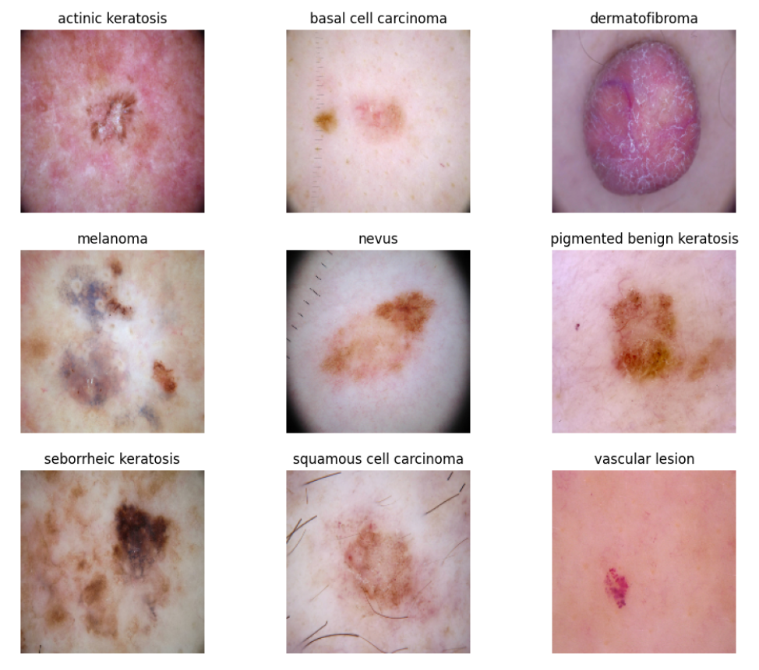
Fig 1: 9 Classes of the Datasets

Slide 9
PROPOED METHODOLOGIES
We did this project using python language on platform of Visual Studio Code
Image preprocessing plays a crucial role in melanoma detection using computer vision or machine learning techniques. Common preprocessing steps for melanoma detection include:
Color Space Conversion, Image Enhancement, Resizing, Noise Reduction, Segmentation, Feature Extraction, Data Augmentation, Normalization, Data Balancing.
These preprocessing steps help improve the quality of input data for machine learning models or computer vision algorithms, leading to more accurate melanoma detection.

Slide 10
We must train our CNN network till our generative images should be looks like real images.
Training a model involves optimizing its parameters on a labeled dataset, typically by iteratively adjusting them to minimize a loss function, which measures the difference between model predictions and actual target values.
Validation is the process of evaluating the trained model's performance on a separate dataset not used during training, allowing us to assess its generalization capabilities and detect potential overfitting or underfitting.
Data augmentation is a technique used in machine learning and computer vision to artificially increase the diversity and size of a dataset by applying various transformations to the existing data. Here are two key points about data augmentation.

Slide 11
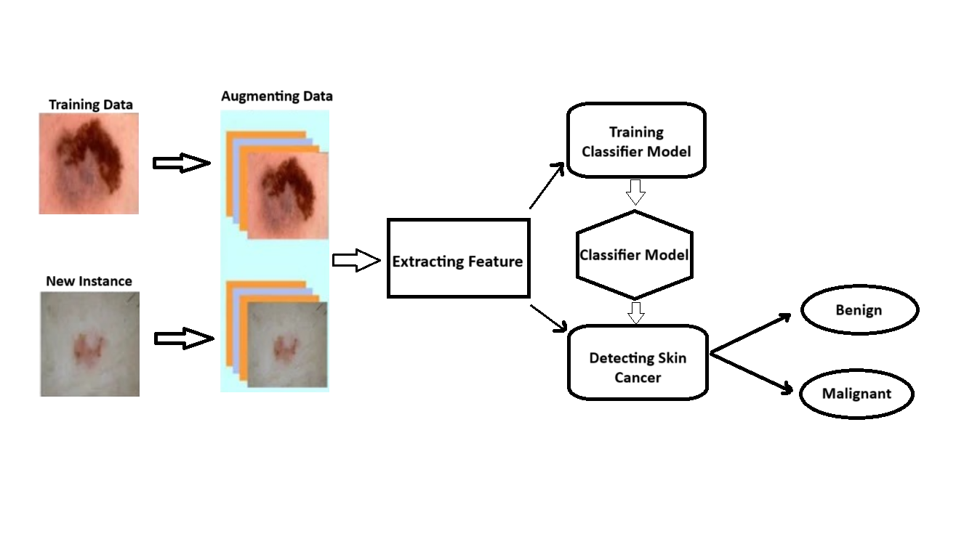
Fig 2: Detection of Skin Cancer Based on Skin Lesion Images Using Deep Learning

Slide 12
RESULT
we had to make sure that the generator and discriminator are on a similar level throughout the training process.
Melanoma detection through deep CNNs represents a ground breaking advancement, often surpassing an accuracy rate of 94.2%, and holds great potential in these medical fields.
During the experiment we noticed :
Our generator was proficient enough to trick the discriminator thus proving that the discriminator was not able to extract the finer detail features in the skin lesion image data during the training process.
But When we train our dataset with 60 epochs, we got an accuracy of 94.20%.

Slide 13
RESULT
Table 1. Evaluating the performance of various Networks and Proposed model.
Networks Comparison | Accuracy
VGG | 42.72%
DenseNet | 60.71%
XceptionNet | 72.77%
MobileNet | 73.20%
LeNet | 82.25%
Proposed Model (CNN) | 94.20%

Slide 14
Fig 3: Accuracy comparison between various Networks and Proposed Model CNN.

Slide 15
(a)

Slide 16
Fig. 4. Performances for of the model for various epochs from 1-60 (a) Loss (b) Accuracy

Slide 17
CONCLUSION
This project presents the findings of our research, highlighting the success of our melanoma detection model. Our approach combines machine learning techniques with deep Convolutional Neural Networks (CNN) for feature extraction, and the results demonstrate its superior performance compared to other methods.
Our model achieved an impressive accuracy rate of 94.2%, underscoring its effectiveness in melanoma detection. This indicates that our approach is a robust and reliable solution for identifying melanoma, a critical step in early diagnosis and improving patient outcomes.

Slide 18
REFERENCES
A. Bibi, M.A. Khan, M.Y. Javed, U. Tariq, B.-G. Kang, Y. Nam, R.R. Mostafa, R.H. Sakr, Skin lesion segmentation and classification using conventional and deep learning-based framework, Compute. Mater. Contin. 71 (2) (2022) 2477–2495.
Sachdeva, M., & Kushwaha, A. K. S. (2023). The power of deep learning for intelligent tumor classification systems: A review. Computers and Electrical Engineering, 106, 108586.
Narayanan, D. L., R. N. Saladi, and J. L. Fox. (2010) “Ultraviolet radiation and skin cancer.” International Journal of Dermatology 49 (9): 978–986, doi: 10.1111/j.1365-4632.2010.04474.x.
World Health Organization. Global health observatory. 1999.
Huang, Gao, et al. "Densely Connected Convolutional Networks." Proceedings of the IEEE Conference on Computer Vision and Pattern Recognition (CVPR), 2017. DOI: [10.1109/CVPR.2017.243](https://doi.org/10.1109/CVPR.2017.243).
Jain, S., Pise, N., et al.: Computer aided melanoma skin cancer detection using image processing. Procedia Computer Science 48, 735–740 (2015) https://doi.org/10.1016/j.procs.2015.04.209.

Slide 19
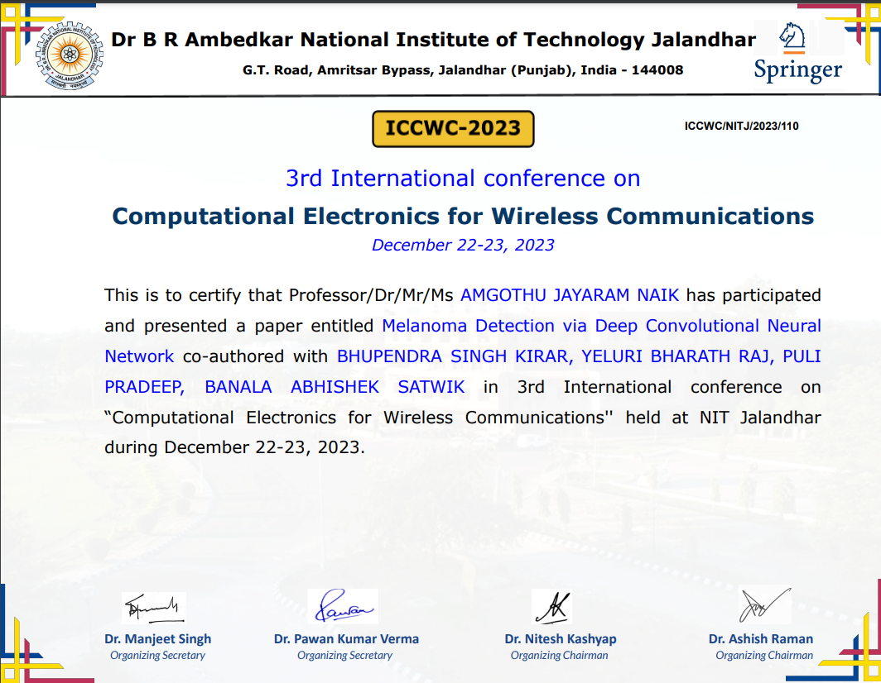

Slide 20
*THANK YOU*

