Slide 1
Karpagam College Of Engineering Coimbatore-32
DATA STRUCTURE-2
ASSIGNMENT
PRADEEP.S
12F129
B.TECH [IT’A’]

Slide 2
QUESTION
In hashing, suppose we stored n keys in a hash table of size m, with collision resolved by chaining, and that we know the length of each chain, including the length L of the longest chain. Describe a procedure that selects a key uniformly at random from among the keys in the hash table and returns it in expected time .

Slide 3
PROGRAM
#include <stdio.h>
#include<conio.h>
#include <stdlib.h>
struct hash *ht = NULL;
int eCount = 0,ccount=0;
char l[100];
struct node {
int key;
struct node *next;
};

Slide 4
struct hash {
struct node *head;
int count;
};
struct node * createNode(int key)
{
struct node *newnode;
newnode = (struct node *)malloc(sizeof(struct node));
newnode->key = key;
newnode->next = NULL;
return newnode;
}

Slide 5
void insert(int key) {
int Index = key % eCount;
struct node *newnode = createNode(key);
if (!ht[Index].head)
{
ht[Index].head = newnode;
ht[Index].count = 1;
return;
}
newnode->next = (ht[Index].head);
ht[Index].head = newnode;
ht[Index].count++;
return;
}

Slide 6
void display() {
struct node *myNode;
int i;
for (i = 0; i < eCount; i++) {
if (ht[i].count == 0)
continue;
myNode = ht[i].head;
if (!myNode)
continue;
printf("\n\nData at index %d in Hash Table:\n", i);
printf("key \n");
printf("------\n");
ccount=0;
while (myNode != NULL) {
printf("%-12d", myNode->key);
ccount++;

Slide 7
myNode = myNode->next;
}
printf("\nlenght of chain : %d",ccount);
l[i]=ccount;
}
return;
}
int main() {
int n,x=1, key, ele,i,j,temp;
printf("Enter the number of elements:");
scanf("%d", &n);
eCount = n;
ht = (struct hash *)calloc(n, sizeof (struct hash));
while (x==1) {

Slide 8
printf("Enter the key value:");
scanf("%d", &key);
insert(key);
scanf("%d",&x);
}
display();
for(i=0;i<strlen(l);i++)
{
for(j=i+1;j<strlen(l);j++)
{
if(l[i]>l[j])
temp=(int)l[i];
}
}
printf("\nthe longest chain in the chaining is %d\n",temp);
}

Slide 9
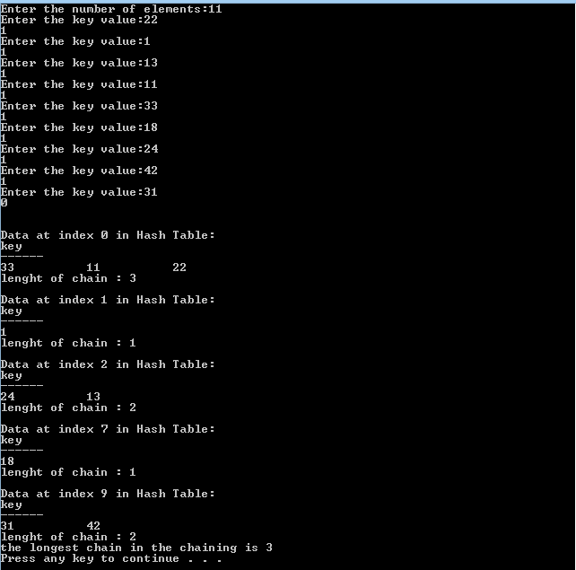
OUTPUT

