Slide 1

Academic Session 2025-26
Even Semester Jan-Jun’26
Apex Institute of Technology
Department of Artificial Intelligence and Machine Learning
System Design (23CST-390)
Faculty: (Er.) Kamaljeet Kaur (E19147)
DISCOVER . LEARN . EMPOWER
Lecture
Introduction to System Design

Slide 2
Learning Objectives
Understand the fundamental concepts of system design and its importance in building
scalable applications.
Learn the principles of scalability, availability, and reliability in large systems.
Differentiate between Monolithic and Microservices architectures.
Explain key performance metrics such as latency and throughput.
Understand how caching improves system speed and reduces load on backend services.

Slide 3
Course Outcomes
On completion of this course, the students shall be able to:-
CO1 | Understand the fundamental system design principles, including scalability, high availability, and fault tolerance, while analyzing how these core principles influence architectural decisions in real-world distributed environments.
CO2 | Apply various distributed architectural patterns, key database models (SQL and NoSQL), and critical communication protocols to evaluate their specific applications and trade-offs in modern system designs.
CO3 | Apply advanced scaling techniques, such as caching, load balancing, database sharding, and replication, to design system components that effectively handle massive user traffic and data volumes.
CO4 | Analyze the trade-offs between different system architectures, data storage solutions, and consistency models (like the CAP theorem) to select and justify optimized configurations for performance, cost, and reliability goals.
CO5 | Create and document comprehensive, end-to-end system designs that are inherently scalable, distributed, and fault-tolerant, leveraging modern paradigms such as cloud computing and microservices architecture.

Slide 4
Unit-1 Syllabus
Unit-1 | System Design
Introduction to System Design | Introduction to System Design, Functional & Non-Functional Requirements, Scaling Challenges, Load Balancing, Caching Strategies, Replication, Sharding.
Databases in System Design | Databases in System Design – SQL vs NoSQL, CAP Theorem, Distributed Databases, Consistency Models, Eventual Consistency, Distributed Caching (Redis, Memcached), High Availability, Fault Tolerance, Microservices vs Monolithic Architecture.

Slide 5
Topic to be Covered
      Microservices Architectures
      Key Benefits of a Microservices Architecture
      How Do I Get Started with a Microservices Architecture?
      How to Decompose
      Design the Individual Services Carefully
      Importance of Monolithic Systems
      Characteristics of Monolithic Architecture
      Challenges in deploying Monolithic Architecture

Slide 6
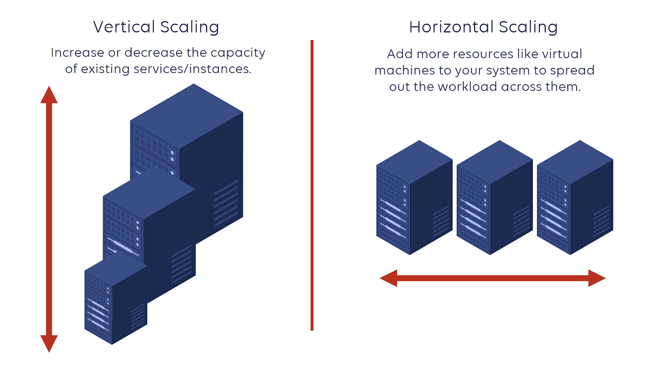
Scaling Strategies
Vertical Scaling (Scale Up): Adding more power (CPU, RAM) to your existing server. Simple, but has a hard ceiling (hardware limits).
Horizontal Scaling (Scale Out): Adding more servers to your resource pool. Requires complex logic to distribute load but offers infinite theoretical scale.

Slide 7
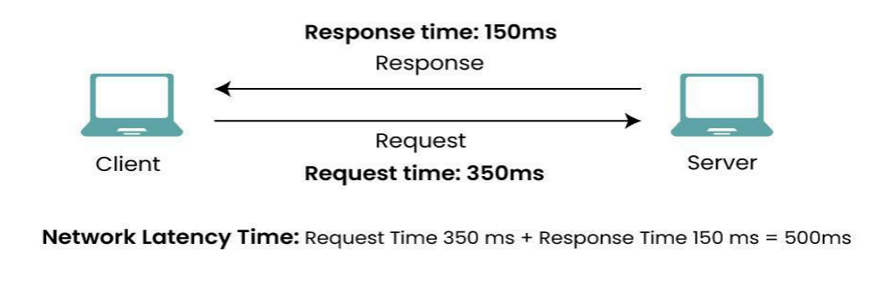
Latency & Throughput
Latency: Time per request.
Throughput: Requests per second

Slide 8
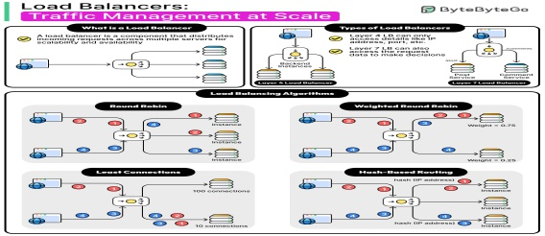
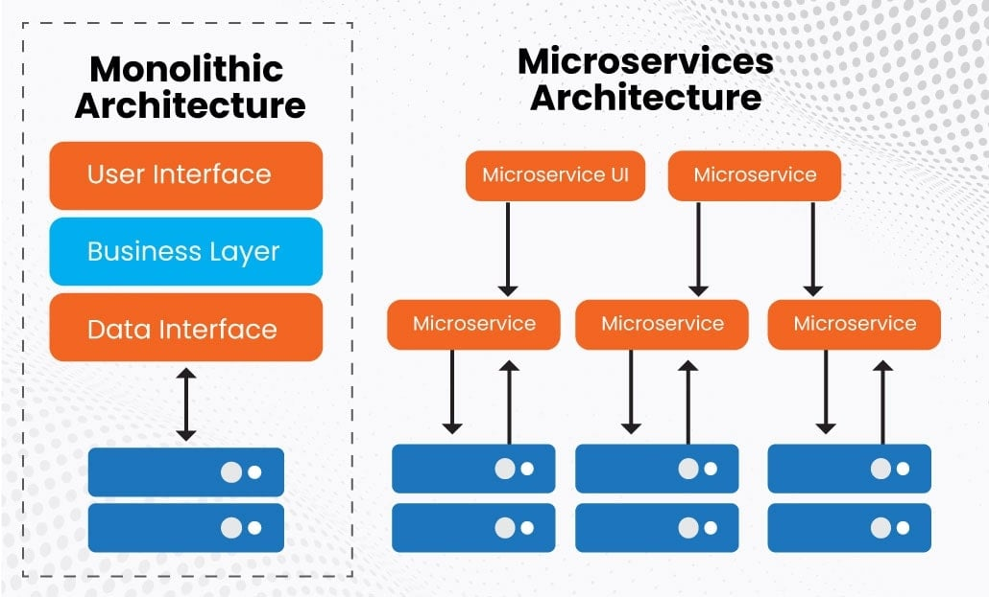
Architecture Patterns
Monolithic: A single codebase where all components are tightly coupled. Easy to develop initially, hard to scale.
Microservices: A collection of loosely coupled services. Each service runs independently and communicates via API.
Allows independent scaling and deployment.
Increases operational complexity.

Slide 9
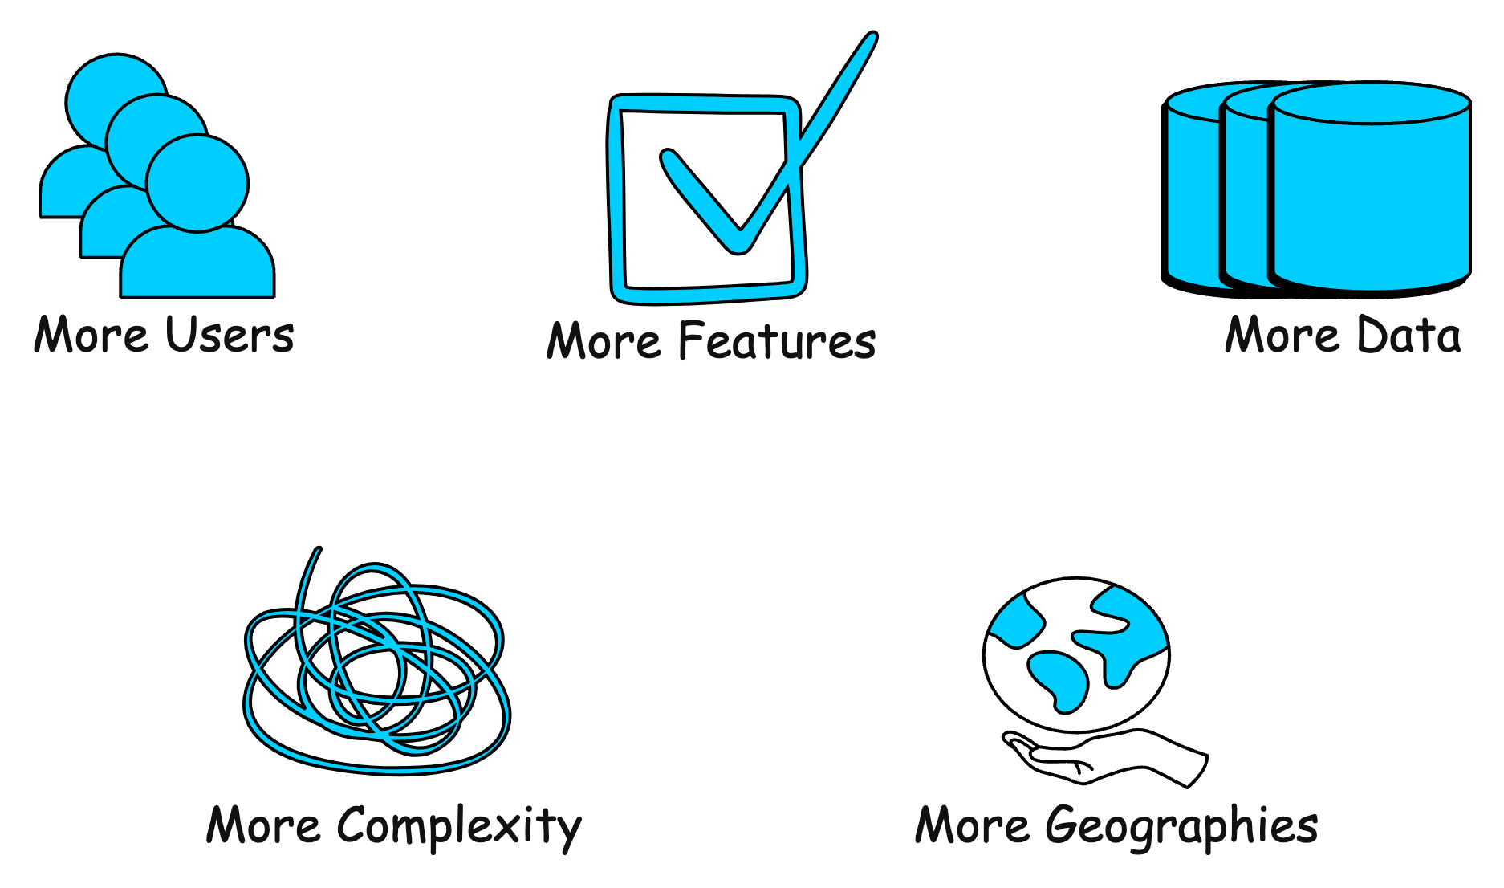
How can a System Grow(Con..)

Slide 10
How can a System Grow?
Growth in User Base
More users started using the system, leading to increased number of requests.
Example: A social media platform experiencing a surge in new users.
2. Growth in Features
More features were introduced to expand the system's capabilities.
Example: An e-commerce website adding support for a new payment method.
3. Growth in Data Volume
Growth in the amount of data the system stores and manages due to user activity or logging.
Example: A video streaming platform like youtube storing more video content over time.
4. Growth in Complexity
The system's architecture evolves to accommodate new features, scale, or integrations, resulting in additional components and dependencies.
Example: A system that started as a simple application is broken into smaller, independent systems.
5. Growth in Geographic Reach
The system is expanded to serve users in new regions or countries.
Example: An e-commerce company launching websites and distribution in new international markets.

Slide 11
Vertical Scaling
Vertical scaling, also known as scaling up, refers to the process of increasing the capacity or capabilities of an individual hardware or software component within a system.
We upgrade the same system rather than adding more systems. Add more power to your machine by adding better processors, increasing RAM, or other power-increasing adjustments.
Simple to implement and useful for monolithic and small scale applications.
Examples
Upgrading a MySQL server from 16 GB RAM to 64 GB to handle more queries.
Moving a website hosted on a 2-core VM to an 8-core, higher-RAM VM to improve performance.
E-commerce platform running on a single large AWS EC2 instance with increased resources (CPU, RAM, disk).

Slide 12
Advantages and Disadvantages of Vertical Scaling
Advantages
Increased capacity: A server's performance and ability to manage incoming requests can both be enhanced by upgrading its hardware.
Easier management: Upgrading a single node is usually the focus of vertical scaling, which might be simpler than maintaining several nodes.
Disadvantages
Limited scalability: Vertical scaling is constrained by the hardware's physical limitations. Horizontal Scaling is not limited.
One server still receives all incoming requests thus increasing the possibility of downtime in the event of a server failure.
Scaling up often requires restarting or replacing the machine, causing downtime.

Slide 13
Horizontal Scaling
Horizontal scaling, also known as scaling out, refers to the process of increasing the capacity or performance of a system by adding more machines or servers to distribute the workload across a larger number of individual units.
There is no need to change the capacity of the server or replace the server.
There is no downtime while adding more servers to the network.
Examples
A website like GeeksforGeeks adds more web servers behind a load balancer to handle traffic spikes.
Netflix scales different microservices independently — e.g., multiple instances of the streaming service across regions.
Amazon Auto Scaling spins up more EC2 instances during peak shopping hours (e.g., Black Friday).

Slide 14
Advantages of Horizontal Scaling
Advantages
Increased capacity: More nodes or instances can handle a larger number of incoming requests.
Improved performance: By distributing the load over several nodes or instances, it is less likely that any one server will get overloaded.
Increased fault tolerance: Incoming requests can be sent to another node in the event of a node failure, lowering the possibility of downtime.

Slide 15
Real-World Examples of Scalable Systems
Google: Google's infrastructure is highly scalable, allowing it to handle billions of search queries and serve millions of users worldwide. Google uses a distributed system architecture and technologies like Bigtable, MapReduce, and Spanner to achieve scalability.
Amazon Web Services (AWS): AWS provides a wide range of scalable cloud computing services, including computing power, storage, and databases. AWS's scalable infrastructure allows businesses to quickly scale resources up or down based on demand.
Netflix: Netflix's streaming service is built on a highly scalable architecture that allows it to deliver high-quality video content to millions of users simultaneously. Netflix uses a combination of caching, and cloud computing to achieve scalability.

Slide 16
Challenges and Trade-offs in Scalability
Cost vs. Scalability: Adding extra resources is a common step in system scaling, which might raise expenses. A trade-off exists between the advantages of increased performance and availability and the expense of scaling.
Complexity: Systems typically get more complex as they grow in size. Because of its complexity, the system may be more difficult to maintain and debug, which could result in higher operating cost.
Latency vs. Throughput: There is often a trade-off between Latency vs. Throughput . Optimizing for low latency may reduce throughput, and vice versa.
Data Partitioning Trade-offs: Partitioning data can improve scalability by distributing it across multiple nodes. However, choosing the right partitioning strategy involves trade-offs, such as balancing the size of partitions, minimizing data movement, and ensuring data locality.

Slide 17
Summary of the Lecture
Scaling:
Scaling refers to the ability of a system to handle increased load (users, data, or requests) without degrading performance.
Types of Scaling:
Vertical Scaling (Scale Up) increases resources of a single machine (CPU, RAM), while Horizontal Scaling (Scale Out) adds more machines to distribute the load.
Importance of Scaling:
Scaling ensures high performance, availability, and reliability as application demand grows.
Common Scaling Techniques:
Load balancing, caching, database replication, sharding, and asynchronous processing are used to improve scalability.
Challenges in Scaling:
Data consistency, increased system complexity, latency, and cost management.
Conclusion:
Effective scaling is essential for building robust, high-traffic systems and is a key concept in modern system design.

Slide 18
Next Lecture
Load Balancing Algorithms
Caching Strategies Overview
Client-Side vs Server-Side Caching
Replication Techniques
Sharding Strategies

Slide 19
Quiz
What is scaling in system design?
a) Reducing system size
b) Improving system security
c) Increasing system capacity to handle more load
d) Removing system components
Which type of scaling adds more machines to the system?
a) Vertical scaling
b) Horizontal scaling
c) Diagonal scaling
d) Manual scaling
Which component helps distribute traffic across servers?
a) Cache
b) Database
c) Load Balancer
d) Firewall

Slide 20
FAQ’s
What is scaling in system design?
Scaling is the process of increasing a system’s capacity to handle more users, data, or requests.
Why is scaling important?
It ensures good performance, availability, and reliability as system usage grows.
What is the difference between vertical and horizontal scaling?
Vertical scaling increases resources on one machine, while horizontal scaling adds more machines.
Which techniques are commonly used for scaling?
Load balancing, caching, database replication, and sharding.
What are the challenges of scaling systems?
Managing data consistency, system complexity, latency, and cost.

Slide 21
References/ Articles/ Videos
Book Reference:
Kleppmann, Martin
Designing Data-Intensive Applications, O’Reilly Media.
Richards, Mark & Ford, Neal
Fundamentals of Software Architecture, O’Reilly Media.
Tutorial Link:
https://www.youtube.com/watch?v=xpDnVSmNFX0
Video Link:
https://www.youtube.com/watch?v=EWS_CIxttVw

Slide 22

Class-Wise Feedback

Slide 23
Thank You
For queries Email: kamaljeet.e19147@cumail.in

