Slide 1
ATM (Automated Teller Machine)
Name Roll no
G G S Pradeep Reddy 21A91a05j5

Slide 2
Abstract:
The provided application is an “ATM (automated teller machine)” GUI application implemented in java using swing. It simulates the functionality of an ATM system, allowing users to log in, check their account balance, withdraw funds, change their PIN, and logout. The GUI is designed with a user-friendly interface, and it includes error handling and validation for user inputs. Key components and features include a login panel for entering the account number and PIN, a post-login panel with buttons for ATM operations, such as withdraw, check balance, change PIN, deposit money, transfer money and logout. The check balance button displays the current account balance, the withdraw button allows users to enter withdrawal amounts and validates them against the account balance, the change PIN button lets users set a new PIN, and there's comprehensive error handling for invalid login attempts, incorrect withdrawal amounts, and invalid input formats. The project integrates the “freetts” library for text-to-speech capabilities, ensuring spoken feedback and guidance. In this project, account data is managed and persisted using a CSV file. The CSV file format is used to store account numbers, pins, and account balances, which are loaded into the program upon startup and updated as transactions occur.

Slide 3
Introduction:
This project introduces a functional automated teller machine (ATM) system that utilizes a graphical user interface (GUI) implemented with java swing. An ATM is a part of banking providing customers with convenient access, to various transactions. The primary goal of this system is to offer users the features expected from an ATM;
User friendly interface:
To ensure an enjoyable experience the project incorporates java swing to create a GUI.
Secure login and pin management:
Security is of importance in any application. Our system includes a robust login mechanism thatverifies user credentials and allows for management of pins.
Withdraw funds and Balance inquiry :
Users can specify the desired amount for withdrawal and balance validation ensures that the requested Amount is available and they can conveniently check their account balance with the result displayed on the GUI.

Slide 4
Data storage:
Account information such, as account numbers, pins and balances are stored in a CSV file ensuring data management and persistence of user accounts.
Voice assistant:
The voice assistant is a component of the ATM GUI application that leverages the FreeTTS library. It provides spoken feedback, guidance, and notifications to the ATM users
Transaction validation:
The system validates user inputs to ensure they are in the correct format and within acceptable limits (e.g., Withdrawal amount, deposit amount).
Improving user experience:
In order to enhance the user friendliness of the ATM system we have incorporated tooltips and visual Feedback, into the graphical user interface. This decision was made to improve user understanding and Interaction.

Slide 5
Technology:
Java:
In our project we utilize java as the programming language. Java is an high level language that is Known for its ability to work across platforms making it suitable, for various applications. It offers Support, for object oriented programming includes a standard library and takes care of memory Management automatically.
Java swing:
Java swing is utilized to create the graphical user interface (GUI) of the ATM system. It offers a range of components that enable the development of visually appealing applications.
FreeTTS:
The freeTTS library is integrated into the project to provide text-to-speech capabilities. It is used for creating a voice assistant that provides spoken feedback and instructions to users. It can be easily integrated into java-based projects and run on various platforms without the need for platform-specific code.

Slide 6
Specifications:
Hardware requirements:
Computer/laptop:
You can use any regular computer like a laptop or desktop to work on this project.
Memory (ram):
The computer's memory, or ram, doesn't need to be super big. Having at least 4GB of RAM is good enough.
Storage:
you'll need some space on your computer to keep your project files, like the code and data files. A few Gigabytes of space should be plenty.
Input and output devices:
you'll use a keyboard and a mouse or touchpad to control your computer and work on your project. You might Also want a monitor to see what you're doing and test your program. You might also want a external speakers for the voice assistant.

Slide 7
Software Requirements:
Java development kit (JDK):
you need the java development kit to compile and run java programs. Make sure you have a JDK
installed. You can download the latest version of the JDK from the official oracle website.
Integrated development environment (ide):
While not strictly required, using an IDE like eclipse or visual studio code can greatly
Simplify java development and help you manage your project.
Operating system:
The code should be compatible with any operating system that supports java, such as windows,
macos, or linux.
Csv file editor:
You need a text editor or spreadsheet software to create and edit the CSV file containing account data.

Slide 8
Modules:
Here are the primary modules that are used in the project:
User authentication module
Account data management module
User interface (UI) module
Change PIN module
Transaction module
Logout module
Voice assistant module

Slide 9
User authentication module:
Responsible for user login and authentication.
Verifies account numbers and pins.
Manages the transition between the login screen and post-login operations.
Account data management module:
Handles the loading and saving of account data.
Reads and writes account information to/from a csv file.
Updates account balances after withdrawals or pin changes.
User interface module:
Manages the graphical user interface (GUI) components and their interactions.
Contains the login panel and the post-login panel with buttons for operations.
Displays user balance and handles user inputs and interactions.

Slide 10
Transaction module:
Withdrawal:
Manages the withdrawal functionality, including input validation and balance updates.
Communicates with the account data management module to save changes.
Balance inquiry:
Allows users to check their account balance.
Retrieves and displays the account balance from the data management module.
Deposit:
manages the deposit operation, updating the account balance when money is deposited.
Transfer:
facilitates the transfer of funds between accounts, validating the transfer and updating balances accordingly.

Slide 11
Change pin module:
Enables users to change their pins.
Communicates with the account data management module to save new pins.
Logout Module:
Handles user logout, resetting the session and returning to the login screen.
Voice Assistant Module:
The voice assistant module in the ATM GUI project utilizes the free tts library to convert text into natural speech.
It plays a key role in making the atm system user-friendly by combining visual and auditory feedback.

Slide 12
Implementation:
Logging in:
When you start the program, it shows a screen where you need to enter your account number and a secret pin. This is like the login step for your bank account. After successful login you will get a voice message.
Checking details:
The program checks if the account number and pin you entered match the ones it has in its memory. If they match, you're allowed to access your account; if not, you get an error message.
Main menu:
once you're logged in, you see a menu with options like “withdraw,” “check balance,” “Transfer,” “change pin,” and “logout.”
Checking balance:
If you select "check balance," the program shows you how much money is left in your account . You will get a voice message as “your current balance is some rupees”
Tranfer Money:
If you select “transfer”,The program shows to which account you want to send the money and how much amount of money will be sent .

Slide 13
Withdrawing money:
If you choose "withdraw," you can enter how much money you want to take out. The program checks if you have enough money in your account and if the amount you want to withdraw is valid. If it is the Program gives you the money and updates your account balance.
Deposit money:
If you choose “deposit,” you can enter how much money you want to deposit.The deposited money will be updated in the current balance
Changing pin:
You can also change your secret PIN by choosing "change PIN." The program will ask you for a new PIN. After entering the new pin, The pin will be updated.
Logging out:
At any time, you can choose to log out of your account. This means you're finished with your banking Session.

Slide 14
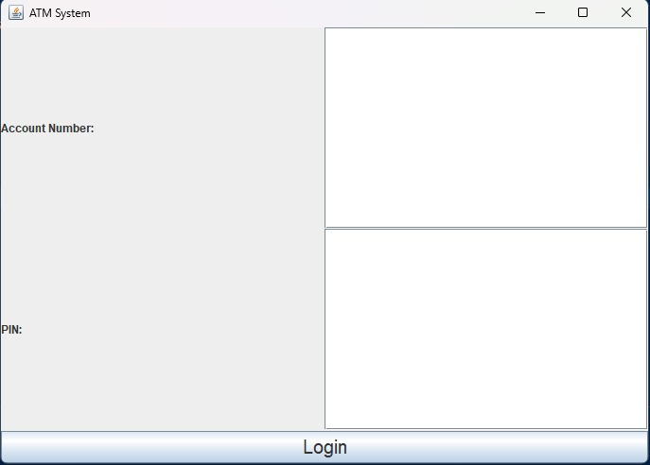
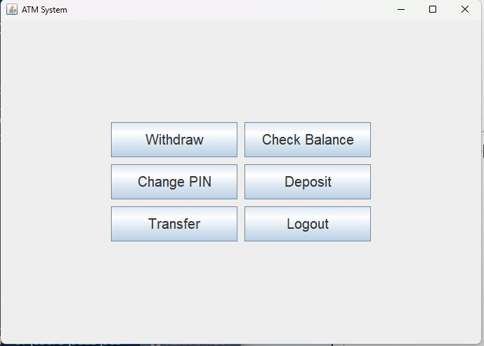
Output

Slide 15
THANKYOU!

