Slide 1

PRESENTATION ON
PIPE AND BARS DETECTION
MODEL
Team Name : Toggler
Member1: Shubham Sharma (Team Leader)
Member2: Pradeep Soni
Member3: Shoubik Mitra
Member4: Rajat Sharma

Slide 2
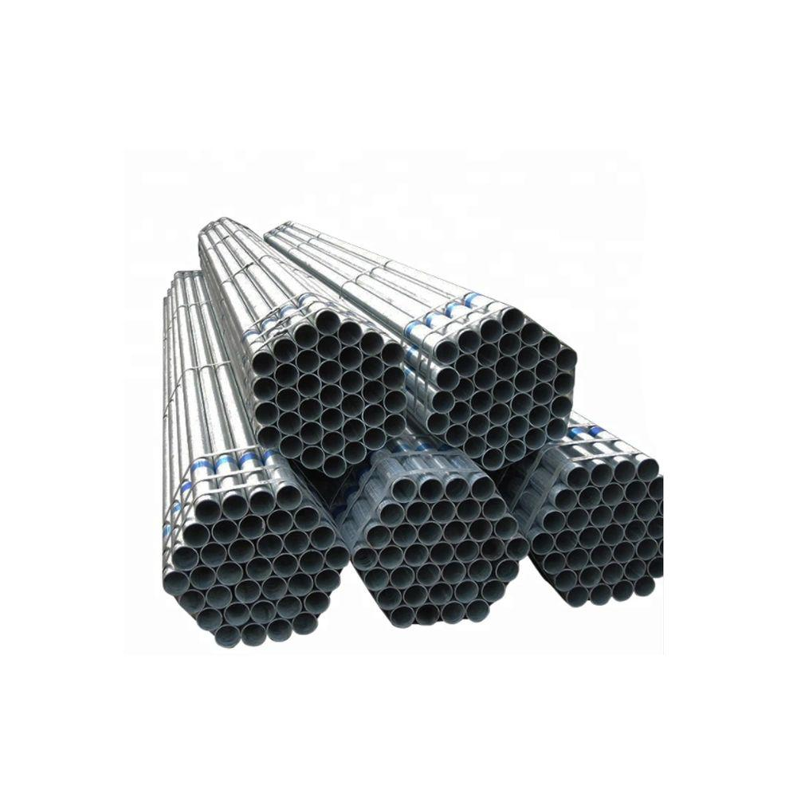
INTRODUCTION
Welcome to the presentation on Pipes and Bars Detection Model. This model utilizes cutting-edge technology to count the pipes and bars in an image.

Slide 3
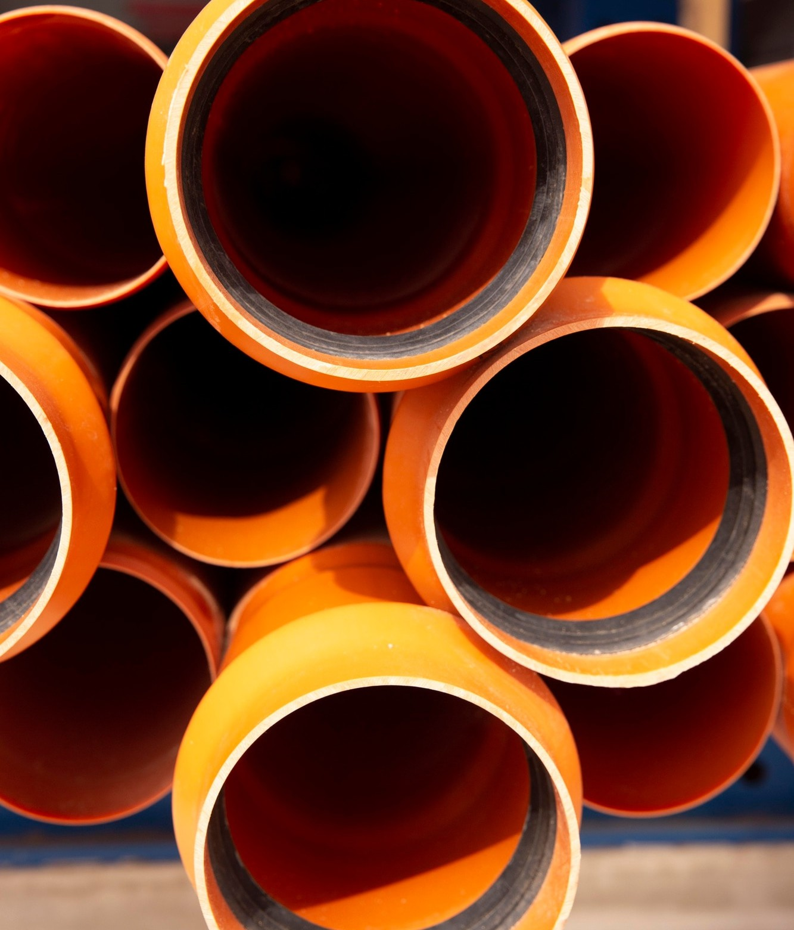
CHALLENGES IN PIPE DETECTION :
The current pipe detection systems face challenges in accurately identifying pipes in bunches and in bundles. These challenges can lead to very time consuming tasks. It is crucial to address these issues and improve the detection accuracy.

Slide 4

Advanced Detection Technology
Our advanced model integrates state-of-the-art image detection(OpenCV and Image Processing Algorithms) technology and machine learning algorithms to achieve highly accurate and real- time detection of pipes and bars.
This technology significantly improves accuracy and time factor required in pipe counting.

Slide 5
CONCLUSION
In conclusion, the Pipe and Bars Detection Model presents a significant advancement in enhancing the counting of the pipes and bars. By addressing the challenges in detection and implementing cutting-edge technology, we can ensure a more accurate and efficient systems.

