Slide 1



Predictive Model for Lifestyle-Diabetes Association
1. Pavan Teja Gupta Allenki
2. Gayatri Mohan Kshirsagar
3. Manvitha Nagandla
4. Pradeep Chand Potturi
5. Sneha Panjala

Slide 2

Data Wranglers
1. Pavan Teja Gupta Allenki
2. Gayatri Mohan Kshirsagar
3. Manvitha Nagandla
4. Pradeep Chand Potturi
5. Sneha Panjala

Slide 3
INTRODUCTION
Diabetes is a growing public health concern in the United States, affecting millions of individuals and imposing a significant economic burden on the healthcare system.
Lifestyle factors, such as age, sex, and mental health, physical health, are known to influence the risk of developing diabetes. However, the intricate interplay between these factors and the prevalence of diabetes remains a complex and insufficiently explored issue.
This data mining project aims to investigate and model the relationship between lifestyle factors and the prevalence of diabetes in the United States.

Slide 4
DATASET OVERVIEW
Number of Instances: 253,680
Features
HighBp, HighChol, CholCheck, BMI, Smoker, Stroke, HeartDiseaseorAttack, PhysActivity, Fruits, Veggies, HvyAlcoholConsump, AnyHealthCare, NoDocbcCost, GenHlth, MentHlth, PhysHlth, DiffWalk, Sex, Age, Education, Income
Target
Diabetes
Number of Features: 21
Notes:
GenHlth, MentHlth, PhysHlth, Age, Education, Income are the numerical features. Others are Binary. The target variable is Diabetes_012.

Slide 5
FLOW
Data Preprocessing
Model Selection and Evaluation
Comparison among the Models
Choosing the Best Model
Selecting Most IMP Indicators for Diabetes
Notes:
This is the basic flow of our project.

Slide 6
DATA PREPROCESSING
Raw Data Loading
Data Preprocessing
Under Sampling
Balancing the data using Under Sampling
Assessing Correlation
Target Transformation
Data Splitting
Assessing target variable correlation with other columns to identify and drop irrelevant features.
Transforming multiclass “Target” variable into binary class
Splitting the Data into Train and Test Sets
Notes:
These are the steps we have performed during Data Preprocessing/Data cleaning.

Slide 7
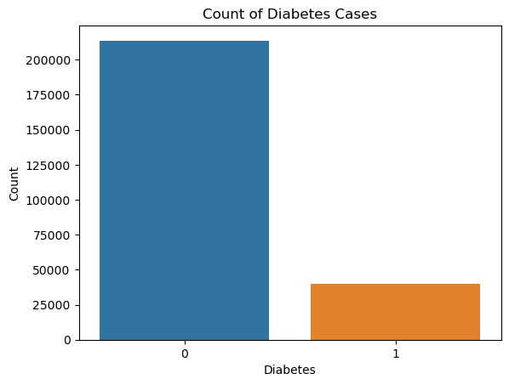
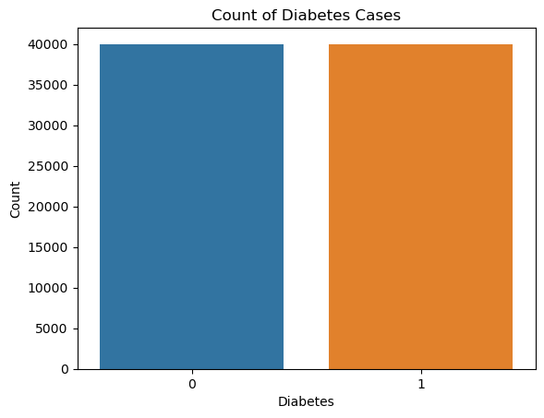
COUNT PLOT OF TARGET
Imbalanced Data
Balanced Data after Under Sampling
Notes:
As the data is imbalanced, we performed under sampling on majority class which is non-diabetic.

Slide 8
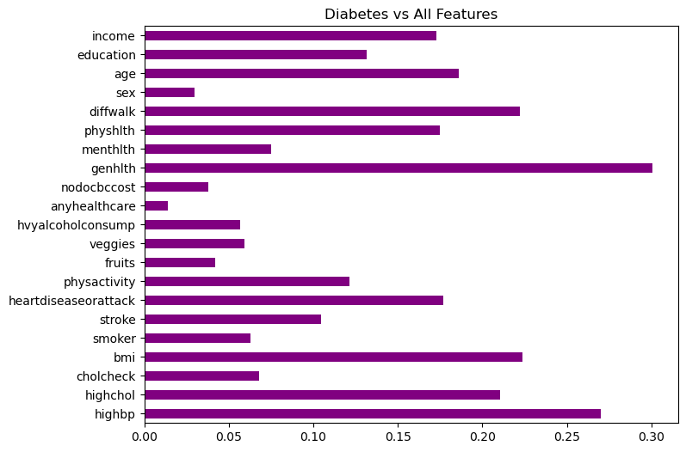
CORRELATION GRAPH
Notes:
This is the correlation of different variables or features (lifestyle factors and activities of population considered in data set) with the target variable

Slide 9
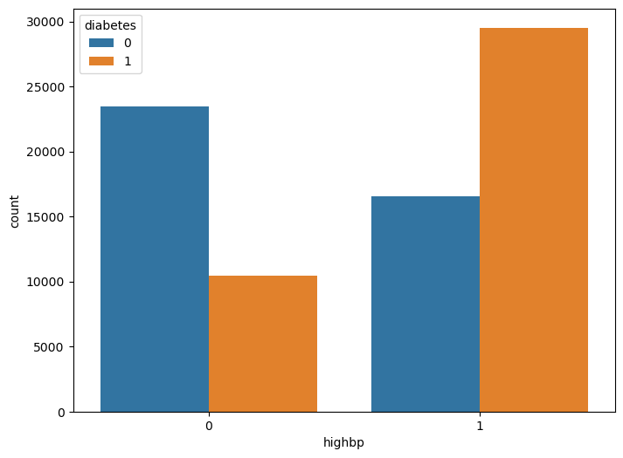
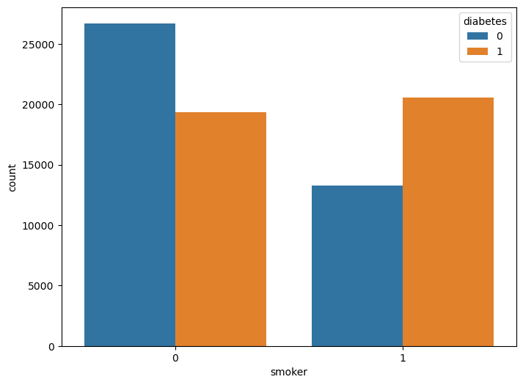
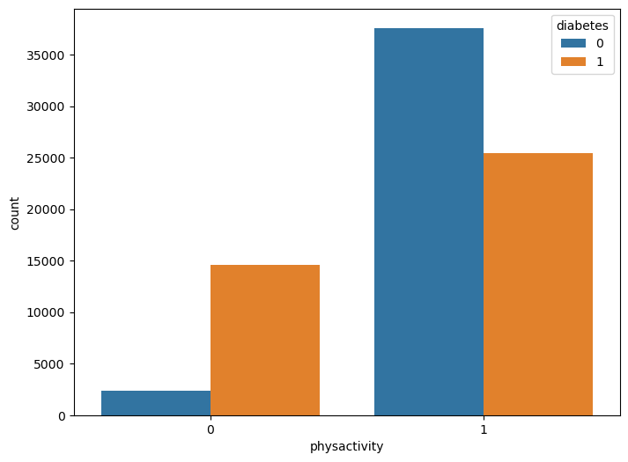
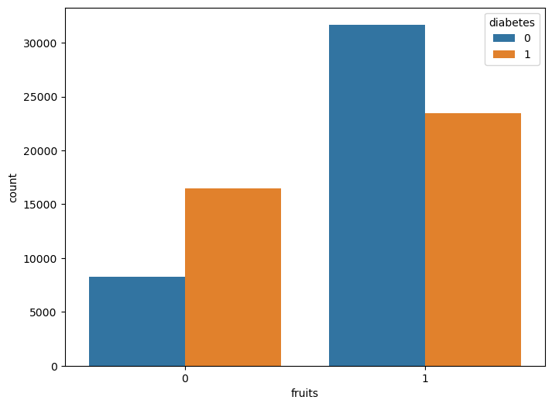
EXPLORATORY DATA ANALYSIS
highbp
smoker
physactivity
fruits
Notes:
Data analysis for few features like high BP, smoking, physical activity and fruits ( for basic understanding of feature’s relation with diabetes classes)

Slide 10
MODELS EVALUATED
1. Decision Tree Classifier
2. Logistic
Regression
Models Used
3. Random Forest Classifier
4. AdaBoost
Notes:
Models that are evaluated in our project for classification

Slide 11
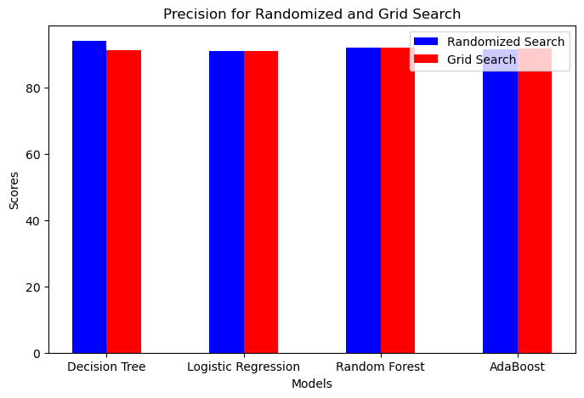
PRECISION COMPARISON FOR RANDOM AND GRID SEARCH
Notes:
Precision comparison of four models we used and we also used both randomized and grid search for every model.

Slide 12
PERFORMANCE METRICS SELECTION
High precision ensures accurate positive diagnosis in medical settings.
It reduces false positives, preventing unnecessary treatments and interventions.
Precision fosters trust in medical decisions and healthcare providers.
Ultimately, it improves patient outcomes by reducing the risk of incorrect diagnoses and unnecessary procedures.
Notes:
We have selected precision as evaluation metric for certain reasons.

Slide 13
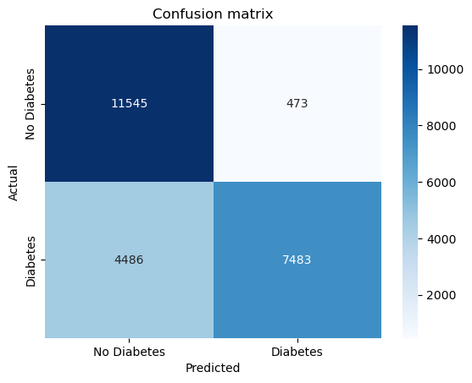
RESULTS
Decision Tree Classifier after using Randomized search
Precision Score: 0.94
Confusion Matrix
11545 : True Negative
473: False Positive
4486: False Negative
7483: True Positive

Slide 14
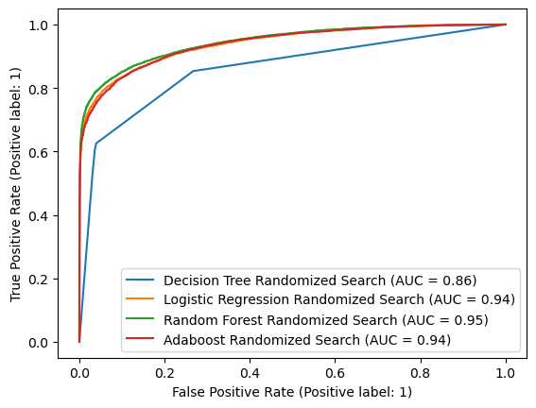
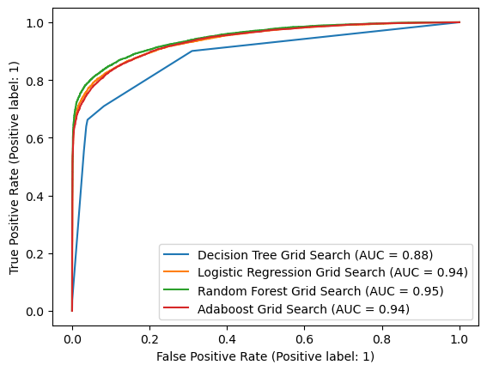
ROC CURVES FOR MODELS WITH RANDOMIZED AND GRID SEARCH
Randomized Search
Grid Search
Notes:
ROC Curve represents Area under curve, higher the area under curve, better is the model performance.

Slide 15
MODEL RECOMMENDATION
We selected the Random Forest Classifier as our best model based on high precision and a strong ROC curve, indicating its ability to make accurate positive predictions and excellent overall model performance.
The second-best model in contention is AdaBoost, which achieved a precision of 91.70%. Additionally, it showed a high AUC (Area Under the Curve) score of 94%, highlighting its capability to distinguish between classes effectively.
Our choice of Random Forest is justified by its robust precision and ROC performance, making it a reliable option for tasks where accurate positive diagnoses are crucial, such as medical diagnosis.
AdaBoost's strong precision and AUC also make it a valuable alternative for applications where a slightly different trade-off between precision and overall classification performance is acceptable.
Notes:
We suggest Random Forest Classifier as the best model, followed by AdaBoost.

Slide 16
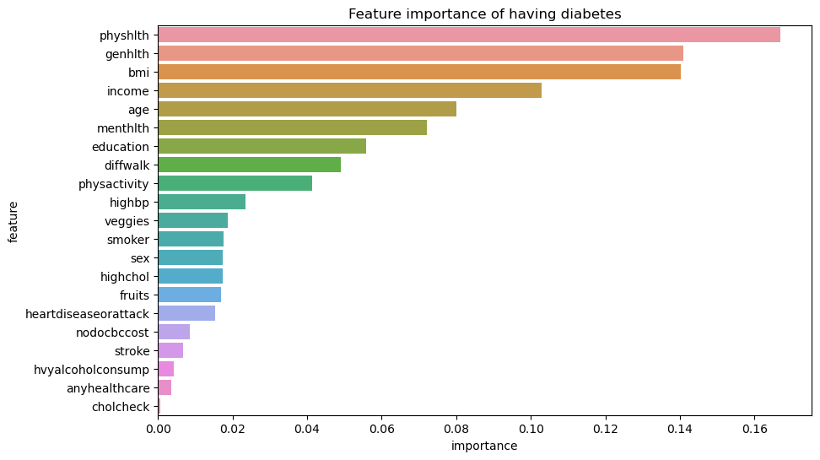
MOST IMPORTANT INDICATORS FOR DIABETES
Physical Health
General Health
BMI
Income
Age
Mental Health
Education
Difficulty Walking
Physical Activity
Notes:
Finally We can conclude our project with looking into the most influencing indicators of diabetes.

Slide 17
Thank You

