Slide 1
JMeter
Mar-1-2024

Slide 2
Agenda
Introduction
What is JMeter
Why do we need JMeter
What is Performance Testing
Advantages of JMeter
Elements of JMeter
JMeter for Load Testing and Performance Testing
Conclusion

Slide 3

Introduction

Slide 4

JMeter
JMeter also known as 'Apache JMeter' is an open source, 100% java based application with a graphical interface.
It is designed to analyse and measure the performance and load functional behaviour of web application and variety of services.

Slide 5

Why JMeter?
If we do not prioritize performance, it will adversely affect the user experience, especially considering the vast number of users for web and mobile applications.
While it's not always possible to anticipate every scenario, tools like Apache JMeter help us simulate and overcome potential load issues.

Slide 6

Performance Testing
It is very important to verify whether the product meets expected performance.
Performance testing ensures that software applications will perform well under their expected workload, focusing on certain factors such as speed, scalability, and stability.
It involves checking whether the application under test satisfies required benchmarks for both load and stress testing.
Load testing assesses whether the system or application under test can handle the required number of concurrent user accesses on the web server without failure.
Stress testing evaluates how the web server copes with high loads and limited resources under constrained conditions.

Slide 7
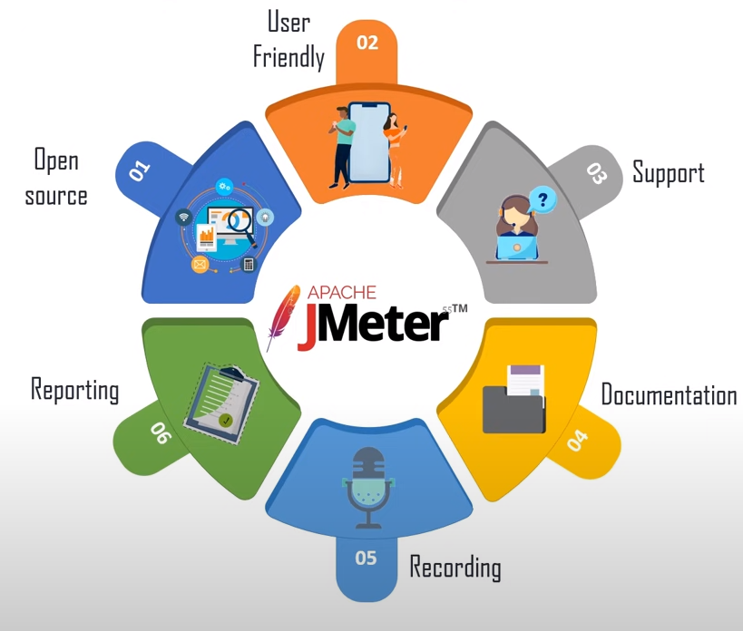
Advantages of JMeter

Slide 8
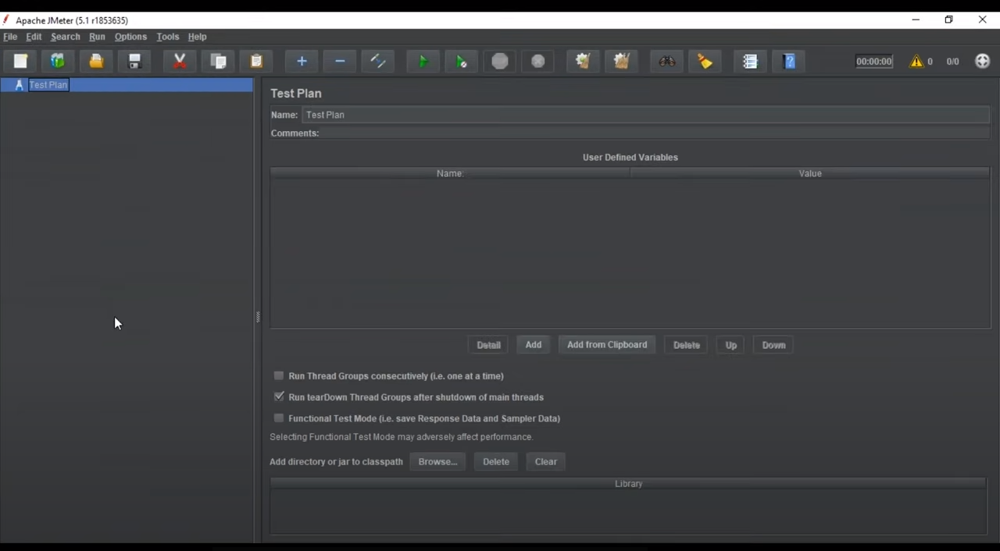
Apache JMeter

Slide 9
Test Plan
It is a container that describes what and how to test.
The complete test plan consists of one or more elements.
Once we configure the elements, we save them and then run the test plan, analyzing the results in various graphical formats such as tree, table, and graph.
It is quite difficult for humans to perform performance testing manually.
JMeter is the best tool for ensuring quality deliveries on time.
Elements of JMeter
Thread Group
Samplers
Listeners
Configuration

Slide 10
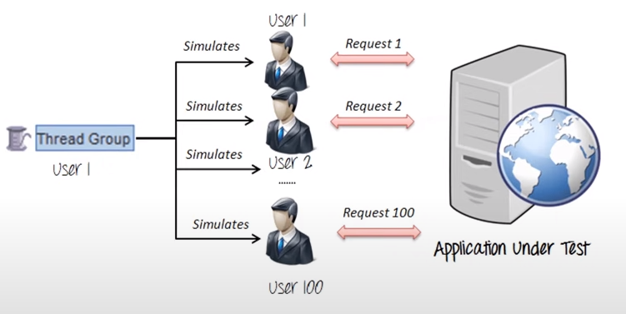
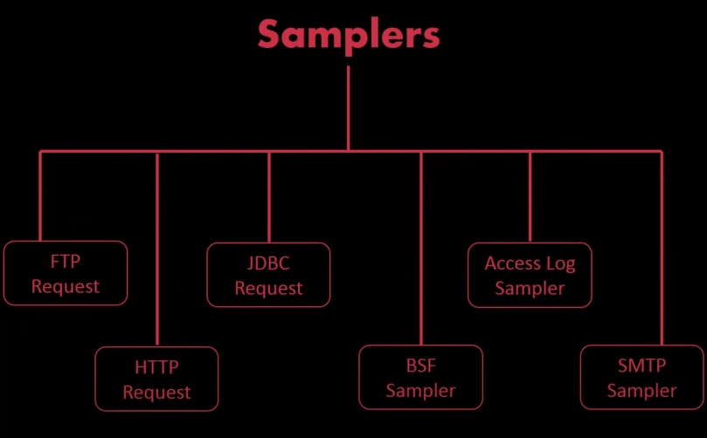
Thread Group
Samplers

Slide 11
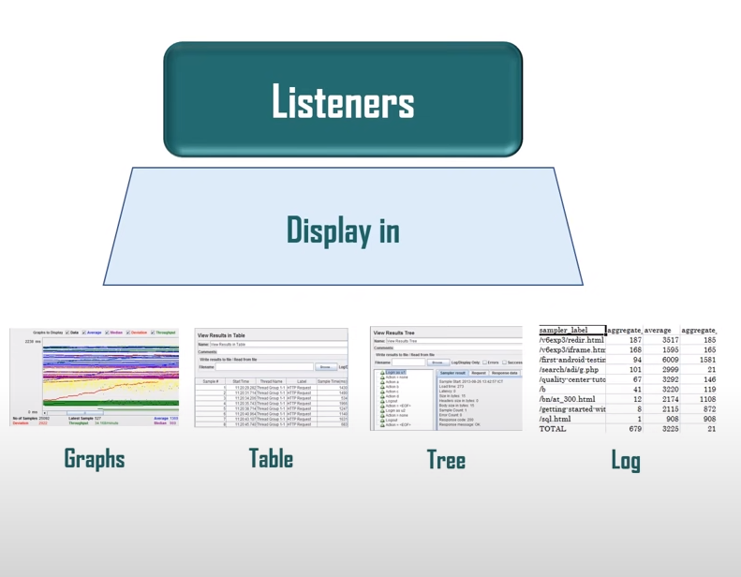
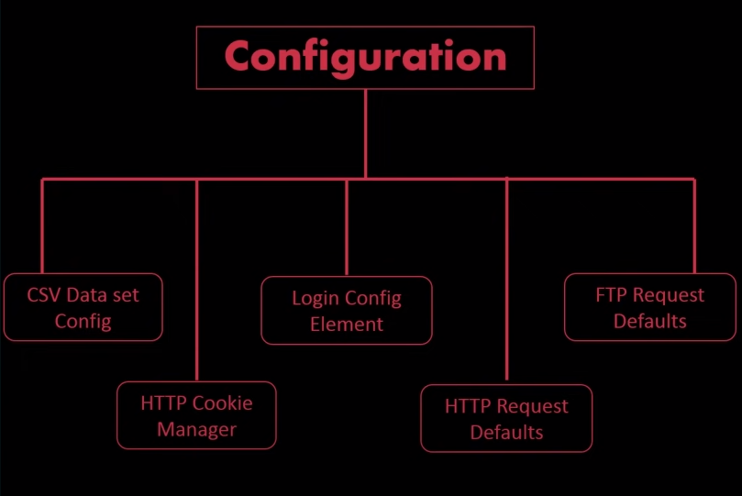
Configuration
Listeners

Slide 12
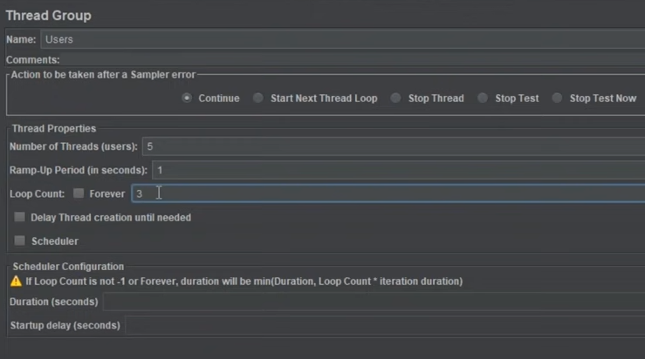
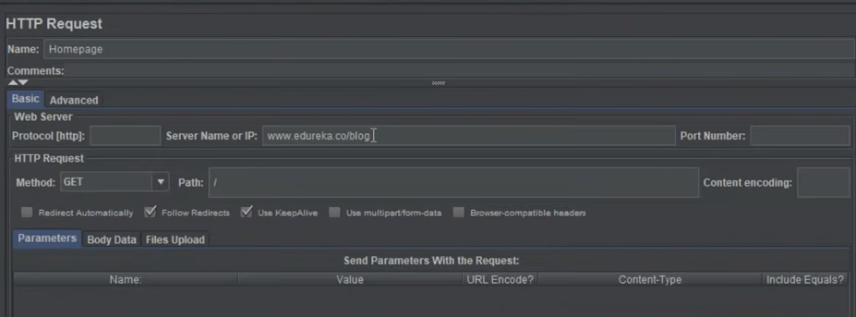
Example

Slide 13
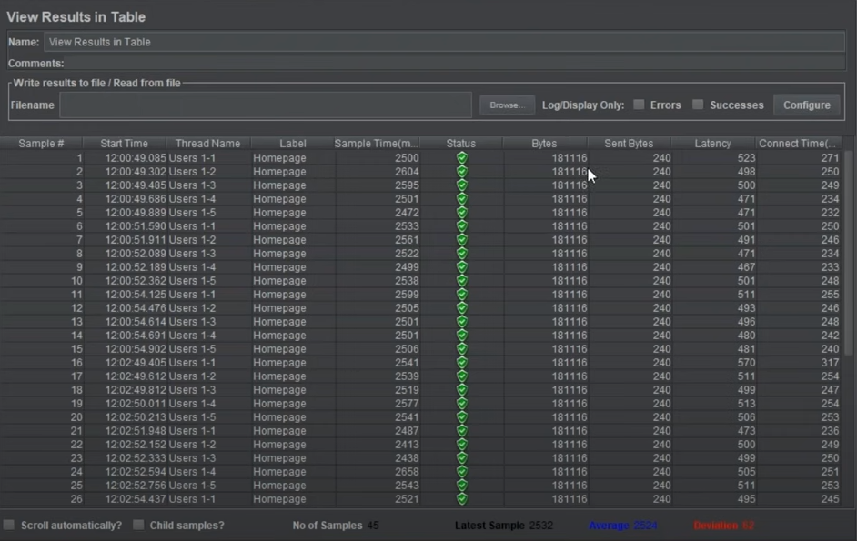
Result in table

Slide 14
Conclusion
Apache JMeter is a powerful and versatile open-source tool for performance testing.
It allows users to create detailed test plans, simulate various loads, and analyze performance metrics through graphical representations.
JMeter is easy to use, extensible, and widely adopted in the industry, making it an excellent choice for ensuring the quality and scalability of software applications.

