Slide 1
Reflection
Nov-21-2023

Slide 2


AGENDA
WHAT IS REFLECTION
WHERE AND HOW
CONS
SCREENSHOTS
API
WHY API
SOAP API
SOAP REQ AND RES
API EVOLUTION
REST API
FACTORS FOR EVOLUTION
REST REQ AND RES
HTTP REQ AND RES

Slide 3
WHAT IS noiɟɔɘlʇɘЯ ?
IRL reflection is were we examine ourselves, just as that in java reflection is used examine and modify runtime behavior of program .
It can modify class, method parameters and fields at runtime.
Reflection in Java is primarily facilitated by the java.lang.reflect package, which provides classes like Class, Method, Field, Constructor. Allowing you to query and manipulate class members dynamically.

Slide 4
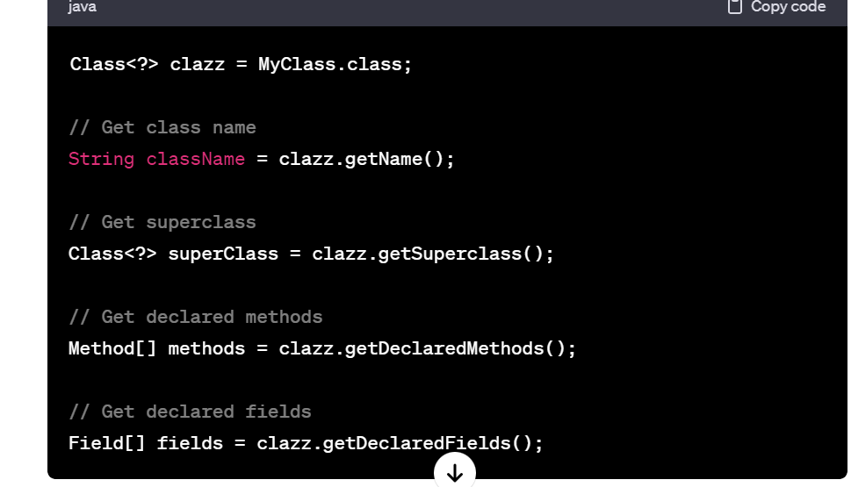
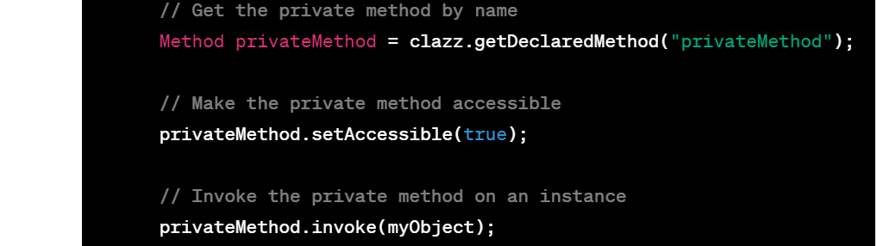
BASIC REFLECTION METHODS

Slide 5
WHERE & HOW IT’s USED
In frameworks and libraries.
In AoP
Most of features of Spring framework like DI,IoC,component scanning,Annotation processing,Property binding,custom annotation were done by use of reflection in the background .

Slide 6
IN SPRING FRAME WORK
Dependency Injection
Bean Instantiation
In Developing AOP paradigm
Annotation processing
Initializing application context
Custom annotation

Slide 7
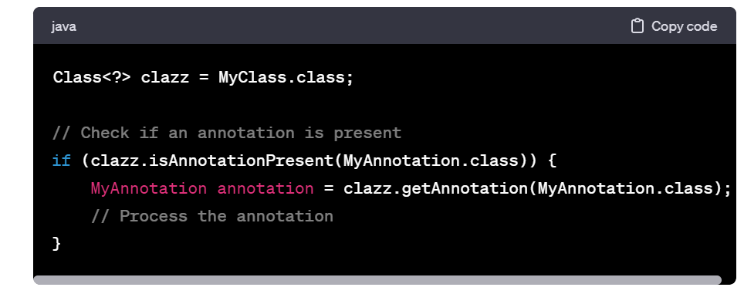
ANNOTATION PROCESSING

Slide 8
Cons:
Since the Reflection monitor and modify during run time compile time optimization cannot be done
The above reason relatively make the application slow.
Security risks(even a private class or member can be accessed )
More use of reflection leads to complex code structure and hard readability and not easy to maintain
So reflection advices to use when it is absolute necessary.

Slide 9
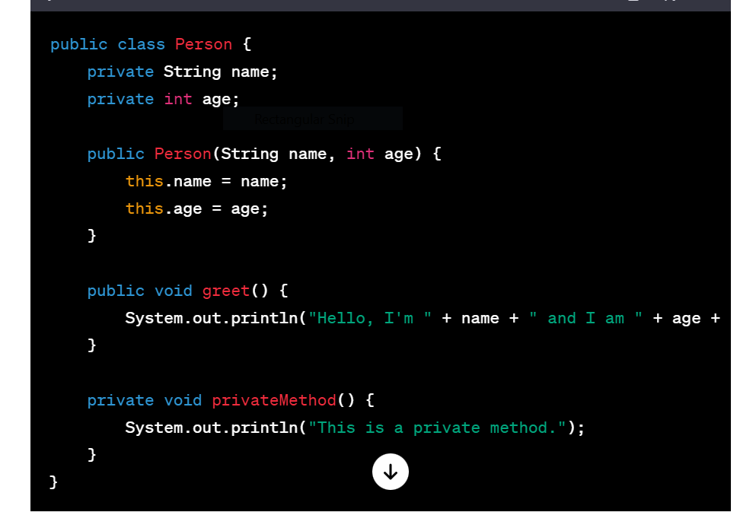
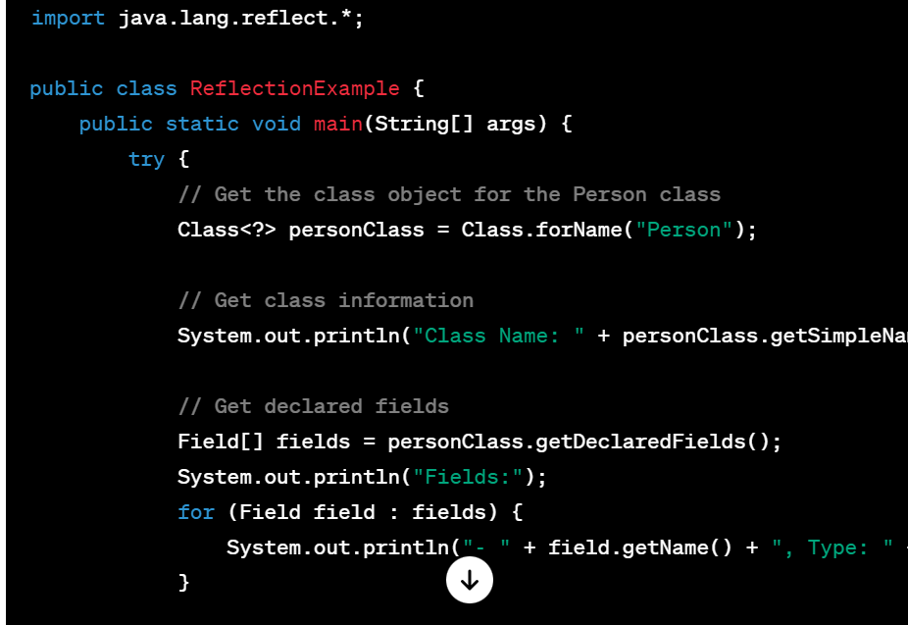
SCREEN SHOTS

Slide 10
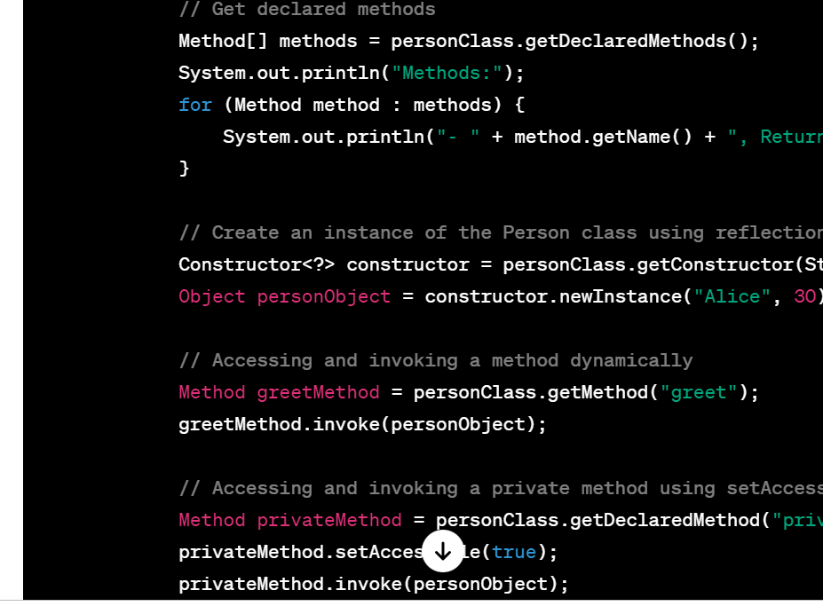

Slide 11
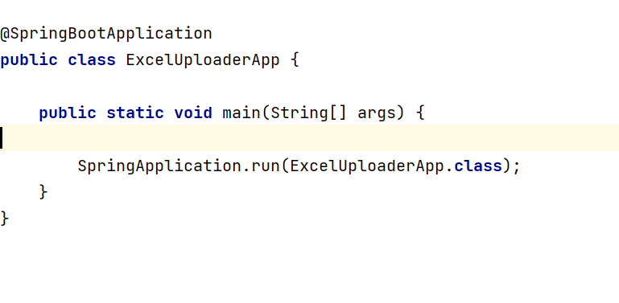
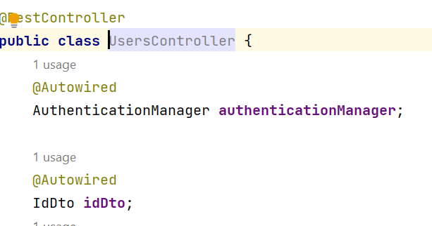
SCREEN SHOTS IN SPRING BOOT

Slide 12
API
Interface can be thought of as a contract of service between two applications.
interpreters between different programs, connecting services via endpoints and relaying messages, making software integration seamless
WHY API?
used to integrate new applications with existing software systems
use APIs to leverage existing code
allows you to collect data without expending time or effort..

Slide 13
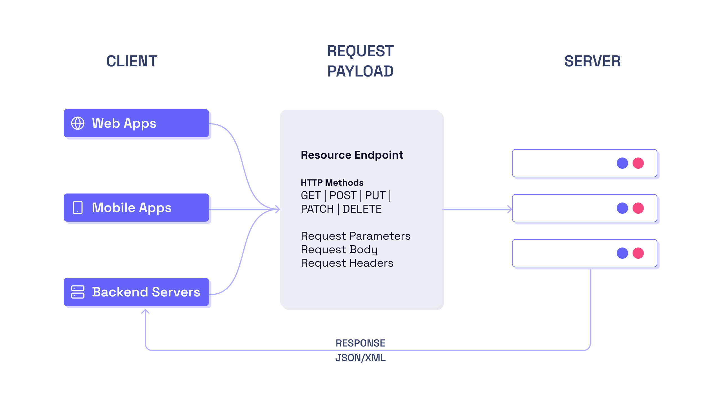
HOW API WORKS ?

Slide 14
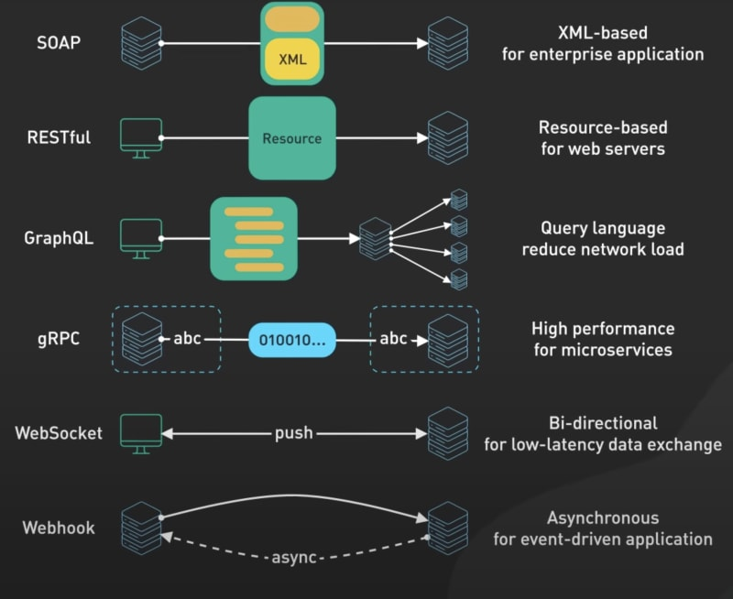
API TYPES

Slide 15
SOAP API
SOAP (Simple Object Access Protocol) is a protocol used for exchanging structured information in the form of XML-based messages over a network. SOAP APIs (Application Programming Interfaces) follow this protocol to allow communication and interaction between different systems over the internet or within a network.
It can work over various transport protocol like HTTP,FTP and etc
WHY SOAP
Standardized
Protocol independence
Security

Slide 16
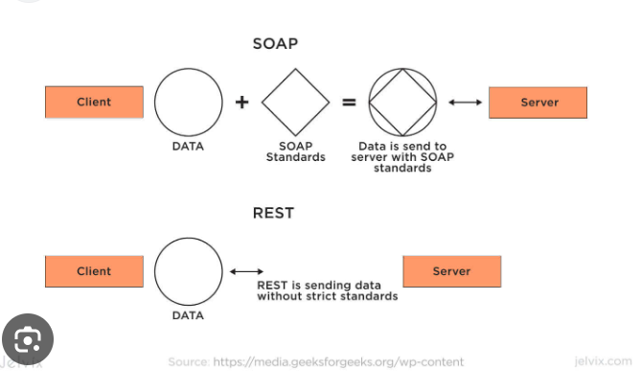
SOAP API

Slide 17
USED IN
Enterprise Applications
B2B Applications
Financial services
Healthcare applications
Legacy systems
CONS OF SOAP API
Complexity
Performance compared to REST API
Tight coupling.
Bandwidth consumption because of size.

Slide 18
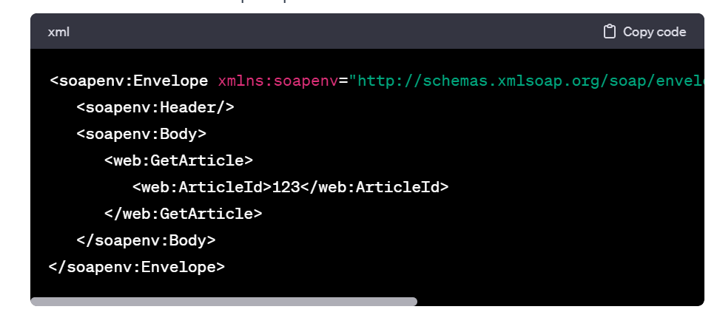
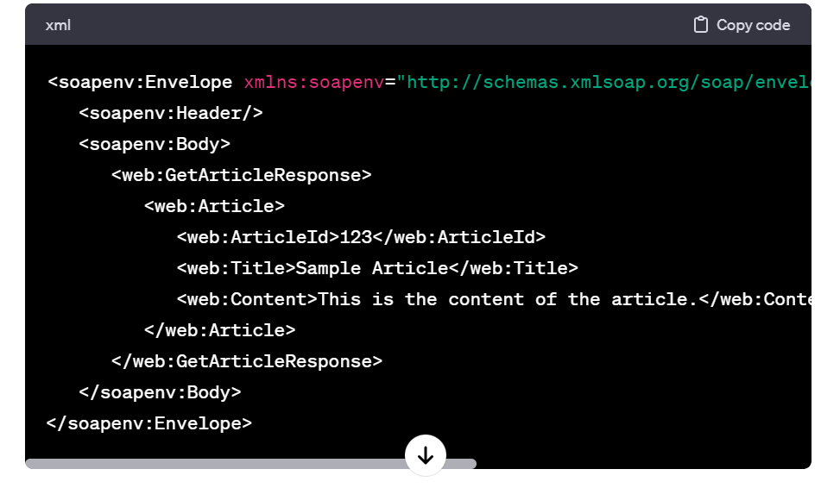
SOAP REQ AND RESPONSE:

Slide 19
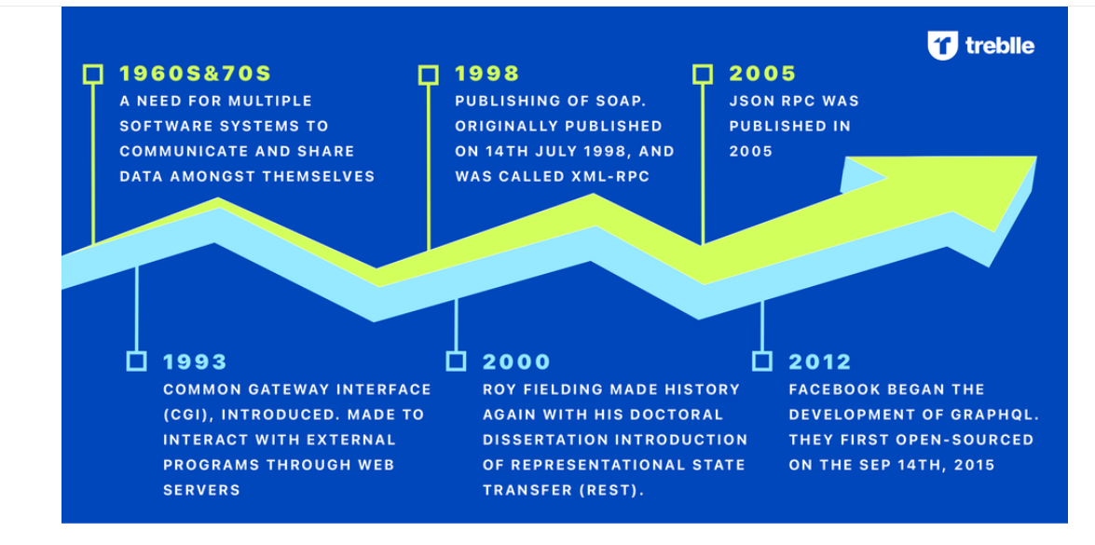
API EVOLUTION:

Slide 20
REST API:
REST improved from where SOAP left off
in contrast with SOAP's complex and weighty structure, emerged as an easier and lighter approach for creating web APIs.
REST's primary advantage lies in its ease of use: RESTful APIs take advantage of HTTP, which has long been widely supported across web servers and clients, to facilitate rapid development
data can be exchanged using lightweight formats like JSON (JavaScript Object Notation)

Slide 21
WHERE REST USED:
Web development
Public APIs like social media.
E-Commerce site where the URI can be accessed from other sites for visibility increase.
IoT – Since most of Iot devices uses comparatively smaller processing unit using REST api would not add more weightage on it.
Mobile App development

Slide 22
FACTOR DRIVING EVOLUTION
The shift towards more lightweight and agile development practices.
Mobile and Single Page Applications (SPAs).
Emergence of Social media app and E-Commerce
Compatibility with Web Standards
REST is considered more flexible and agile, allowing for quick development and iterations. It is well-suited for scenarios where rapid changes and updates are frequent.
Handling of multimedia file

Slide 23
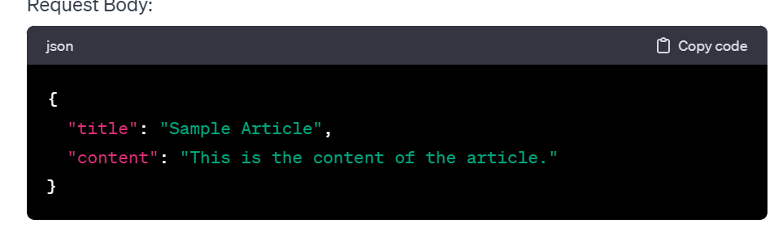
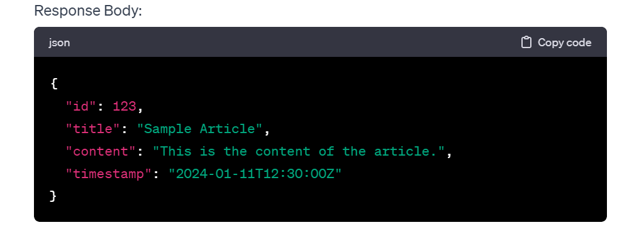
REST REQ AND RESPONSE

Slide 24
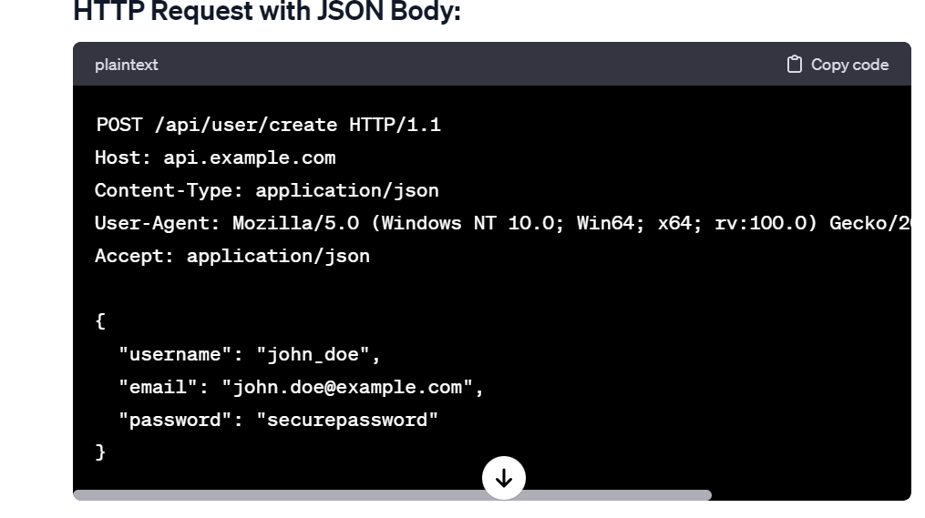
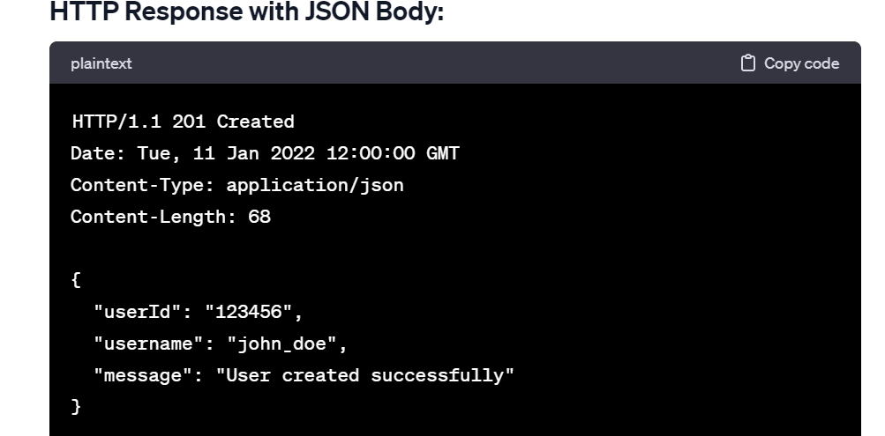
HTTP REQ AND RESPONSE:

