Slide 1

MINI PROJECT ON CPU SHEDULING SIMULATOR
Presented By:
Pradeep Singh
B.TECH (C.S.E) – 3rd year
(Roll No.: 2219247)
DEPARTMENT OF COMPUTER SCIENCE ENGINEERING
GRAPHIC ERA UNIVERSITY, DEHRADUN

Slide 2

OUTLINE
Objective
Tools And Technology Used
Features
GUI Interface
Demonstration
Application Or Uses
Conclusion

Slide 3

OBJECTIVE
The main objective of this project is:
"To develop an interactive CPU Scheduling Simulator that enables users to understand, analyze, and compare different CPU scheduling algorithms in real-time through visual demonstrations."

Slide 4



Tools And Technology Used
Programming Language:
Python
Libraries:
Tkinter: For building the GUI interface.
Pillow (PIL): For handling and displaying images.
Other Tools:
Windows or preferred IDE for development.
Icon and background assets for UI enhancement.

Slide 5
Features
Graphical User Interface (GUI):
A visually appealing design with:
Clear and interactive widgets (dropdowns, buttons, and input fields).
Dynamic canvas updates based on the selected algorithm and user input.
Dropdown menus for algorithm and process count selection.
An action button to start the simulation.
Selection of CPU scheduling algorithms:
First Come First Serve (FCFS)
Shortest Job First (SJF)
Shortest Remaining Time First (SRTF)
Priority Scheduling
Round Robin (with customizable time quantum).
Real-time error handling to ensure valid input values.
Visual representation of processes and their execution order.
Modular structure for easy scalability and maintenance.

Slide 6
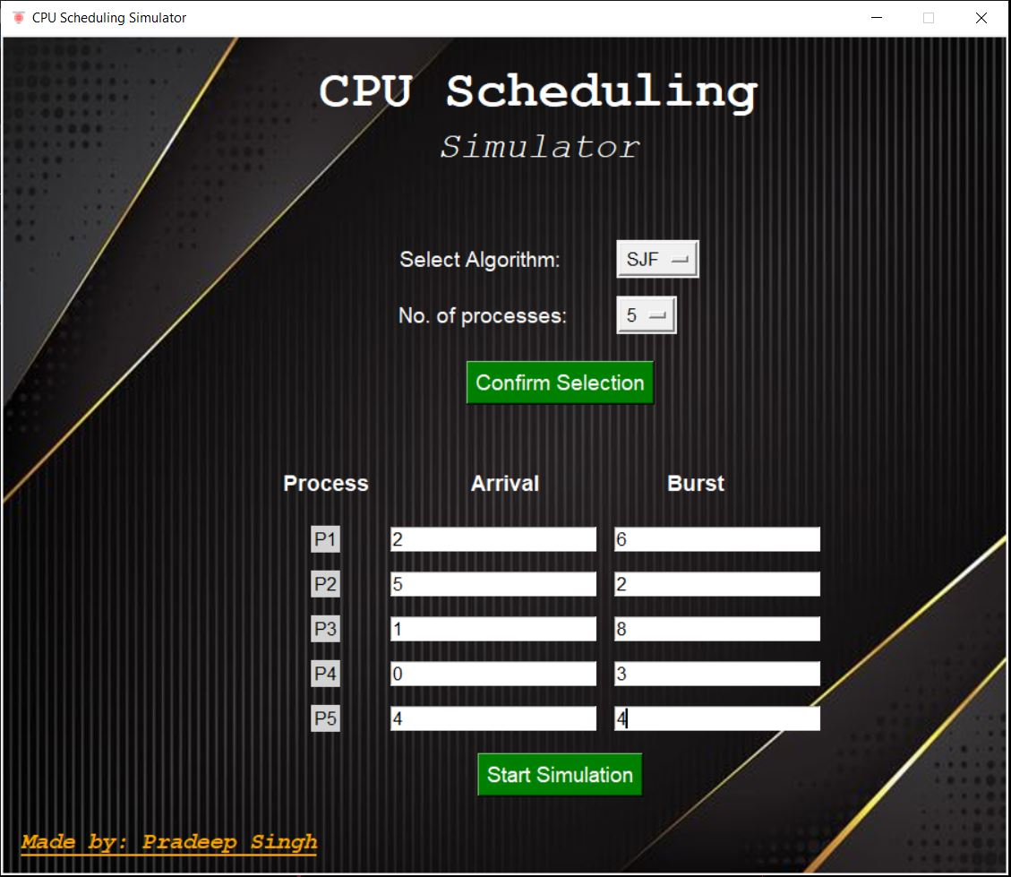
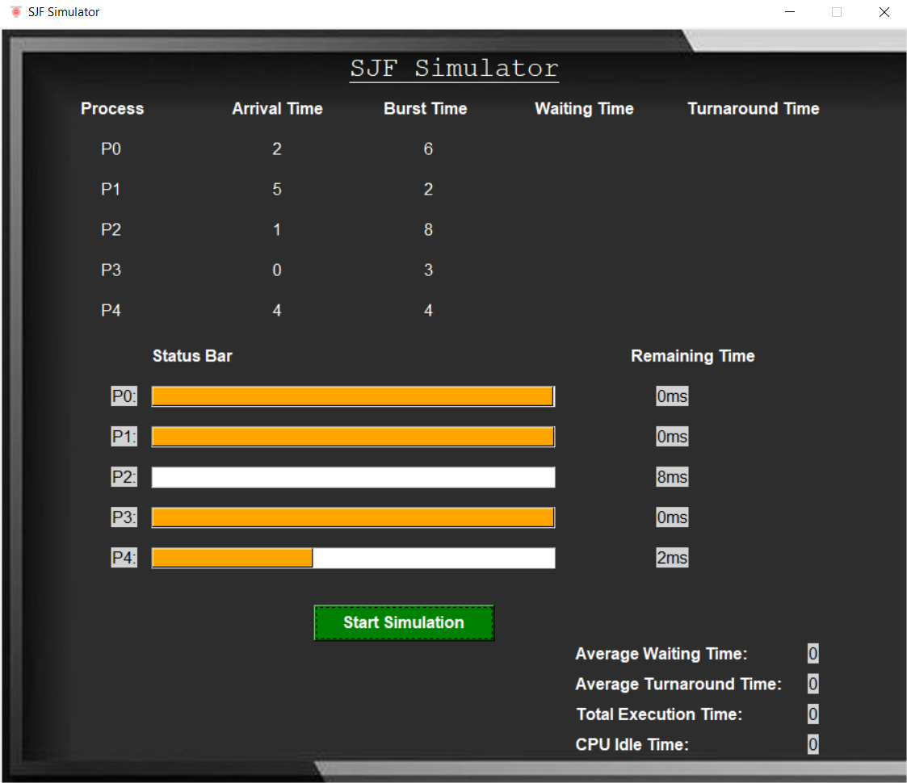
GUI Interface:

Slide 7
Demonstration
Run Program
Select the desired CPU scheduling algorithm.
Specify the number of processes.
Enter the necessary parameters (arrival time, burst time, priority, or time quantum).
Start the simulation and observe:
Process execution order.
Relevant statistics (e.g., waiting time, turnaround time)
Highlight error-checking by providing invalid inputs.

Slide 8
Application Or Uses
Academic learning tool for understanding CPU scheduling concepts.
Visual aid for explaining scheduling algorithms during lectures or tutorials.
Foundation for further projects involving process scheduling and optimization.
Can be extended for professional environments to simulate and test scheduling policies.

Slide 9

Conclusion
Successfully implemented a functional simulator for CPU scheduling.
Simplified complex scheduling concepts using an interactive GUI.
Highlighted the modular approach, which allows easy addition of new algorithms.
Future Work:
Adding Gantt chart visualizations.
Supporting multi-threaded or parallel process simulations.
Hosting the simulator on the web for wider accessibility.

Slide 10
Thank You…

