Slide 1
Automated Diagnostics Using LATTE
Author:
Pradeep Singh
Feb 2017

Slide 2

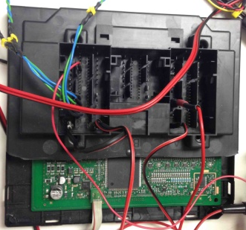
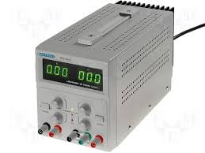
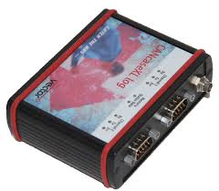
Overview of Automated Diagnostics using LATTE
Automated Diagnostics execution involves following:
Set of LATTE python libraries and other support libraries in a computer .
A Lear ECU connected to computer via CANcase that allows to perform automatic tests.
ECU powered by power supply.
CAN case
Power Supply
ECU
Computer

Slide 3
Tools for Automated Diagnostics using LATTE
In setup PC is needed:
Python 2.6.X or 2.7.X 32 bits version
Python Editor → PyScripter, latest 32 bits version available
Latte libs
Supporting scripts and Testcase template can be found at shared drive:
\\pun-20-5084\Workspace\Shared_Data\X590_Hybrid_Charger_Shared_Drive\X590_LATTE_EXCEL

Slide 4
Required Latte libraries
Python libraries for communication ( \latte_libs\com_v1 ) :
Vector devices for CAN/LIN → send CAN frames, read CAN frames sent by our module, send LIN frames, simulate LIN slaves, read LIN frames sent by our module, send diag requests and responses by CAN.
Python library for Report ( \latte_libs\ report_api_v2.0.0 ) :
Report with all tests performed in an integration test Python script.

Slide 5
Supporting Scripts
- In IEC we have created “LatteScriptGenerator_X590.py “ python script that extracts the data from
excel and writes it in LATTE accepted format to a xxx.py file

Slide 6
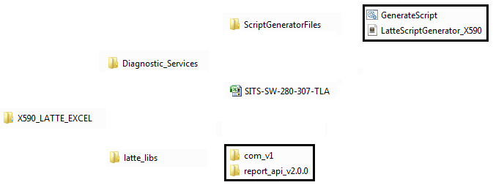
Folder Hierarchy
X590_LATTE_EXCEL folder contains following:
Diagnostic_Services
- ScriptGeneratorFiles (Contains scripts created by IEC)
- LatteScriptGenerator_X590.py
- GenerateScript.bat
- SITS-SW-280-307-TLA.xlsm(Testcase template file)
latte_libs
- com_v1 (latte library for communication over CAN)
- report_api_v2.0.0 (latte library for generating test report in xml format)

Slide 7
Overview of Testcase template
Testcase template SITS-SW-280-307-TLA.xlsm contains following sheets:
- Change History (To log changes done by people over the time)
- tla_library (Contains Report headers and CAN/LIN configuration)
- Integration Test (Testcases need to be written here)
- Guidelines (Contains guidelines regarding terms used in template)

Slide 8
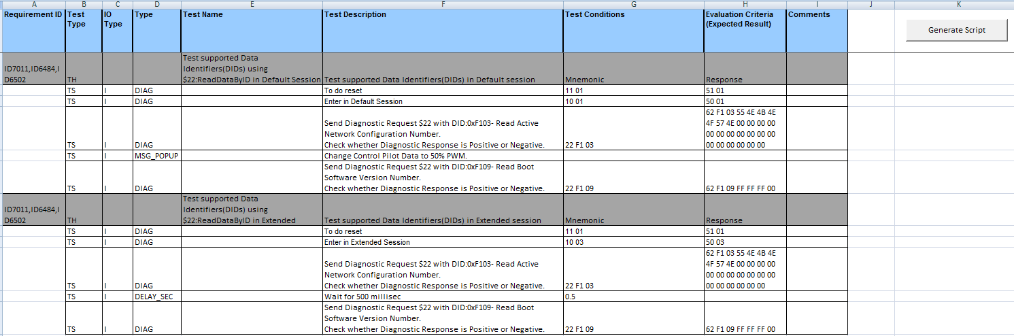
Steps for Automated Diagnostics using LATTE
Write Diagnostics testcases using the template SITS-SW-280-307-TLA.xlsm

Slide 9
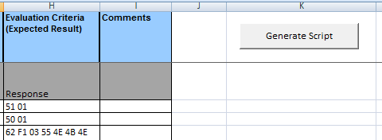
Steps for Automated Diagnostics using LATTE
2. After writing testcases click on “Generate Script” button as shown below.
Clicking on this button generates following :
- LATTE script file (xxx.py) for the testcases written in excel.
- Batch file (xxx.bat) for future execution of the script.
Click this button to generate Latte script for the testcases.

Slide 10
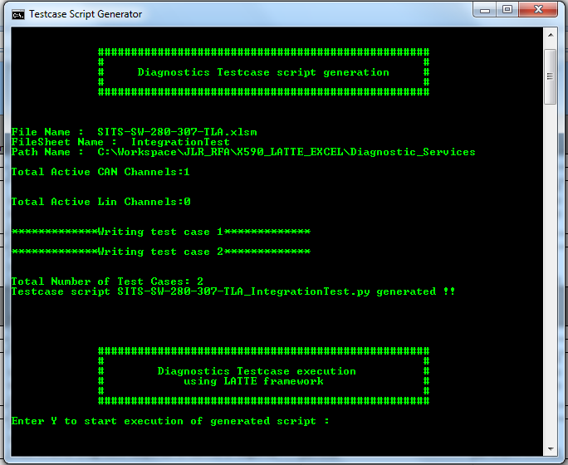
Steps for Automated Diagnostics using LATTE
3. On clicking “Generate Script” button , following window will open :
Latte script for the testcases generated.

Slide 11
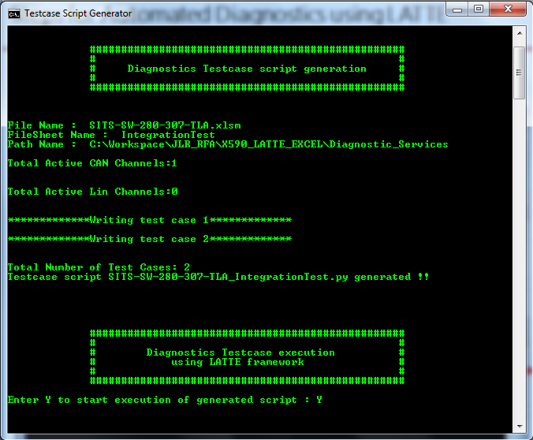
Steps for Automated Diagnostics using LATTE
4. Enter Y to start execution of LATTE script for the testcases:
Enter Y to start execution

Slide 12
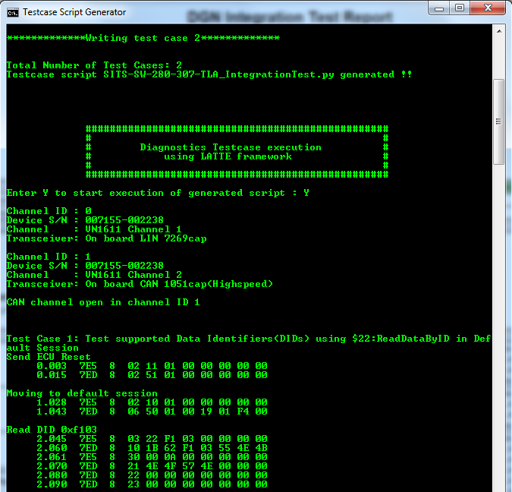
Steps for Automated Diagnostics using LATTE
5. You will see following status once the execution of LATTE script starts :
Before execution make sure that hardware is powered up and connected to PC via CANcase.

Slide 13
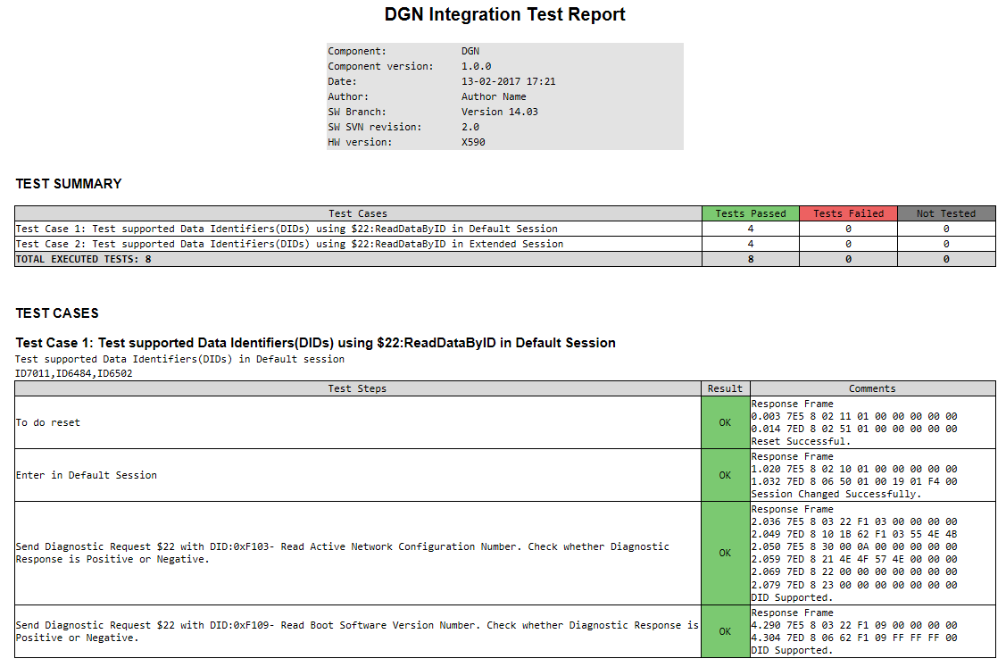
Steps for Automated Diagnostics using LATTE
6. After execution of script is complete , it will generate corresponding report as shown below:

Slide 14
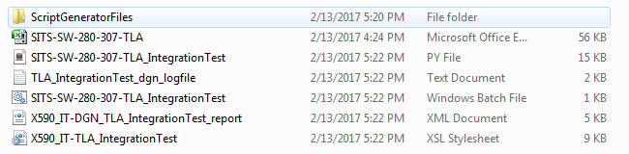
Steps for Automated Diagnostics using LATTE
7. After execution of script is complete , the folder Diagnostic_Services will contain all the generated files related to that particular testcase:
8. The batch file created “SITS-SW-280-307-TLA_IntegrationTest.bat “ can be used for future execution of the testcase script .

