Slide 1
Latte (Lear Automated Target Tools Environment)
November 2013

Slide 2

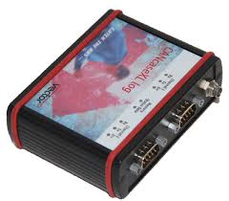
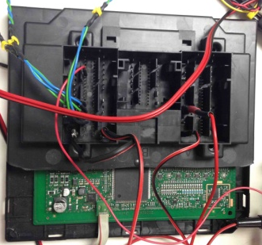
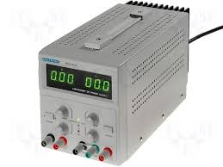
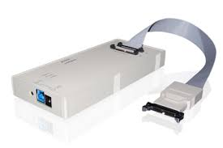
What is Latte?
Set of python libraries used in a test setup with a Lear ECU connected that allows to perform automatic tests.
Connections need it in the setup where test will be performed:
No license cancase
VW module
Notes:
Lear is a Leading Tier 1 global automotive supplier with annual revenue last year of $12 billion.
We have a $2.2 billion three-year sales backlog as of the start of this year and we continue to win new business in all regions of the world.
We have strong global market positions in two critical automotive segments:
Seating
Electrical Power Management Systems
We are a leader in product quality, customer service and innovation.
We have a diversified sales and customer base, and
We have a strong financial position.

Slide 3
What allows Latte?
Python libraries that allows to communicate with:
Trace 32 debugger → download code, run , stop, read var, write var, break points
Vector devices for CAN/LIN → send CAN frames, read CAN frames sent by our module, send LIN frames, simulate LIN slaves, read LIN frames sent by our module, send diag requests and responses by CAN.
Python library that allows to create:
Report with all tests performed in an integration test Python script.
Notes:
Lear is a Leading Tier 1 global automotive supplier with annual revenue last year of $12 billion.
We have a $2.2 billion three-year sales backlog as of the start of this year and we continue to win new business in all regions of the world.
We have strong global market positions in two critical automotive segments:
Seating
Electrical Power Management Systems
We are a leader in product quality, customer service and innovation.
We have a diversified sales and customer base, and
We have a strong financial position.

Slide 4
What is needed to use Latte?
In setup PC is needed:
Python 2.6.X or 2.7.X 32 bits version
Python Editor → PyScripter, latest 32 bits version available
In your PC is needed:
OPTIONAL: Python 2.6.X or 2.7.X 32 bits version
Python Editor → PyScripter, latest 32 bits version available
Latte libs
Python integration test script
Notes:
Lear is a Leading Tier 1 global automotive supplier with annual revenue last year of $12 billion.
We have a $2.2 billion three-year sales backlog as of the start of this year and we continue to win new business in all regions of the world.
We have strong global market positions in two critical automotive segments:
Seating
Electrical Power Management Systems
We are a leader in product quality, customer service and innovation.
We have a diversified sales and customer base, and
We have a strong financial position.

Slide 5
What is needed to use Latte?
Integration Test is executed in the setup PC:
Always work with a network mapped drive
Run the tests scripts always on the setup PC, but using mapped drive → so, the script is located in your personal PC but it runs in setup PC.
PC setup
Your PC
Mapped drive: example = z
Your code is here
Your IT script is here
Your report will be generated here
Mapped drive: example = z
Run IT script from here
Notes:
Lear is a Leading Tier 1 global automotive supplier with annual revenue last year of $12 billion.
We have a $2.2 billion three-year sales backlog as of the start of this year and we continue to win new business in all regions of the world.
We have strong global market positions in two critical automotive segments:
Seating
Electrical Power Management Systems
We are a leader in product quality, customer service and innovation.
We have a diversified sales and customer base, and
We have a strong financial position.

Slide 6
Where is Latte?
In VW project you can find latte libraries and tools in this directory:
PQ26_trunk\tools\latte_libs
00_guidelines
LATTE_General_Guidelines.doc
LATTE_VW_PQ26_Guidelines.doc
01_template
SITS-SW-280-VWBCMPQ26-swc.py
com_v1
Docs → Com Python API.doc
Example
files
report_v1
Docs → IT Report Python API.doc
example
files
trace32_v1
Docs → Trace32 Python API.doc
Example
Files
Important to read this docs
- PQ26_trunk\tools\latte_tools
gen_c_files_dict.py → file that has to be executed manually and generates a dictionary with the full mapped path of the C, H, CPP and HPP project files that will be used in case of using breakpoints (set and clear). Avoid using complete absolute paht in the IT script.i
Notes:
Lear is a Leading Tier 1 global automotive supplier with annual revenue last year of $12 billion.
We have a $2.2 billion three-year sales backlog as of the start of this year and we continue to win new business in all regions of the world.
We have strong global market positions in two critical automotive segments:
Seating
Electrical Power Management Systems
We are a leader in product quality, customer service and innovation.
We have a diversified sales and customer base, and
We have a strong financial position.

Slide 7
Where to put the integration test?
In VW project the IT will be located in a folder called itest inside the swc.
The name of the IT script will have this format: SITS-SW-280-VWBCMPQ26-swc.py
for example:
swcHorn\itest\ SITS-SW-280-VWBCMPQ26-swcHorn_Diags.py
Notes:
Lear is a Leading Tier 1 global automotive supplier with annual revenue last year of $12 billion.
We have a $2.2 billion three-year sales backlog as of the start of this year and we continue to win new business in all regions of the world.
We have strong global market positions in two critical automotive segments:
Seating
Electrical Power Management Systems
We are a leader in product quality, customer service and innovation.
We have a diversified sales and customer base, and
We have a strong financial position.

Slide 8
What to include in the IT folder?
The Python integration test script (SITS-SW-280-VWBCMPQ26-swc.py )
CAN dbc file if needed
LIN ldf file if needed
After executing the Python script, following output files are generated:
Xml and html files containing the report
Txt containing log frames
The output files will be commited in:
VW_BCM_PQ26_PRJDATA/trunk/40_Software/05_SW_ARCHITECTURE/SW_COMPONENTS/swc/04_IntegrationTest
Notes:
Lear is a Leading Tier 1 global automotive supplier with annual revenue last year of $12 billion.
We have a $2.2 billion three-year sales backlog as of the start of this year and we continue to win new business in all regions of the world.
We have strong global market positions in two critical automotive segments:
Seating
Electrical Power Management Systems
We are a leader in product quality, customer service and innovation.
We have a diversified sales and customer base, and
We have a strong financial position.

Slide 9
Examples:
In com_v1 folder there is an Example of how to use the CAN Python library.
In trace32_v1 folder there is an Example of how to use the Trace Python library.
In report_v1 folder there is an Example of how to use the Report Python library.
With a combination of the three ones we will create our Python IT script.
It is important to begin using the template that is in latte_libs\01_Template
Notes:
Lear is a Leading Tier 1 global automotive supplier with annual revenue last year of $12 billion.
We have a $2.2 billion three-year sales backlog as of the start of this year and we continue to win new business in all regions of the world.
We have strong global market positions in two critical automotive segments:
Seating
Electrical Power Management Systems
We are a leader in product quality, customer service and innovation.
We have a diversified sales and customer base, and
We have a strong financial position.

