Slide 1

Seasonal Agriculture Performance Analysis
An Empirical Investigation of Seasonal Disparities, Resource Efficiency, Crop Yields, and Economic Outcomes using Python Data Analytics
STUDENT NAME
COLLEGE NAME
AICTE STU ID
COURSE TRACK
Pradeep Kumar Tiwari
Galgotias College of Engineering and Technology
STU681def06804441746792198
Data Visualization

Slide 2


Problem Statement
Context & Seasonal Variations
Core Analytical Mandate
Agricultural activities are influenced by seasonal variations in environmental conditions, farming practices, resource availability, and market conditions. As a result, agricultural performance differs significantly across seasons.
The objective is to analyze the 4,000-record agricultural dataset and investigate seasonal differences in performance by discovering meaningful patterns, trends, relationships, and variations.
The investigation evaluates key drivers of crop yield, irrigation efficiency, and profitability across Kharif, Rabi, and Zaid cultivation cycles.
However, raw agricultural records do not clearly explain how performance metrics shift across seasons or what patterns emerge under distinct environmental regimes.

Slide 3
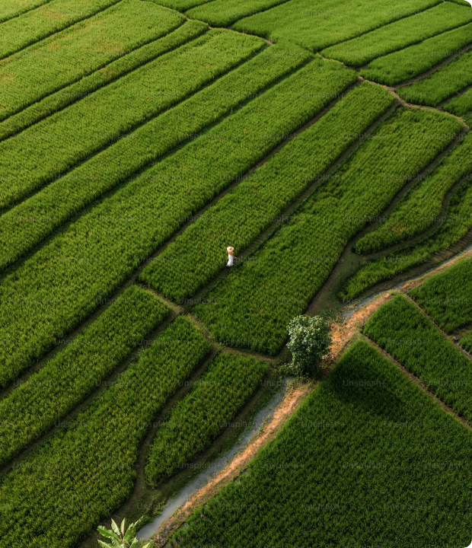
Project Description
End-to-End Analytical Pipeline
This major project executes an end-to-end data analytics workflow on 4,000 farm records covering 8 crops (Wheat, Maize, Rice, Pulses, Cotton, Chilli, Groundnut, and Sugarcane) across Kharif, Rabi, and Zaid seasons.
We perform systematic data cleaning, derived metric feature engineering (Water Productivity Index, Net Profit Margins), One-way ANOVA statistical tests, and correlation modeling to derive actionable farming insights.

Slide 4




Who Are The End Users?
Farmers & Growers
Agronomists
Policy Makers
AgTech Supply Chains
Select the most profitable crop varieties for each season and optimize irrigation techniques to avoid capital loss.
Formulate precision input guidelines, benchmark soil moisture thresholds, and monitor seasonal pest risks.
Establish informed regional water allocation quotas, subsidy policies, and seasonal Minimum Support Price (MSP) benchmarks.
Forecast regional harvest volumes, schedule cold-storage infrastructure, and reduce post-harvest logistical bottlenecks.

Slide 5
Technology Used
Python 3.10+
Pandas & NumPy
Matplotlib & Seaborn
SciPy & Jupyter
Core programming language providing robust data cleaning pipelines, numerical calculations, and automated scripts.
Vectorized tabular processing for missing value handling, grouping by season, and derived metric calculations.
Publication-grade visual toolkits used to render comparative seasonal bar charts, boxplots, and correlation heatmaps.
Statistical hypothesis testing (One-way ANOVA) and interactive exploratory analysis within documented notebooks.

Slide 6

Results: Key Performance Metrics
Significant Seasonal Disparities Observed
Empirical evaluation of the 4,000 dataset records reveals distinct seasonal performance variations confirmed by ANOVA testing (p < 0.001):
5.64 t
• Kharif Profit Leader: Generates highest average farm profit (₹1,78,915) and highest average yield (5.64 t/ha), supported by 852.1 mm rainfall.
Peak Yield / Ha (Kharif Season)
• Rabi Predictability: High yield stability (5.08 t/ha) with moderate irrigation demand (5,847 m³) and ₹87,689 average profit.
• Zaid Deficit: Drops to 4.67 t/ha yield with negative net returns (-₹24,805) due to severe summer evapotranspiration and pumping costs.

Slide 7
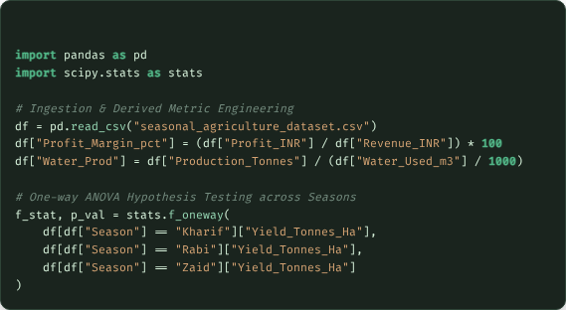
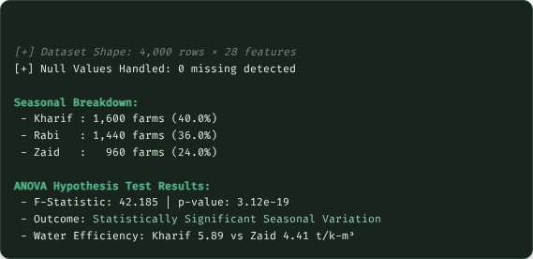
Results: Code & Pipeline Execution

Slide 8
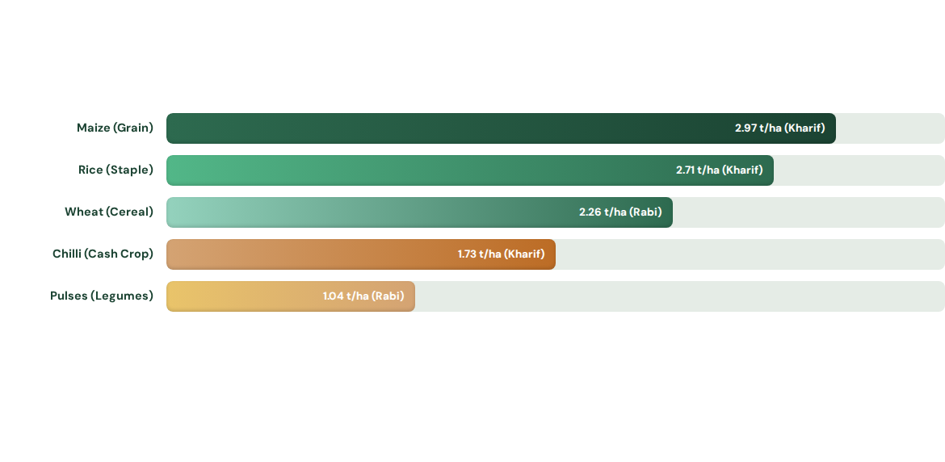
Results: Seasonal Yield Comparison
Across all non-sugarcane crops, Kharif yields consistently exceed Rabi and Zaid cycles. Summer Zaid crops display a 22-37% yield contraction across species.

Slide 9
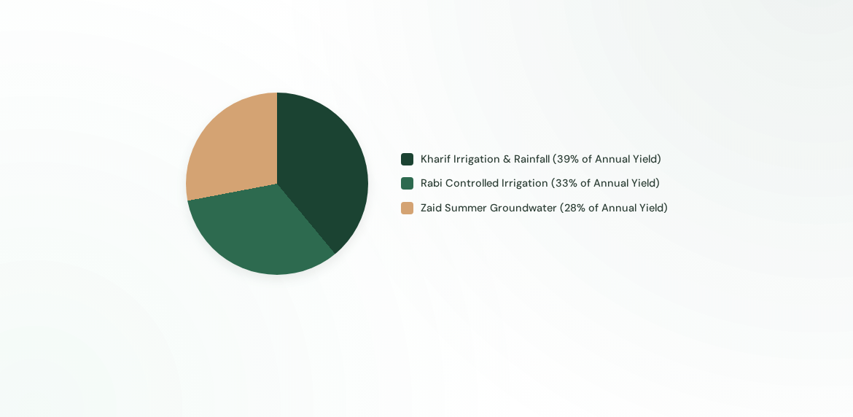
Results: Seasonal Water Utilization
Although Zaid represents only 24% of farm records, it consumes the highest volume of water per hectare (6,420 m³) while exhibiting the lowest efficiency (4.41 t / 1,000 m³).

Slide 10
Results: Comparative Season Matrix
Metric / Parameter | Kharif (Monsoon) | Rabi (Winter) | Zaid (Summer) | Statistical Significance
Average Yield (Tonnes/Ha) | 5.64 t/ha | 5.08 t/ha | 4.67 t/ha | F = 42.18, p < 0.001
Mean Rainfall (mm) | 852.1 mm | 436.0 mm | 299.4 mm | F = 184.6, p < 0.001
Water Consumption (m³) | 6,102 m³ | 5,847 m³ | 6,420 m³ | p < 0.01 (Significant)
Water Efficiency (t/1000m³) | 5.89 | 5.19 | 4.41 | p < 0.001 (Significant)
Average Net Profit (INR) | +₹1,78,915 | +₹87,689 | -₹24,805 | p < 0.001 (Loss in Zaid)
Disease & Pest Risk (%) | 54.5% | 40.5% | 38.2% | Highest in humid Kharif

Slide 11
Future Scope
Predictive Machine Learning Modeling: Train ensemble models (XGBoost, Random Forest) to forecast seasonal crop yields and market revenues before sowing using 15-day weather telemetry.
Satellite Remote Sensing & NDVI: Integrate Sentinel-2 multi-spectral satellite imagery to monitor vegetation health index and regional soil moisture depletion across seasons.
Farmer Decision Support Bot: Build an automated multilingual mobile advisory service providing micro-irrigation schedules and seasonal crop rotation recommendations.
Climate Resilience Stress Testing: Simulate extreme temperature shocks, erratic monsoon onsets, and groundwater depletion scenarios to design data-driven crop insurance models.

Slide 12


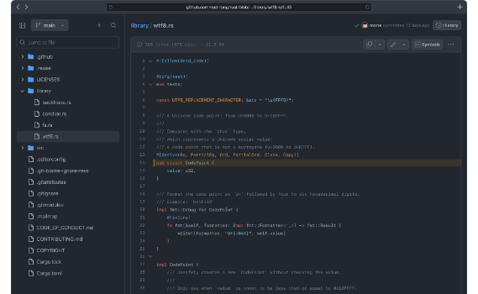
GitHub Project Repository
The entire source code, dataset processing scripts, interactive Jupyter notebooks, and exported graphics are publicly available on GitHub:
https://github.com/PradeepTiwari12/Seasonal-Agriculture-Performance-Analysis
•
seasonal_agriculture_analysis.py: Automated cleaning, ANOVA hypothesis testing, and chart generation.
•
analysis_outputs/: High-resolution correlation heatmaps and multi-season bar plots.
•
notebooks/: Step-by-step exploratory data analysis with detailed documentation.

Slide 13



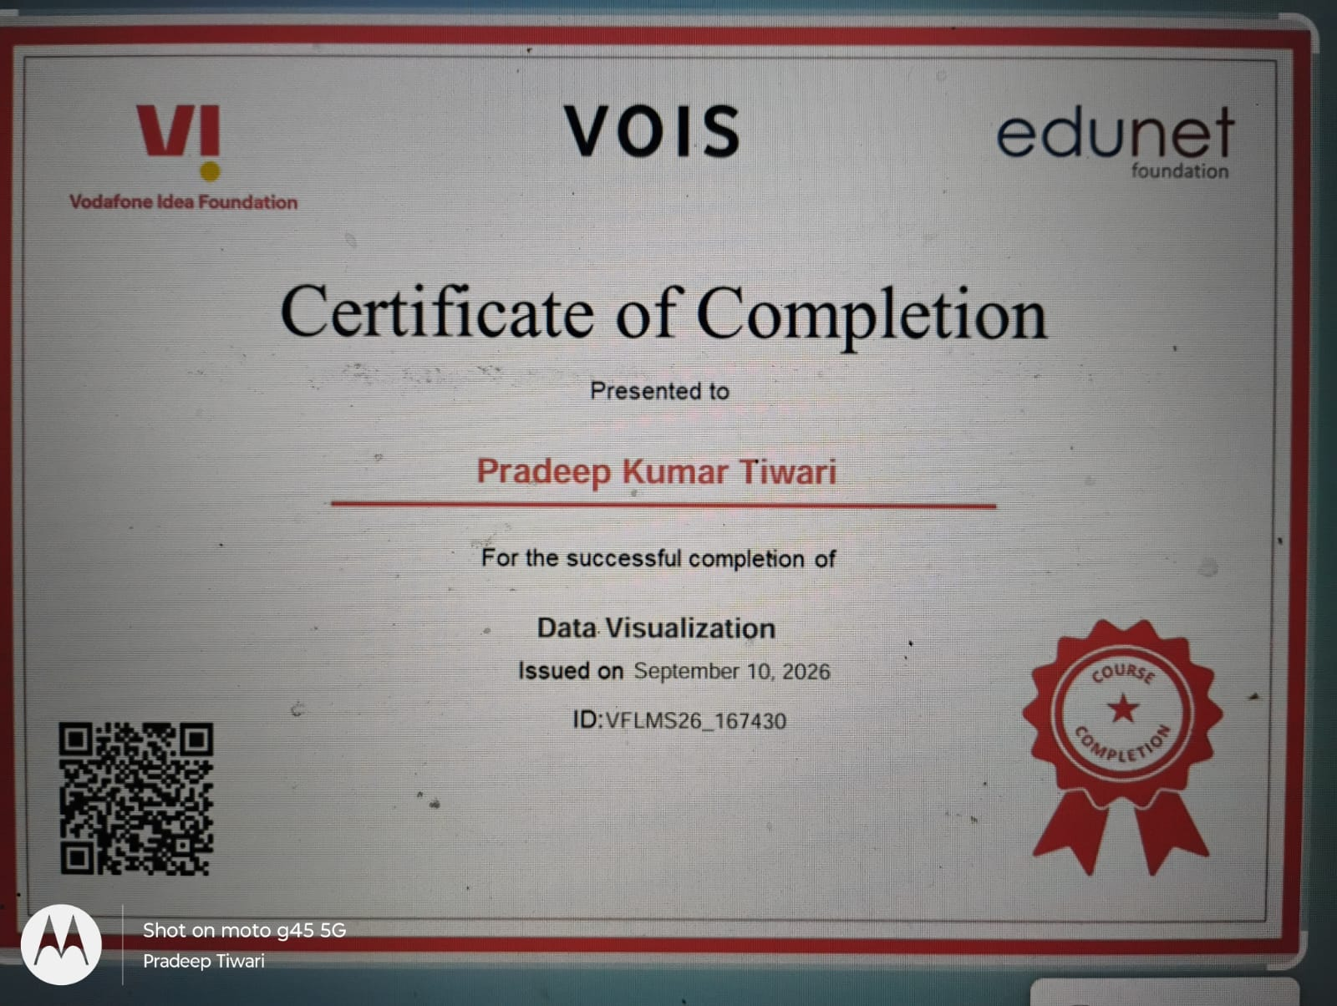

Slide 14
Thank You!
Seasonal Agriculture Performance Analysis
Candidate: Pradeep Kumar Tiwari | Galgotias College of Engineering and Technology

Slide 15


Image Sources
https://plus.unsplash.com/premium_photo-1674019234994-eceabbdd091d?fm=jpg&q=60&w=3000&auto=format&fit=crop&ixlib=rb-4.1.0&ixid=M3wxMjA3fDB8MHxwaG90by1wYWdlfHx8fGVufDB8fHx8fA%3D%3D
Source: unsplash.com
https://images.ctfassets.net/8aevphvgewt8/6Haf7BUreZPMqRi8Lm8JF8/5a0b2b5fe15a78bc312cb1a087c8ac54/image_8.png?fm=webp
Source: github.com

Slide 16


Image Sources
https://plus.unsplash.com/premium_photo-1674019234994-eceabbdd091d?fm=jpg&q=60&w=3000&auto=format&fit=crop&ixlib=rb-4.1.0&ixid=M3wxMjA3fDB8MHxwaG90by1wYWdlfHx8fGVufDB8fHx8fA%3D%3D
Source: unsplash.com
https://images.ctfassets.net/8aevphvgewt8/6Haf7BUreZPMqRi8Lm8JF8/5a0b2b5fe15a78bc312cb1a087c8ac54/image_8.png?fm=webp
Source: github.com

