Slide 1
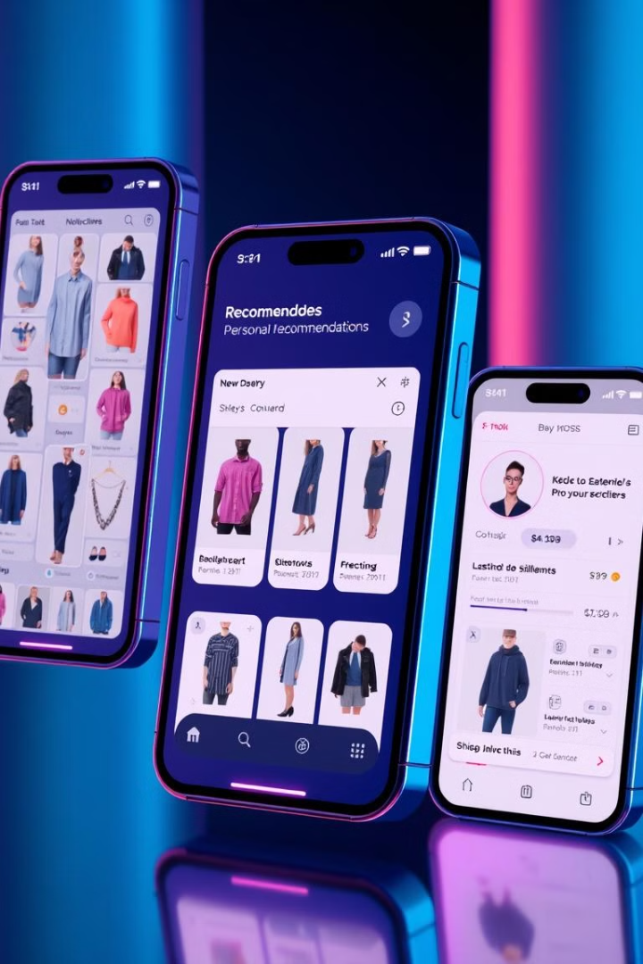
E-Shopmate: Your Personalized Clothing Recommendation System
Welcome to the presentation of E-Shopmate, a revolutionary clothing recommendation system designed to simplify your shopping experience and help you find the perfect outfit. E-Shopmate utilizes advanced machine learning algorithms to understand your individual style and preferences, providing you with personalized recommendations for clothing that you'll love.

Slide 2
Introduction to E-Shopmate
E-Shopmate is a user-friendly platform that utilizes advanced machine learning algorithms to analyze your past purchases, browsing history, and style preferences.
E-Shopmate seamlessly integrates with various online clothing retailers, making it easy for you to browse and purchase recommended items directly within the app.
This data is used to generate personalized recommendations for clothing items that are tailored to your individual style.
It offers a convenient and personalized shopping experience, saving you time and effort while ensuring you find clothing that you'll love.

Slide 3
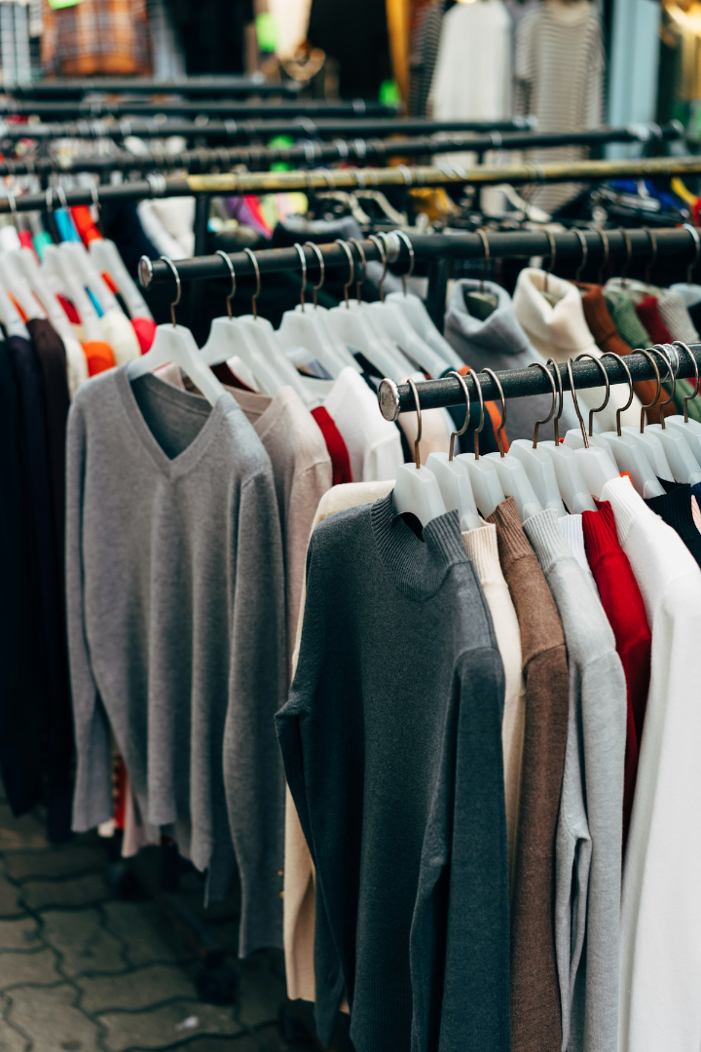
Goals of E-Shopmate
1
Personalized Shopping
2
Enhanced User Experience
E-Shopmate aims to deliver highly personalized clothing recommendations that cater to individual style preferences, ensuring users discover clothing items they'll truly love and wear.
E-Shopmate seeks to streamline the shopping process by providing relevant recommendations, saving users time and effort while making shopping enjoyable and rewarding.
3
Seamless Integration
E-Shopmate aims to seamlessly integrate with various online clothing retailers, providing a unified platform for browsing, discovering, and purchasing clothing recommendations.

Slide 4

How It Works
1
Data Collection
E-Shopmate gathers data from various sources, including user profiles, browsing history, past purchases, and style preferences.
2
Data Analysis
Advanced machine learning algorithms analyze the collected data to identify patterns and trends, revealing the user's individual style and preferences.
3
Recommendation Generation
Based on the analyzed data, E-Shopmate generates personalized clothing recommendations that align with the user's unique style and preferences.
4
Recommendation Delivery
Recommendations are presented to the user in a visually appealing and interactive format, allowing them to browse, discover, and purchase items directly within the app.

Slide 5



Machine Learning Models
1
Collaborative Filtering
2
Content-Based Filtering
3
Deep Learning
E-Shopmate utilizes a combination of machine learning models to ensure accurate and relevant recommendations. Collaborative filtering analyzes the preferences of similar users to identify items that the current user might like.
Content-based filtering leverages the user's past interactions and style preferences to recommend similar items. Deep learning algorithms further enhance recommendation accuracy by learning complex patterns from vast amounts of data, providing increasingly personalized and refined recommendations.

Slide 6
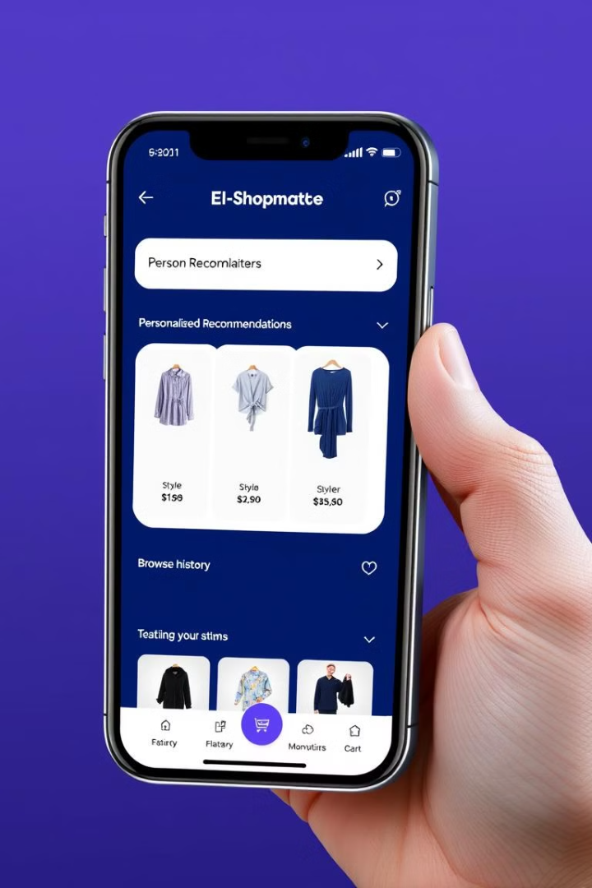




Key Features
Personalized Recommendations
Style Quizzes
E-Shopmate provides tailored clothing recommendations based on individual style preferences and past interactions.
Interactive style quizzes help users refine their preferences and provide E-Shopmate with additional information to generate more accurate recommendations.
Visual Search
Seamless Shopping
Users can upload photos of clothing items they like to find similar items and explore new style options.
E-Shopmate seamlessly integrates with online clothing retailers, allowing users to browse and purchase recommended items directly within the app.

Slide 7
Benefits to Users and Businesses
User Benefits
Business Benefits
Personalized clothing recommendations tailored to individual preferences
Increased sales and customer engagement
Improved customer satisfaction and loyalty
Time-saving and efficient shopping experience
Reduced customer churn and enhanced brand image
Access to a wide range of clothing styles and brands
Valuable insights into customer preferences and market trends
Discovery of new and exciting fashion trends

Slide 8
Future Scope
AI-powered Styling
1
Develop AI-powered styling assistants that can suggest complete outfits based on the user's wardrobe and preferences, offering virtual styling services.
Virtual Try-on Technology
2
Integrate virtual try-on technology to allow users to try on clothing digitally, enhancing the shopping experience and reducing return rates.
Sustainable Fashion Recommendations
3
Develop a feature that prioritizes sustainable and eco-friendly brands and clothing items, encouraging conscious consumption and promoting sustainable fashion.

Slide 9
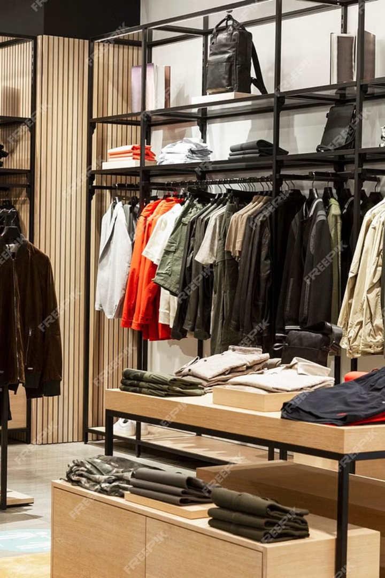
Conclusion
E-Shopmate offers a revolutionary approach to clothing recommendation, empowering users with personalized insights, streamlining the shopping process, and fostering a more fulfilling and enjoyable fashion experience.
As E-Shopmate continues to evolve, it will leverage cutting-edge technology and data analytics to provide even more personalized, intuitive, and impactful shopping experiences, revolutionizing the way we discover and purchase clothing.

