Slide 1

Kickstarter Crowdfunding
Group 3 :-
Komal Swami
Pradeepa R
Sandyashree C

Slide 2
About Kickstarter & Crowdfunding
Crowdfunding is a method of raising funds by collecting small amounts from a large number of people. Kickstarter is one of the most popular crowdfunding platforms, focusing on creative projects.
On Kickstarter:
Project creators set funding goals and deadlines.
Backers pledge money only if the project meets its goal.
Kickstarter collects a 5% fee from successful campaigns.
Why people back projects: They may be inspired by a creative idea, rewards, personal connection, or social impact. Many support projects that align with their values or offer early access to a product.

Slide 3
Tools Used & Project Workflow
In this projects, we used four tools MS Excel ,Power BI ,Tableau and MySQL Workbench to answer the same set of business questions using Kickstarter dataset.
Workflow:
Converted Epoch time to regular date format.
Created Calendar Table with year, month, financial quarter, etc.
Converted goal amount into USD using a static rate
Joined tables: Projects, Locations, Calendar, Creator, Category.
Solved business questions using each tools.
Designed dashboards in Excel, Power BI, and Tableau
SQL was used only for queries, not for dashboards.

Slide 4
Data Model, Tables & Relationships
Main Tables Used:
Crowdfunding_Projects
Crowdfunding_Location
Calendar_Table
Key Columns:
Different ID columns
Date related columns (after Epoch conversion)
Goal Amount (converted to USD)
Outcome, Backers, Amount Raised , Category , USD Pledge.
Relationships:
Location ,Creator ,Category and calendar tables are connected to projects table using their respective ID columns.
 | Crowdfunding_Creator
 | Crowdfunding_Category

Slide 5
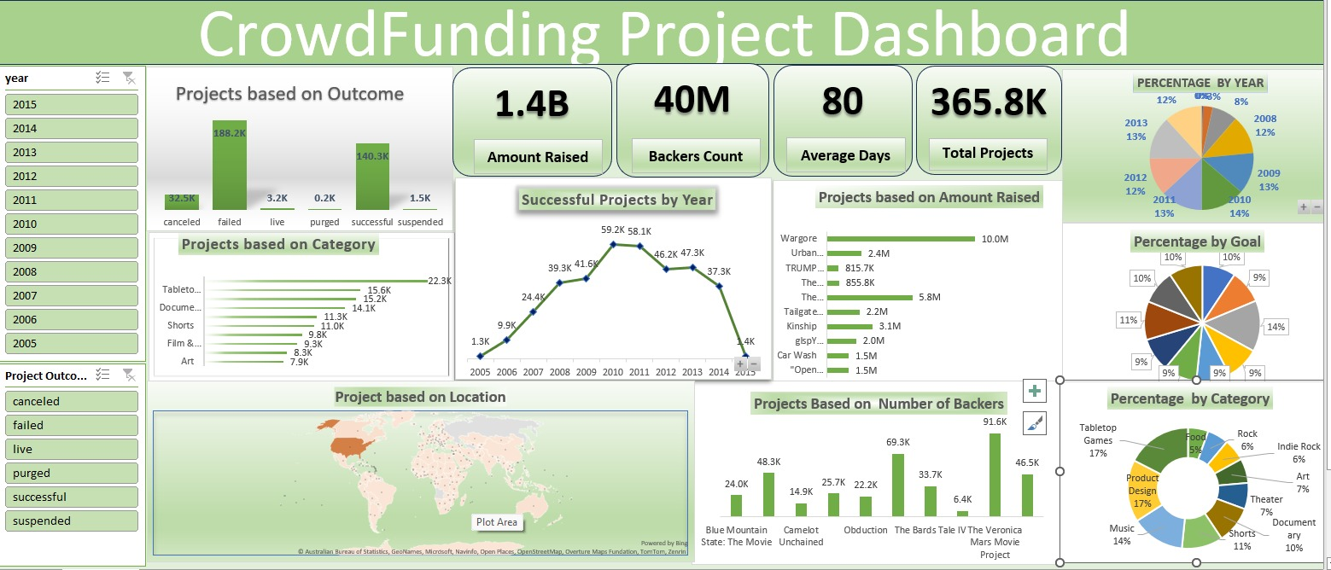
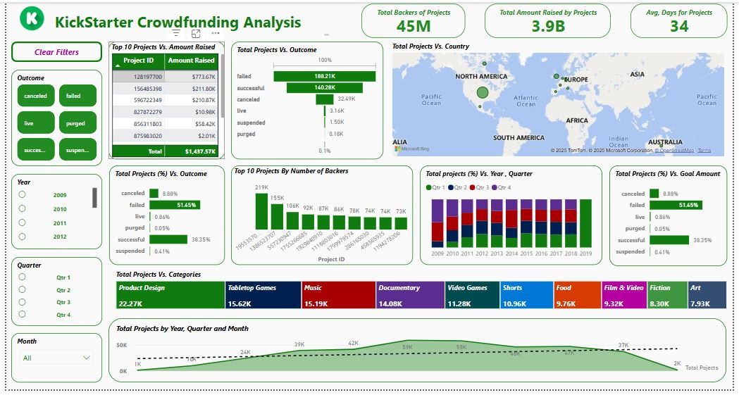
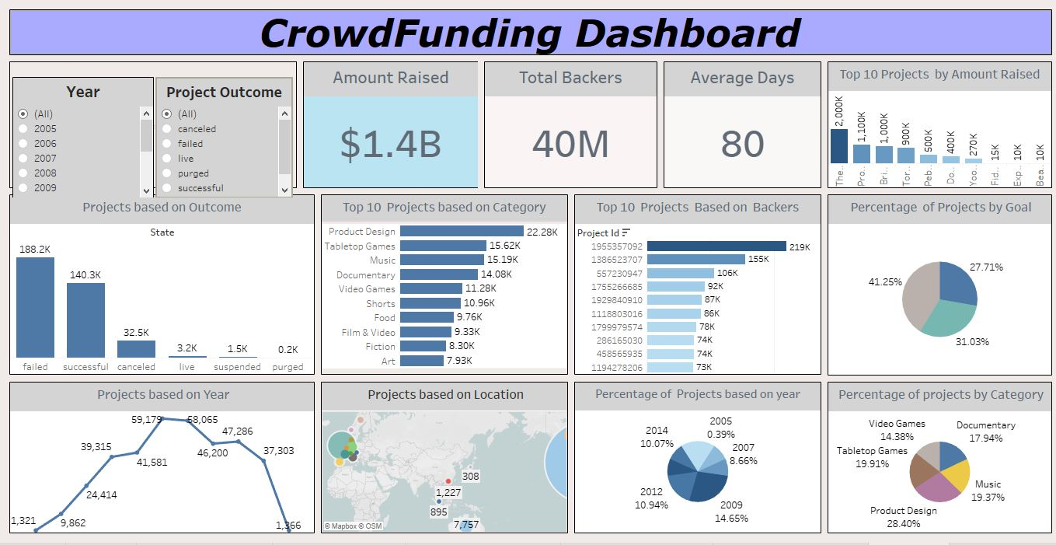
Dashboards
Excel Dashboard
Power BI Dashboard
Tableau Dashboard

Slide 6
Key Insights & Patterns
Based on the dashboards
Total Projects Analyzed: Over 364,000
Success Rate: Around 38.35% of projects were successful
Failure Rate: 51.45% of projects failed to meet their goals
Avg. Project Duration: 34 days
Total Backers: 45 million
Total Amount Raised: $3.9 billion
Top Categories by Volume:
Product Design: 22.27K projects
Tabletop Games: 15.62K
Music: 15.19K
Documentary and Video Games follow closely,
Funding Trends:
Highest number of projects were launched between 2015–2018
Steady growth across quarters; Q3 and Q4 often had more launches
Top projects by backers had up to 219K supporters
Top Locations:
North America and Europe contributed the most in project volume and backers
Goal Related Insights:
Projects with moderate goal ranges were more successful.
Extremely high or low goals had lower success rates.

Slide 7
Project Conclusion
Successful Kickstarter projects often belong to specific categories like Product Design, Tabletop Games, and Music, which consistently perform better.
Moderately set goal amounts have higher success rates, while extremely low or high goals often lead to failure.
Geographic location plays a vital role—North America and Europe lead in both number of projects and funding success.
Projects launched in Q3 and Q4 showed relatively higher engagement, indicating seasonal trends in crowdfunding.
A significant portion of projects—over 50%—fail to meet their goals, which highlights the need for strong planning and backer engagement.

Slide 8
Some Key Business Suggestions for Kickstarter Success
1. Set Achievable Funding Goals
Many projects fail due to unrealistic targets. Analyzing past successful campaigns in the same category helps set practical, trust-building goals that are more likely to get funded.
2. Launch at the Right Time
Engagement is higher during Q3 and Q4. Planning launches around peak seasons or relevant events can lead to more backers and higher funding.
3. Invest in Pre-Launch Marketing
Strong campaigns begin before launch. Build buzz through email, social media, and teaser content to ensure a powerful first 48 hours.
4. Offer Attractive and Tiered Rewards
Backers are motivated by value. Create multiple reward levels with exclusive perks, early-bird pricing, or limited editions to increase pledges and engagement.

Slide 9
Thank You.

