Slide 1
Problem Statement
Title: Introduction to GenAI and Simple LLM Inference on CPU and Fine-tuning of LLM Model to Create a Custom Chatbot
Content:
Category: Artificial Intelligence, Machine Learning, LLM, NLP
Participants: 1st-4th Semester Students
Prerequisites:
Understanding of Machine Learning Concepts
Programming Skills (Python, NLP Libraries like Hugging Face, Transformers)
Experience with NLP and Text-based AI Models (e.g., Language Models, Chatbots)
Description: Introduction to GenAI, simple LLM inference on a CPU, and fine-tuning an LLM to create custom chatbots​​​​.

Slide 2
Unique Idea Brief (Solution)
Title: Solution Overview
Content:
Objective: Perform simple LLM inference on a CPU and fine-tune an LLM model to create a custom chatbot.
Challenges:
Managing large pre-trained models.
Performing LLM inference on CPU.
Understanding and applying fine-tuning.
Creating a custom chatbot using Intel AI tools.
Expected Outcomes:
Foundational understanding of GenAI.
Ability to perform LLM inference on CPU.
Understanding of fine-tuning LLMs for custom applications.
A 5-page report detailing the problem, technical approach, and results.

Slide 3
Features Offered
Title: Features of the Custom Chatbot Solution
Content:
Foundational understanding of GenAI.
Simple LLM inference on CPU.
Fine-tuning LLMs.
Utilization of Intel AI tools for chatbot creation.
Educational value for beginners in AI and ML​​​​.

Slide 4
Process Flow
Title: Process Flow of the Solution
Content:
Step 1: Understanding GenAI concepts.
Step 2: Performing simple LLM inference on CPU.
Step 3: Fine-tuning the LLM model.
Step 4: Creating and deploying a custom chatbot using Intel AI tools​​.

Slide 5
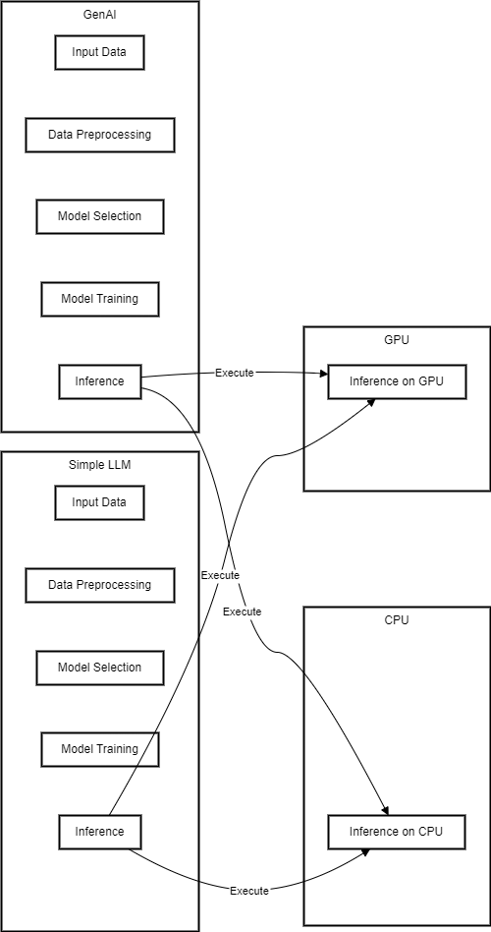
Architecture Diagram

Slide 6
Technologies Used
Title: Technologies and Tools Used
Content:
Python: Used as the programming language.
NLP Libraries: Hugging Face, Transformers.
Intel AI tools:
Intel® Extension for Transformers
Intel® Developer Cloud
Processors: 4th Generation Intel® Xeon® Scalable processors.

Slide 7
Team Members and Contribution
Title: Team Members and Their Contributions
Content:
List of team members Pradeepa V T
Specific contributions:
Data collection
Model training
Fine-tuning
Deployment

Slide 8
Conclusion
Title: Conclusion
Content:
Summary of the solution's impact:
Educational value: Foundational understanding of GenAI and practical experience in LLM inference and fine-tuning.
Technical proficiency: Ability to perform LLM inference on CPU and fine-tune LLMs for custom applications.
Future exploration: Potential for further development and application of AI and ML techniques in various domains.

