Slide 1
NODE.JS ARCHITECTURE
PRADEEPA S

Slide 2
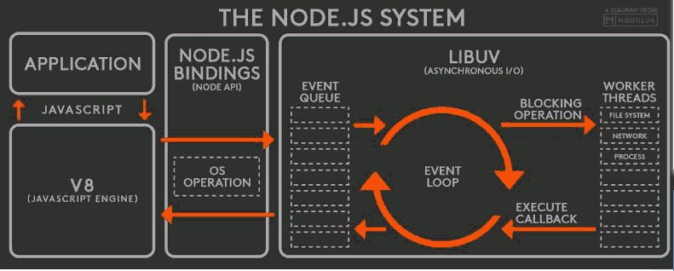

Slide 3
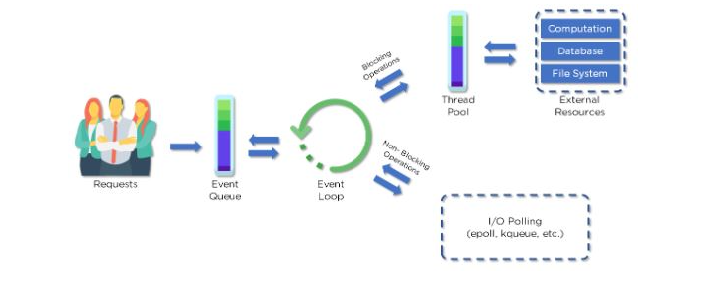

Slide 4
Advantages of node.js architecture
Handling multiple concurrent client requests is fast and easy
No need for creating multiple threads
Requires fewer resources and memory

