Slide 1
SRM INSTITUTE OF SCIENCE AND TECHNOLOGY RAMAPURAM CAMPUS,CHENNAI - 600089
ATTENDANCE SYSTEM USING FACIAL RECOGNITION
SEMINAR II PRACTICAL – MAY 2023
SUBMITTED BY
Pradeepan P – RA20011027020081
Vikash R – RA2011027020096

Slide 2
ABSTRACT
Automatic face recognition (AFR) technologies have made many improvements in the changing world. Smart Attendance using Real-Time Face Recognition is a real-world solution which comes with day-to-day activities of handling student attendance system. Face recognition-based attendance system is a process of recognizing the students face for taking attendance by using face biometrics based on high - definition monitor video and other information technology

Slide 3
OBJECTIVE
To identify the student faces accurately. To mark the attendance automatically. To reduce the time and the efforts required for manual attendance to provide a valuable attentive system for both teacher and students. It provides flexibility and reduces time loss. There will be no chance for a proxy. The objective of this project is to develop a face recognition based automated student attendance system. Expected achievements to fulfill the objectives are:
To detect the face segment from the video frame. To extract the useful features from the face detected.
To classify the features to recognize the face detected.

Slide 4
SCOPE
Facial recognition systems can be used to identify people in photos, videos, or in real-time. Facial recognition is a category of biometric security. Other forms of biometric software include voice recognition, fingerprint recognition, and eye retina or iris recognition.

Slide 5
LITREATURE REVIEW
Attendance System Using NFC Technology with Embedded Camera on Mobile Device
According to research journal “Attendance System Using NFC (Near Field Communication) Technology with Embedded Camera on Mobile Device” (Bhise, Khichi, Korde,Lokare, 2015). The attendance system is improved by using NFCtechnology and mobile application. According to the research paper, each student is given a NFC tag that has a unique ID during their enrolment into the college. Attendance of each class will then be taken by touching or moving these tags on the lecturer mobile phone. The embedded camera on the phone will then capture the student‟s face to send all the data to the college server to do validation and verification. The advantages of this method is where the NFC is simple to use, and the speed of connection establishment is very high.

Slide 6
Face Recognition Based Attendance Marking System
The second research journals “Face Recognition Based Attendance Marking System” (SenthamilSelvi, Chitrakala, Antony Jenitha, 2014) is based on the identification of face recognition to solve the previous attendance system‟s issues. This system uses camera to capture the images of the employee to do face detection and recognition. The captured image is compared one by one with the face database to search for the worker‟s face where attendance will be marked when a result is found in the face database. The main advantage of this system is where attendance is marked on the server which is highly secure where no one can mark the attendance of other

Slide 7
PROPOSED WORK
Contrary to what other attendance systems did, the camera was installed outside the classroom near of the door. However, in our proposed system, a high-resolution camera device is installed in a suitable location within the classroom, which is in the middle of the front wall as shown in the benefit of this installation position is to easily identify faces. The angle of view of the camera is clear and flexible until it scans all aspects of the students at the same moment and more efficiently than shown in Figure . Meanwhile, students are satisfied with only sitting on their seats, their task is limited to sitting only. The location of the camera gave him a lot of time, unlike if the camera was at the front of the door, there would be a crowd and a long waiting line and a waste of time. When capturing images from the camera, machine-learning algorithm is implemented to identify the faces. After this phase, the identification process is successfully completed, and we have a clear, specific image that can help us in the next phase. After the face detection and recognition phase, images are entered as an input to the system. When creating an IAU database, students’ images must be added to the basic data to compare the image entered to the system with the image saved in the IAU database and check whether it is identical or not. The goal of matching images is whether the students are enrolled in this course or not on the same day and time, in case the images do not match, i.e., students are enrolled in this course but not on this day nor at the same time. Hence, the system brings the student information and sends it to the instructor. Thus, the decision is made for the instructor whether to consider the attendance or not. After the comparison of the images entered with the images stored in the IAU database is completed, the system confirms the attendance of the student by registering the time he entered the class in the attendance field.

Slide 8
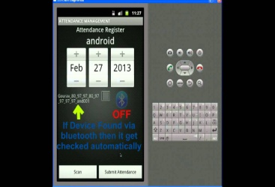
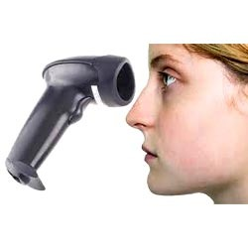
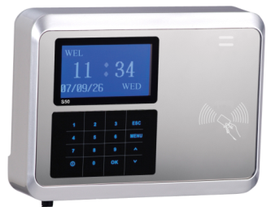
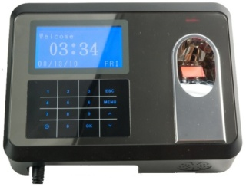
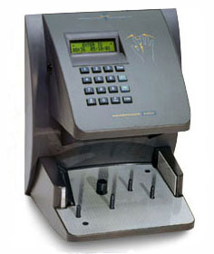
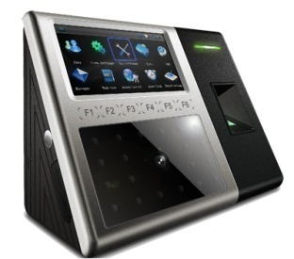
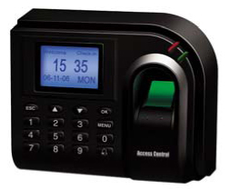
EXISTING ATTENDANCE TERMINALS
Barcode Readers
Fingerprint Readers
RFID system
Computerized Attendance System
Iris based
Bluetooth based

Slide 9
WHY FACE RECOGNITION?
Non contact process
Zero effort from user
Computer based digital technology
Compare face of persons with training images

Slide 10
MODULE DESCRIPTION
IMAGE ENHANCEMENT
user's side, checks the overall image quality, and improves the image quality with machine learning techniques. The quality of the image is the most important factor in identifying a particular person, so the Haar Cascade algorithm is well suited for image enhancement and enhancement process.
FACE DETECTION
In the attendance management system, a photo is first entered by the student, and this photo is sampled in the database created by the administration.

Slide 11
FEATURE EXTRACTION
This step extracts all the data from the template created for the using facial recognition
FACE DATABASE
In this step, the system can use the previous dataset in the system database to parallelize an imported copy with the database image. In the database recording all student information helps the system to detail students in a very short time.

Slide 12
FACE RECOGNITION
In this final face recognition step, the facial structure of collected samples is the same or not with the structure of face database. It will only take one second. In this system we can use Cascade method. A cascade is a type of artificial neural network used for image recognition and processing, specially designed for pixel data.

Slide 13
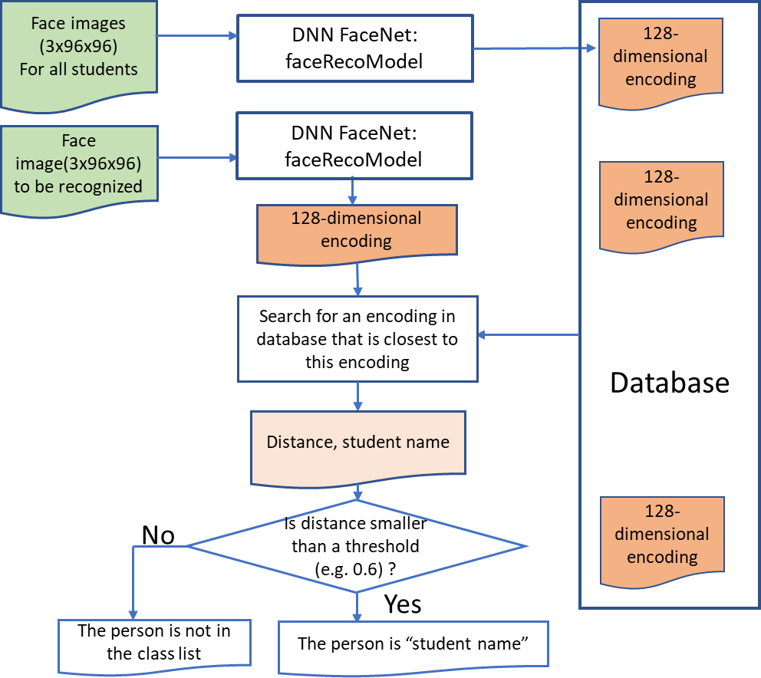

Slide 14
RESULT
The attendance system has been implemented in a Lenovo laptop computer with the following specifications: Ryzen 5000 series CPU @2.50GHz, RAM 8.00GB, Windows 10 Pro. The system consists of three programs developed in Python 3. The first program captures 10
face pictures for each student in the class. The second one compiles FaceNet model and loads parameters. The third one generates the database based on the pictures captured by the first program, recognizes the face at the real-time web camera, and updates the attendance record in the excel file. Thus, all visible results are delivered by the third program.

Slide 15
FUTURE ENHANCEMENT
Facial recognition devices are already being tested or implemented for airport protection, and it is reported that their faceprint has now been produced by more than half the United States populace. Information may be collected and processed by a facial recognition program, and a person does not even recognize it. Then, a hacker might reach the details, and the knowledge of a person would propagate without even realizing it. Government entities or marketers may use this data to monitor individuals too. Worse still, a false positive may include a person for a crime they are not.
Hundreds of companies have embraced face recognition. Integrating and installing is reasonably straightforward, but it has also provided users a feeling of utilizing a system that is more sophisticated and safer than passwords or PINs, thereby increasing user experience. Nonetheless, plenty is often unclear on the road to implementing what many deem the ideal biometric approach, causing several relatively severe blunders along the way.

Slide 16
CONCLUSION
This system proposes a smart attendance monitoring system using facial recognition as concept of verification. The system starts by acquiring images that will be used for training. Each of this image will be saved with the name of the individual. The acquired images were saved into a folder called training images. This images was read into directory as a list by using the os.listdir() function. For face recognition, we used a face recognition library in python which was built using dlib’s state-of-the facial recognition with deep learning, which have about 99.38% of accuracy. We created two arrays namely image and class Names. The image holds the training images and the class Names hold the name of the individuals whose images are stored in our training folder. After the processes, we encoded our training images in other to generate some measurements in which we will be using in comparing other images read from camera and live streaming videos.

Slide 17
REFERENCE
Mrunmayee Shirodkar,Varun Sinha,Urvi Jain and Bhushan Nemade, ”Automated Attendance Management System using Face Recognition”, International Conference and Work- shop on Emerging Trends in Technology (ICWET 2015)
Seema Verma Prof. Sonu Agrawal, ”A Study on A Soft Biometric Approach: Face Recognition”, International Journal of Advanced Research in Computer Science and Software Engineering, Volume 3, Issue 3, March 2013.
Faizan Ahmad, Aaima Najam and Zeeshan Ahmed, ”Image-based Face Detection and Recognition: State of the Art”,IJCSI International Journal of Computer Science Issues, Vol. 9, Issue 6, No 1, November 2012.

Slide 18
REFERENCE
William Robson Schwartz, Member, IEEE, HuiminGuo, Student Member, IEEE, Jonghyun Choi, Student Member, IEEE, and Larry S. Davis, Fellow, IEEE, ”Face Identi- ﬁcation Using Large Feature Sets”, IEEE TRANSACTIONS ON IMAGE PROCESSING, VOL. 21, NO. 4, APRIL 2012
P. N. Belhumeur, J. P. Hespanha and D. J. Kriegman, ”Eigenfaces vs. Fisherfaces: recog- nition using class speciﬁc linear projection”, Published in: IEEE Transactions on Pattern Analysis and Machine Intelligence Volume:19 , Issue: 7 ,Aug 2002.

Slide 19
THANK YOU

