Slide 1


Organization Name:Government of Kerala.
PS Code: 1323.
Problem Statement Title: Development of Smart Toilet.
Hygienic toilet while traveling and tracking the location through android app .
Team Name: Innovators.
Team Leader Name: Navin kumar.V.
Institute Code : 6108.
Institute Name: Er.Perumal Manimekalai College of Engineering.
Theme Name: MedTech/BioTech/HealthTech.

Slide 2
ABSTRACT
In today's modern world, access to hygienic public restrooms, especially for women, remains a pervasive challenge. This automatic self-cleaning toilet system addresses this problem.
Initially the nearest available restroom will be noted by the user. The restroom door will be opened and closed automatically through IR sensors and the lights will be on and off by the PIR sensors.The solar panel generate electricity from sunlight, which can be stored in a battery for power source.
Unlike traditional systems, this toilet emphasizes ultraviolet (UV) disinfection, hot air drying, and intelligent water conservation. The urine samples are collected to detect the kidney failures.
The concept of a smart toilet, incorporating the monitoring of urine samples for kidney failure detection through IoT (Internet of Things) technology adds a critical health-related dimension to the system.
Our project empowers users to effortlessly pinpoint the nearest available smart toilets in real-time, also user can register their complaint about toilet condition through android app.

Slide 3
OBJECTIVES
To improve access to hygienic public restrooms, especially for women, by deploying automatic self-cleaning toilets in strategic locations.
To create a user friendly, energy efficient and hygienic restroom system.
To implement sensors to detect when a restroom is occupied or vacant, also ensuring efficient usage of water.
To develop a system for early kidney failure detection and improve public health.

Slide 4
INTRODUCTION
In today's rapidly advancing world, despite the numerous technological breakthroughs, one persistent challenge remains largely unaddressed – the availability of clean and accessible public restrooms, particularly for women.
Our project endeavors to tackle this problem head-on by introducing an innovative and transformative solution “The Automatic Self-Cleaning Smart Toilet System”.
The heart of our system lies in its emphasis on hygiene and convenience, achieved through a combination of advanced features including ultraviolet (UV) disinfection, hot air drying, intelligent water conservation, and even an integrated air freshener.
This comprehensive approach ensures that each visit to our smart toilet is not just a necessity but also a pleasant experience.

Slide 5
EXISTING METHOD
In this existing method public restroom systems have long relied on manual cleaning and maintenance practices, resulting in various challenges related to hygiene, accessibility, and user satisfaction.
These conventional restrooms typically incorporate basic flushing mechanisms and limited sanitation features, often leading to issues such as unpleasant odors, insufficient cleanliness, and water wastage.
The users cannot track the locations of the restrooms.

Slide 6
BLOCK DIAGRAM
IOT cloud storage
PIR sensor
ultrasonic sensor
bio enzyme sensor
sensor data collected
API Key
ATMEL 328 Microcontroller & wi-fi device Esp8266
Driver board
IR sensor
solar panel
Lid open and close
Battery
Relay device channel 7
Exhaust fan
UV sensor
Flushing pump motor
Hot air drying pump
Air freshener
Light
Door open and close.

Slide 7
ANDROID APPLICATION
welcome page
users
Track current location using gps coordinates
Search nearest toilet location and pin point the location
Restroom availability
Health status monitor
Feed back and compliant register about toilet
admin
login for IOT cloud
prediction of users kidney failure details view.

Slide 8
PROPOSED METHOD
In this proposed method we developed a smart toilet system. When the user comes in front of restroom ,the IR sensor will detect the person and automatically open the door.
The PIR sensor will detect the human thermal radiation and it will turn on the light, if the person exits from the restroom, it automatically turns off the light.
The Ultrasonic sensor detect the person distance and automatically opens and closes the toilet lid according to the person’s distance from toilet. It also activates the UV disinfection, hot air drying process and also activates the Exhaust fan and air fresheners before and after use.
Our smart toilet system integrates with health monitoring by collecting urine samples for kidney failure detection. Machine learning algorithms are designed and implemented to analyze sensor data in real-time, aiding in the early detection of kidney disfunction.
The Atmel 328 microcontroller is used for control and monitor the input and output devices.the ESP8266 wifi device is used for collecting raw data form the bio enzyme sensor and stored in IOT cloud .

Slide 9
CONT.,
Solar panels generate electricity from sunlight, which can be stored in a battery for power source.
This is a user-friendly Android application with features such as real-time restroom location tracking using GPS, restroom availability status updates , and navigation tracking.
IoT integration facilitates data transmission between the smart toilet system and the Android application.
Here the users can also register complaint about toilet and share there feedbacks through android application.

Slide 10
PROBLEM STATEMENT
The problem at hand revolves around the pervasive challenge of providing clean and accessible public restrooms, with a specific focus on addressing the needs of women.
The hygiene maintenance remains a critical concern. Many public restrooms suffer from inadequate cleaning routines and sanitation practices, leading to unsanitary conditions that can pose health risks and discomfort for users.
The information gap regarding the availability and condition of nearby public restrooms exacerbates the problem, leading to inconvenience and discomfort during urgent restroom needs.

Slide 11
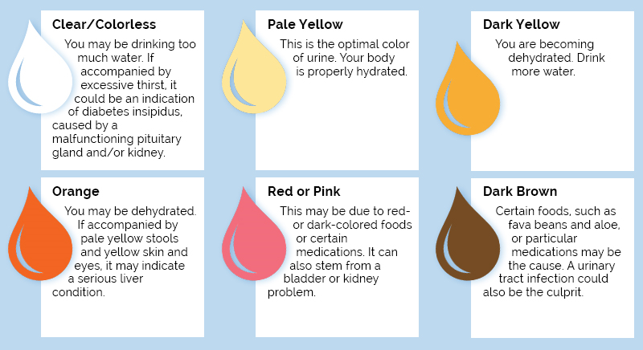
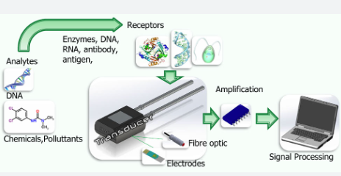
URINE COLOUR SAMPLES

Slide 12
ADVANTAGES
Enhanced Hygiene: UV disinfection and hot air drying ensure a clean and bacteria-free restroom environment.
Water Conservation: Intelligent water usage reduces waste and promotes environmental sustainability.
Early Health Detection: Integrated urine protein sensor and machine learning enable early kidney disease detection.
Convenience: Users can easily locate and navigate to nearby clean restrooms via a mobile app.
Real-time Information: Users receive up-to-date details on restroom availability and cleanliness.
Environmental Responsibility: Water and energy-efficient features align with eco-consciousness.
User Comfort: Air fresheners and home-like amenities enhance the restroom experience.

Slide 13
FUTURE SCOPE
The future scope of the Automatic Self-Cleaning Smart Toilet System with integrated health monitoring and developments and transformative possibilities.
As sustainability gains increasing importance, future iterations of smart toilets will likely focus on minimizing their environmental footprint, through advanced waste disposal methods and eco-friendly energy sources.
The utilization of data analytics and artificial intelligence could enable smart toilets to offer health recommendations and early interventions, thereby contributing to preventive healthcare.
Moreover, integration with healthcare systems and the establishment of a wider network of smart toilets in public spaces could create a seamless of care and improve healthcare outcomes.
Privacy and security will be paramount concerns, necessitating the continuous evolution of robust cybersecurity measures to safeguard user data.

Slide 14
SYSTEM SPECIFICATION
Hardware specification
Atmel328 Microcontroller.
Esp8266 wi fi device.
bio enzyme sensor
PIR sensor
Ultrasonic sensor
Driver controller
Relay
Light
Exhaust fan
water pump
Hot air dryer
Air freshener
Software specification
Keil software
Android studio
Thingspeak IOT cloud.
Programming language
For android application
Front end: XML
back end: java.
For hardware.
C++.

Slide 15
TEAM MEMBER DETAILS
Team Leader Name: Navin Kumar.V.
Branch : BE Stream : Electronics and Communication Engineering Year : III
Team Member 1 Name: Pavithra.V.
Branch : BE Stream : Electronics and Communication Engineering Year : III
Team Member 2 Name: Pradeep.S.
Branch : BE Stream : Electronics and Communication Engineering Year : III
Team Member 3 Name: Sowndharya.S.
Branch : BE Stream : Electronics and Communication Engineering Year : II
Team Member 4 Name: Vaishnavi.L.
Branch : BE Stream : Electronics and Communication Engineering Year : II
Team Member 5 Name: Prithika.V.
Branch : BE Stream : Computer Science Engineering. Year : II

Slide 16
Thank you

