Slide 1

Basic Details of the Team and Problem Statement
Organization Name:Government of Kerala.
PS Code: 1323.
Problem Statement Title: Development of Smart Toilet.
Hygienic toilet while traveling and tracking the location through android app .
Team Name: Innovators.
Team Leader Name: Navin kumar.V.
Institute Code : 6108.
Institute Name: Er.Perumal Manimekalai College of Engineering.
Theme Name: MedTech/BioTech/HealthTech.

Slide 2
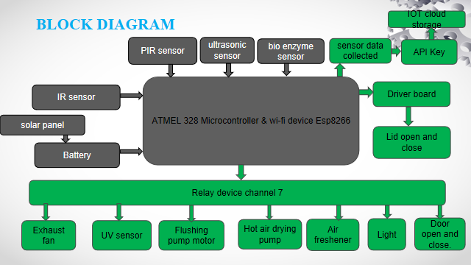
Idea/Approach Details
Describe your idea/Solution/Prototype here:
In today's modern world, access to hygienic public restrooms, especially for women, remains a pervasive challenge. This automatic self-cleaning toilet system addresses this problem.
Initially the nearest available restroom will be noted by the user.The restroom door and light are accessed using sensorw
Unlike traditional systems, this toilet emphasizes ultraviolet (UV) disinfection, hot air drying, and intelligent water conservation. The urine samples are collected to detect the kidney failures.
Our project empowers users to effortlessly pinpoint the nearest available smart toilets in real-time, also user can register their complaint about toilet condition through android app.
Describe your Technology stack here:
Hardware specification
Atmel328 Microcontroller.
Esp8266 wi fi device.
bio enzyme sensor
PIR sensor
Ultrasonic sensor
Driver controller
Relay
Light
Exhaust fan
water pump
Hot air dryer
Air freshener
Software specification
Keil software
Android studio
Thingspeak IOT cloud.
Programming language
For android application
Front end: XML
back end: java.
For hardware.
C++.

Slide 3
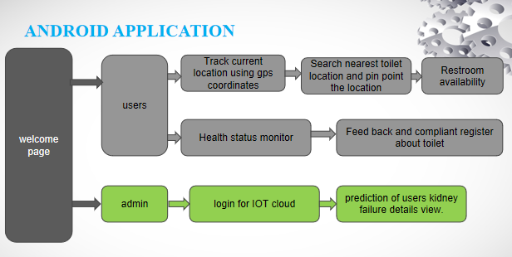
Idea/Approach Details
Describe your Dependencies / Show stopper here
Describe your Use Cases here
DEPENDENCIES:
Technological Dependencies
Infrastructure and Location Dependencies
Healthcare and Medical Dependencies
User Engagement and Feedback Dependencies
Maintenance and Support Dependencies
Regulatory and Compliance Dependencies
Financial Support
Willingness and Community Support
In this proposed method we developed a smart toilet system. When the user comes in front of restroom ,the IR sensor will detect the person and automatically open the door.
The PIR sensor will detect the human thermal radiation and it will turn on the light, if the person exits from the restroom, it automatically turns off the light.
The UV sensor access the lid of toilet. It also activates the UV disinfection, hot air drying process and also activates the Exhaust fan and air fresheners before and after use.
The Atmel 328 microcontroller is used for control and monitor the input and output devices.the ESP8266 wifi device is used for collecting raw data form the bio enzyme sensor and stored in IOT cloud .
Solar panels generate electricity from sunlight, which can be stored in a battery for power source.
IoT integration facilitates data transmission between the smart toilet system and the Android application.

Slide 4
Team Member Details
Team Leader Name: Navin Kumar.V.
Branch : BE Stream : Electronics and Communication Engineering Year : III
Team Member 1 Name: Pavithra.V.
Branch : BE Stream : Electronics and Communication Engineering Year : III
Team Member 2 Name: Pradeep.S.
Branch : BE Stream : Electronics and Communication Engineering Year : III
Team Member 3 Name: Sowndharya.S.
Branch : BE Stream : Electronics and Communication Engineering Year : II
Team Member 4 Name: Vaishnavi.L.
Branch : BE Stream : Electronics and Communication Engineering Year : II
Team Member 5 Name: Prithika.V.
Branch : BE Stream : Computer Science Engineering. Year : II

