Slide 1
Green Car Wash
On-Demand Car Wash
Consumer market for cars has increased rapidly in the past few years. So the goal is to design a car wash system where if the user tells us the car location and the washers will go and provide a professional car wash service.
So we need to design a web app to enable users a easy sign up and then fill up certain details and then book a car wash and also a system that will allocate washers for the jobs and also transactions. And also we need to create a Review system for the users.We have mainly 3 profiles, Client, manager and washer.

Slide 2
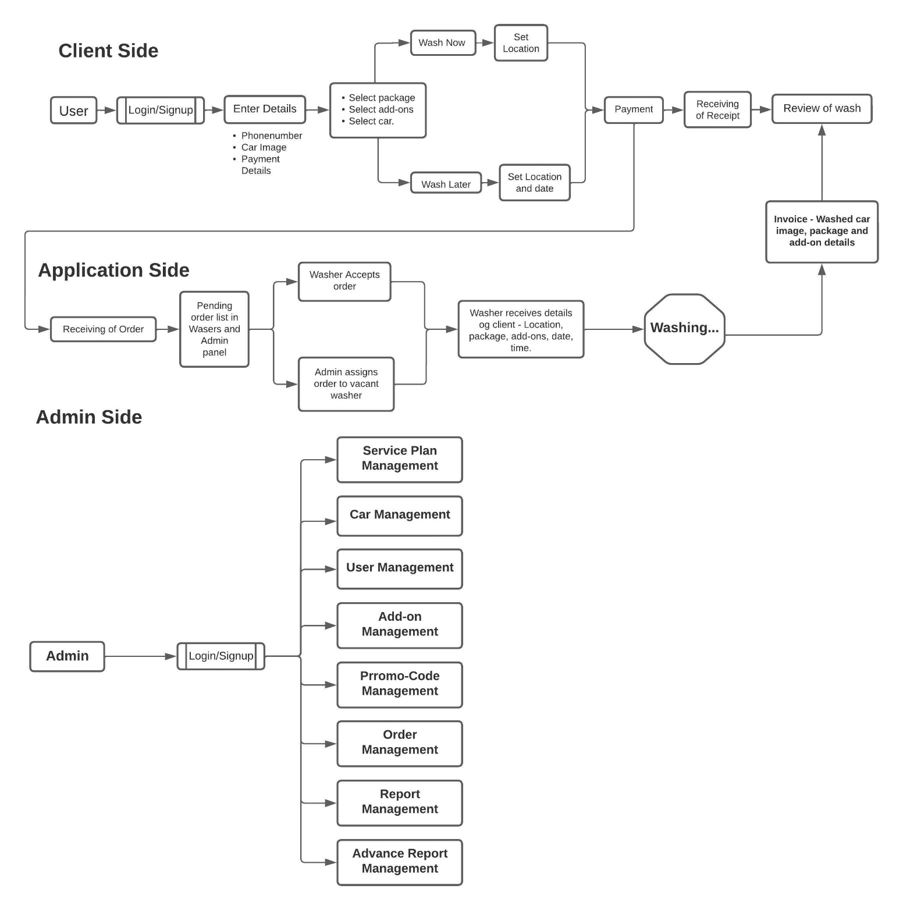
Block Diagram

Slide 3
Customers
Functionalities:-
Signup/Login - Sign up with basic details. A user can login using Email or Facebook
Car and Payment Details - Add car details along with its image. Also, add payment details for further transaction process.
Wash Now – Add appropriate details, select car and package, add-ons, package.
Schedule Later – Select preferred date, time location and package. Wash is assigned to employee by admin.
Payment – User confirms booking and pays washers through debit or credit card.
Receipt – After wash, Washer sends payment receipt to user, including wash car photo, and add-on details.
Review and ratings – users can share reviews and ratings for washers.
Notification – Washer accepts or rejects the request, washer starts and completes the service, receipt received.
Profile – View and edit profile.
My orders – View list of pending, accepted, in process orders and past orders.
Leader board - list of leaders who saved maximum water gallons by washing cars.

Slide 4
Car Washers
Functionalities:-
Signup/Login - Sign up with basic details. A user can login using Email or Facebook.
Wash Request – Accept or decline wash request. On accepting navigate to address by google navigation.
Invoice Generation – After wash, invoice is generated and sent to user (including car image, package and add on details).
Ratings and reviews – after wash, share experience with users through ratings and reviews.
Profile – View and update their profile (Profile picture and contact information).
Notification – Scheduled wash before 12 hours, new order, cancellation of order, on successful payment.
My orders – view current and past orders.

Slide 5
Admin
Functionalities:-
Signup/Login - Sign up with basic details. A user can login using Email or Facebook.
User Management
Customer – Edit profile, View Ratings, active or inactive customers.
Washer – Add/Edit washer, active/inactive washer, View customer ratings, export washers report to excel.
Car Management – Add/Edit car details, active or inactive car.
Service Plan Management – Add/Edit Service plan, active and inactive service plan.
Add-on Management – Add/Edit add-on, active and inactive add-on.
Promo-Code – add/edit promo-code.
Order-Management – Wash-now or schedule, view order details, assign pending orders, List of pending, accepted, under process, completed, and cancelled orders.
Report Management – filter and generate reports based on order number, washer name, type, service and date.
Leader board - list of leaders who saved maximum water gallons by washing cars.
Advance Report Management – admin can generate advanced wash reports based on business, sales, users and locations.

Slide 6
List Of Tables
User_profiles
User_Id (PK)
Name
Phn_number
Email
Address
Car_model
Order_ref_number (FK)
Orders
Order_ref_number (PK)
Order_status (pending/accepted/rejected)
Order date/time
Allocated_washer_Id
Package (FK)
Add-ons (FK)
Promocode (FK)
Order_amount
Washer
Washer_Id (PK)
Name
Phn_number
Water_consumption
Accepted Orders
Rejected Orders
Pending Orders
Package
Package_ref_number (PK)
Package_Details
Add-ons
Add_on_ref_number (PK)
Add_on_Details
Admin
Washer_Id (PK)
Name
Promo-code
Promo_code_ref_number (PK)
Promo_code_Details

