Slide 1

Glottal Closure Instants
Tanumay Mandal

Slide 2
Slide Title
EGG Signal
Hilbert Transform
Phase Extraction
Unwrap Phase
Low Pass Filtering
1St Order diff. of unwrapped Phase
Peak Picking
Algorithm
GCI Location

Slide 3

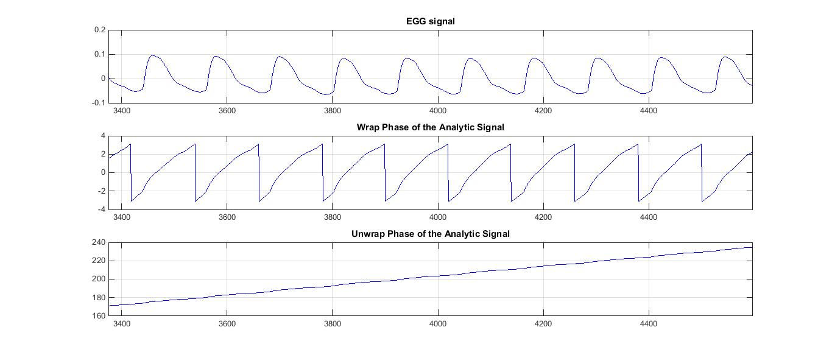
Slide Title

Slide 4
